Slide 1

Workshop 6: ASHRAE Standards Authorship: Moving Toward a Convention
Kyle Kisebach, P.E., CEM
kylek@energyaims.com
+1 801.589.4926
Creating Terms and Their Definitions

Slide 2
Learning Objectives
Identify how various authoring bodies are already creating and updating terms and their definitions
Understand the pros and cons for each method in use now
Understand best practices in authorship
Make better decisions when creating or updating a term, including the use of the TC 1.6 repository of terms

Slide 3
Let’s Start with List of ASHRAE Glossary Sources
ASHRAE Standards and Guidelines
ASHRAE Handbooks, Position Papers
ASHRAE MCO, ISO
IIR
AHRI, US DOE, etc.
Special Publications
ASHRAE Terms Online
Harmonized Terms (~4000 terms) free. Search online for “ASHRAE Terms”.
ASHRAE TC 1.6 Working File (~20,000 terms)
Terms online + all terms in stds and guidelines in last 6 years + selected other sources (free, TC 1.6 basecamp excel file, contact TC 1.6 chair for access)
SME Extracts (IRR example)

Slide 4
Acknowledgements
Past and Current Members of TC 1.6 who have contributed much of their time.
Special thanks to Roger Lautz, Chuck Dale-Derks, Bruce Billedeaux, Steve Comstock, Mark Owen and Sarah Boyle
Lynn G. Bellenger, ASHRAE President 2010-11, who started a Presidential adhoc on ASHRAE Terminology Improvements that lead to where we are today.
Future contributors – either as a TC 1.6 member or as a Subject Matter Expert (SME) like Don Gatley, FASHRAE

Slide 5
Next on Agenda
High Level Overview
  Possible origins of terms and their definitions
  Examples of ASHRAE terms and definitions from various methods
Discussion
  Current practices of various ASHRAE Authors
  What paths are more and less ideal
  Where should ASHRAE guide the paths
  Hard lines not to cross.

Slide 6
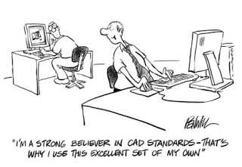
An old drafter joke…
Note: This image was labeled for non-commercial re-use. (http://www.seifert.com/images/marketing/blog/standards.jpg)

Slide 7
Underlying Terms

Slide 8
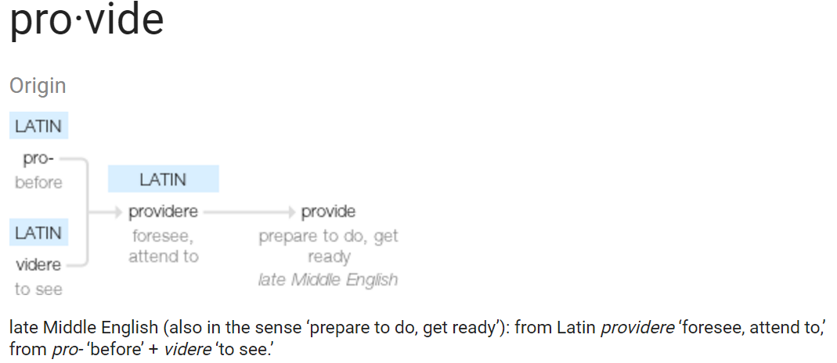
PROVIDE
Notes:
From Google search for “provide etymology”

Slide 9
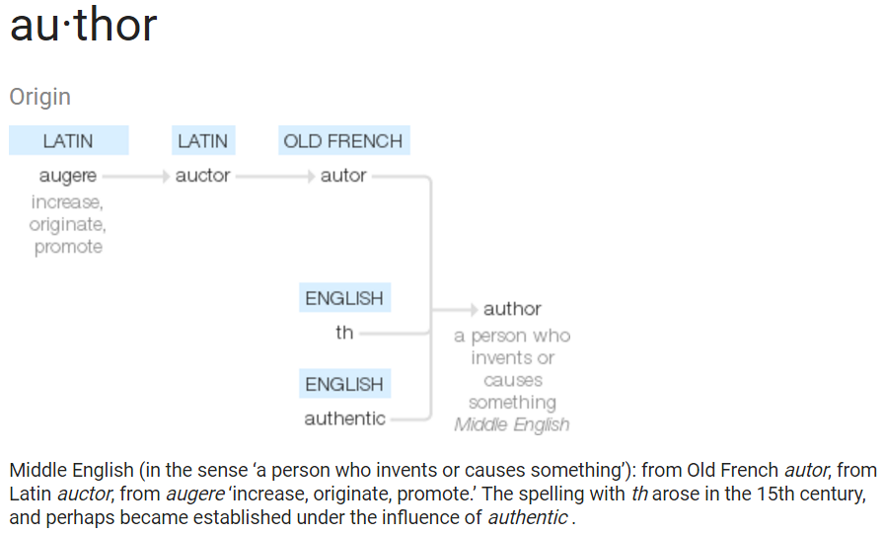
Author
Notes:
From Google search for “author etymology”
Reference is one of the viable options to producing a term and/or its definition.
Should it be restricted to when there is no suitable term, or suitable definition for that term in context of an ASHRAE standard?

Slide 10
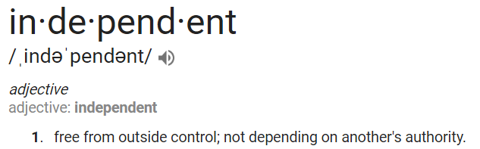
independent
Notes:
From Google search for “independent etymology”
When is ASHRAE really independent? At all times?

Slide 11
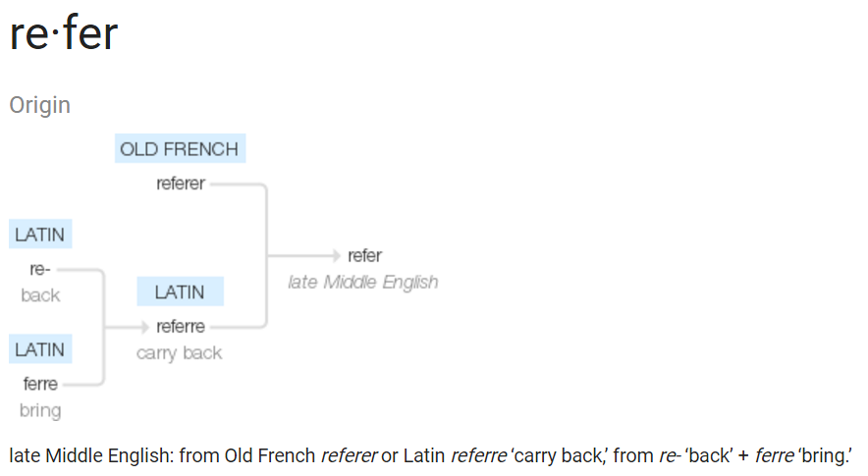
Reference
Notes:
From Google search for “refer etymology”
Reference is one of the viable options to producing a term and/or its definition.

Slide 12
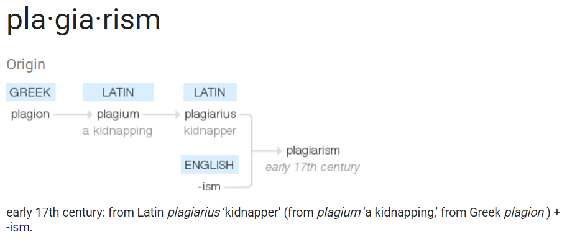
plagiarize
Notes:
From Google search for “plagiarism etymology”
If ASHRAE uses a definition and does not cite it, is that a concern?
If so, how do we mitigate that from a policy standpoint?

Slide 13
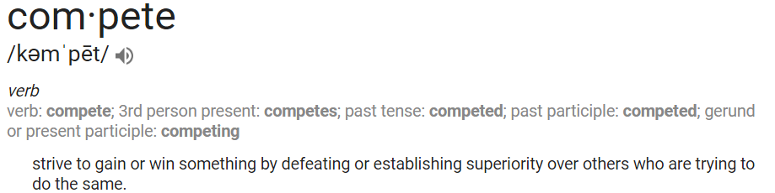
compete
Notes:
We at ASHRAE compete with other organizations, if we recognize that two standards are providing the same thing and wish to have ours be recognized as authoritative as compared to the other organization. For example, we are developing
We at ASHRAE compete within the organization, if we recognize that two standards are providing the same thing

Slide 14
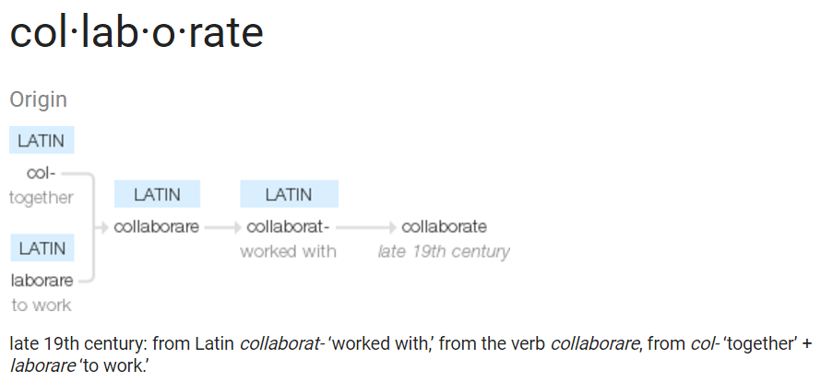
collaborate
Notes:
We of course at ASHRAE collaborate within the organization.
We also collaborate on some standards, with others.
S90.1 is IES-collaboration

Slide 15
Structure
Provide
Author
Collaborate
Compete
Refer
Internal
External
Internal
External
Notes:
Structurally, we then have this decision tree.
It may not be thought of in this way by the ASHRAE standards and guidelines authors.
Question: Do we know or have influence in encouraging
Question: Is there a policy of ASHRAE whether or not to have authors
Question: If there is a policy is there – or if there is not a policy should there be – a tool to assist in finding definitions?

Slide 16
Illustrative Example
“Standard” Air

Slide 17
Standard Air: External Views
 | Temperature (°C) | Temperature (°F) | Pressure (kPa) | Pressure (mmHg) | Pressure (psi) | Pressure (inHg) | Specific Volume (m3/kg) | Relative Humidity (%) | Publishing or establishing entity
 | 0 | 32 | 100 | 750.06 | 14.5038 | 29.53 | 0.784 |  | IUPAC (STP) since 1982^{[1]}
 | 0 | 32 | 101.325 | 760 | 14.6959 | 29.921 | 0.774 |  | NIST,^{[8]} ISO 10780,^{[9]} formerly IUPAC (STP) until 1982^{[1]}
 | 15 | 59 | 101.325 | 760 | 14.6959 | 29.921 | 0.816 | 0^{[2][10]} | ICAO's ISA,^{[10]} ISO 13443,^{[2]} EEA,^{[11]} EGIA^{[12]}
 | 20 | 68 | 101.325 | 760 | 14.6959 | 29.921 | 0.830 |  | EPA,^{[13]} NIST.^{[14]} This is also called NTP, Normal Temperature and Pressure.^{[15]}
 | 22 | 72 | 101.325 | 760 | 14.6959 | 29.921 | 0.847 | 20–80 | American Association of Physicists in Medicine^{[16]}
 | 25 | 77 | 100 | 750.06 | 14.5038 | 29.53 | 0.856 |  | IUPAC (SATP)
 | 25 | 77 | 101.325 | 760 | 14.6959 | 29.921 | 0.845 |  | EPA[17]
 | 20 | 68 | 100 | 750.06 | 14.5038 | 29.53 | 0.842 | 0 | CAGI^{[18]}
 | 15 | 59 | 100 | 750.06 | 14.5038 | 29.53 | 0.827 |  | SPE^{[19]}
 | 20 | 68 | 101.3 | 760 | 14.69 | 29.9 | 0.840 | 50 | ISO 5011[20] - Air Intake Filters
 | 20 | 68 | 101.33 | 760 | 14.696 | 29.92 | 0.830 | 0 | GOST 2939-63
 | 16 | 60 | 101.33 | 760 | 14.696 | 29.92 | 0.819 |  | SPE,^{[19]} U.S. OSHA,^{[21]} SCAQMD^{[22]}
 | 16 | 60 | 101.6 | 762 | 14.73 | 30 | 0.817 |  | EGIA,^{[12]} OPEC,^{[23]} U.S. EIA^{[24]}
 | 15 | 59 | 99.99 | 750 | 14.503 | 29.53 | 0.838 | 78 | U.S. Army Standard Metro^{[25][a]}
 | 15 | 59 | 101.33 | 760 | 14.696 | 29.92 | 0.825 | 60 | ISO 2314,^{[26]} ISO 3977-2^{[27]}
 | 21 | 70 | 101.3 | 760 | 14.7 | 29.92 | 0.834 | 0 | AMCA,^{[28][b]} air density = 0.075 lbm/ft³. This AMCA standard applies only to air.
 | 15 | 59 | 101.3 | 760 | 14.7 | 29.92 | 0.817 |  | Federal Aviation Administration (FAA)^{[29]}
Min | 0 | 32 | 99.99 | 750 | 14.503 | 29.53 | 0.774 | 0
Max | 25 | 77 | 101.6 | 762 | 14.73 | 30 | 0.856 | 78
Average | 16.5 | 61.6 | 100.9 | 757.2 | 14.6 | 29.8 | 0.8
Stddevp | 6.9 | 12.4 | 0.6 | 4.6 | 0.1 | 0.2 | 0.0
SDp as % Average | 42% | 20% | 0.6% | 0.6% | 0.6% | 0.6% | 2.5%
Notes:
Notes:
1. According to Wikipedia, the most commonly referred to are NIST and IUPAC definitions.
2. IUPAC Definition changed in 1982
Sorta good news if you take it that way – lack of coordination is not a purely ASHRAE issue, and arguably it’s not an issue at all – but we should maybe refer to “Standard” with a modifier of which standard and know what the purpose of that particular standard is.

Slide 18
Key Question: Does it matter?
In standard air, the difference from a density viewpoint is ????
Turns out – 2.5% variation across all definitions.
When does a definition need to be consistent?

Slide 19
Author Example
Standard 55: “clo: a unit used to express the thermal insulation provided by garments and clothing ensembles, where 1 clo = 0.155 m2 °C/W (0.88 ft2·h·°F/Btu).”
Notes:
Standard 55 is a good example of where ASHRAE is a clear authority on the subject, worldwide.
No other references in Standard 55:2004 definitions. ISO is referenced in the body.

Slide 20
Collaboration Example
All terms in ANSI/ASHRAE/ASHE Standard 170-2008, “Ventilation of Health Care Facilities”
Notes:
ASHE is the American Society for Healthcare Engineering
Joint Commission

Slide 21
Reference Examples
Standard 90.1-2013, “fan efficiency grade (FEG): the fan efficiency without consideration of drives, as defined in AMCA 205.”
Standard 90.1-2013, “historic: a building or space that has been specifically designated as historically significant by the adopting authority, or is listed in The National Register of Historic Places or has been determined to be eligible for such listing by the U.S. Secretary of the Interior.
Standard 90.1, “general purpose electric motor (subtype I): [refers to NEMA MG-1-1967, NEMA MG1, and IEC]”
Notes:
These are all examples of Standard 90.1-2013 referring to any other internal or external standard in its definitions.
Lack of citations implies that ASHRAE is the Author for all other definitions, which may be plagiarism.
Per https://plagiarism.arts.cornell.edu/tutorial/logistics3.cfm:
documentation is the general practice of acknowledging sources by clearly indicating what you have borrowed and giving the proper bibliographic information for each source
a citation occurs when you use a specific source in your work and then follow up with the proper bibliographic information; plagiarism issues arise when you use a specific source, but fail to indicate what you have borrowed, and/or fail to provideproper bibliographic information
a reference is the bibliographic information that guides readers to your source.

Slide 22
Competition Example
ISO 50002-2014, “Energy audits — Requirements with guidance for use”
Standard 211p “Standard for Commercial Building Energy Audits”
  audit objective
  boundary
  energy audit
  energy audit scope
  energy auditor
  energy balance
  energy consumption
  energy efficiency
  energy flow
  energy performance
  energy performance indicator
  energy use
  organization
  relevant variable
authority having jurisdiction (AHJ)
base case
building energy model
energy auditor
energy cost
Energy Cost Index (ECI)
energy efficiency measure (EEM)
Energy Use Intensity (EUI)
gross floor area
interactive effect
model
practical measure
qualified energy auditor
recommended measure
simple payback
simple return on investment (Simple ROI)
site energy
Notes:
In fact the entire standard structure IS A DEFINITION, and the two are drastically different

Slide 23
Competition Example
ISO 50002-2014, “Energy audits — Requirements with guidance for use”
Standard 211p “Standard for Commercial Building Energy Audits”
  Energy Auditor:
  individual, or team of people, conducting an energy audit
  Competence can be shown by:
  appropriate education, skills, experience and/or training considering local or national guidelines and recommendations;
  relevant technical skills specific to the energy uses, scope, boundaries and audit objective;
  knowledge of appropriate legal and other requirements;
  familiarity with the energy uses being audited;
  knowledge of the requirements of this International Standard, national and local energy auditing standards;
  (for a team member designated as lead energy auditor) having the skills to manage and provide leadership to the energy audit team: a lead auditor should have managerial, professional and leadership skills in order to manage a team.
<qualified> Energy Auditor:
An energy solutions professional who assesses building systems and site conditions; analyzes and evaluates equipment and energy usage; and recommends strategies to optimize building resource utilization.
Experience must include completion of five commercial (non‐residential) building energy audits within the past three years.
The auditor must be one of the following
a) A Building Energy Assessment Professional (BEAP), Certified Energy Manager (CEM),
or Certified Energy Auditor (CEA) as certified by ASHRAE or AEE respectively,
b) A person who holds a certification from a credentialing program approved by the U.S. Department of Energy Better Buildings Workforce Guidelines for Building Energy Auditors.
c) A licensed Professional Engineer or a Licensed Contractor specifically approved to conduct energy audits by the authority having jurisdiction (AHJ).
d) A person qualified by the authority having jurisdiction
Notes:
Note that Standard 211p’s definition of an “energy auditor” simply refers to its own definition of “qualified energy auditor”

Slide 24
Structure
Provide
Author
Collaborate
Compete
Refer
Internal
External
Internal
External
Notes:
Structurally, we then have this decision tree.
It may not be thought of in this way by the ASHRAE standards and guidelines authors.
Question: Do we know or have influence in encouraging
Question: Is there a policy of ASHRAE whether or not to have authors
Question: If there is a policy is there – or if there is not a policy should there be – a tool to assist in finding definitions?

Slide 25
What Path(s) are Ideal, and when?
Can we make a hierarchy of approaches?
Example:
  Search for other cognizant authorities on a subject when defining a term, starting within ASHRAE.
  Reference a [the most] cognizant authority’s standard if ASHRAE or the specific authoring group is not that authority, and the cognizant authority has a suitable definition in a relevant published standard
    Get permission to do reference, and cite it.
  Author a definition if there is none suitable.
  Collaborate when possible.
  Compete if necessary.

Slide 26
How should authors choose which path?
As ASHRAE and specifically TC1.6
Tools
  New DB query
  Old DB online
Policy
Guidelines
Trainings
External – non-author review and comment or
Enforcement

Slide 27
QUESTIONS
When does a definition need to be consistent, or correlated within or without ASHRAE?
Is it too late, for old terms, to try?
What path(s) are ideal, and when?
Should cross-checking of other authorities outside ASHRAE be recommended practice?
Should ternms be in IP and SI? Rational or soft conversions?
Notes:
S

