Slide 1
How Accurate is Your Air Flow Capture Hood Measurement?
Capture Hood Errors Associated with Commercial Diffuser Types
Presenter: Robert Moss, Dwyer Instruments
Date: Tuesday, January 23, 2018
Time: 3:30 PM to 4:30 PM
Location: Palmer House: Hilton floor: Honore

Slide 2
Learning Objectives
Demonstrate capture hood errors associated with diffuser type
Understand the root-cause of diffuser errors
Describe the impact of these errors on balancing accuracy
AIA Disclaimer:
ASHRAE is a Registered Provider with The American Institute of Architects Continuing Education Systems. Credit earned on a completion of this program will be reported to ASHRAE Records for AIA Members. Certificates of Completion for non-AIA members are available on request.
This program is registered with the AIA/ASHRAE for continuing professional education. As such, it does not include content that may be deemed or construed to be an approval or endorsement by the AIA of any material of construction or any method or manner of handling, using, distributing, or dealing in any material or product. Questions related to specific materials, methods, and services will be addressed at the conclusion of this presentation.

Slide 3
Agenda
Background
Methods
Computation Fluid Dynamic (CFD) Models and experimental test results:
  3 Cone Diffuser Baseline
  Swirl Diffuser
  1-Way Diffuser; 2 cases
  Slot Diffuser
Summary of results
Conclusions

Slide 4
Background
Commercial HVAC air handling systems must be properly balanced as required by the HVAC design requirements to:
  distribute air properly for comfort, via dampers and diffusers
  minimize energy consumption
Air Flow Capture Hoods are the accepted measurement instrument to assure the air balancing is performed to specification
While the Air Flow Capture Hoods are calibrated to assure accuracy, they are calibrated on either one diffuser type or an open plenum
Commercial Diffusers (or registers) come in a wide variety of shapes and sizes to meet specific applications
The varying flow patterns of diffusers are known to have significant impact on the accuracy of commercial Capture Hoods
The root-cause of the errors can be understood by comparing CFD models to actual experimental results

Slide 5
Methods
A precision calibration station was used to measure air flow with a traditional capture hood using various types of commercial diffusers
A Computation Fluid Dynamic baseline model was created by determining the differential pressure across a 3D model of an averaging pitot array inside the capture hood model
A CFD model of the capture hood with a 3 cone diffuser reference was used to establish a baseline flow
CFD models of other diffusers were analyzed against the baseline and compared to experimental results

Slide 6
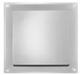
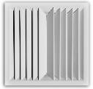
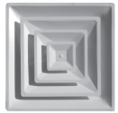
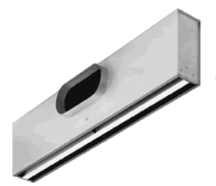
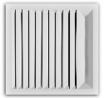
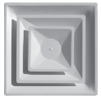

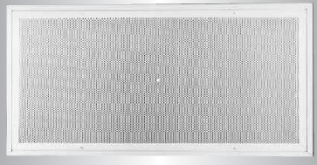

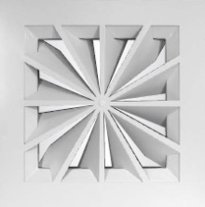
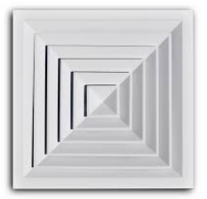
Example Diffusers
Step-down Plaque
Directional
2-way
Step-down
3-cone
2x1 slot
Directional
1-way
Step-down
2-cone
2way-corner
2x4 Laminar
3way-side
Swirl Diffuser
Directional
4-way

Slide 7
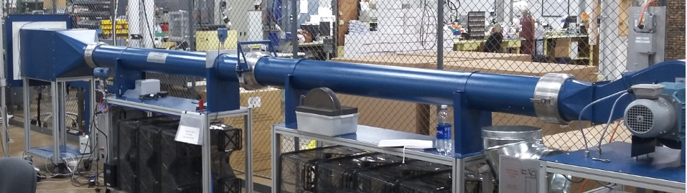
Precision Air Capture Hood Calibration Station
Quantity | Source | Raw Quantity -% | Confidence Level | Uncertainty Type | Probability Distribution | Prob. Dist. Divisor | Rel Sensitivity Coefficient | Correlated Quantity %
Discharge Coefficient Uncertainty ¹ | ISO 5167 | 0.5000 | 95% | B | Normal | 2 | 1 | 0.2500
Expansibility factor ^{2,3} | ISO 5167 | 0.0376 | 95% | B | Normal | 2 | 1 | 0.0188
Pipe Diameter ⁴ | Measurement Uncertainty | 0.0010 | 100% | B | Rectangular | 1.732 | 0.01 | 0.0000
Bore Diameter ⁴ | Measurement Uncertainty | 0.0010 | 100% | B | Rectangular | 1.732 | 2.01 | 0.0012
Differential Pressure Measurement | DP Measurement Calibration?? | 0.0190 | 95% | A | Normal | 2 | 0.5 | 0.0048
Calibration of Ruska DP Source | Ruska 7250LP Reference Uncertainty ⁵ | 0.0522 | 95% | B | Normal | 2 | 0.5 | 0.0131
Static Pressure Effect on Density | Pressure Measurement Uncertainty ⁵ | 0.203 | 95% | B | Normal | 2 | 0.5 | 0.0507
Temperature Effect on Density | Temperature Measurement Uncertainty ⁵ | 0.414 | 95% | B | Normal | 2 | 0.5 | 0.1036
Univ Gas Const. | Scientific Constant | 0.0010 | 68% | B | Normal | 1 | 0.5 | 0.0005
Mol Wt. | Uncertainty of Air Composition | 0.0025 | 68% | B | Normal | 1 | 0.5 | 0.0013
 |  | Mass Flow Combined Uncertainty |  |  |  |  |  | 0.276

Slide 8
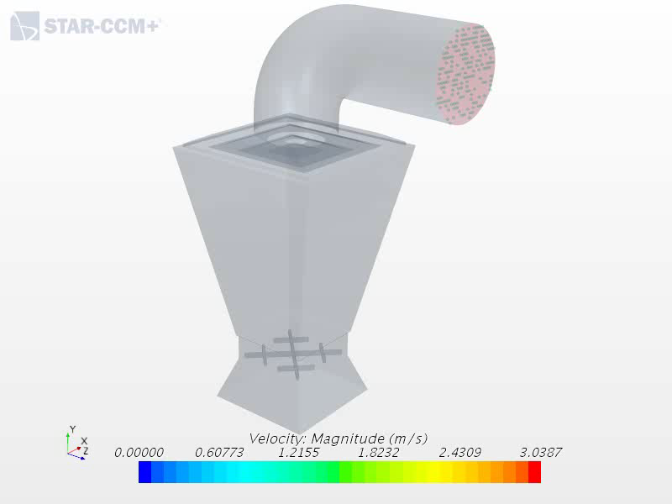
CFD Model: 3 Cone Calibration Baseline
Velocity =1m/sec
12 inch diameter
~150cfm
3 Cone
3 Cone Diffuser Baseline
top pressure avg 7.47
bot pressure avg -6.46
pressure difference 13.93

Slide 9
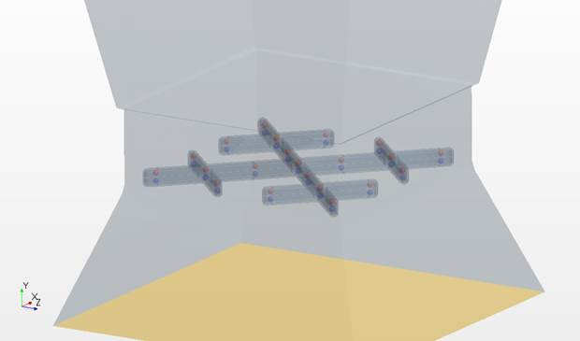
Pressure Points on Averaging Grid
Velocity pressure points
Velocity through
this grid should be
0.785 m/sec avg
Vacuum pressure points
3 Cone Diffuser Baseline
top pressure avg 7.47
bot pressure avg -6.46
pressure difference 13.93
SQRT of DP 3.73

Slide 10
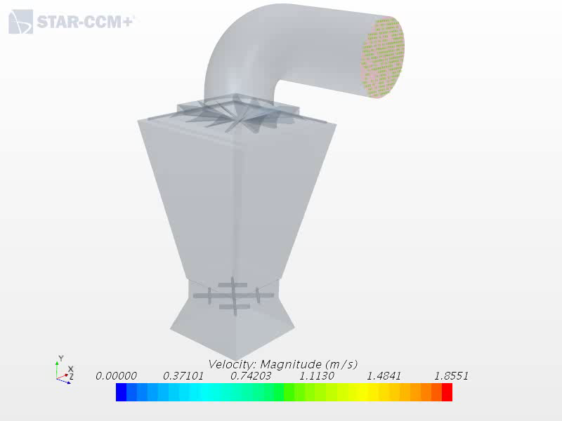
CFD Model: Swirl Diffuser
Velocity =1m/sec
12 inch diameter
~150cfm
Swirl A
+13.3% over
3 cone
Velocity through
this grid should be
0.785 m/sec avg

Slide 11
CFD Model Prediction vs. test results

Slide 12
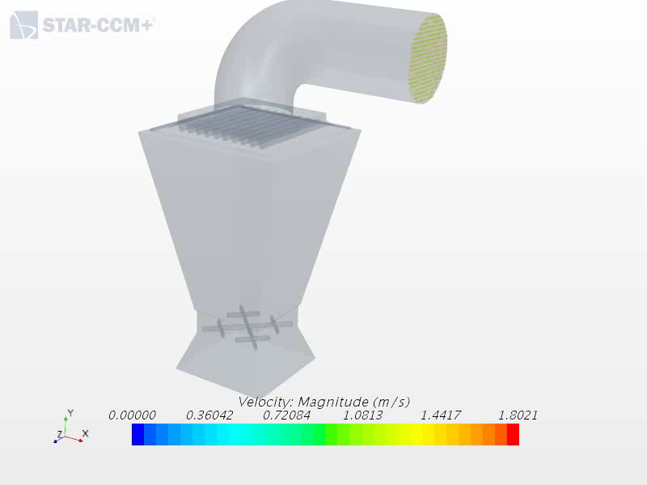
1 Way Diffuser: Duct Elbow Inline with Vanes
Velocity =1m/sec
12 inch diameter
~150cfm
One Way Inline
+5.2% over
3 Cone

Slide 13
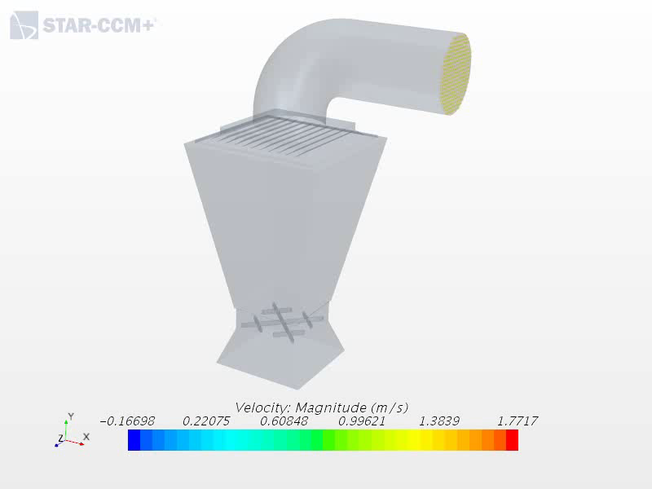
1 Way Diffuser: Duct Elbow Opposite of Vanes
Velocity =1m/sec
12 inch diameter
~150cfm
One Way Opposite
+8.5% over
3 Cone

Slide 14
Experimental Results: Traditional Hood on One Way Diffuser: Two Directions
CFD Model Prediction vs. Test Results

Slide 15
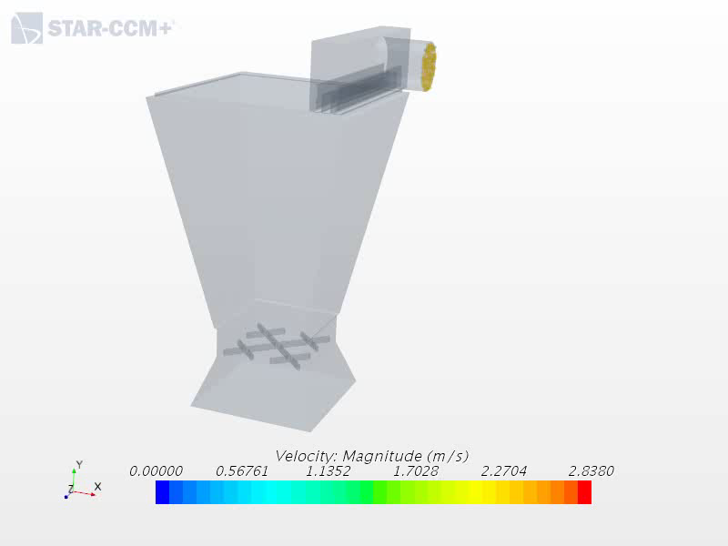
Slot Diffuser
Velocity = 4.24m/sec
5.82 inch diameter
150cfm
Slot
+7.4% over
3 Cone

Slide 16

Slot Diffuser Test Results
CFD Model Prediction vs. test results

Slide 17
Summary of Results

Slide 19

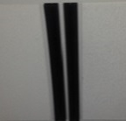

Branch with a mix of various diffusers
T-1
T-6
T-5
T-2
T-3
T-4
It is difficult to balance a branch like this when there is a 9% error between the
3 cone and slot diffusers?

Slide 20
Traditional Capture Hood Tested on Specific Diffusers Relative to 3 Cone

Slide 21
Example Diffusers
Step-down Plaque
Directional
2-way
Step-down
3-cone
2x1 slot
Directional
1-way
Step-down
2-cone
2way-corner
2x4 Laminar
(Tested with Skirt)
3way-side
Swirl Diffuser
Directional
4-way

Slide 22
Conclusions
While there is a constant offset, CFD models confirm experimental results
The CFD models demonstrate a tortuous flow path from common diffusers, including those often used to calibrate capture hoods
When a diffuser drives flow through the pitot array with limited disruption, output increases
There is a large disparity in errors from different diffuser types, particularly swirl diffusers
Errors cannot be accurately determined by a K factor because the %error with flow is inconsistant
However, errors can be corrected using % Error verses flow charts

Slide 23
Questions?
Bob Moss
rmoss@dwyermail.com

