Slide 1
TC 8.2 Main Meeting
Tampa Summer – Hybrid Meeting
June 26th, 2023
Notes:
Updated 1/31 7:15 with Research
Updated 1/31 8:27 with Webmaster
Updated 2/1 standards portion of agenda. Per phil Johnson
Updated 2/1 entire standards section per Phil Johnson
Updateed 2/1 9:20 90.1 from Phil J
Updated 2/1 Std 1520P with slide from Matt Cambio
2/1 Updated Honors and Awards based on Rick Heiden email.
Updated 2/1 Membership and Chairs breakfast updates – from Drew Turner’s email

Slide 2
Call to Order, Welcome, and Introductions
Welcome - Hybrid Meeting Format
Introductions:
  Officers
  Members
  Liaisons
  Guests
Notes:
Updated 6/27

Slide 3
Quorum Check – Trent Hunt
8 Voting Members (in lieu of 9 w/ Jaime, 7 present online or in person)
Scott MacBain
Dan Kemper
Brandon Gill
Chris Miller
Michael Perevozchikov
Nick Zupp absent
Drew Turner
Tiffany Bates Abruzzo
Jaime Yeh – not added, needs to be
Notes:
Updated 6/27

Slide 4



In all your interactions at these meetings, please remember…
Code of Ethics
“As members of ASHRAE or participants in ASHRAE activities, we pledge to act with honesty, fairness, courtesy, competence, integrity and respect for others in our conduct.
We will avoid conflicts of interest and behavior that is discriminatory and/or harassing.”
https://www.ashrae.org/about/governance/code-of-ethics
Notes:
The Code of Ethics is the basis for which we interact with one another.

Slide 5
Agenda
Call to Order, D. Turner
Introductions
Quorum check – T. Hunt
ASHRAE Code of Ethics Commitment – D. Turner
Agenda Review – D. Turner
TC 8.2 Mission Statement & Scope & Vote to Re-affirm – D. Turner
Reviewed/Approve Winter 2023 Meeting Minutes – Basecamp – D. Turner
Reports:
  Standards - P. Johnson
    ASHRAE Standard 30 (cognizant TC) – P. Johnson on behalf of N. Zupp
    ASHRAE Standard 184 (cognizant TC) – P. Johnson
    ASHRAE Standard 225 (cognizant TC) – P. Johnson
    ASHRAE Guideline 22 (monitoring) – P. Johnson on behalf of D. Showalter
    ASHRAE Standard 23 (monitoring) – S. MacBain
    ASHRAE Standard 90.1 (monitoring) – R. Good
    AHRI Standard 550/590|551/591 (monitoring) – P. Johnson
    AHRI Standard 1520 (monitoring) – M. Cambio
  MTG Low GWP Liaison Update – P. Johnson Program - M. Rogan
  Research – D. Showalter
  Handbook - S. MacBain
  Membership & Transition – T. Bates Abruzzo
  Web Master – D. Kemper
  Honors and Awards – R. Good
  Chair’s Breakfast Report – T. Abruzzo
Old Business – D. Turner
New Business – D. Turner
For the Good and Wellbeing ….
Adjourn

Slide 6
TC8.2 Centrifugal Machines Scope
TC 8.2 is concerned with packaged equipment which involves centrifugal compressors, including those heat exchangers, drivers, controls and accessories, which are specific to packaged centrifugal equipment.
TC 8.2 is also concerned with the design and performance of centrifugal compressors, steam turbines and gas turbines for use in refrigerating applications.

Slide 7
TC8.2 Centrifugal Machines Mission Statement
The mission of Technical Committee 8.2, Centrifugal Machines, is to provide world class technical expertise on all aspects of centrifugal refrigeration machines.
This committee is a resource to industry, academia, and others following society protocols through seminars, standards, technical papers/articles and other presentations.

Slide 8
TC8.2 Centrifugal Machines Mission Statement
The mission of Technical Committee 8.2, Centrifugal Machines, is to provide world class technical expertise on all aspects of centrifugal refrigeration machines.
This committee is a resource to industry, academia, and others following society protocols through seminars, standards, technical papers/articles and other presentations.
Discussion and Vote to Continue, Merge, or Dissolve
Trent Motioned & Tiff 2nd, all voted to continue (7 yes, 1 abstained (absent))

Slide 9
Review and Approve Previous Meeting Minutes
2023 Winter (Atlanta) Hybrid Meeting Minutes

Slide 10
Standards Report
Standards Subcommittee – Phil Johnson (chair)
TC 8.2 is the cognizant TC for:
  ASHRAE Standard 30-2019 Method of Testing Liquid Chillers
    [TC 8.2 is lead; TC 8.5 is co-cognizant]
  ASHRAE Standard 184-2020 Method of Test for Field Performance of Liquid-Chilling Systems
  ASHRAE Standard 225-2020 Method for Performance Testing Centrifugal Refrigerant Compressors and Condensing Units
TC 8.2 also monitors activity for the following standards of interest to members:
  ASHRAE Guideline 22-2012 Instrumentation for Monitoring Central Chilled-Water Plant Efficiency
    [TC 9.1 is cognizant]
  ASHRAE Standard 23-2022 Methods for Performance Testing Positive Displacement Refrigerant Compressors and Compressor Units
  [TC 8.1 is cognizant]
ASHRAE Standard 90.1-2022 Energy Standard for Buildings Except Low-Rise Residential Buildings
    [TC 7.6 is cognizant]
  AHRI Standards 550/590|551/591-2023 Performance Rating of Water-chilling and Heat Pump Water‑heating Packages using the Vapor Compression Cycle
  AHRI Standard 1520-2022 Performance Rating of Centrifugal Refrigerant Compressors
  ISO TC 86 / SC 4 Testing and rating of refrigerant compressors (ISO/AWI 18501, 18483, 18976)

Slide 11
Standards Report
ASHRAE Standard 30-2019 (Nick Zupp, Chair SSPC30)
Standard 30-2019
Addendum a. Published in May 2020. Mainly clean-up including a requirement to test based on defined operating mode set points.
Addendum b. Published in April 2020. Mainly clean-up including clarification of Δp_{adj}. Republished to add missing calibration workbook (.xlsx).
Addendum c. Addition of adiabatic, free-cooling, and 4-pipe chillers by introduction of hybrid operating modes. APR1 Nov 2020. PPR1 public review expected later in 2023.
Addendum d. Review of steady-state criteria. APR1 Nov 2020. PPR1 (Jun23~Jul23 2023) public review.
Addendum e. Harmonization with AHRI 550/590, Section 4. Addition of air sampling arrays. PPR1 public review expected later in 2023.
Addendum f. Published Feb 2023. Inclusion of AHRI 550/590 water pressure drop calculation tool.
Standard 30-2024 will consolidate of 2019 version with Addenda a, b, f, and likely c & d, possibly e.
Membership: Zupp (Phil reported)
No action required by TC 8.2.
Notes:
Updaetd 6/27

Slide 12
Standards Report
ASHRAE Standard 184-2020 (Phil Johnson)
Standard 184-2020 was published in November under periodic maintenance.
TC 8.2 needs to decide if and when to form another committee, if there is interest to revise the standard (e.g. additional work on the uncertainty calculator spreadsheet workbook). 5-year cycle would need to publish next edition by 2025, deadline to decide “withdraw, reaffirm, or revise” is 2023-Nov-30.
Motion: to recommend revision of ASHRAE Standard 184-2020

Slide 13
Standards Report
ASHRAE Standard 184-2020 (Phil Johnson)
Discussion for motion:
ASHRAE Standards staff provided a review of the standard
There is quite a list of issues that could be “cleaned up”, including out of date references, use of permissive language (need to better word-smith it), and inconsistent units of measure formatting
staff recommendation is “Revision”
I found some errors in the example spreadsheet (part of Informative Appendix I). I agree with the recommendation, with the expectation that the work plan would limit the scope to correcting the issues from the staff review and any other “minor” changes identified
6/26/23: TBA made motion & Chris 2nd, all voted yes- passes & SPC will be formed. Phil will submit paperwork. Mark to chair & Chris Miller to help.

Slide 14
Standards Report
ASHRAE Standard 225-2020 (Phil Johnson)
Standard 225-2020 was published under periodic maintenance (5‑year cycle) SPC 225. SPC 225 has been disbanded.
TC 8.2 will need to decide if and when to form another committee to revise the standard. 5-year cycle would need to publish next edition by 2025, deadline to decide “withdraw, reaffirm, or revise” will be 2024 (??) but can act earlier. Possible that staff still list TC 8.1 as cognizant, so notification may go to TC 8.1.
Discussion: any action required? 6/26/23 no notification received- but did 8.1 receive something? Phil will inquire- on standards committee- no action at this time, may contact by email per staff review- Justin P- combining 8.1 & 8.2?
Follow-up- email ballot sent by Drew on 7/3/23 Subject: Letter Ballot on TC8.2 Cognizant to ASHRAE Standard 225
  Hi all. Per discussion at our TC8. 2 committee meeting in Tampa, this is a letter ballot to approve/deny/abstain on: “TC 8. 1 is willing to have TC 8. 2 be the cognizant TC”, and that “TC 8. 2 is willing to accept the responsibility
  Hi all. Per discussion at our TC8.2 committee meeting in Tampa, this is a letter ballot to approve/deny/abstain on:
  “TC 8.1 is willing to have TC 8.2 be the cognizant TC”, and that “TC 8.2 is willing to accept the responsibility to be the cognizant TC”
  Please let me know your response on the latter statement for us to accept responsibility for being the cognizant TC. Please provide your response by this Friday, the 7th.
  Thanks.
  Drew

Slide 15
Standards Report
ASHRAE Guideline 22-2012 (Daryl Showalter, Chair GPC22)
Guideline 22-2012 was published with editorial updates to references as revision to 2008 edition.
GPC 22 formed in 2016 and drafted an update. PPR1 during 2021 (Jul16-Aug30), received 26 comments from 5 commenters. Comment responses sent to commenters, draft revisions in process. Anticipate a PPR2 (perhaps PPR2 ISC) during 2023 to resolve comments.
Expect publication by end of 2023 or early 2024.

Slide 16
Standards Report
ASHRAE Standard 23 (Scott MacBain, Chair SPC23)
Standard 23-2022 published “Methods for Performance Testing Positive Displacement Refrigerant Compressors and Compressor Units”.
There remains potential for either a future merger of 23 and 225, or perhaps harmonization activities.
6/26/23: 23 is positive disp does have /225 has unique splits our centr section- delete redundant content? Slim down but keep separate?
Can combine & only have 1 document, con is part of 225 is not positive disp- amend 225 to state follow 23 or unique part of 225
Justin- should design/ use 225 for pos disp? Scott- no can’t (Phil std 30 co-cognizant w/ 8.6)
Ray- very similar- combine & streamline
Alex- 23 be std & 225 be appendix?
Scott- who uses these stds today? Asking for 23 format or 225 format? Matt & Mike- we developed separate due to work load in past
Drew- no strong opinion one way or other but does not make sense to have 2, should have been a joint committee subjest- Scott- 8.1 does not want to merge, no benefit vs work for 8.1, don’t need extra info- at next joint meeting propose combination- will bring it up tmrow at 8.1 meeting formally
Mike motion/ Scott 2nd, passed formally (Ray- only record no’s)

Slide 17
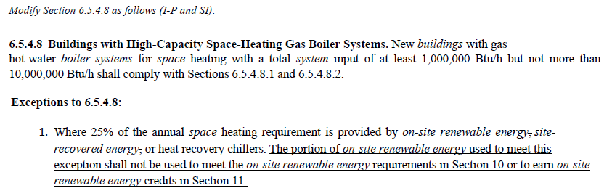
Standards Report
ASHRAE Standard 90.1-2022 (Ray Good)
Standard 90.1-2022 published (December 2022)
The following addenda have been published: a, bo, and cv
  None appear to be of interest to TC 8.2
New addenda to the 2022 edition (when published) will be available at:
  https://www.ashrae.org/technical-resources/standards-and-guidelines/standards-addenda
Proposed addenda:
  Addendum L (APR1 during May 2023, review closed) see next slide for details
  Addendum H (PPR1 during Jun 9 ~ Jul 9) “This addendum adds language throughout the 90.1 mechanical provisions to clarify that on-site renewable energy used to meet the requirements of Section 10 or to gain energy credits in Section 11 cannot also be used to meet the exceptions to efficiency requirements in Sections 6 and 7.” Potential impact for heat recovery chillers.

Slide 18
Standards Report
ASHRAE Standard 90.1-2022 (Ray Good)
Proposed Addendum L
FOREWORD The modification below includes a new informative appendix that modifies Section 3, Section 4, and Appendix G. It is intended to be adopted by jurisdictions or rating authorities wanting to achieve zero emission (ZE) buildings with the energy code over one to three code cycles. The method requires the use of the performance compliance path and includes two performance metric targets. The Performance Energy Index Site (PEIsite) provides an efficiency backstop. The Performance Emissions Index Greenhouse Gas (PEICO2e) measures zero emissions achievement. The modifications establish the ZE performance requirements for the code cycle. This includes updated BPF values reflected in Table 4.2.1.1 that require additional reductions in regulated energy use calculated from a 12% reduction in total energy use compared to ASHRAE Standard 90.1-2022 values.
INFORMATIVE APPENDIX M
NET ZERO OPERATIONAL ENERGY EMISSIONS PERFORMANCE PATH
M1. GENERAL This Informative Appendix provides a compliance pathway that may be adopted by a jurisdiction or the rating authority to achieve net zero operational energy emission (ZE) buildings over a defined number of code cycles. The amendments include changes to Section 3, Section 4, and Appendix G. The method requires use of the Appendix G Performance Rating Method and includes two performance metric targets. The Site Performance Energy Index (PEIsite) target establishes minimum energy efficiency, and the Greenhouse Gas Performance Emissions Index (PEICO2e) target establishes the required CO2e emissions reduction.

Slide 19
Standards Report
ASHRAE Standard 90.1-2022 (Ray Good)- 6/26/23 meeting discussion:
Ray Good to take over supporting- 3 addenda added, nothing affecting centrifugals- see slides added- Addendums (H,L, & M) by Rick H- Proposed addendum L ZE (zero emissions) CO, WA, net zero energy codes but no way to get there- can adopt appendix only
Rick H: Dick Lord new 90.1 chair, charged with becoming net zero/ zero carbon by 2031, about 22% reduction in 3 cycles (usually get 3-4% per cycle increase) equipment increase in efficiency (AHRI/ Manufacturers need to help with what is available, regional part load metrics & equipment being used appropriately) part of 22% may be part pf better modeling- ref std 205 so codes can include in bldg. modeling tools- better characterization by equipment type, this TC 8.2 should have a say in what goes into this for rating chillers/ means for rating chillers at jobsite for that machine to compare to local codes. Charge to get to zero carbon path. Refrigerant management & better eff important. Action item: whole committee review 205 usability (feedback- reveal too much? No way- no speeds or approach temps/ nothing for back calculator- giving points & maps- no only on ) & send summary to 90.1 & AHRI 1550- reasonable to provide this info to bldg. modelling team? Also- What should std ratings be for chillers? 85/97? 56/42? Depend on climate zone? Chris M- should depend on exact design conditions, mythical for single point & single chiller- multiples Phil- concept of eliminating single OP, map in lieu of single rating point, Tom W original author of
Rick & Drew- chiller group at AHRI; Jaime- now Applied Systems Working Group & will spawn sub-working groups 205 & 225 are at least both out there & are something to refer to, Rick & Jaime to connect, 205 provides another avenue for better coordination/ comments
Phil- no publishing anything anymore using selection programs at discreet points only (no mapping for competitors). Rick- check out data exchange? Security new layer, cont maintenance. Notify Chillers STC at AHRI- Dick Lord on both- published standard
Drew made motion & 2nd by TBA- no no’s or abstentions, Brandon will look into it, action item- manufacturer to review 205

Slide 20
Standards Report
AHRI Standards 550/590|551/591 (Phil Johnson)
AHRI 550/590 (I-P) and 551/591 (SI) – 2023, Performance Rating of Water-Chilling and Heat Pump Water‑Heating Packages Using the Vapor Compression Cycle
2023 Editions of both standards are published as ANSI/AHRI. Include minor revisions to the 2020 editions. Include normative reference to ASHRAE 30 for method of test.
AHRI 1550P (proposed) Performance Rating of Liquid-Chilling and Heat Pump Water‑Heating Packages Using the Vapor Compression Cycle (6/26/23 Jamie Yeh stated was approved to move forward)
Would replace 550/590 and 551/591, merge separate IP & SI edition into a single standard.
Project charter scope of revisions for next edition after that (circa 2025) includes the following items:
  Review tolerances and incorporate units with variable flow
  Continue to work toward harmonizing section 4 with ASHRAE 30
  Review uncertainty analysis reporting requirements
  Adiabatic cooled condensers
  Heat Pump Part-Load Metrics
  Review of rounding throughout documents
  Review Standard Rating Conditions
  Regional part load metrics
  Ratings for units with more than two heat exchangers

Slide 21
Standards Report
AHRI Standard 1520 (Matt Cambio)
AHRI Standard 1520-2022, Performance Rating of Centrifugal Refrigerant Compressors
This standard will provide a rating method for centrifugal compressors and a calculation method to compare centrifugal compressors with positive displacement compressors.
Published
New method is compressor performance specification (table format)
A tool is being created by Purdue for reading data and calculating performance as well as comparisons with positive displacement compressor 10 coefficient model
The tool is MatLab based and will be made available along with source code
Additional Notes:
Reference to ASHRAE 225, Methods for Performance Testing Centrifugal Refrigerant Compressors and Condensing Units
Similar format to AHRI 540, Performance Rating of Positive Displacement Refrigerant Compressors and Compressor Units
AHRI Compressor Standards Technical Committee will maintain the standard (responsible for a total of 7 standards including 1520)
Matt C saw some clarity weaknesses will propose to AHRI/Jaime Weh

Slide 22
Standards Report
ISO/TC 86/SC 4 (Justin Prosser)
TC 86: Refrigeration and air-conditioning
SC 4: Testing and Rating of refrigerant compressors
TC = Technical Committee
SC = SubCommittee
WG = Working Group
AWI = Approved Work Item

Slide 23
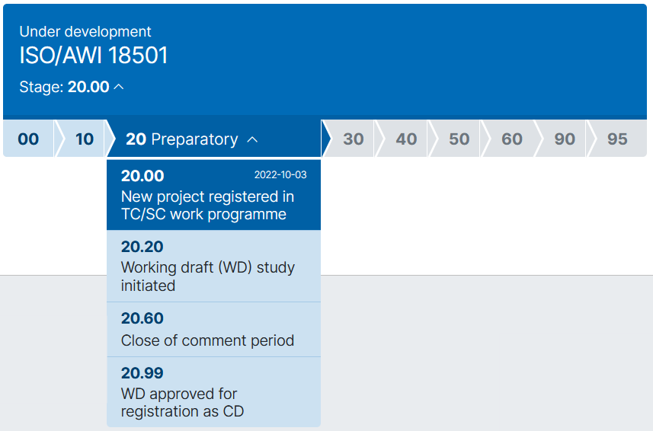
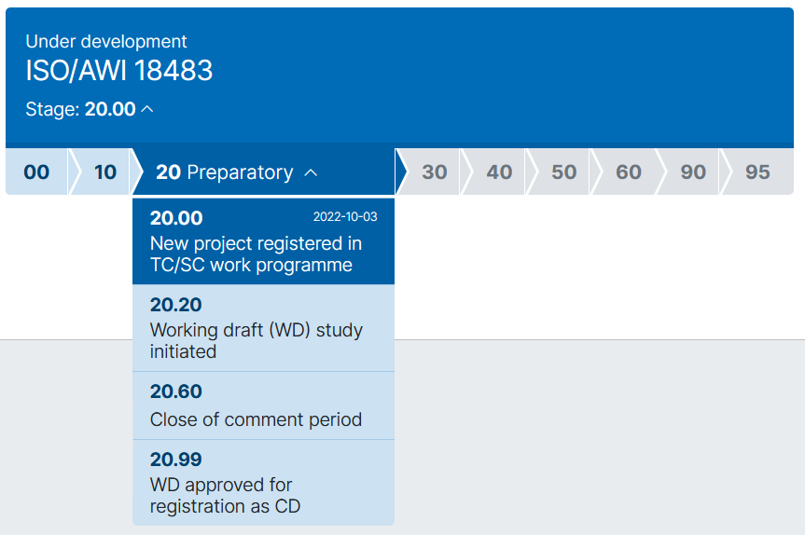
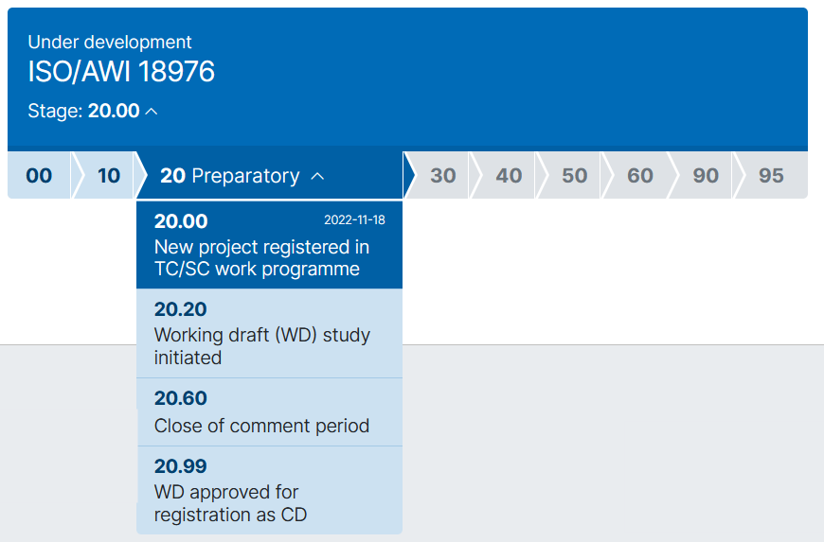
Standards Report
ISO/TC 86/SC 4 (Justin Prosser)
Current Meeting Schedule:
Justin- on top of it- accepted a lot of work- harmonize no obstacles seen, good reason to combine 23 & 225
July 12 (online) - WG3
Combination of
ISO 917, ASHRAE 23 and ASHRAE 225
Similar to AHRI 540
Similar to AHRI 1520
https://www.iso.org/standard/85298.html
https://www.iso.org/standard/85297.html
https://www.iso.org/standard/85541.html
WG2 participants:
CN, DE, ES, JP, UK, US
WG3 participants:
CN, DE, ES, JP, UK, US
WG4 participants:
CN, DE, JP, US

Slide 24
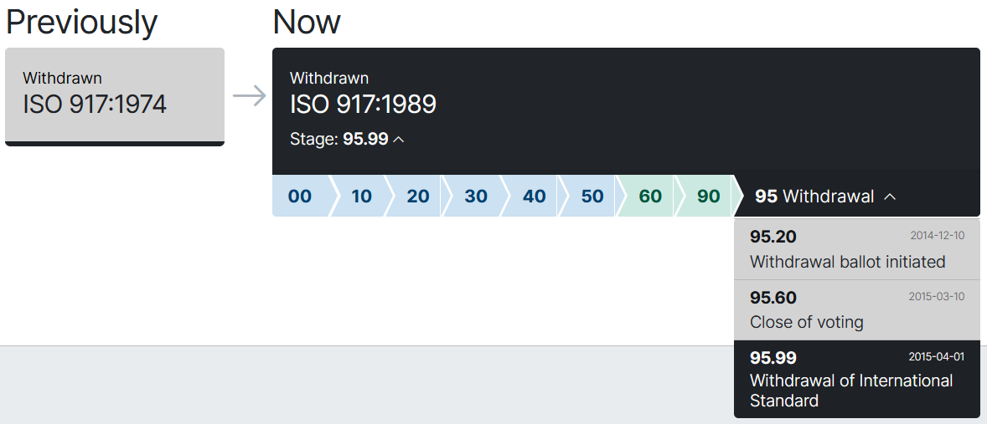
Standards Report
ISO/TC 86/SC 4 (Justin Prosser)
https://www.iso.org/standard/5327.html

Slide 25
MTG.LowGWP Report (Phil Johnson, TC 8.2 Liaison)
The MTG met Sun Jun 25 and will meet again Wed Jun 28.
Program Subcommittee. Seeking programs from TCs for co‑sponsorship.
Codes & Standards Subcommittee meets Tue Jun 27.
Research Subcommittee, current activity at the PMS level.
Research projects on-going include RP-1806 and RP-1855. Expecting MTG vote to approve RP-1855 report on Wednesday. Monitoring a few projects sponsored by other TCs.

Slide 26
MTG.LowGWP Report (Phil Johnson, TC 8.2 Liaison)
Research project status.
RP-1806 “Flammable Refrigerants Post-Ignition Simulation and Risk Assessment Update”
  Start date: Jan-2017.
  Slow progress. PMS received revised Task 1 interim report Jan-2022.
  Original scope included updating AHRI risk assessments for 2L refrigerants in 5 types of equipment, including chillers (centrifugal & screw, machinery room).
  Project has re-allocated the budget (more to Task 1) and not yet clear what scope will be reduced (or if more funding will be requested to complete original scope).
  PMS will soon receive a pilot study that completes the Task 2 and Task 3 work for just a small subset of the original scope (reach-in coolers). Results will determine go/no-go/redirect for remainder of the project

Slide 27
MTG.LowGWP Report (Phil Johnson, TC 8.2 Liaison)
Research project status.
RP-1855 “Determination of the Impact of Combustion Byproducts on the Safe Use of Flammable Fluorinated Refrigerants”
  Start date: Jan-2020
  Slow progress to finalize the report. PMS sent second round of requested revisions to contractor Dec-2021. Contractor sent revised report Mar-2022. PMS final review completed Jan-2023. MTG to vote for approval on Wed Jun 28 in Tampa.

Slide 28
MTG.LowGWP Report (Phil Johnson, TC 8.2 Liaison)
More detailed report document available for the meeting minutes.
Reconfirm the representatives from TC 8.2 (Primary: Phil Johnson, Alternate #1: Laurent Abbas, Alternate #2: Ray Good).

Slide 29
Program Subcommittee Report – Mark Rogan (chair)
Combined TC 8.02/8.01 Program Subcommittee Report
2023 Summer Meeting, Tampa, FL
Subcommittee Meeting: June 20th, 1:00 pm -3:00 pm EST
Attendees: Mark Rogan, Drew Turner, Matt Cambio, Justin Prosser, Michael Perevozchikov, Davide Ziviani, Ray Good, Craig Bradshaw, Dan Kemper, Alex Schmig, Tiffany Abuzzo, Jamie Yeh, Haotian Liu, Phil Johnson, Scott McBain, Brandon Gill, Chris Miller, Joe Sanchez, Chee Sheng Ow, Harshad Rheem, Farhan Jurati, Pradeep
Tampa Meeting Update: 3 Programs Approved with TC 8.1: Seminar 37, Seminar 46, and Seminar 71
Great Job to all involved!!!!!

Slide 30
Program Subcommittee Report – Mark Rogan (chair)
Current Programs – Summer Meeting Tampa June 24th- 28^{th,} 2023
Seminar 37 – Challenges in Selecting an Appropriate Compressor Technology Based on Refrigeration and Application - 8:00-9:30 Tuesday June 27th Alex Schmig(Trane) is chair of seminar. Sponsored by TC8.1 and cosponsored by TC8.2 and 10.6. Presenters: Craig Bradshaw(OSU), Nilesh Purohit, PhD(Honeywell), Drew Turner(Danfoss), Davide Ziviani, PhD(Purdue University).
Seminar 46 – ASHRAE/AHRI Compressor Test and Rating Standards: Everything you would ever want to know(and more) – 11:00-12:30 Tuesday June 27th Justin Prosser(Danfoss)is chair of seminar. Sponsored by TC8.1 and cosponsored by TC8.2 and 1.2. Presenters: Matthew Cambio(Trane), Joseph Sanchez(Bitzer), Alexander Schmig(Trane).
Seminar 71 – Livestreamed – Advanced Cycle Architecture for Decarbonizing Heating – 11:00-12:30 Wednesday June 28th Davide Ziviani, PhD (Purdue) is chair of seminar. Sponsored by TC8.1 and cosponsored by TC8.2 and 8.11. Presenters: Craig Bradshaw (OSU), Haotian Liu, PhD(Purdue), Bo Shen, PhD(Oak Ridge National Labs).

Slide 31
Program Subcommittee Report – Mark Rogan (chair)
Future Program Ideas – Beyond Tampa
What Impact has 90.1-2019 had on Design Practices regarding a 15° ΔT / Low Flow Tube Study – These two topics have been proposed for combination which the subcommittee thought made sense. Co-Sponsor potential with TC 1.3 (coil heat transfer)and TC 8.1 (positive displacement compressors) Drew Turner offered to line up a tube guy for that topic. Other speakers discussed were Trent Hunt and Rick Heiden. Have any direct consultants at the meeting adjusted or standardized their design practices to use larger delta Ts and could include real project data when presenting? Doing these topics as a Forum instead of a Seminar was also discussed but then warned about since very few Forum proposals are approved. Open the floor for discussion. Good candidate for Track # 1; Fundamentals and Applications
Electrification of Heating Chapter 2: Industrial and Healthcare Markets as well as Hybrid Applications – Possible Track 4 (Pathways to Net Zero Energy and Decarbonization) or Track 5 (Future-Proofing the Built Environment) Chris Miller possible chair. Discussed pushing this one out to the next summer meeting in Indianapolis to ensure full data acquisition from the Kaiser project. Good candidate for Track # 4; Decarbonization & Climate Change. from Las Vegas (healthcare) Mazetti will speak- won’t have data until Indy or Orlando? Good with either- 2 tracks for annual/ 7 tracks for winter (larger show, will also have more data…decide in Chicago
System Design & Controls on Heat Pump & Heat Recovery Applications – Trent Hunt as possible chair. Rick Heiden, Drew Turner, and Chris Miller have been discussed as speakers. Chris should have at least desuperheater data from Kaiser Baldwin Project but not sure about HR data off the steam boiler as that system may not be running yet. Good candidate for Track # 2; HVAC&R Systems and Equipment or Track # 4; Decarbonization & Climate Change. Chicago Chapter 1, Indy Chapter 2- Trent Hunt as possible chair & Rick to speak or someone from Trane (he had to leave today)
Natural Refrigerants – Matt Cambio mentioned as a possible chair. Would be a good fit for Track # 3 in Chicago; Refrigeration and Refrigerants
Any other topic ideas? Open to the floorSide note- Trent- CIBSE used our Seminar 63’s Trent’s section as highlight of AHR show
Annual Decarb Conf moving forward- DC 2023, Madrid 2024- Trent- do we want to propose seminars/provide speakers from 8.2? Recycle material? Tom W, not allowed. Drew interested, Mark will look into, keep track of Seminar 71 & update appropriately for Spain
Next Meeting
Subcommittee will meet via conference call in early January 2024

Slide 32
Program Subcommittee Report – Mark Rogan (chair)
2024 Winter Meeting/Conference Chicago:
Important dates:
Wednesday August 2nd - Program Proposals Due
Wednesday November 8th Program accept/reject notifications
TBD Program submission deadline
2024 Winter Meeting/Conference Program Tracks Chicago
  Track 1 - Fundamentals and Applications – Track Chair: Craig Bradshaw
  Track 2 - HVAC&R Systems and Equipment – Track Chair: Ng Yong Kong
  Track 3 – Refrigeration and Refrigerants – Track Chair: Atilla Biyikoglu
  Track 4 – Decarbonization and Climate Change – Track Chair: Som Shrestha
  Track 5 – Hydronic Systems – Track Chair: Joe Chow
  Track 6 – Ventilation, Indoor Air Quality and Air Distribution Systems – Track Chair: Ahmed Abdel Salam
  Track 7 – Comfort, Indoor Environmental Quality and Energy Efficiency – Track Chair: Kristen Cetin
  Track 8 – HVAC&R Controls – Track Chair: Alekhya Kaianathbhatta
  Track 9 – Project Delivery Methods – Track Chair: Ehab Mamdouh Abu Taleb

Slide 33
Research Subcommittee Report – Daryl Showalter (chair)
Research S/C Chair Breakfast notes of interest: Not attending, nothing to report.
Current Activities
Research Subcommittee online meeting was held June 20
Project Status
1716 - Oil concentration of field-installed liquid chillers with flooded type evaporators.
  Went out for bid again – Single bid received; currently under evaluation by PES
  Haotian Liu added to Proposal Evaluation SubC (PES)
  PES recommends to accept the bid, need a vote by the TC
    Phil showed summary sheet, only single bidder must score min 80 in lieu of 70 for multiple, avg scores of mid 90’s, everyone knows project, issue is RP from 1990’s always mentioned/ but mis represented- only sampled 10 chillers on 1 campus using R-11 (looking for air, water, etc not specifically for oil) to get current info with current technology & refrigerants & oils; Drew, valid proposal? Ray- high score = strength of proposal- great pedigree of researcher- looking in Europe & US since in Germany & partnering with US company Chris motioned TBA 2nd, vote anonymous, Nick missing (Chris asked for sampling report- will get before start- centrifugal with S&T) Phil & Carl will take care of electronic submittal forms.
1793 - Development of Method of Test for Motor Component Thermal Conductivity
  TC8.1 is taking the lead on this one and will resubmit from the comments.
  Planning to resubmit this one but not sure that happened yet.
Notes:
Updated 6/28

Slide 34
Research Subcommittee Report – Daryl Showalter (chair)
1879 – Foamability properties of LGWP Refrigerant and Oil Mixtures
  Sponsored by TC3.4 and Co-Sponsored by TC8.1
  MORTS needs revised WS to rebid w/ Expanded Bidders list, new Budget Est. , Etc.
Future Activities
Decarb and heating mode how to get higher-temp heat pumps – willing to entertain a proposed Title for this if anyone wants to put one forward.
Notes:
Updated 6/28

Slide 35
TC 8.1 & 8.2 Handbook – Scott MacBain (Chair)
Agenda
TC 8.1: Refrigeration: Chapter 8 - Factory Dehydrating, Charging & Testing
  2026 Next Revision
TC 8.1 & 8.2: 2024 HVAC Systems & Equipment: Chapter 38 and 43 (due July 2023)
  Davide Ziviani, Craig Bradshaw, Michael Perevozchikov, Rick Heiden, Scott MacBain, Fred Betz, Drew Turner, Trent Hunt, Steve Duda
  Confirm document access on authoring portal: https://authoring.ashrae.org/
  Contact Chris Walter (CWalter@ashrae.org) if any issues with Microsoft login
  Status at ASHRAE is carryover from January. Timing for their upload of 38 & 43 to portal delayed from March, May, July:, (6/22)
  Scott- meeting twice a week- need to vote by end of July via email
Notes:
UPDTED 6/27

Slide 36
TC8.2 Leadership Roles – Drew Turner
Chair – Drew Turner
V Chair – Trent Hunt
Secretary – Tiffany Bates Abruzzo
Handbook – Scott MacBain
Programs – Mark Rogan
Standards – Phil Johnson
Research – Daryl Showalter
Webmaster – Dan Kemper
Honors and Awards – Ray Good
MTG. LowGWP Liaison – Phil Johnson
MTG. LowGWP Alternate – Ray Good
Effective until next summer annual meeting
Notes:
Updated 6/27

Slide 37
Membership – T. Hunt https://tpc.ashrae.org/Membership?cmtKey=83a02e09-1a12-4ee1-bbf8-3ba74490dec7
Final modifications to TC membership –
  Deleted – 13
  Delayed submitting final based on confirming Secretary and (if necessary) replacing current role
Updated 2023-2024 roster attached
Request from Steve Duda to be removed
How to Import Your TC Roster Information into MS-Outlook - http://www.ashrae.org/TCs

Slide 38
Webmaster – Dan Kemper
General updates and maintenance
  Meeting time, agenda and links posted
  Winter 2023 agenda, power point and draft minutes posted
Please send slides from 2023 seminars so they can be added to the presentations section of the website
https://tc0802.ashraetcs.org
Notes:
Updated 6/28

Slide 39
Honors and Awards – Ray Good
Previous Deadline | New Deadline | Award | How does this impact me?
December 1 | May 1 | ASHRAE Award for Distinguished Public Service ASHRAE Hall of Fame ASHRAE Pioneers of the Industry Fellow F. Paul Anderson Award Honorary Member | You may have been preparing nominations to submit by December 1, 2023, but you now have an additional six months to submit those nominations since the deadline is now May 1, 2024. These awards will still be presented at the 2025 Winter Conference.
May 1 | December 1 | Andrew T. Boggs Service Award Distinguished Service Award (DSA) Exceptional Service Award (ESA) Louise & Bill Holladay Distinguished Fellow Award | These awards just had a deadline earlier this month, but you’ll get another chance to submit more nominations by December 1, 2023. Any approved nominees from the recent May 1, 2023 deadline and the upcoming December 1, 2023 deadline will be honored at the 2024 Annual Conference.
Full list of ASHRAE Awards can be found at: https://www.ashrae.org/membership/honors-and-awards
Full H&A Presentation located at:
  https://www.ashrae.org/file%20library/membership/honors%20and%20awards/ashrae-ha-ppt_may-2023.pptx

Slide 40
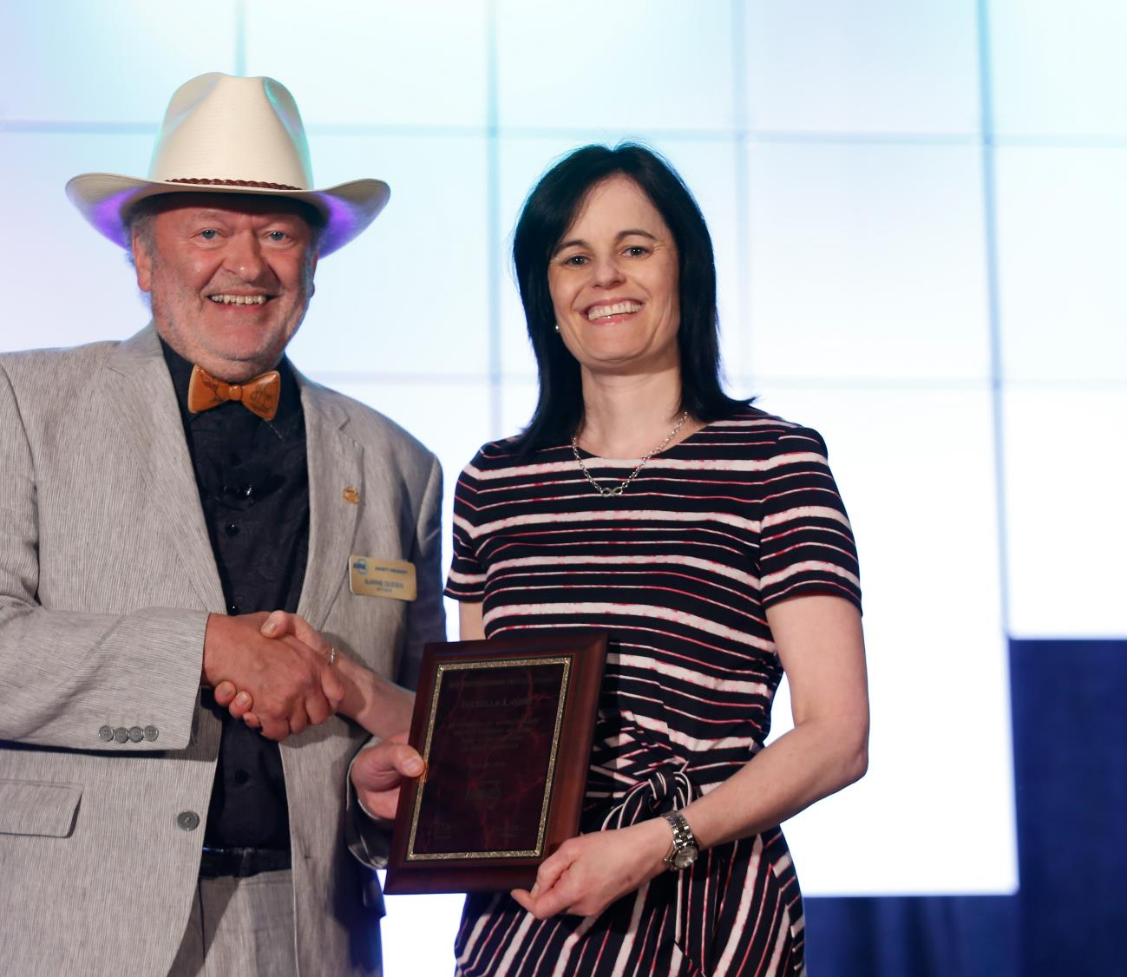
Personal Awards for
General Society Activities
Distinguished Service Award (DSA)
  Recognizes members who have served the Society faithfully and with distinction or otherwise given freely of their time and talent on behalf of the Society. A minimum of 15 points required on the point tally form.
  Nomination deadline: December 1
Exceptional Service Award (ESA)
  Similar to the DSA, except 45 points are required on the point tally form and the member must have been a Full Member for at least ten years.
  Nomination deadline: December 1
Developing Leader Award
  This award recognizes new members who have shown diverse involvement and commitment to ASHRAE withing five years of their Association Member join date.
  Recommended by the YEA Committee

Slide 41
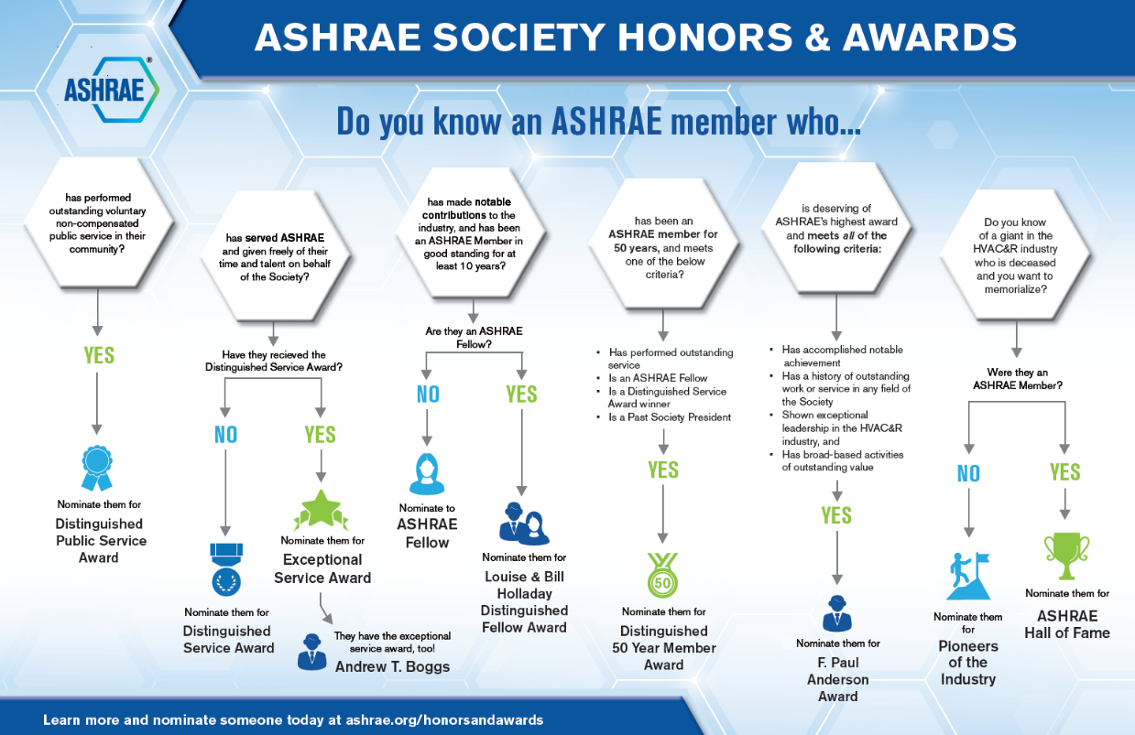
Honors and Awards Flowchart
Notes:
Flowchart is posted on the H&A webpage (www.ashrae.org/Honors) and available in printouts.

Slide 42
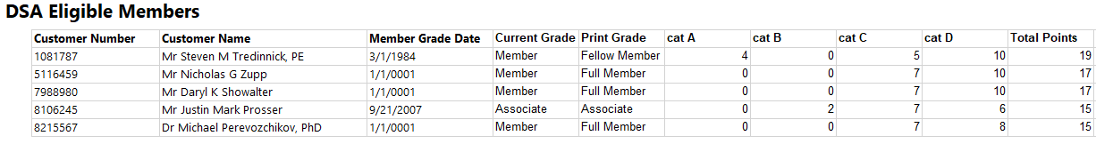
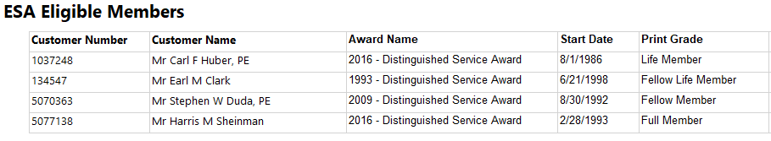
Honors and Awards – Ray Good Continued
TC8.2 Member DSA Qualifications (15 Points)
TC8.2 Member ESA Qualifications (45 Points)

Slide 43
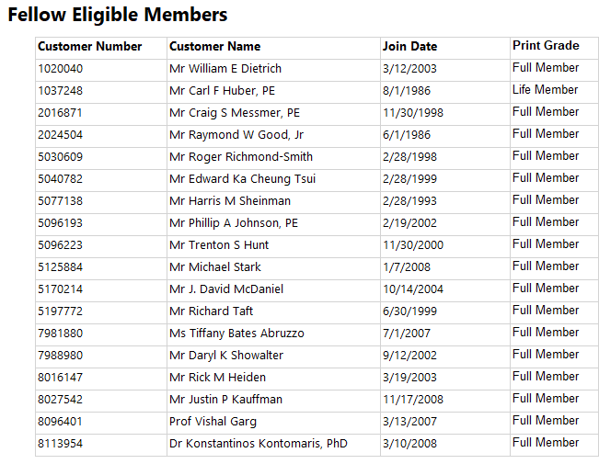
Honors and Awards – Ray Good Continued
TC8.2 Member Qualifictions

Slide 44
Honors and Awards – Ray Good Continued
Current Activities:
Currently Exploring
  Phil Johnson for Standards Achievement Award
  Matt Cambio – Does not yet meet minimum qualification points
Encourage all members to update their ASHARE bios in an effort to qualify for additional honors and awards recognition
Consider others who may qualify as a Fellow or other awards

Slide 45
TC Chairs Breakfast Report – T. Abruzzo
Agenda 6/25/23
Welcome and Code of Ethics – Kevin Mercer
Task Force on Building Decarbonization – Luke Leung
Government Affairs Committee – Alice Yates
Virtual Meeting tips – Kevin Mercer
TAC strategic plan & DEI – Craig Messmer
Activity Form Operations – Satheesh Kulankara
Section Breakouts
Handbook Training- Authoring Tool: Adrienne Thomle & Heather Kennedy (staff)
Closing Remarks – Kevin Mercer

Slide 46
Old Business – D. Turner

Slide 47
New Business – D. Turner
New members intros

Slide 48
For the Good and Wellbeing

Slide 49
Adjourn

