Slide 1
TC 8.2 Vapor Compression Cooling and Heat Pump Chillers – Main Meeting
Orlando Winter – Hybrid Meeting
February 10th, 2025

Slide 2
ASHRAE Value Statement
In ASHRAE meetings, we will act with honesty, fairness, courtesy, competence, inclusiveness and respect for others, which exemplify our core values of excellence, commitment, integrity, collaboration, volunteerism and diversity, and shall avoid all real or perceived conflicts of interest. Our culture is one of inclusiveness, acknowledging the inherent value and dignity of each individual. We celebrate diverse and inclusive communities, understanding that doing so fuels better, more creative and more thoughtful ideas, solutions and strategies for the Society and the communities our Society serves. We respect and welcome all.

Slide 3
Call to Order, Welcome, and Introductions
Welcome - Hybrid Meeting Format
Introductions:
  Officers
  Members
  Guests
Notes:
Updated 6/27

Slide 4
Quorum Check – Trent Hunt
? Voting Members/ … in attendance (… online)
Trent Hunt
Tiffany Bates Abruzzo
Scott MacBain
Brandon Gill
Chris Miller
Michael Perevozchikov – Currently listed on committee site as non-voting
Nick Zupp
Need more; Nominations?
Notes:
Updated 6/27

Slide 5
Agenda
Call to Order, T. Hunt
Introductions
Quorum check – T. Abruzzo
ASHRAE Code of Ethics Commitment – T. Hunt
Agenda Review – T. Hunt
TC 8.2 Mission Statement & Scope & Vote to Re-affirm – T. Hunt
Reviewed/Approve Annual Summer 2025 Meeting Minutes – Basecamp – T. Hunt
Reports:
  Standards – P. Johnson (+ others)
  MTG Low GWP Liaison Update – P. Johnson
  Program - M. Rogan
  Research – D. Showalter
  Handbook – J. Medina
  Membership & Transition – S. MacBain
  Web Master – D. Kemper
  Honors and Awards – R. Good
  Chair’s Breakfast Report – T. Hunt / T. Abruzzo
Old Business – T. Hunt
New Business – T. Hunt
For the Good and Wellbeing ….
Adjourn

Slide 6
TC8.2 Vapor Compression Cooling and
Heat Pump Chillers Mission Statement
The Mission Statement of Technical Committee 8.2, Vapor Compression Cooling and Heat Pump Chillers is to provide world class technical expertise on all aspects of centrifugal refrigeration machines.
This committee is a resource to industry, academia, and others following society protocols through seminars, standards, technical papers/articles and other presentations.
The Scope of TC 8.2 is concerned with cooling and heat pump chillers that involves centrifugal or positive displacement compressors, including those with heat exchangers, drivers, controls, split evaporators and condensers, and other accessories.
Motion to Re-Affirm 8.2 Vapor Compression Cooling
and Heat Pump Chillers?

Slide 7
Review and Approve Previous Meeting Minutes
2024 Annual Summer (Indianapolis) Hybrid Meeting Minutes

Slide 8
Standards Report
Standards Subcommittee – Phil Johnson (chair)
TC 8.2 is the cognizant TC for:
  ASHRAE Standard 30-2019 Method of Testing Liquid Chillers
    [TC 8.2 is lead; TC 8.5 is co-cognizant]
  ASHRAE Standard 184-2020 Method of Test for Field Performance of Liquid-Chilling Systems
  ASHRAE Standard 225-2020 Method for Performance Testing Centrifugal Refrigerant Compressors and Condensing Units
TC 8.2 also monitors activity for the following standards of interest to members:
  ASHRAE Guideline 22-2012 Instrumentation for Monitoring Central Chilled-Water Plant Efficiency
    [TC 9.1 is cognizant]
  ASHRAE Standard 23-2022 Methods for Performance Testing Positive Displacement Refrigerant Compressors and Compressor Units
  [TC 8.1 is cognizant]
ASHRAE Standard 90.1-2022 Energy Standard for Buildings Except Low-Rise Residential Buildings
    [TC 7.6 is cognizant]
  ASHRAE Standard 205-2023 Representation of Performance Data for HVAC&R and Other Facility Equipment
    [TC 4.7 is cognizant]
  AHRI Standards 550/590|551/591-2023 Performance Rating of Water-chilling and Heat Pump Water‑heating Packages using the Vapor Compression Cycle
  AHRI Standard 1520-2022 Performance Rating of Centrifugal Refrigerant Compressors
  ISO TC 86 / SC 4 Testing and rating of refrigerant compressors (ISO/AWI 18501, 18483, 18976)

Slide 9
Standards Report
ASHRAE Standard 30-2019 (Nick Zupp, Chair SSPC30)
Developing addenda to ASHRAE Standard 30-2019 “Method of Testing Liquid Chillers” (designated as continuous maintenance)
Will publish a 2025 edition (with Addenda a, b, c, d, f, h, i). Galley proof being prepared.
Updated errata sheet issued 2024-Apr-24
2025-Feb-10 meeting:
  Resolved public comment to Addendum h (which will now proceed to publication).
  AHRI has a test plan to collect test data for air sampler temperature array versus air sampler with aspirating psychrometer (for developing ‘Addendum e’, for the next edition). Contract in process. Test data collection pending.
  Voted to recommend a seminar in Phoenix for ‘what’s new’ in Standard 30-2025.
Next meeting: late Mar / early Apr (Arlington/hybrid), joint meeting with AHRI Chillers STC
Addendum a. Published in May 2020. Mainly clean-up including a requirement to test based on defined operating mode set points.
Addendum b. Published in April 2020. Mainly clean-up including clarification of Δp_{adj}. Republished to add missing calibration workbook (.xlsx).
Addendum c. Addition of adiabatic, free-cooling, and 4-pipe chillers by introduction of hybrid operating modes. APR1 Nov 2020. PPR1 public review May~Jul 2024. Published December 2024.
Addendum d. Published March 2024. Update to steady-state criteria.
Addendum e (for next edition). Harmonization with AHRI 550/590, Section 4. Addition of air sampling arrays. PPR1 public review possible in late 2025 after AHRI research data collection.
Addendum f. Published January 2023. Inclusion of AHRI 550/590, water pressure drop calculation tool.
Addendum g. Nomenclature to use for temperature differences (keep as-is or change). Advisory Public Review Jun~Jul 2024. Only 1 comment. SSPC30 decision to not change.
Addendum h. Miscellaneous changes, harmonization with AHRI 550/590. PPR1 public review Nov29~Dec 29 2024. One public comment received and resolved; will publish soon.
Addendum i. TPS changes, water to liquid. PPR1 public review Oct25~Nov24 2024. No public comments received. Published December 2024.
Notes:
Updaetd 6/27

Slide 10
Standards Report
ASHRAE Standard 184-2020 (Phil Johnson)
Standard 184-2020 was published in November under periodic maintenance.
TC 8.2 decided and voted (7-0-0-1) in Tampa on 2023-Jun-26 to recommend forming a committee to revise the standard (e.g. additional work on the uncertainty calculator spreadsheet workbook). 5-year cycle would need to publish next edition by 2025 (-ish?), deadline to decide “withdraw, reaffirm, or revise” was 2023-Nov-30.
Periodic Maintenance Recommendation form submitted 2024-01-18. Standards Reaffirmation Subcommittee (SRS to StdC) approved recommendation. StdC approved ballot ending 2024-10-25.
Status of call for members? (Chair: M.Rogan)

Slide 11
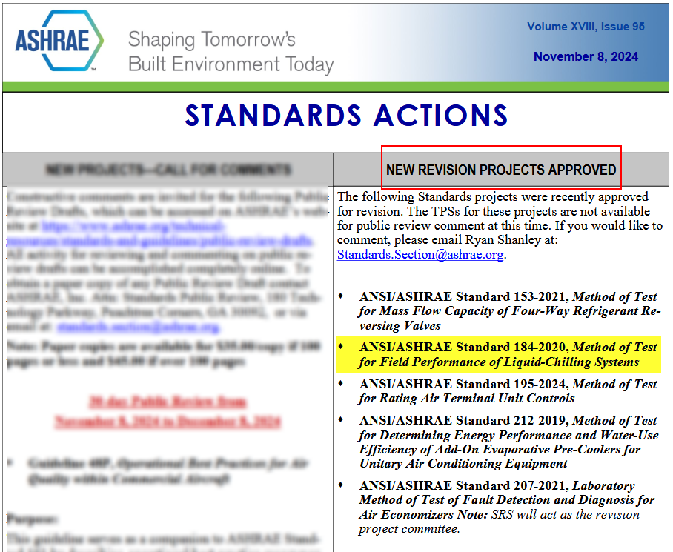
Standards Report
ASHRAE Standard 184-2020 (Phil Johnson)

Slide 12
Standards Report
ASHRAE Standard 184-2020 (Phil Johnson)
Recap of discussion points from Tampa (2023-Jun):
ASHRAE Standards staff provided a review of the standard
There is quite a list of issues that could be “cleaned up”, including out of date references, use of permissive language (need to better word-smith it), and inconsistent units of measure formatting
staff recommendation is “Revision”
P. Johnson found some errors in the example spreadsheet (part of Informative Appendix I), agrees with the recommendation, with the expectation that the work plan would limit the scope to correcting the issues from the staff review and any other “minor” changes identified

Slide 13
Standards Report
ASHRAE Standard 225-2020 (Phil Johnson)
Standard 225-2020 was published under periodic maintenance (5‑year cycle) SPC 225. SPC 225 has been disbanded.
Based on a TC 8.2 letter ballot passing, to accept being the cognizant TC, Mark Weber (staff liaison) confirmed on 2023-Jul-10 that the change was made.
5-year cycle would need to publish next edition by 2025, deadline to decide “withdraw, reaffirm, or revise” was 2023-Apr-13 (TC 8.1 was listed as cognizant at that time & notification went to TC 8.1). Notification with attachments received 2023-Jul-10.
Staff recommended revision due update references (and possibly to remove a 3 instances of permissive language). Scope of effort appears to be minimal.
TC 8.2 decided & voted on 2024-Jan-22 to recommend formation a SPC 225 committee to revise the standard.
Form submittal was in process as of 2024-Jun-17 prior to Indianapolis

Slide 14
Standards Report
ASHRAE Standard 225-2020 (Phil Johnson)
SRS recommended and StdC approved at the Fall October 2024 meeting to reaffirm Standard 225-2020.
With the revised titles, scope, and mission statements of TC 8.2 and TC 8.1, it is now okay for TC 8.1 to be the cognizant TC.
See meeting minutes, motion to request transfer from TC 8.2 to TC 8.1 for cognizant TC of Standard 225.
(also voted on similar motion in Indianapolis in June 2024)

Slide 15
Standards Report
ASHRAE Guideline 22-2012 (Daryl Showalter, Chair GPC22)
Developing next edition of ASHRAE Guideline 22-2012 “Instrumentation for Monitoring Central Chilled Water Plant Efficiency” (designated as periodic maintenance)
PPR2 closed 2024-Jan-15. Some supportive comments with editorial changes.
Finally wrapping up since 2015, final publication submittal form sent and galley proof in process.

Slide 16
Standards Report
ASHRAE Standard 196P (Phil Johnson, Chair SPC 196P)
Developing new document ASHRAE Standard 196 “Method of Test for Measuring Refrigerant Leak Rates”
As of 2023-Jun (Tampa), have reached consensus on resolving a fundamental question with the measurement method (under what range of conditions are ideal gas assumptions sufficiently valid), now need to implement the changes into the draft (and propagate changes into the examples in the informative appendices)
Committee behind target to have PPR1 sent out in Q4 2024, now expecting Q2 2025

Slide 17
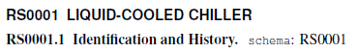
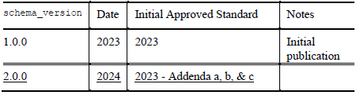
Standards Report
ASHRAE Standard 205 (Phil Johnson)
Standard 205-2023 was published under continuous maintenance. SPC 205 was disbanded and SSPC 205 formed.
Published Addenda a, b, c in March 2024.
Developing additional representation specifications (e.g. for air-cooled chillers) to be published as addenda.
Addendum a. Published in March 2024. Mainly clean-up including revisions to the RS0001 chiller rep spec.
Addendum b. Published in March 2024. Removed requirement to in include part load “ratings” (e.g. IPLV) as reference info (but performance map retains part load points).
Addendum c. Published in March 2024. Added provisions for scalable representation of equipment performance.

Slide 18
Standards Report
ASHRAE Standard 23 (Scott MacBain, past Chair SPC23)
Standard 23-2022 published “Methods for Performance Testing Positive Displacement Refrigerant Compressors and Compressor Units”.
Discussion of cognizant TC for 225, or perhaps harmonization activities.

Slide 19
Standards Report
ASHRAE Standard 90.1-2022 (Rick Heiden)
Standard 90.1-2022 published (December 2022)
New addenda to the 2022 edition (when published) are available at:
https://www.ashrae.org/technical-resources/standards-and-guidelines/standards-addenda
Addenda of interest:
  L – of general interest → net zero operational energy emissions (NZOEE), informative appendix that jurisdictions could adopt for buildings to achieve NZOEE over 1-3 code cycles. Includes chiller emission factors.
  M – of interest for split chillers → hydronic and dx coils must be rated in accordance with AHRI 410-2023 (SI/I-P) Performance Rating of Forced-Circulation Air-Cooling and Air-Heating Coils
  Q – of interest for water cooled chiller systems → add pad-type (wetted media) adiabatic fluid coolers along with a minimum efficiency and the recently published CTI acceptance test code to Table 6.8.1-7 Heat Rejection Equipment. Technology being offered on some “free-cooling” air-cooled chillers https://www.thermalcare.com/adiabatic-fluid-coolers/
  V – of general interest → reference Std 169 Climate Data for Building Design Standards version 2021 instead of 2013, wrt US counties 85% no changes, 9% move to warmer zones, 3% to colder zones, 3% changes subzones (i.e. A, B, C)
Discussion topics within the 90.1 Mechanical Subcommittee of interest to this committee
  >15 dT chilled water distribution requirements (Hydronics working group)
  Chiller efficiency table updates in collaboration with related AHRI committee (Hydronics working group)
  Requirements for all electric buildings (Decarb working group)
Published (*of interest to this committee) | In process
bo,ca,cv,cw,a,b,d,f,h,I*,j,k,l,m*,n,o,p,q*,r,t,v*,x,z | c,g,i,s,u,w,y,aa,ab,ac,ad,ae,af,ag,ah

Slide 20
Standards Report
ASHRAE Standard 90.1-2022 (Rick Heiden)
Standard 90.1-2022 published; New addenda to the 2022 edition (when published) are available at:
https://www.ashrae.org/technical-resources/standards-and-guidelines/standards-addenda
Items of interest to TC 8.2
Proposed Addenda BK – heat pump primary, new prescriptive path section that requires that heat pumps serve a specified amount of the building design heating load in applications that have both cooling and heating loads. Includes new buildings and substantial alterations
  Exceptions for some HVAC systems with thermal energy storage or multiple-zone VAV systems and some alterations
  Heat pumps can be electric, or fuel based.
  Heating capacity depends on load profile
  Multiple exceptions for secondary heating
Discussion topics within the 90.1 Mechanical Subcommittee
  Chiller efficiency table updates in collaboration with related AHRI committee (Hydronics working group)
  Energy credit updates

Slide 21
Standards Report
AHRI Standards 550/590|551/591 (Phil Johnson)
AHRI 550/590 (I-P) and 551/591 (SI) – 2023, Performance Rating of Water-Chilling and Heat Pump Water‑Heating Packages Using the Vapor Compression Cycle
2023 Editions of both standards are published as ANSI/AHRI. Include minor revisions to the 2020 editions. Include normative reference to ASHRAE 30 for method of test.
AHRI 1550P (proposed) Performance Rating of Liquid-Chilling and Heat Pump Water‑Heating Packages Using the Vapor Compression Cycle
Would replace 550/590 and 551/591, merge separate IP & SI edition into a single standard.
Project charter scope of revisions for next edition after that (circa 2025) includes the following items:
  Review tolerances and incorporate units with variable flow
  Continue to work toward harmonizing section 4 with ASHRAE 30
  Review uncertainty analysis reporting requirements
  Adiabatic cooled condensers
  Heat Pump Part-Load Metrics
  Review of rounding throughout documents
  Review Standard Rating Conditions
  Regional part load metrics
  Ratings for units with more than two heat exchangers

Slide 22
Standards Report
AHRI Standard 1520 (Matt Cambio)
AHRI Standard 1520-2022, Performance Rating of Centrifugal Refrigerant Compressors
This standard provides a rating method for centrifugal compressors and a calculation method to compare centrifugal compressors with positive displacement compressors.
A MatLab open-source tool is being created by Purdue for reading data and calculating performance as well as comparisons with positive displacement compressor 10 coefficient model
It is probable that a WG will be formed this year to review the standard to see how it’s working.
Would like to encourage use of the standard and participation in the next WG.
Additional Notes:
Reference to ASHRAE 225, Methods for Performance Testing Centrifugal Refrigerant Compressors and Condensing Units
Similar format to AHRI 540, Performance Rating of Positive Displacement Refrigerant Compressors and Compressor Units
AHRI Compressor Standards Technical Committee will maintain the standard (responsible for a total of 7 standards including 1520)

Slide 23
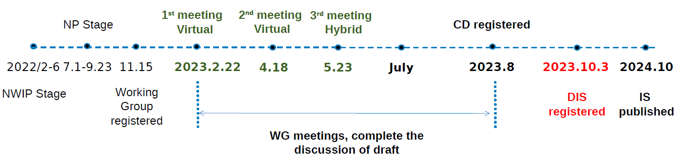
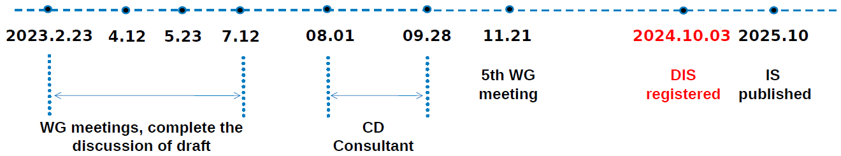
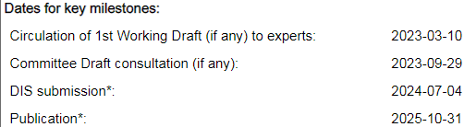
Standards Report
ISO/TC 86/SC 4 (Justin Prosser)
Key:
TC = Technical Committee
SC = SubCommittee
WG = Working Group
AWI = Approved Work Item
TC 86: Refrigeration and air-conditioning, SC 4: Testing and Rating of refrigerant compressors
WG2: ISO 18501, Positive displacement refrigerant compressor (harmonizing: AHRI 540, EN 12900)
WG3: ISO 18483, Centrifugal refrigerant compressor (harmonizing: AHRI 1520)
WG4: ISO 18976, Testing of refrigerant compressors (harmonizing: ASHRAE 23 & 225, EN 13771-1, and withdrawn version of ISO 917)

Slide 24
MTG.LowGWP Report (Phil Johnson, TC 8.2 Liaison)
The MTG will meet Wed Feb 12.
Program Subcommittee. Seeking programs from TCs for co‑sponsorship. Contact Danny Halel (danny.halel@nthalpengineering.com).
Codes & Standards Subcommittee. Not meeting Orlando.
Research Subcommittee, current activity at the PMS level.
Active research project: RP-1806 active. RP-1855 final report was published fall 2023. Monitoring a few projects sponsored by other TCs.

Slide 25
MTG.LowGWP Report (Phil Johnson, TC 8.2 Liaison)
Research project status.
RP-1806 “Flammable Refrigerants Post-Ignition Simulation and Risk Assessment Update”
  Start date: Jan-2017.
  Slow progress. PMS received revised Task 1 interim report Jan-2022.
  Original scope included updating AHRI risk assessments for 2L refrigerants in 5 types of equipment, including chillers (centrifugal & screw, machinery room).
  Project has re-allocated the budget (more to Task 1) and not yet clear what scope will be reduced (or if more funding will be requested to complete original scope).
  Spring 2024 PMS received a pilot study that completes the Task 2 and Task 3 work for just a small subset of the original scope (reach-in coolers). Results will determine go/no-go/redirect for remainder of the project

Slide 26
MTG.LowGWP Report (Phil Johnson, TC 8.2 Liaison)
Research project status.
RP-1855 “Determination of the Impact of Combustion Byproducts Hydrogen Fluoride (HF) and Carbonyl Fluoride (COF2) on the Safe Use of Fluorinated Refrigerants”
  Start date: Jan-2020
  Final report approved by MTG.LowGWP via letter ballot conducted after the Tampa meeting in June 2023.
  Report is available via the ASHRAE Technology Portal.
https://technologyportal.ashrae.org/

Slide 27
MTG.LowGWP Report (Phil Johnson, TC 8.2 Liaison)
More detailed report document available for the meeting minutes.
Reconfirm the representatives from TC 8.2 (Primary: Phil Johnson, Alternate #1: Ray Good, Alternate #2:Trent Hunt).

Slide 28
Program Subcommittee Report – Mark Rogan (chair)
Combined TC 8.02/8.01 Program Subcommittee Report
2025 Winter Meeting, Tampa, FL
Subcommittee Meeting: February 3rd, 12:00 pm -2:00 pm EST
Attendees: Mark Rogan, Tiffany Abruzzo, Daryl Showalter, Mathew Cambio, Justin Prosser, Michael Perevozchikov, Davide Ziviani, Craig Bradshaw, Dan Kemper, Alex Schmig, Tiffany Abruzzo, Phillip Johnson, Chris Miller, Farhan Jurati, Riley Barta, Jethrow Medina, Nicholas Zupp, Margaret Mathison, Erik Anderson, Yintao Wang, Bruno de Carvalho, Heinz Juergensen, Kalen Gabel, Andreas Hoess, James Spalding, Sugun Tej Inampudi, Rick Heiden
Tampa Meeting Approval Update: 2 Programs Approved: Seminar 23(Refrigerants), and Seminar 25(Energy Storage)

Slide 29
Program Subcommittee Report – Mark Rogan (chair)
Current Approved Programs – Winter Meeting Tampa February 8th-12th, 2025
Seminar 23 – Refrigerant, Refrigeration Trends and Compliance - Tiffany Abruzzo (Envirosep) is chair of seminar. Sponsored by TC10.2 and cosponsored by TC8.2. Presenter: Mick Schwedler(Trane Technologies) Monday February 10th, 2025, 8:00-9:30 EST Room 5 (Near Speakers Lounge)
Seminar 25 LIVESTREAM – Energy Storage to Enhance Building and Grid Resilience - Tiffany Abruzzo (Envirosep) is chair of seminar. Sponsored by TC8.2. Presenter: Sheila Hayter (NREL). Monday February 10th, 2025, 9:45 – 10:45 EST Room 5 (Near Speakers Lounge)
Great Job to all involved!!!!!

Slide 30
Program Subcommittee Report – Mark Rogan (chair)
Future Program Ideas – Beyond Tampa
Electrification of Heating Chapter 2: Industrial and Healthcare Markets as well as Heat Recovery Applications – Chris Miller possible chair.(should have good jobsite data by June) Good candidate for Track # 6; Heat Pumps, Refrigerants, and Decarbonization.
ROM Seminar – Drafted for Orlando and will resubmit for Phoenix. Craig Bradshaw possible chair. Good candidate for Track 3; Research Summit
Electrification of various Heating Applications and the challenges of capacity modulation using different compressor types: Which applications can be served by electrification today and which ones cannot. Rick Heiden as a potential chair. Good candidate for Track # 6: Heat Pumps, Refrigerants and Decarbonization
Application Issues with New Refrigerants and Indoor Chillers: Does Standard 15 (equipment room design) properly cover the flammability issue? Phil Johnson as a potential chair. Good candidate for Track # 2: HVAC Systems and Equipment
Case Studies in retrofitting existing buildings with Heat Pumps for Decarbonization. Good candidate for Track # 6; Heat Pumps, Refrigerants, and Decarbonization.
Decarbonization and District Cooling / Heating – Tiffany Abruzzo possible chair. Good candidate for Track # 6; Heat Pumps, Refrigerants, and Decarbonization.
Applying Centrifugal Compressors to all Chiller Types. Oil Free Centrifugal Compressors increasing efficiency of Air-Cooled Chillers. Mark Rogan possible chair. Possible speakers mentioned: Ray Good, Tom Watson, Phil Johnson. Good candidate for Track # 2: HVAC Systems and Equipment.
Any other topic ideas? Open to the floor
Next Meeting
Subcommittee will meet via conference call in early June 2025

Slide 31
Program Subcommittee Report – Mark Rogan (chair)
2025 Summer Meeting/Conference Phoenix, AZ June 21st–25th:
Important dates:
Wednesday February 26th - Program Proposals Due
Friday April 11th - Program accept/reject notifications
TBD - Program submission deadline
2025 Summer Meeting/Conference Program Tracks Phoenix
  Track 1 - Fundamentals and Applications – Track Chair: Atilla Biyikoglu
  Track 2 - HVAC&R Systems and Equipment – Track Chair: Ng Yong Kong
  Track 3 – Research Summit – Track Chair: Haotian Liu
  Track 4 – Workforce Development – Track Chair: Anuj Gupta
  Track 5 – Industrial Ventilation, Refrigeration, Air-Conditioning and Energy Utilization
  Track Chair: Vinod Venugopal
  Track 6 – Heat Pumps, Refrigerants and Decarbonization – Track Chair: Money Khanna
  Track 7 – Onsite Energy Storage – Track Chair: Kevin Brown

Slide 32
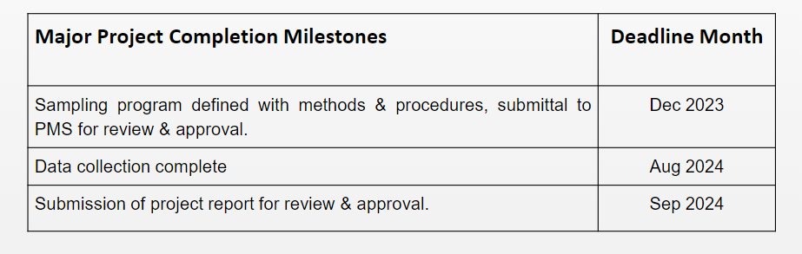
Research Subcommittee Report – Daryl Showalter (chair)
Research S/C Chair Breakfast notes of interest
Not attending, nothing to report.
Current Activities
Research Subcommittee online meeting was held Feb 3rd,
Project update waiting on status
Project Status
1716 - Oil concentration of field-installed liquid chillers with flooded type evaporators.
  Project has been awarded. Philip Johnson is the chair.
Notes:
Updated 6/28

Slide 33
Research Subcommittee Report – Daryl Showalter (chair)
1793 - Development of Method of Test for Motor Component Thermal Conductivity
  TC8.1 is taking the lead on this one and will resubmit from the comments.
  Waiting to hear back from TC8.1 chair but if we want to take this on happy to work on it.
1879 – Foamability properties of LGWP Refrigerant and Oil Mixtures
  Sponsored by TC3.4 and Co-Sponsored by TC8.1
  Update during the meeting from Chris Seaton & Kyle Shephard
Notes:
Updated 6/28

Slide 34
Research Subcommittee Report – Daryl Showalter (chair)
  New RTAR ideas:
    TC8.2 Decarb in heating mode discussed
      Joe Sanchez also mentioned high temperature heat pumps – modeling- (RTAR initiated)
    TC8.2 What is the limit of high temperature heat pump vs. vapor recompression? (Bruno)
      Other novel architectures?
      What application 100, 150, 200C temperatures?
    TC 8.1 Davide & Craig submitting - Assessment of Extrapolation Capabilities and Uncertainty Quantification of Multi-Refrigerant Semi-Empirical Compressor Models TC 8.1
    TC 8.1 & 8.2 Effects of sub-atmospheric operation with low GWP, low ambient heat pumps. Leak rates and design suggestions (Matt / Daryl to follow up)
      System Contaminants
      Refrigerant breakdown
      Possibility of electrical arching in a vacuum
      Potential for combustion in the presence of oil
Notes:
Updated 6/28

Slide 36
TC 8.1 & 8.2 Handbook – Jethro Medina (Chair)
TC 8.1:
  Refrigeration: Chapter 8 - Factory Dehydrating, Charging & Testing
    2022 Last Publication: MacBain, Sanchez, Perevozchikov
    2026 Next Up Revision: Scott MacBain, Joe Sanchez, Chris Seaton, Michael Perevozchikov (Looking for participants) – Contact Jethro Medina: jethro.medina@chemours.com
TC 8.1 & 8.2:
  2024 HVAC Systems & Equipment: Chapter 38 and 43 – Compressors & Liquid Chilling Systems
    Publication: Approved by TC8.1 & 8.2 Committees via mail ballot and submitted to ASHRAE Q423
    Davide Ziviani, Craig Bradshaw, Michael Perevozchikov, Rick Heiden, Scott MacBain
    2028 Next Revision
Authoring Portal: Confirm document access on authoring portal: https://authoring.ashrae.org/
  Contact Heather Kennedy(hkennedy@ashrae.org) if you have any issues with Microsoft login

Slide 37
TC8.2 Leadership Roles – T. Hunt
Chair – Trent Hunt
V Chair – Tiffany Bates Abruzzo
Secretary – Scott MacBain
Handbook – Jethro Medina
Programs – Mark Rogan
Standards – Phil Johnson
Research – Daryl Showalter
Webmaster – Dan Kemper
Honors and Awards – Ray Good
MTG. LowGWP Liaison – Phil Johnson
MTG. LowGWP Alternate – #1 Ray Good (#2 Trent Hunt)
Effective until 2026 Annual Summer meeting – Phoenix, AZ
Notes:
Updated 6/27

Slide 38
Membership – S. MacBain https://tpc.ashrae.org/Membership?cmtKey=83a02e09-1a12-4ee1-bbf8-3ba74490dec7
Updated 6/2024, 2/2025 roster attached
How to Import Your TC Roster Information into MS-Outlook - http://www.ashrae.org/TCs

Slide 39
Webmaster – Dan Kemper
General updates and maintenance
  Meeting time, current power point agenda and links posted
  Past agenda, minutes, and power point posted
  Updated scope and verbiage throughout website to reflect accordingly
Please send documents from 2024 seminars so they can be added to the presentations section of the website
https://tc0802.ashraetcs.org
Notes:
Updated 6/28

Slide 40
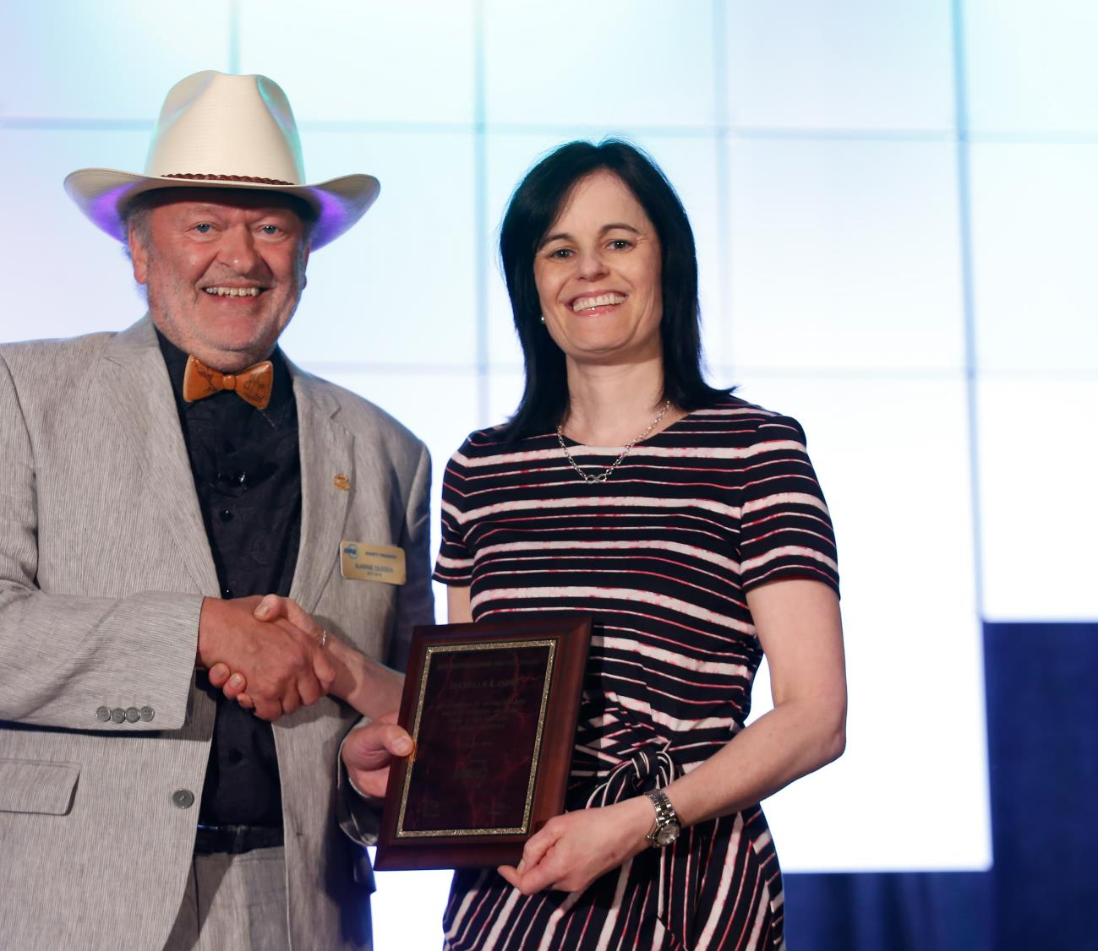
Personal Awards for
General Society Activities
Distinguished Service Award (DSA)
  Recognizes members who have served the Society faithfully and with distinction or otherwise given freely of their time and talent on behalf of the Society. A minimum of 15 points required on the point tally form.
  Nomination deadline: December 1
Exceptional Service Award (ESA)
  Similar to the DSA, except 45 points are required on the point tally form and the member must have been a Full Member for at least ten years.
  Nomination deadline: December 1
Developing Leader Award
  This award recognizes new members who have shown diverse involvement and commitment to ASHRAE withing five years of their Association Member join date.
  Recommended by the YEA Committee

Slide 41
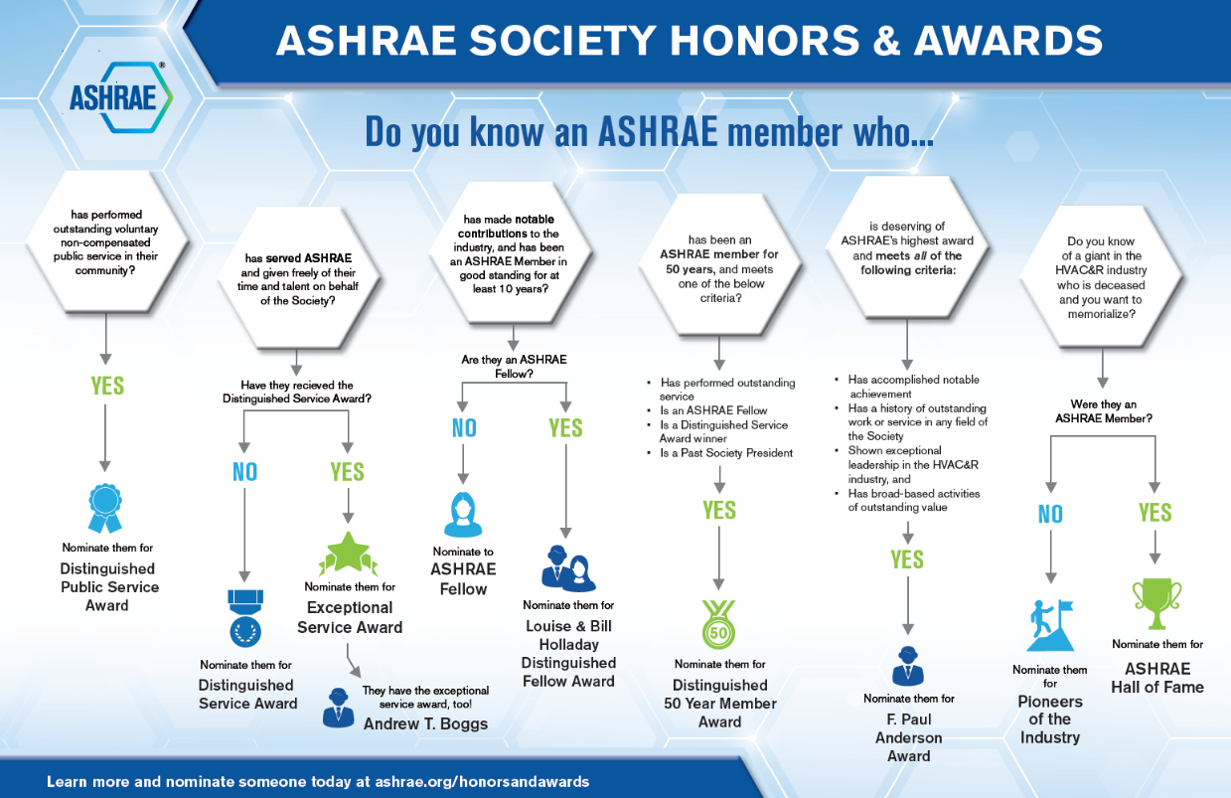
Honors and Awards Flowchart
Notes:
Flowchart is posted on the H&A webpage (www.ashrae.org/Honors) and available in printouts.

Slide 42
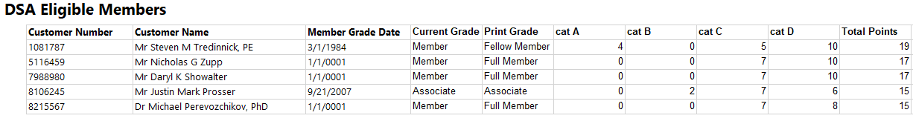
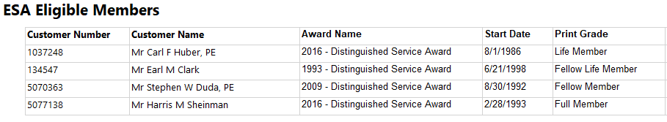
Honors and Awards – Ray Good Continued
TC8.2 Member DSA Qualifications (15 Points)
TC8.2 Member ESA Qualifications (45 Points)

Slide 43
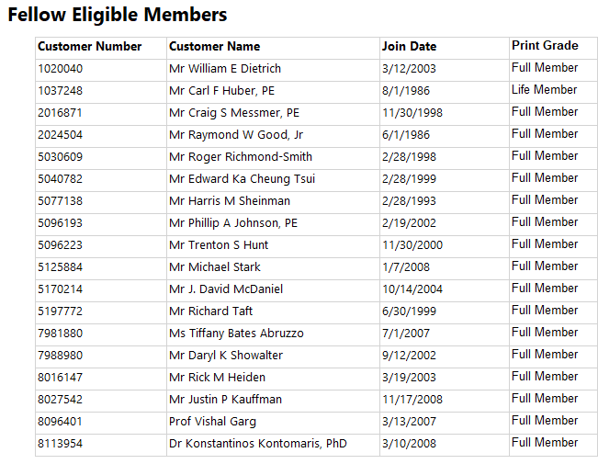
Honors and Awards – Ray Good Continued
TC8.2 Member Qualifications

Slide 44
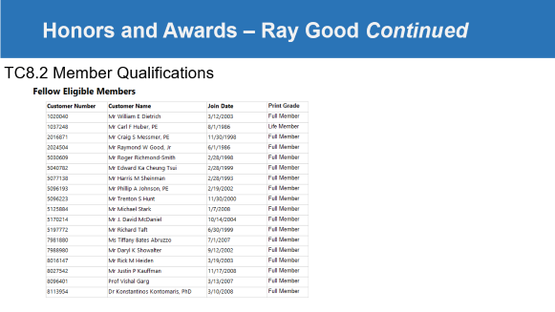

Honors and Awards – Ray Good Continued
Current Activities:
Currently Exploring
  Phil Johnson for Standards Achievement Award
Encourage all members to update their ASHARE bios in an effort to qualify for additional honors and awards recognition
Consider others who may qualify as a Fellow or other awards
T Abruzzo & Ray Good to Coordinate on ESA/DSA & email out Fellow PP

Slide 45
TC Chairs Breakfast Report – T. Hunt/T. Abruzzo
New ASHRAE Strategic Plan
GAC Update - Concerns about recent changes!
Global Interactions Committee - ISO Workshops/GTIC Survey
Publications Committee
College of Fellows – How to Apply and What they do…
Center of Excellence for Building Decarbonization

Slide 46
Old Business – T. Hunt

Slide 47
New Business – T. Hunt
New members (additions since Annual Summer meeting)
..
Attendees not on roster:
…

Slide 48
For the Good and Wellbeing

Slide 49
Adjourn

