Slide 1
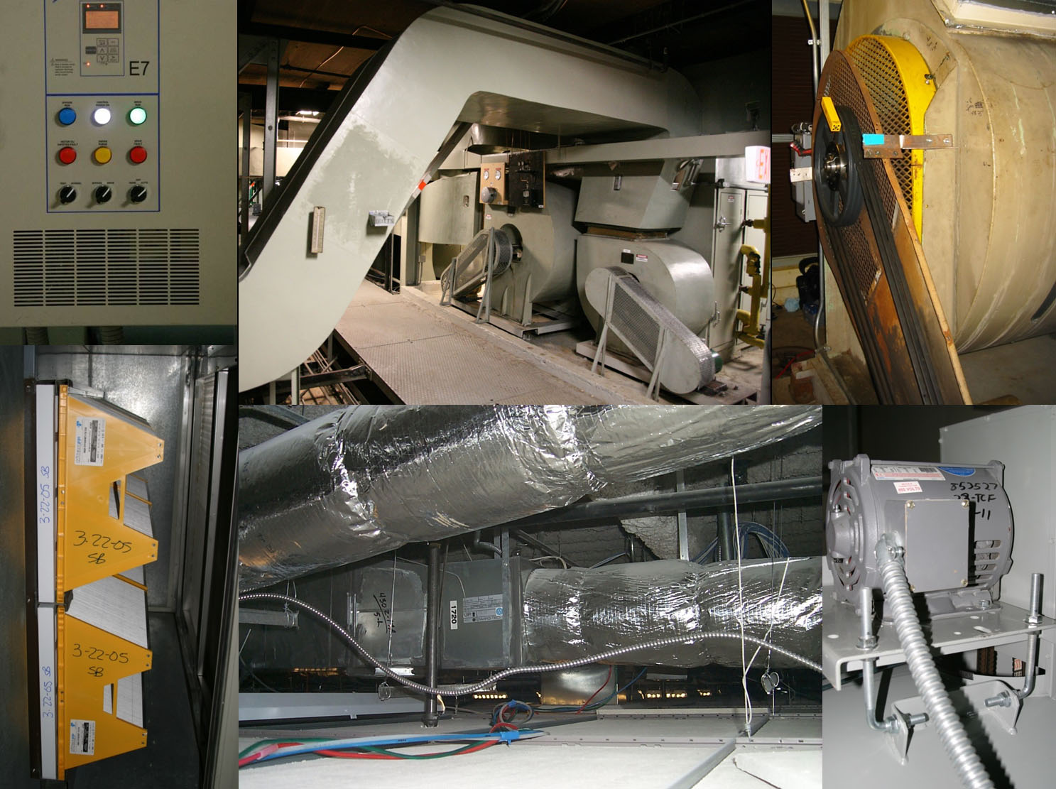
ASHRAE TC 5.2 “ Duct Design” – TC Seminar
ASHRAE Standard 215-2018:
Rationale and Background
Craig Wray, P.Eng.
12 January 2021

Slide 2
Presentation Outline
  Estimated vs measured leakage flows
  What is Standard 215?
  System curves, component efficiencies, fan power
  plus leakage effects
  Outlet flow measurement precision
  Field experiment and simulations to assess impacts of system air leakage on energy performance
  Next steps

Slide 3
“System” Leakage - Pressurization Results
cfm/100 ft² per in.w.c.^{0.65} / 710 = L/(s·m²) per Pa^{0.65}
Notes:
Some of the duct pressurization test data that have been collected over the past several years in several U.S. large commercial buildings are shown here. These data include VAV, CAV, and dual-duct systems, and both “high-pressure” (“main”) and “low-pressure” (“branch”) duct sections. For VAV systems, the data include fan-powered boxes (“VAV Fan”) and cooling-only boxes. Most of the systems supply air through rectangular diffusers, but some use slot diffusers.
There is a wide range of leakage: branches are three times leakier than mains on average (branches usually are not pressure tested); the main sections might be tighter because of testing. Most sections are leakier than ASHRAE suggests for unsealed ducts. Building 2 (B2) appears leaky, but actually has relatively low leakage flows (as shown in the next slide based on “measured” whole-system airflows). Dual duct systems have more ducts and more leakage. Slot diffuser plenums are leaky and operate at higher pressures than other diffusers.

Slide 4
Leakage Flow Fractions – 10 Systems
L/s x 2.119 = cfm
Notes:
Pressurization test procedures focus on determining component airtightness (typically only used for ductwork located upstream of terminal box inlet dampers). To determine system leakage airflows, one must also then estimate system pressures during system operation. To that end, it is important to recognize that the pressure difference at each leak in a system section where duct static pressure is not controlled (e.g., downstream of a terminal box inlet damper) is determined by the airflows through the ducts and the airflow resistance of the duct system. In such cases, this means that system leakage airflows depend on system airflows. Determining the location of every leak and the pressure difference across each leak is practically impossible for most systems and can cause significant uncertainty in leakage airflow estimates using this approach.
Measured leakage flows from ten large commercial duct systems at operating conditions are shown here. Three had low leakage (less than 5%), and seven had substantial leakage (9 to 26%). By comparing these flows with leakage flows estimated using the industry method, it is clear that the latter method by itself is not always a reliable indicator of whole-system leakage flow, and that leakage flows need to be “measured” to properly commission a duct system when pressurization tests indicate significant leakage.
In particular, the estimated fraction for Building 1 is seven times greater than the measured fraction. This estimate is not useful to show compliance with design specifications, and could lead to adversarial relations between designers, installers, and test and balance contractors.
There is better agreement for systems that are tighter (e.g., Building 8 after sealing). In this case, the estimated leakage flow fraction agrees well with the “measured” fraction for the “sealed” case. Small estimated leakage fractions are good indicators of a tight system; the converse is not true for large fractions that indicate a system is leaky.

Slide 5
ASHRAE Standard 215-2018
Specifies field MOT to determine leakage airflow and fractional leakage of operating HVAC air distribution systems, and uncertainty of the test results
Essentially a subset of normal TAB activities:
Limited for now to single-duct supply (CAV and VAV)
systems, and independent exhaust air systems
Does not replace pressurization-based leakage testing
Notes:
To eliminate the uncertainty associated with estimating pressure differences across leaks, Standard 215 provides a method of test for determining leakage airflows, either for the whole system or for selected parts. Flows into and out of the section being tested are measured at a repeatable reference operating condition: the difference is the leakage flow. The operating condition is not necessarily the design operating condition, but corresponds to the greatest system inlet flow (outlet flow for exhaust systems) possible without being detrimental to the occupants of the building, the building structure, or to the HVAC mechanical components, while maintaining the duct static pressure set point (where applicable) specified in design documents.
Standard 215 does not mandate a calibration method for any instrument, nor does it dictate that the user employ a specific flow measurement technique. Informative Annex A provides a general discussion of airflow measuring instrument technologies and their capabilities. Informative Annex B provides recommended airflow measuring instrument calibration and verification procedures.

Slide 6
ASHRAE Standard 215-2018
Reference operating condition:
Greatest inlet flow possible for supply systems
(outlet flow for exhaust systems)
Maintain design duct static pressure set point
(where applicable)
Not detrimental to occupants, building structure,
& HVAC components
Can be used on VAV systems with DDC- or pneumatically-controlled terminal boxes
Notes:
DDC Box Setup Procedure: VAV terminal unit controls are overridden so that each terminal unit is set to its design maximum airflow. Then, with the system supply fan operating at the greatest speed possible without being detrimental to the occupants of the building, the building structure, or to the HVAC mechanical components, if the duct static pressure at its control location is less than the maximum duct static pressure design set point, each terminal unit’s airflow is uniformly reduced by the same percentage of the terminal unit’s design maximum airflow until the maximum duct static pressure design set point is achieved. If instead the duct static pressure at its control location is greater than the maximum duct static pressure design set point, the fan speed is reduced until the maximum duct static pressure design set point is achieved.
Pneumatic Box Setup Procedure: Each VAV terminal unit is set to its design maximum airflow by setting the thermostat to its minimum setting (e.g., 17°C, 55°F). Then, with the system supply fan operating at the greatest speed possible (with the same caveats as above), if the duct static pressure at its control location is less than the maximum duct static pressure design set point, starting at the zone located closest to the primary fan, override every other terminal box to its minimum airflow set point by setting the thermostat to its maximum setting (e.g., 35°C, 95°F) until the maximum duct static pressure design set point is achieved or just exceeded. For example: Box 1 is at minimum, Box 2 is at maximum, Box 3 is at minimum, Box 4 is at maximum, and so on. If instead the duct static pressure at its control location is greater than the maximum duct static pressure design set point, then the fan speed is reduced until the maximum duct static pressure design set point is achieved.

Slide 7
Std 215: Example Leakage Uncertainty
L/s x 2.119 = cfm
Notes:
The term n_{j} in the leakage calculation accounts for the compensating effects of positive and negative precision errors in measurements at multiple grilles or diffusers (as opposed to compensating errors for a single grille or diffuser). In particular, the precision error at each grille/diffuser, which can be assumed to be normally distributed, will be randomly dispersed about the central mean value that is measured. Sometimes, the error will be positive and sometimes it will be zero or negative. When airflow measurements are made at several grilles/diffusers, Monte Carlo statistical analyses can be used to show that the errors will tend to reduce the overall precision error of the sum of the grille/diffuser flows, with the reduction approximating 1/sqrt(n_{j}). In the example here, 3.0% / sqrt(18) = 0.7%.
Due to this compensating effect, if the inlet and outlet flow measurement instruments have similar precision errors, the inlet flow precision error will dominate the overall standard uncertainty for Q_{leak,std}. Therefore, it is imperative to measure the inlet flow of a supply system or the outlet flow of an independent exhaust system with the greatest possible precision to minimize the uncertainty when determining the leakage flow and leakage fraction.

Slide 8
VAV System Curves & “Fan” Power
Pa / 249 = in.w.c.
m³/s x 2119 = cfm
Notes:
The Sherman and Wray (2010) model for air-handling systems with variable-position supply dampers (e.g., VAV box dampers modulating to control flow) depends on the square of the fan flow, as is commonly considered. However, it also includes a term that accounts for linear-like flow resistances such as filters and coils, and it also includes a term for the duct static pressure control set point (P_{sm}). When the system operates with a variable outdoor air fraction, four parameters are needed to define the system curve: a, b, β, and P_{sm}. At a constant outdoor fraction, the terms a and b can be combined into one term.
The equation shown in the red box above is a commonly used representation for input power (H_{VFD}) to a VAV system. However, the actual equation is more complicated, as shown in the green box. There, the equation has multiple terms, most of which vary with flow.

Slide 9
Component Efficiencies & System Power
hp x 0.746 = kW
in.w.c. x 249 = Pa
cfm / 2119 = m³/s
Notes:
The curves here represent a hypothetical system with a commercially-available 18 in. (460 mm) diameter double-width double-inlet backward-inclined airfoil centrifugal supply fan; a medium efficiency V-belt; a high efficiency motor; a VFD with a 50 hp (37 kW) rated output; and a variable air volume (VAV) supply air distribution system with coil and filter elements and a duct static pressure setpoint of 1 in. w.c. (249 Pa). In SI units, the system curve used here has the form: Δp = 42.2 Q² + 295 Q + 249 where Δp is the fan pressure rise (Pa) and Q is the fan airflow (m³/s).
System efficiency is the product of component efficiencies, which generally decrease non-linearly as airflow is reduced. For example, at full load, VFD, motor, belt, and fan efficiencies here are 97%, 94%, 96%, and 75%, respectively. At 40% part-load, these same efficiencies are 90%, 86%, 84%, and 71%, respectively. In the first case, system efficiency is 66%; in the second case, it is much lower: only 46%.
One cannot ignore the efficiency variations. For example, if the drive belt efficiency was incorrectly assumed to be constant (same value as at full-load: 96%), the part-load system efficiency would instead be 53% (7 points higher than it is with the belt part-load efficiency correctly stated). In terms of energy use, properly including the difference of 7 points in system efficiency means that the system would actually use 0.53/0.46 = 15% more energy at 40% part load than if the variation in belt efficiency was ignored. This difference can be especially significant for VAV systems that often operate at low part load ratios over the year (e.g., a Chicago office building).

Slide 10
Actual VAV System Curve ( f_{oa} = 0.7 - 0.8 )
Actual dP
3.1 times greater
at 40% design flow
If simple quadratic fitted through design point of
995 Pa (4.00 in.w.c.) at
5.7 m³/s (12,000 cfm):
dP = 31.033 Q²
Pa / 249 = in.w.c.
m³/s x 2119 = cfm
Notes:
When VAV box dampers are modulated to control flow, the damper positions are not completely independent of the supply flow and supply pressures. Consequently, with variable-position dampers, reducing or eliminating supply air leakage does not change the system curve. This behavior, however, does not mean that supply air leakage has no effect. Reduced air leakage results in a lower operating point on the same system curve, which means that the fan pressure rise and fan air power (product of fan pressure rise and flow divided by fan efficiency) will also decrease.
Using only a simple quadratic system curve fitted through the design operating point can lead to substantial errors in fan pressure rise estimates, as can the pressure rise difference between design and actual operation at the design flow. In the example shown here with outdoor air fractions in the range of 0.7 to 0.8, at 80% full flow (4.5 m³/s, 9,600 cfm), the simple quadratic fitted through the design point leads to a -29% error in estimated fan pressure rise. At 40% full flow (2.3 m³/s, 4,800 cfm), the error is -68%. In the latter case, the actual pressure rise is about 3.1 times greater than estimated (495 Pa / 159 Pa).
In terms of the “measured” curve for this system, at 40% full flow, the Q squared, Q, and fixed pressure terms contribute 15%, 34%, and 50% to the combined fan pressure rise, respectively. In this case, the second and third terms are clearly important and cannot be ignored.

Slide 11
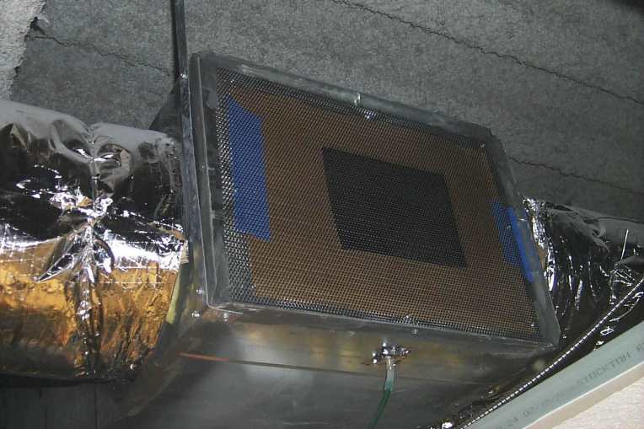

Field Experiment: System Schematic
Notes:
During the cooling season of 2002, an experiment to assess the impact of system supply air leakage on fan power was carried out in a 1 million ft² (90,000 m²) 25-storey LEED Platinum office building located in Sacramento, CA. The building uses a separate single-duct VAV system on each floor, each with two supply AHUs, two relief fans, and 34 VAV boxes. Of these 34 boxes, the perimeter zones are served by 14 parallel-fan-powered boxes with reheat; the interior zones are served by 20 non-powered boxes without reheat. The supply air distribution system is located in a ceiling return plenum.
We installed calibrated leaks in the main duct loop upstream of the VAV boxes at five locations around the loop. The pressure differences for the upstream leaks were the same at all five leak sites over a wide range of total supply airflows. We also installed calibrated leaks in six locations at the end of VAV box discharge plenums (red stars on schematic – example leak shown in overlay with associated static pressure tap). Each “leak” consisted of a perforated plate (similar to the perforated plates that are used in the supply grilles), with the leakage area chosen to achieve a desired leakage airflow during system operation.
In the experiment, procedures similar to the not yet developed Standard 215-2018 were used to determine system airflows and leakage. In addition, minute-by-minute airflows, pressure differences, temperatures, relative humidities, and fan power were measured on two floors (intervention and control, ~400 points total). The collected data arguably represent the most detailed published information on air-handling system performance related to the issue of system leakage in large commercial buildings.

Slide 12
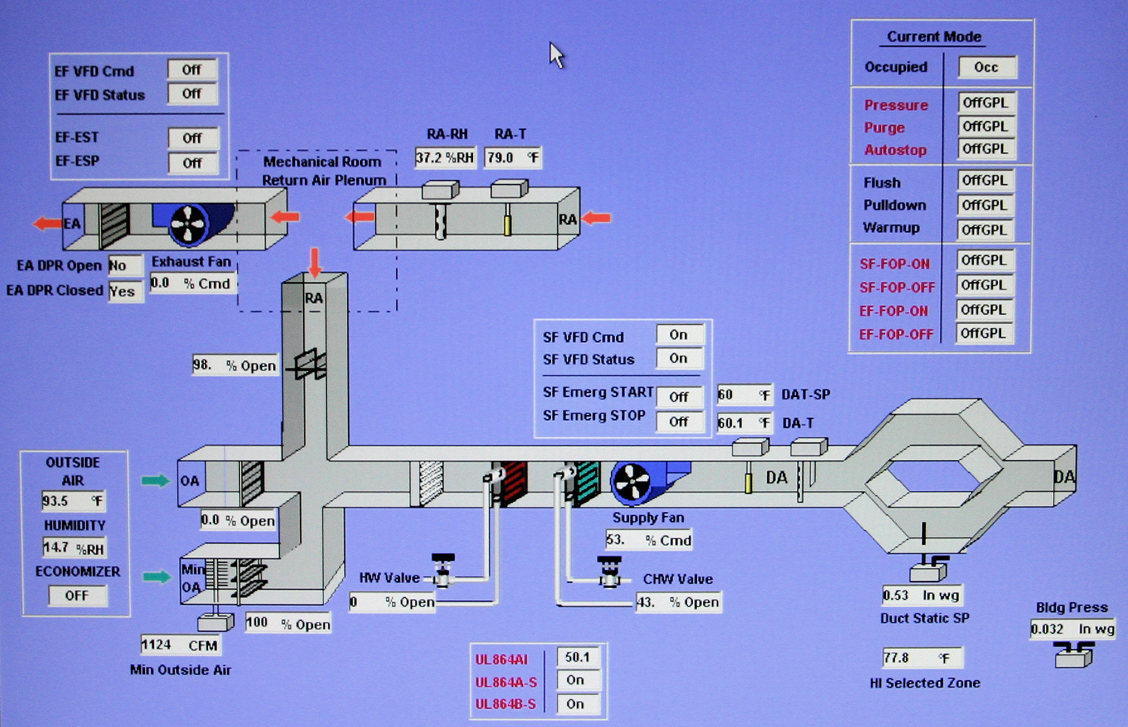
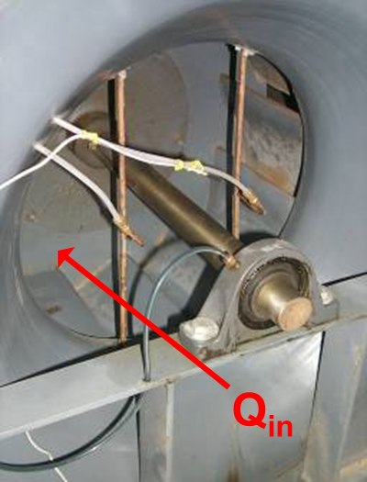
Field Experiment: AHU Schematic
Notes:
As found, each supply fan (two on the control floor and two on the intervention floor) had an inlet airflow grid (two Fechheimer probes – shown in overlay) to “measure” the supply airflow, but none of the grids were connected to the EMCS system; each grid was instead connected only to an analog gauge that allows building engineering staff to “read” the airflow on a snapshot basis.
To monitor the supply airflow continuously (minute by minute), we installed a pressure sensor in parallel with the analog gauge, connected it to our data loggers, and recorded the pressure differences that the airflow grid generates. For each fan, to determine the relationship between the pressure difference across the supply fan airflow grid and the airflow through the supply fan, we calibrated the flow grid using a constant-injection tracer gas technique with the system set for 100% outdoor air (with closed and sealed return air dampers). The resulting uncertainty of the airflows calculated from a measured pressure difference was about 3 to 4%.

Slide 13
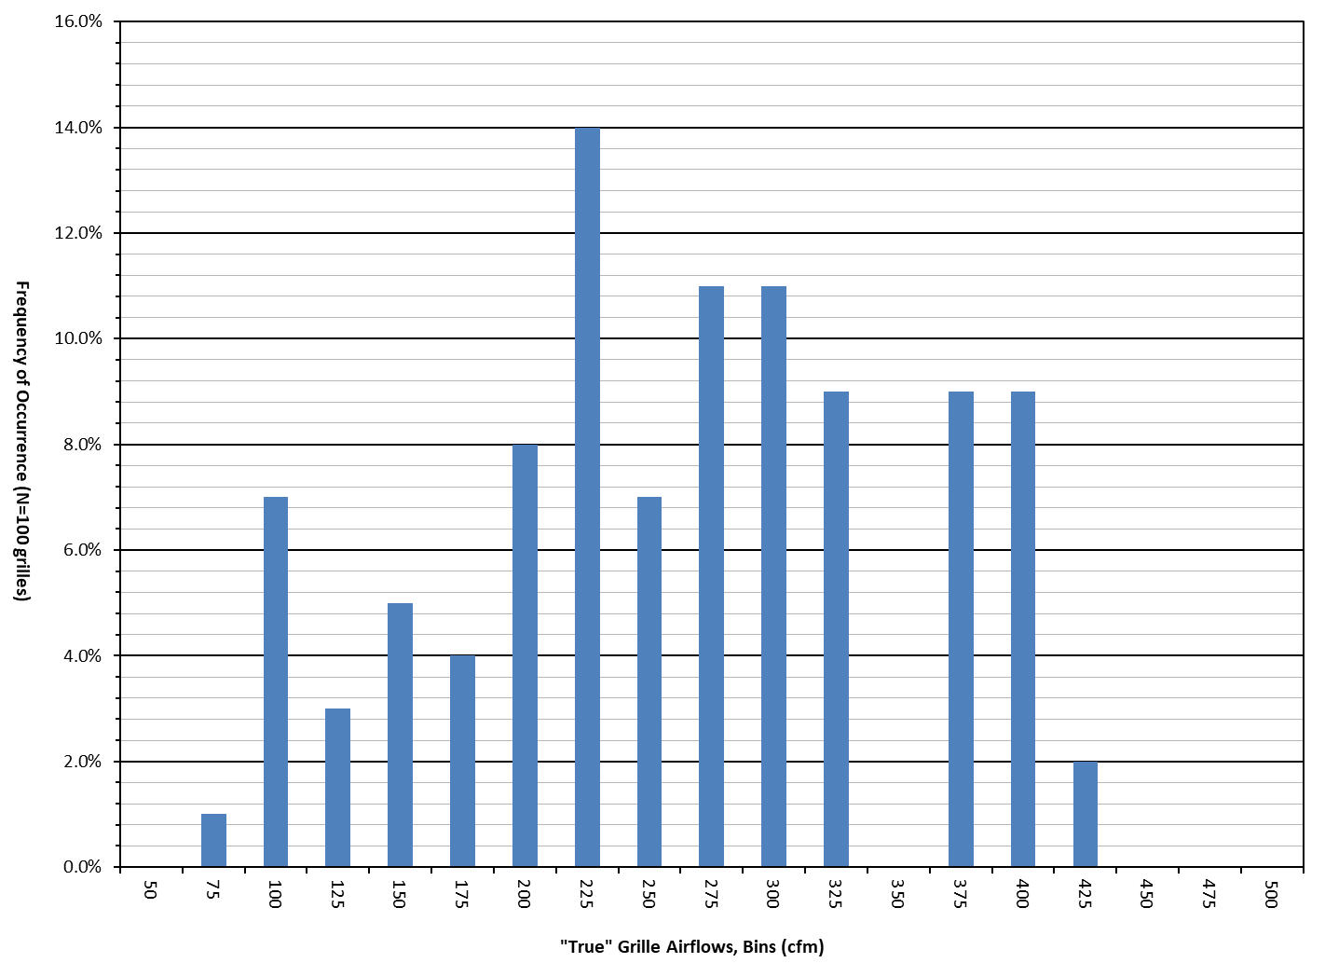
Test Building: Supply Grille Airflows

Slide 14
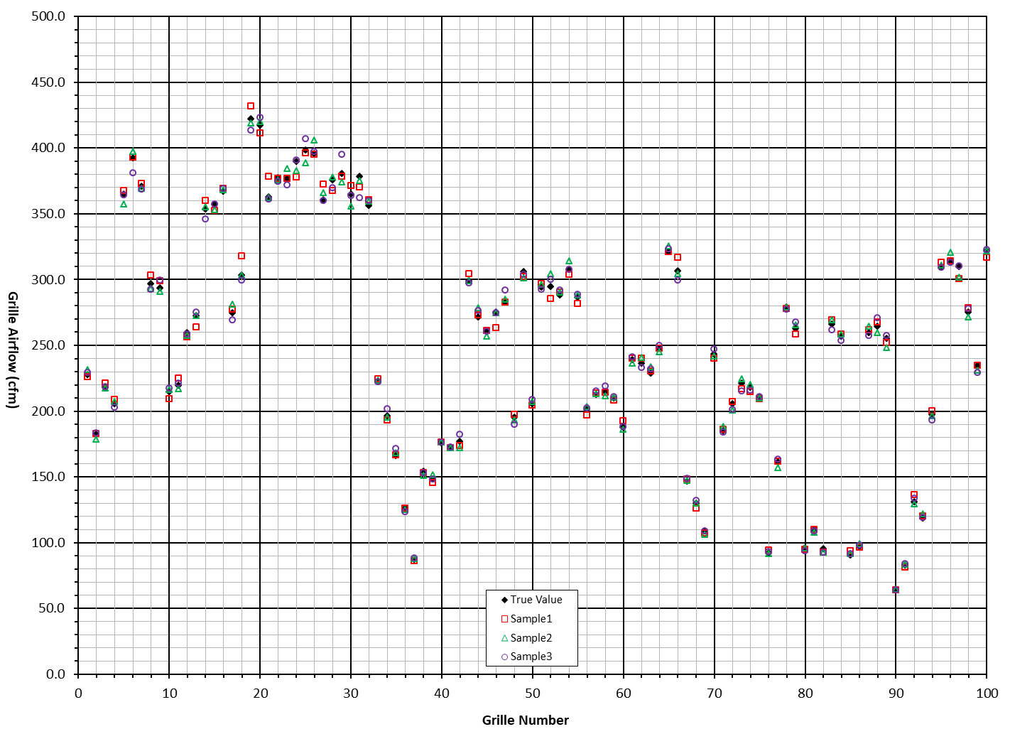
Supply Flow Errors: Monte Carlo Analysis
Notes:
Error Propagation Numerical Approach:
Coleman, H.W., and G. Steele. 2009. Experimentation, Validation, and Uncertainty Analysis for Engineers, 3rd Edition. Hoboken, NJ: Wiley.
BIPM. 2008. JCGM 101:2008, Evaluation of Measurement Data - Supplement 1 to the Guide to the Expression of Uncertainty in Measurement - Propagation of Distributions using a Monte Carlo Method, First Edition. Joint Committee for Guides in Metrology. Paris, France: Bureau International des Poids et Mesures.

Slide 15
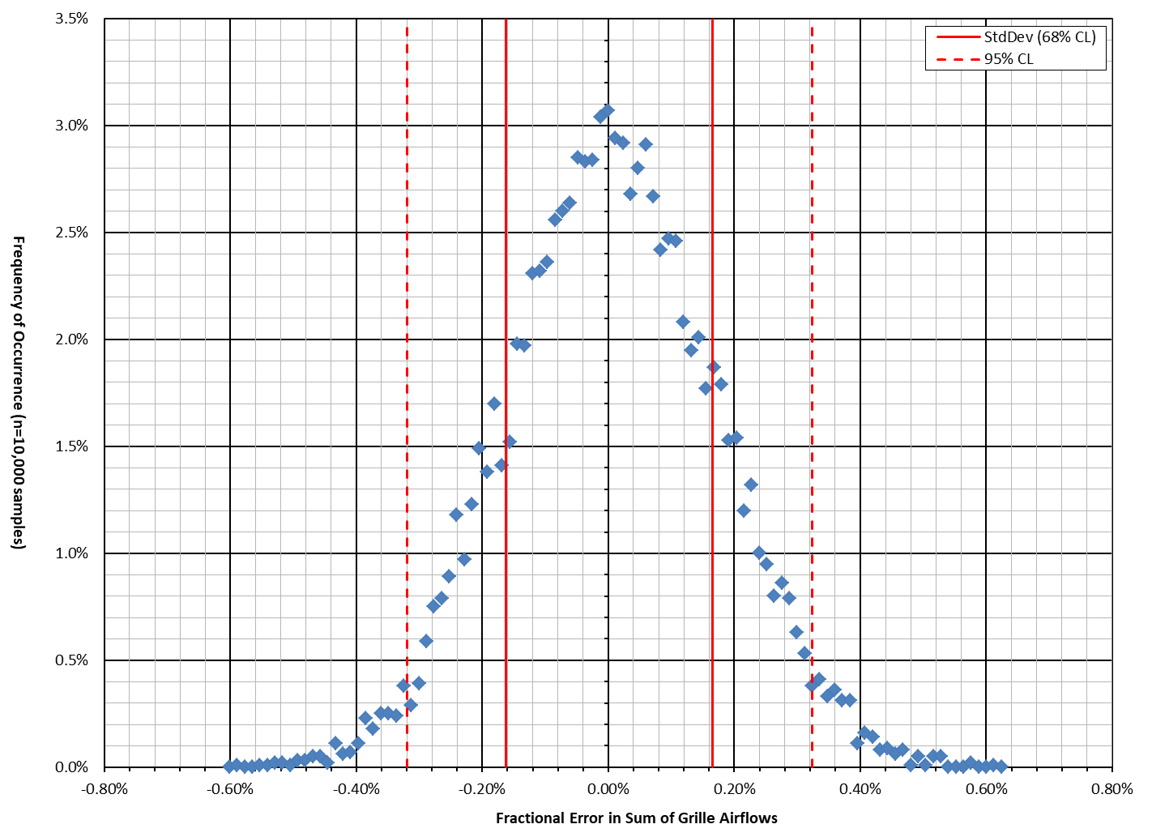
Sum of Supply Flows Precision
Notes:
Instrument precision: 3.0% of reading (95% coverage level; zero systematic error)
Sum of supply grille airflows: 24,400 cfm
Standard deviation: 0.16% (68% CL)
Expanded precision: 0.32% (95% CL); approximately 3.0% / sqrt(100)

Slide 16
System Airflows:
As Found and with Added Leakage
cfm / 2119 = m³/s
Notes:
Supply and leakage airflows over a typical day are shown here for the “as found” (Base) and three “added” system air leakage cases, respectively. Weather normalization was used for the added leakage cases at average operating conditions. That is, normalization techniques that compare the variable of interest on the control and intervention floors were used to estimate what the average airflows (and associated fan power) on the intervention floor would be if the system ran with that leakage, but during the base case weather period instead.
Note that the average operating condition and Standard 215 fractional leakages are different, because the supply fan airflows and downstream leakage airflows on which they are based differ. For average operating conditions in the “Base” case, the average total supply fan airflow is 10,700 cfm (5.05 m³/s) and leakage is 340 cfm (0.16 m³/s) upstream and 245 cfm (0.12 m³/s) downstream of the VAV box inlet dampers (585 cfm, 0.28 m³/s total). In the “added leakage” (Up+Down) case, the average total supply fan airflow is 14,100 cfm (6.65 m³/s) and leakage is 1,738 cfm (0.82 m³/s) upstream and 1,042 cfm (0.49 m³/s) downstream (2,780 cfm, 1.31 m³/s total).
For the Standard 215 test conditions (not normal operation, but repeatable), the supply fans were operated at full speed (total of 24,400 cfm, 11.52 m³/s). The VAV box inlet dampers were uniformly opened to achieve the design duct static pressure set point (250 Pa, 1.0 in.w.c.). In particular, all of the boxes dampers were open to the same fraction (75%) of their design maximum airflow. Because the upstream pressure is the same for 215 test and average operating conditions, upstream leakage also remains the same relatively in each case. However, downstream and total leakage increases in each case: 567 cfm (0.27 m³/s) downstream (907 cfm, 0.43 m³/s total) in the “as found” (Base) case and 1,507 cfm (0.71 m³/s) downstream (3,244 cfm, 1.53 m³/s total) in the “added leakage” (Up+Down) case.

Slide 17
Fan Power: “As Found” Leakage
System Leakage
Average: 5% of 10,700 cfm
215P: 4% of 24,400 cfm
cfm / 2119 = m³/s
Notes:
Supply and VAV box fan power trends over a typical day are shown here and on the next slide for the “as found” and “added” system air leakage cases, respectively. Relief fan power is not shown, because no correlation was found between relief fan power and leakage.

Slide 18
Fan Power: Added Leakage
System Leakage
Average: 20% of 14,100 cfm 215P: 13% of 24,400 cfm
● Sealing added leakage saves
27% supply fan energy
● 20% net savings due to 76%
more VAV box fan operation
cfm / 2119 = m³/s
Notes:
The average total supply fan power for the base case (5% combined upstream and downstream leakage at average operating conditions) was 5.4 kW (3 am to 6 pm). If the system were to operate with 20% leakage over the same time period, it was estimated that the average total supply fan power in this case would be 7.4 kW. The increase in average total supply fan power due to the added leakage was 37%. Conversely, sealing the added leakage would save 27% of the supply fan energy.
On average during the base case, the VAV box fans ran 72% of the time from 3 am to 6 pm. With 20% leakage over the same time period, it was estimated that the box fan operating time would decrease by 43 points to 41%. It is important to recognize that, conversely, sealing the added leakage would almost double the box fan operating time (increase by a factor of 1.76).
The increase in supply fan power for the 20% leakage case is thus tempered by the decrease in VAV box fan operating time, resulting in a net increase in combined supply fan and induction fan power of 25%. Conversely, sealing the added leakage would save 20% of the combined fan energy.

Slide 19
Air Distribution System Hybrid Model
Notes:
Modeling is needed to understand the impacts of air-handling system improvements throughout the building stock over an entire year, because measuring all of the parameters affected by changes to fan systems is too expensive and difficult, even for a single building.
To that end, Wray and Matson (2003) used a hybrid DOE-2/TRNSYS sequential simulation approach to model the energy use of a VAV terminal-reheat system with six system air leakage configurations (tight to leaky) in nine prototypical large office buildings (representing three construction eras in three California climates where these types of buildings are common). The VAV system that was simulated had perfectly insulated ducts, and maintained constant static pressure in the ducts upstream of the VAV boxes and a constant supply air temperature at the air-handler.
Further evaluations of duct leakage impacts should be carried out in the future after methodologies are developed to deal with duct surface heat transfer effects, to deal with airflows entering VAV boxes from ceiling return plenums (e.g., to model parallel fan-powered VAV boxes), and to deal with static pressure reset and supply air temperature reset strategies.
Later modeling by Wray in 2010 using a more integrated simulation approach (with EnergyPlus) produced results that differ from these earlier simulations and from field measurements. The leakage model there needs further review and likely more extensive validation to determine the causes for discrepancies.

Slide 20
Office Building Modeling Results
3 building construction eras (1980s, 1990s, 2005)
3 California climates (Oakland, Pasadena, Sacramento)
6 upstream + downstream supply leakage cases:
  from 5% to as much as 19% at design conditions
  from 5% to as much as 30% at operating conditions
Results (maximum leakage cases):
  Fan energy up 40 to 50%
  HVAC system annual operating costs up 9 to 18% ($7,400 to $9,500) [year 2000 prices]
  Simple payback period for sealing: about 1.3 years
Notes:
Based on Wray and Matson’s (2003) analyses of 54 cases, the largest effect of system air leakage was to increase fan energy consumption. The increase in annual fan energy was estimated to be 40 to 50% for a system with a total leakage of about 19% at design conditions compared to a “tight” system with 5% leakage. Note that the average system leakage at operating conditions is greater than at design conditions, because fan flows are reduced and upstream leakage flows remain constant at operating conditions.
Using year 2000 average commercial sector energy prices for California, the energy increases in the maximum leakage cases result in 9 to 18% ($7,400 to $9,500) increases in HVAC system annual operating costs. Normalized by duct surface area, the increases in annual operating costs are 0.14 to 0.18 $/ft² (1.5 to 1.9 $/m²).
Using a suggested one-time duct sealing cost of 0.20 $/ft² (2.2 $/m²) of duct surface area, these results indicate that sealing these leaky VAV systems has a simple payback period of about 1.3 years. Even with total leakage rates as low as 10%, sealing is still cost effective. This suggests that sealing should be considered at least for VAV systems with 10% or more leakage.

Slide 21
What’s Still Needed?
Simple, reliable diagnostic/analysis “tools”
Measurement device calibration standards
Field tests of combined retrofit opportunities
  Reduce system flows/leaks/pressures
  Improve component efficiencies and sizing
Computer models: validate, extend test results
“Low power” system specs & install procedures
(ultimately eliminate in-situ testing?)
Air-handling system commissioning guidelines

Slide 22
Bibliography
ASHRAE. 2018. Standard 215: Method of Test to Determine Leakage of Operating HVAC Air-Distribution Systems.
Wray, C.P., R.C. Diamond, and M.H. Sherman. 2005. “Rationale for Measuring Duct Leakage Flows in Large Commercial Buildings”. Proceedings - 26th AIVC Conference, Brussels, Belgium, September. LBNL-58252.
Diamond, R.C., C.P. Wray, D.J. Dickerhoff, N.E. Matson, and D.M. Wang. 2003. “Thermal Distribution Systems in Commercial Buildings”. Lawrence Berkeley National Laboratory Report, LBNL-51860.
Wray, C.P. and N.E. Matson. 2003. “Duct Leakage Impacts on VAV System Performance in California Large Commercial Buildings”. Lawrence Berkeley National Laboratory Report, LBNL-53605.
Sherman, M.H. and C.P. Wray. 2010. “Parametric System Curves: Correlations between Fan Pressure Rise and Flow for Large Commercial Buildings”. Lawrence Berkeley National Laboratory Report, LBNL-3542E.
Wray, C.P. 2010. “EnergyPlus Engineering Reference: Component Fan Model”. Board of Trustees of the University of Illinois and Regents of the University of California through the Ernest Orlando Lawrence Berkeley National Laboratory, October 2010. pp. 675-691.

Slide 23
Acknowledgements
  California Energy Commission
  Public Interest Energy Research Program
  U.S. Department of Energy
  Office of Energy Efficiency & Renewable Energy
  Lawrence Berkeley National Laboratory
  Energy Technologies Area
  Thomas Properties Group / Able Engineering Services

Slide 24
Questions?
Craig Wray, P.Eng.
pharmeng@shaw.ca

