Slide 1
ASHRAE TC 5.2 (Duct Design) years ago recognized that HVAC system air leakage significantly increases fan energy consumption
Fan energy waste is between a square and cubic function of percentage increase of system airflow (due to system curve and static pressure control)
ASHRAE Handbook currently references system air leakage as percentage of airflow and not of air Leakage Classes (airtightness) or Seal Classes (construction method)
Common air leakage test method uses duct pressurization to determine airtightness, but cannot determine operating leakage flow
Why is there a need for Standard 215?
Notes:
Spoiler alert! There is a total of 14 slides in this presentation. I am not going to read the slides nor cover all the bullet points they contain.
Going back almost 10-years this committee recognized that HVAC SYSTEM air leakage and not just DUCT air leakage was important regarding the HVAC system energy consumption.
This will be demonstrated by the upcoming presentation to be given by Craig Wray and is also elaborated in the current ASHRAE Handbooks.
Prior to this Standard a method of test to determine the % leakage of the design airflow was non-existent.

Slide 2
PURPOSE
Standard 215 specifies a method of test to determine leakage airflow and fractional leakage of operating HVAC air distribution systems and determines the uncertainty of the test results.
8% ± 3.5% (range 4.5% - 11.5% of the design airflow)
Notes:
The end results of a Standard 215 test is a repeatable percentage of air leakage with a stated statistical uncertainty.
Or….8% +/- 3.5% which would give you a statistical range of between 4.5% and 11.5% of the design airflow.

Slide 3
What is Uncertainty Analysis?
Determine the uncertainty (“potential error”) of test results (measured or calculated) based on calibration and statistical analysis principles
Terminology:
  Bias error: mean difference that persists between true and indicated values being measured – minimized through calibration
  Precision error: random error about mean that does not necessarily recur – reduced by increasing number of observations
  Accuracy: sum of bias and precision errors
Notes:
The “uncertainty” analysis is based upon accepted statistical analysis.

Slide 4
2. SCOPE
2.1 This standard is for field application in both new and existing buildings.
2.2 This standard can be applied to determine whole-system or sectional leakage airflow.
2.3 This standard provides (1) test procedures and requirements for measuring inlet and outlet airflows during system operation, and methods for (2) calculating leakage airflows to/from system surroundings, (3) calculating leakage test uncertainties, (4) documenting the test plan, and (5) reporting test results.
2.4 The test procedures in this standard are limited to single-duct supply and independent exhaust air systems.
Notes:
The test applies to new and existing buildings, however, is limited to single duct supply and independent exhaust air systems.

Slide 5
2.5 This standard is not for determining return air leakage.
2.6 This standard is not for determining leakage involving ceiling and floor plenums, systems serving pressure-controlled spaces, and air dispersion systems.
2.7 This standard does not replace ductwork pressurization leakage testing.
2.8 This standard does not specify leakage acceptance criteria.
2.9 This standard shall not be used to override any safety, health, or critical process requirements.
Notes:
This test DOES NOT…replace ductwork pressurization testing nor does it specify an acceptance criteria.

Slide 6
The test procedure (13 pages):
Instrumentation (1 page)
Test Setup (4 pages)
Test Procedure (7 pages) – this also includes the calculation procedure
Test Report (1 page)
Notes:
This method of test is short and straight forward on a total of 13 pages

Slide 7
Informative Annex’s (total of 47 pages):
Airflow Measuring Instrument Technologies
Airflow Measuring Instrument Calibration and Verification Procedures
Example Calculations Including Uncertainty Analysis
Derivation of Moist Air Density Equation
Effect of Bias Errors on Measured Airflow
Example Test Plan and Test Report
Diagnostic Procedure For Airtightness Testing of Low-Pressure System Sections During Operation
Bibliography
Excel spreadsheets available for use as templates
Notes:
Most of the information , 47 pages, in this Standard is INFORMATIVE, not a part of the formal standard, with examples and excel spreadsheets

Slide 8
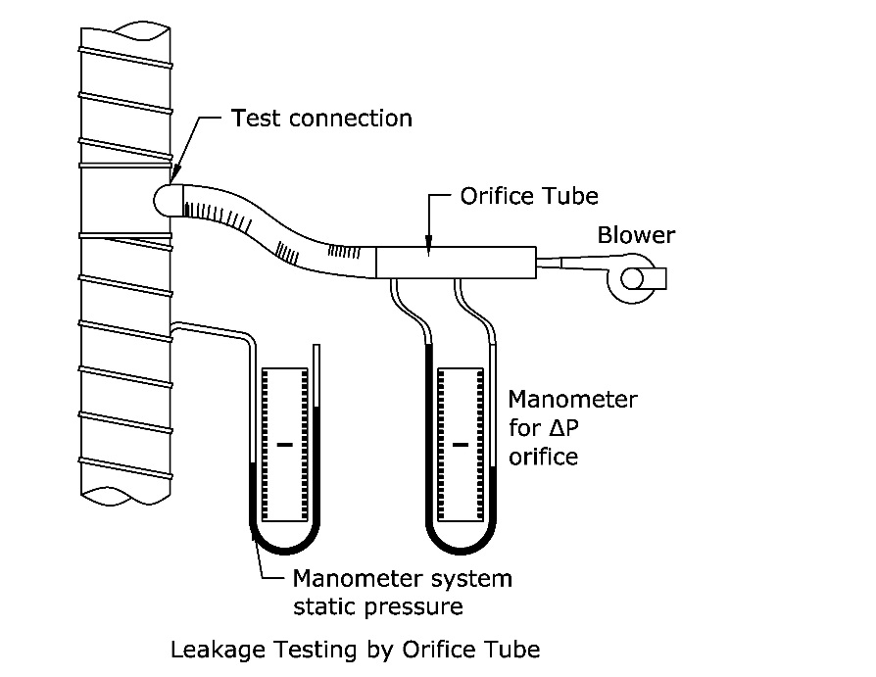
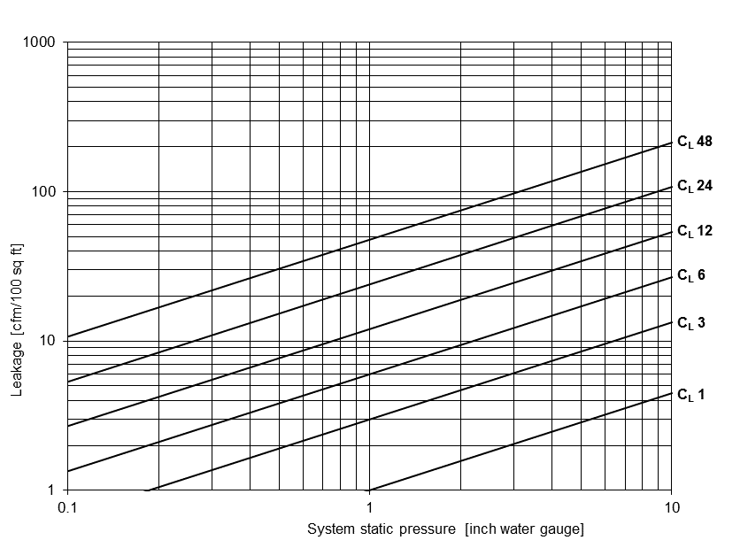
Air Pressurization Test
Notes:
The “standard” duct pressurization test is fairly simple and understood.
The results of the test is a LEAKAGE CLASS and has served the industry for almost 30+ years.
Unfortunately, just like a sleep comfort bed, you end up with a number….. which is NOT related to energy usage.

Slide 9
Standard 215 Test
Notes:
Diagrammatically this shows a single ducted supply air system serving VAV boxes

Slide 10
Standard 215 Test
Reference flow & pressure
Notes:
To conduct a Standard 215 test……set reference flow and pressure…measure duct inlet airflow….measure summation of outlet airflow at the diffusers…and preform the uncertainty analysis to generate the results.
This is nothing significantly different what you would expect from a “traditional” test and balance of the HVAC system.

Slide 11
What is the reference operating condition?
Configuration, as applicable, of system fans and all other system components and commands necessary to achieve desired operating condition.
Corresponds to greatest system inlet flow (outlet flow for exhaust systems) possible without being detrimental to occupants of building, building structure, or HVAC mechanical components, while maintaining duct static pressure set point (where applicable) specified in design documents.
Notes:
The reference operating condition is a DEFAULT setting that provides the greatest design airflow at the design pressure set point without doing harm.

Slide 12
What is the practical use/value of this new MOT?
Establishes a standardized (and repeatable) test of a complete and operational system to calculate the system air leakage as a percentage of the reference operating airflow and its statistical uncertainty.
What is the acceptable system air leakage as a percentage of the reference operating airflow?
This Standard MOT is a “testing procedure”. It is up to the engineer or code authority to specify both the maximum allowable air leakage and its acceptable associated uncertainty. The current ASHRAE Handbook gives some guidance.
Notes:
Standard 215 is a standardized and repeatable test to determine airflow leakage with a statistical uncertainty.
There is NO pass / fail criteria in this Standard.

Slide 13
What affects the upper and lower bounds of the “uncertainty”?
The statistical analysis that is a part of this MOT is influenced primarily by the precision of the testing instruments, but also by the number of readings tabulated for the calculations (e.g., number of supply grille airflows).
Does this replace pressurization leak testing?
No. This Standard recommends that pressurization tests be performed throughout the construction process to ensure that the final system air leakage at operating conditions (as determined by Standard 215) will meet the requirements specified by the Engineer.
Notes:
The statistical uncertainty analysis is influenced by the precision and accuracy of the flow measurement instruments AND the number of readings!
More accurate flow measurements and a larger number of readings results in a smaller uncertainty… or +/-% airflow.

Slide 14
Is this document a suggestion for engineers to put it into their specs?
It is desired that engineers put this Standard into their specs. However, the long-term goal is to have this Standard included in ASHRAE 90.1 (National Energy Standard) and in building codes. Already adopted by U.S. Army Corp of Engineers (Deep Energy Retrofit Guide).
Is there any conflict with Building Codes?
There is currently no conflict with current building codes.
Notes:
This Standard is currently adopted by the US Army Corp of Engineers in their published “Deep Energy Retrofit Guide”.

