Slide 1
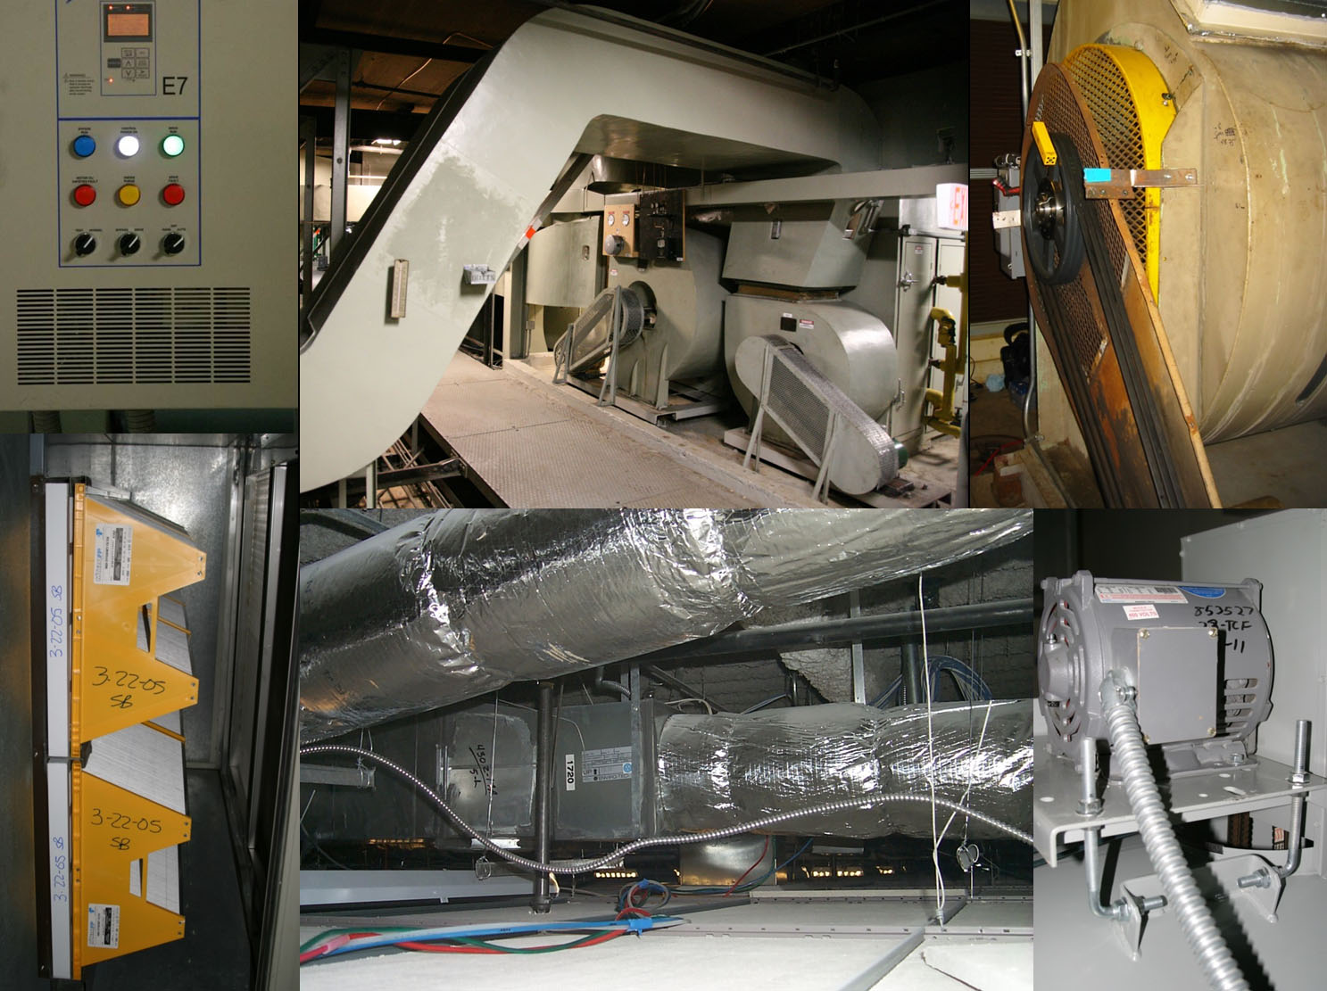
2018 ASHRAE Annual Conference – Houston, TX
Fan Systems:
Part-Load Energy Performance & TAB/Commissioning Opportunities
Craig Wray, P.Eng.
Seminar 37 - Selection and Application Considerations
of Fans Used in Variable Air Volume Systems
25 June 2018

Slide 2

Learning Objectives
  Explain the difference between systems with constant duct pressure set points and those with variable duct pressure set points for fan speed control
  Explain how the proposed FEG and FEI energy metrics are affected as a fan modulates speed in a VAV system application
  Use VAV system characteristics to estimate system efficiency and power at full- and part-load
  Evaluate the effect of duct control type and setting on the fan energy consumption of variable air volume systems

Slide 3
Presentation Outline
  Describe system characteristics and use them
  to estimate system efficiency & input power
  at full- and part-load
  Estimate frequency distribution of system part-load operating hours, average efficiency, and average power
  TAB/Cx Opportunity: Use ASHRAE Standard 215 to determine system airflows (inlet, outlet) & leakage
  Understand impacts of system air leakage and duct static pressure reset on energy performance

Slide 4
Acknowledgements
  California Energy Commission
  Public Interest Energy Research Program
  U.S. Department of Energy
  Office of Energy Efficiency & Renewable Energy
  Lawrence Berkeley National Laboratory
  Energy Technologies Area
  Thomas Properties Group / Able Engineering Services
  Federspiel Controls / Vigilent Corporation

Slide 5
Presentation Outline
  Describe system characteristics and use them
  to estimate system efficiency & input power at
  full- and part-load
  Estimate frequency distribution of system part-load operating hours, average efficiency, and average power
  TAB/Cx Opportunity: Use ASHRAE Standard 215 to determine system airflows (inlet, outlet) & leakage
  Understand impacts of system air leakage and duct static pressure reset on energy performance

Slide 6
Generic VAV System Schematic
Notes:
Fan energy use depends in part on the relationship between system pressure drop (fan pressure rise) and flow through the fan, which is commonly called a “system curve”. As a step toward enabling better selections of air-handling system components and analyses of common energy efficiency measures such as system air leakage sealing and duct static pressure reset, Sherman and Wray (2010) developed a simple four-parameter physical model for use in defining system curves. Non-linear techniques could be used to fit the curve to fan pressure rise and flow measurements over a range of operating conditions. During design, when measurements are unavailable, one could use duct design calculation tools instead to determine the coefficients.
A commercially-available tool to estimate wire-to-air efficiency and to assess time-varying fan system performance over the course of a year is already available. More specifically, EnergyPlus (a building energy simulation computer program) contains fan system component part-load models. They include the Sherman and Wray system curve (fan pressure rise) model for a fixed outdoor air fraction (including the effects of system air leakage and duct static pressure reset), dimensionless fan efficiency and speed models, a belt efficiency model, and motor and VFD efficiency models. These models are more detailed than what AMCA 207 currently describes, because they are intended for time-dependent analyses (and integration of sub-hourly simulation results to estimate annual performance). In particular, note that AMCA 207 does not provide system curve, fan efficiency, or fan speed models.

Slide 7
VAV System Curves & Power
Pa / 249 = in.w.c.
m³/s x 2119 = cfm
Notes:
The Sherman and Wray model for air-handling systems with variable-position supply dampers (e.g., VAV box dampers modulating to control flow) depends on the square of the fan flow, as is commonly considered. However, it also includes a term that accounts for linear-like flow resistances such as filters and coils, and it also includes a term for the duct static pressure control set point (P_{sm}). When the system operates with a variable outdoor air fraction, four parameters are needed to define the system curve: a, b, β, and P_{sm}. At a constant outdoor fraction, the terms a and b can be combined into one term.
The equation shown in the red box above is a commonly used representation for input power (H_{VFD}) to a VAV system. However, the actual equation is more complicated, as shown in the green box. There, the equation has multiple terms, most of which vary with flow (as will be discussed later).

Slide 8
Actual VAV System Curve ( f_{oa} = 0.7 - 0.8 )
Actual dP
3.1 times greater
at 40% design flow
If simple quadratic fitted through design point of
995 Pa (4.00 in.w.c.) at
5.7 m³/s (12,000 cfm):
dP = 31.033 Q²
Pa / 249 = in.w.c.
m³/s x 2119 = cfm
Notes:
When VAV box dampers are modulated to control flow, the damper positions are not completely independent of the supply flow and supply pressures. Consequently, with variable-position dampers, reducing or eliminating supply air leakage does not change the system curve. This behavior, however, does not mean that supply air leakage has no effect. Reduced air leakage results in a lower operating point on the same system curve, which means that the fan pressure rise and fan air power (product of fan pressure rise and flow divided by fan efficiency) will also decrease.
Using only a simple quadratic system curve fitted through the design operating point can lead to substantial errors in fan pressure rise estimates, as can the pressure rise difference between design and actual operation at the design flow. In the example shown here with outdoor air fractions in the range of 0.7 to 0.8, at 80% full flow (4.5 m³/s, 9,600 cfm), the simple quadratic fitted through the design point leads to a -29% error in estimated fan pressure rise. At 40% full flow (2.3 m³/s, 4,800 cfm), the error is -68%. In the latter case, the actual pressure rise is about 3.1 times greater than estimated (495 Pa / 159 Pa).
In terms of the “measured” curve for this system, at 40% full flow, the Q squared, Q, and fixed pressure terms contribute 15%, 34%, and 50% to the combined fan pressure rise, respectively. In this case, the second and third terms are clearly important and cannot be ignored.

Slide 9
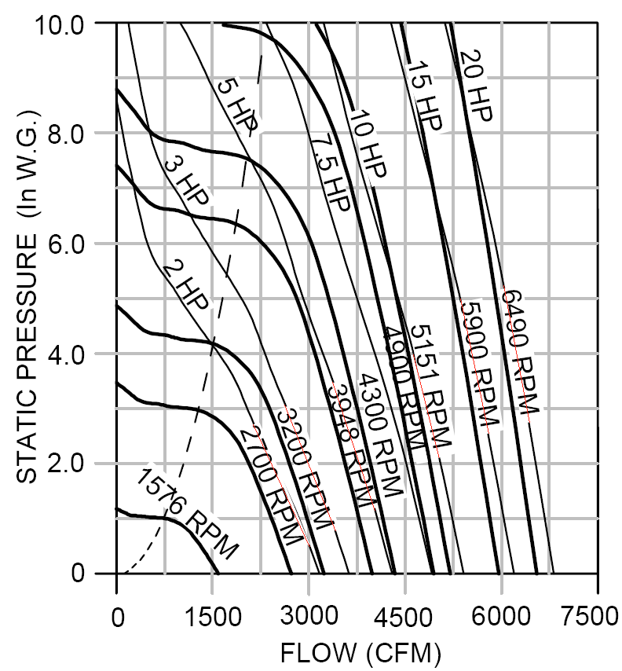
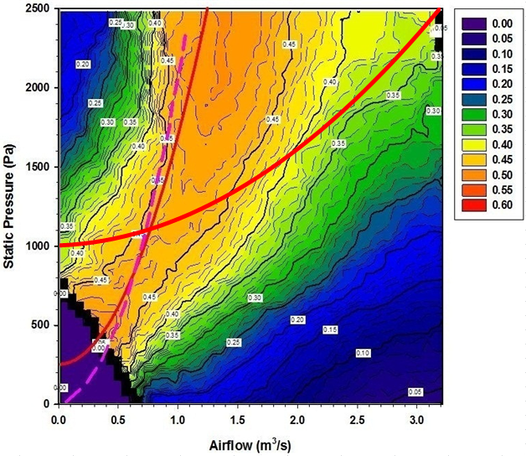
Fan Performance Map -> Fan Efficiency
Static Pressure (in.w.c.)
Airflow (cfm)
in.w.c. x 249 = Pa
cfm / 2119 = m³/s
Notes:
Conventional fan performance maps typically show fan shaft rotational speed and fan shaft input power as a function of airflow through the fan and fan static pressure rise. However, they do not show fan efficiency. Efficiency can be calculated, however, as shown here for each operating point, and then displayed using a contour map. On that map, there is a “ridge” of peak efficiency, with an especially steep drop off in efficiency as the fan moves into stall to the left of the dashed pink line. Note that some system curves may lead to operation in the stall region, if the fan speed is turned down too low.
Entering all of these data into a fan analysis program means that a lookup table is needed along with interpolation between points to fully characterize fan efficiency. The following slide shows a simpler method.

Slide 10
Normalized Fan Efficiency
Notes:
A dimensionless parameter in the form of an Euler number can be used to simplify the description of fan static efficiency variations. The Euler number here is the ratio of pressure force to inertial force, with terms (and SI units): Q_{fan} = volumetric airflow (m³/s), ΔP_{fan} = fan static pressure rise (Pa), D_{fan} = fan wheel diameter (m), and ρ = air density (kg/m³). By plotting the normalized fan static efficiency (static efficiency / maximum static efficiency) versus the logarithm base 10 of the normalized Euler number (Eu / Eu at maximum static efficiency), the dimensionless performance of various fan sizes is very similar (as one might expect from the “fan laws”), but so also is the dimensionless performance of different types of fans (e.g., single-inlet plenum fans, double-inlet housed centrifugal fans, mixed flow fans, vane axial fans, fans with backward or forward curved blades).
To assess whether the models can be applied over a broad range, sets of fan static pressure, flow, shaft power, and speed data for 30 fans were generated using manufacturer’s published performance maps. The fans included a variety of centrifugal, axial, and mixed flow fans and included both housed and plenum types. The overall average root-mean‐square (RMS) difference between predicted and “actual” fan efficiency was 0.7 percent and the maximum was 1.1 percent. The average RMS difference between predicted and actual fan power (where the difference is divided by the corresponding maximum power) was 0.9 percent and the maximum was 2.1 percent. For the fan shaft speed model, the average RMS percent difference between predicted and actual speed was 0.5 percent and the maximum was 0.8 percent.

Slide 11
Normalized Dimensionless Flow
Notes:
To determine shaft torque for belt loading analyses, one needs to determine fan speed (as shown on the next slide, belt efficiency depends on speed and torque). In particular, a parameter φ can be calculated for each operating point on the fan manufacturer’s performance map to represent fan speed as a function of flow and fan pressure rise.
For any operating point of flow (Q_{fan}) and fan pressure rise (ΔP_{fan}), one can calculate the corresponding Euler number (Eu) for the given fan, and then determine the corresponding normalized dimensionless flow (φ(x_{fan}) / φ_{max}) from the sigmoidal dimensionless flow function. With (φ(x_{fan}) / φ_{max}) determined and knowing φ_{max} for the fan, the dimensionless flow is: φ(x_{fan}) = φ_{max} [φ(x_{fan}) / φ_{max}]. With φ(x_{fan}) determined. the fan rotational speed (rad/s) is: ω_{fan} = Q_{fan} / [φ(x_{fan}) * D³_{fan}].
Finally, knowing fan input power (H_{fan}) and fan shaft speed (ω_{fan}), fan shaft torque (τ_{fan}) can be calculated as shown in the slide.

Slide 12
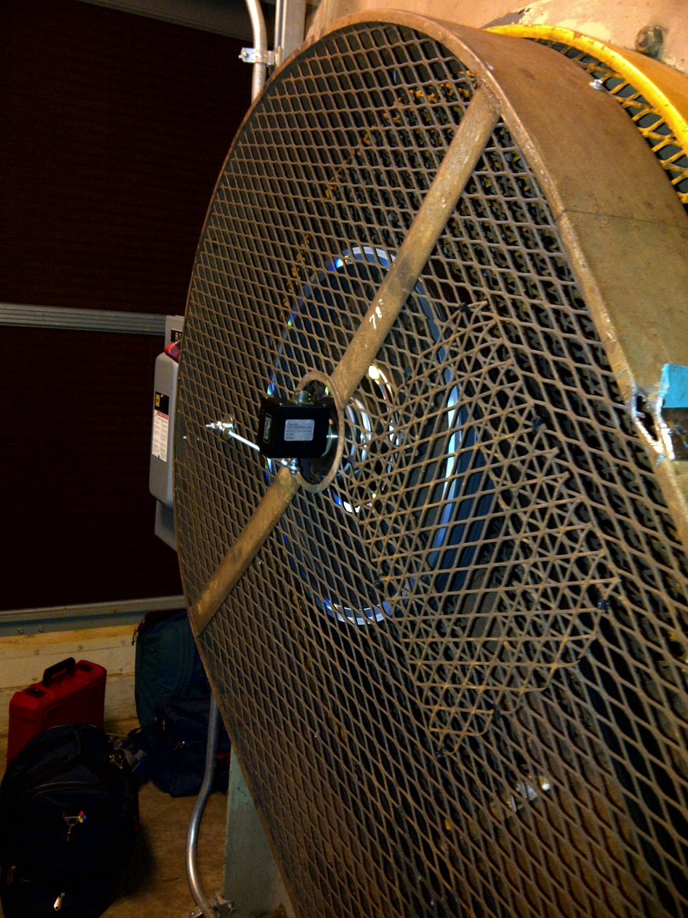
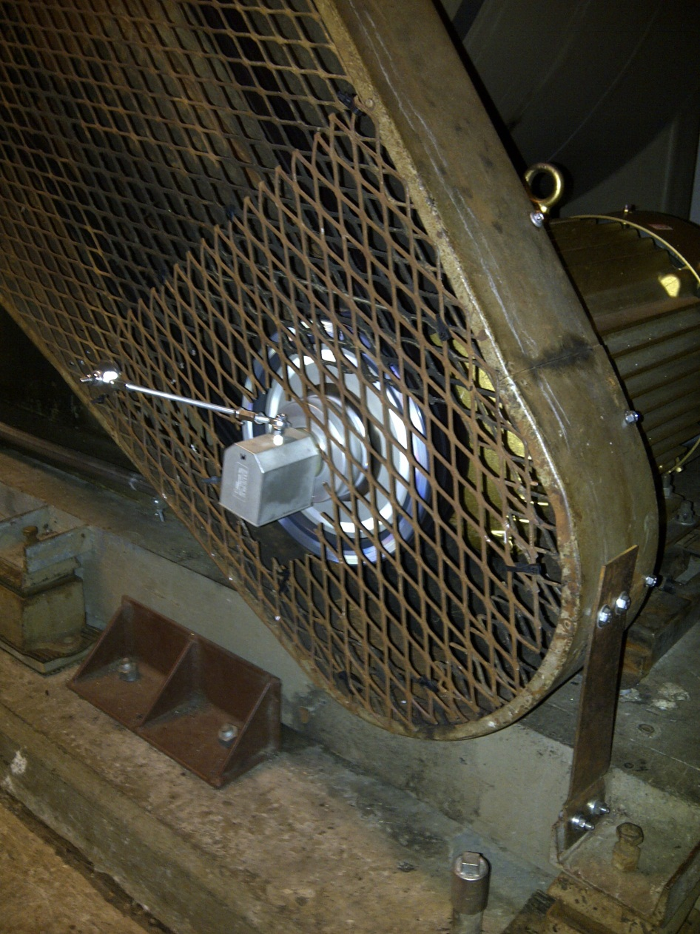
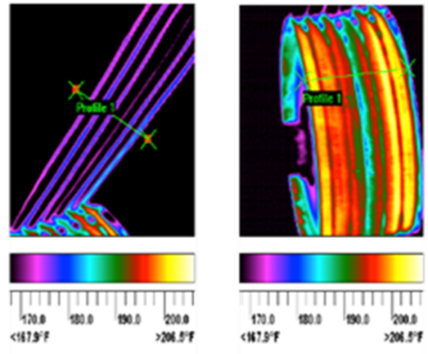
Belt Efficiency
Notes:
Belt drive efficiency depends on the product of torque and speed. There are many design and operation variables that affect belt drive efficiency. They include: belt type and cross-section, pulley diameters, shaft to shaft distance, power delivered, and service (oversizing) factor. As a result, belt drive efficiency depends on the specific design and operating point of the belt drive system.
The results of an unpublished experiment conducted at Lawrence Berkeley National Laboratory in 2013 is provided on the next slide to illustrate that belt efficiency decreases substantially with speed and load. The tested system (shown above) was a centrifugal DWDI backward-inclined fan driven by a 30 hp (22 kW) variable-speed electric motor (rated at 1770 rpm); shaft to shaft centerline span was 48.75 in (1.24 m). The pulleys are three-groove types: fan, 18.75 in. (476 mm) OD and motor, 9.75 in. (248 mm) OD. They were aligned using a reflective laser optical system. The initial tension of each of the three V-belts was set to manufacturer specifications using a deflecting belt tension gauge and was confirmed with a sonic tension meter. Fan shaft and motor shaft torque and speed were measured using two pulley torque and speed meters (custom-made, factory-calibrated). Modified pulley hubs each include a strain gauge. An associated shaft-end-mounted stationary instrument package is connected to the strain gauge through slip rings and includes an optical speed encoder. Sensor outputs were recorded using a digital logging multimeter.

Slide 13
Belt Part-Load Efficiency
in-lb_{f} / 8.85 = N-m
Notes:
AMCA 207 already contains a model for belt efficiency. It is derived from data in AMCA Publication 203 for three maximum efficiency (η_{belt,max}) curves for belts (low, medium, and high efficiency) as a function of maximum fan shaft power). That set of efficiency curves is reportedly based on belt drive loss data from over 400 tests.
The maximum belt efficiency, however, does not represent part-load belt efficiency. Part-load models are needed, because part-load efficiency can fall off rapidly at low load (as shown here) and many systems operate occasionally (and some much of the time) at low loads (as will be discussed later). EnergyPlus provides a normalized part-load belt efficiency model based on very limited data to modify the maximum efficiency of the belt (as derived from the AMCA 203 data). ASHRAE Research Project 1769, which has recently been released for bid, seeks to improve upon these models.

Slide 14
Motor Part-Load Efficiency
hp x 0.746 = kW
Notes:
Motor efficiency depends in part on the motor size (output power) and on the number of poles (which determines the synchronous speed of the motor). As shown here, larger motors with fewer poles have greater efficiency.
Ref: DOE. 2003. “MotorMaster 4.0 User Guide”. U.S. Department of Energy, Industrial Technologies Program.

Slide 15
VFD Part-Load Efficiency (50 hp, 480V)
hp x 0.746 = kW
Notes:
Many manufacturers and engineers assume that VFD efficiency is constant, but there are constant power losses from cooling fans and electric circuit excitations, as well as variable losses that are a product of switching and lead losses. Published data about VFD efficiency at part-loads are limited. The most readily available “data” are provided by DOE, a sample of which is shown here. Other data collected by Krukowski and Wray (2013) in a survey of VFD manufacturers are also shown here.
Available test procedures were only described anecdotally by the VFD manufacturers surveyed by Krukowski and Wray. The lack of a verified and standardized procedure at that time makes a direct comparison of the obtained datasets less useful and may account for a lack of consistency in trends in the datasets. ASHRAE SPC 222P (based on the recently developed method of test in AHRI 1210) is nearing completion, and will provide a standardized method of test for determining combined motor and VFD efficiency.

Slide 16
Component Efficiencies & System Power
hp x 0.746 = kW
in.w.c. x 249 = Pa
cfm / 2119 = m³/s
Notes:
The curves here represent a commercially available 18 in. (460 mm) diameter double-width double-inlet backward-inclined airfoil centrifugal supply fan; a medium efficiency V-belt; a high efficiency motor; a VFD with a 50 hp (37 kW) rated output; and a variable air volume (VAV) supply air distribution system with coil and filter elements and a duct static pressure setpoint of 1 in. w.c. (249 Pa). In SI units, the system curve used here has the form: Δp = 42.2 Q² + 295 Q + 249 where Δp is the fan pressure rise (Pa) and Q is the fan airflow (m³/s).
System efficiency is the product of component efficiencies, which generally decrease non-linearly as airflow is reduced. For example, at full load, VFD, motor, belt, and fan efficiencies here are 97%, 94%, 96%, and 75%, respectively. At 40% part-load, these same efficiencies are 90%, 86%, 84%, and 71%, respectively. In the first case, system efficiency is 66%; in the second case, it is much lower: only 46%.
If the drive belt efficiency was incorrectly assumed to be constant (same value as at full-load: 96%), the part-load system efficiency would instead be 53% (7 points higher than it is with the belt part-load efficiency correctly stated). In terms of energy use, properly including the difference of 7 points in system efficiency means that the system would actually use 0.53/0.46 = 15% more energy at 40% part load than if the variation in belt efficiency was ignored. This difference can be especially significant for VAV systems that often operate at low part load ratios over the year (e.g., a Chicago office building).

Slide 17
Presentation Outline
  Describe system characteristics and use them
  to estimate system efficiency & input power at
  full- and part-load
  Estimate frequency distribution of system part-load operating hours, average efficiency, and average power
  TAB/Cx Opportunity: Use ASHRAE Standard 215 to determine system airflows (inlet, outlet) & leakage
  Understand impacts of system air leakage and duct static pressure reset on energy performance

Slide 18
Operating Profile: PLR vs Toa
Large Office Building - Chicago
Hospital Building - Chicago
(°C x 1.8) + 32 = °F
Notes:
Operating profile data such as these can be measured in the field, or can be generated using EnergyPlus and its prototypical building models, which are typically used for energy code analyses (e.g., for ASHRAE 90.1). As shown here, the prototypical profiles depend on building type and climate. Using these data, however, it is difficult to determine how often the system is operating at a particular supply fan flow.

Slide 19
Operating Profile: PLR Frequency
Hospital Building - Chicago
Large Office Building - Chicago
cfm / 2119 = m³/s
Notes:
Operating hour frequency distributions based on the operating data points shown in the previous slide can be generated to show how often the system is operating at a particular supply fan flow. They too vary by building type and climate. For some buildings (e.g., the prototypical large office building in Chicago), the frequency distribution has many hours at the lowest part-load ratio (e.g., 33%), corresponding to VAV reheat coil operation at minimum airflow. The other hours occur in a decreasing pattern as the ratio increases up to say a maximum of 75%.
Although not shown, for the same type of building in Miami, there is a similar range of part-load operation, but the peak at the lowest ratio is much smaller, because less reheat is needed.
For the prototypical hospital building located in Chicago, the part-load range is narrower (e.g., from 45 to 75%) and there are multiple peaks corresponding to system selection and zoning decisions, with the remainder of the hours spread out in overlapping “normal like” distributions centered about these peaks.

Slide 20
Integrated Part-Load Effects
Large Office Building - Chicago
Notes:
One can combine the component efficiencies and operating hour distribution to determine average system efficiency, and average normalized system input power (system input power / maximum system input power). The averages are not necessarily coincident, because of the non-linear nature of the system efficiency and system curves (as shown earlier). In particular, system efficiency and system curve variations do not scale linearly. Although peak and average efficiency are important because they are a means to an end, ultimately, the design, construction, maintenance, and operation goals should be to achieve the lowest average normalized power. This goal will result in a system that uses as little energy as possible to move the supply air.

Slide 21
Presentation Outline
  Describe system characteristics and use them
  to estimate system efficiency & input power at
  full- and part-load
  Estimate frequency distribution of system part-load operating hours, average efficiency, and average power
  TAB/Cx Opportunity: Use ASHRAE Standard 215 to determine system airflows (inlet, outlet) & leakage
  Understand impacts of system air leakage and duct static pressure reset on energy performance

Slide 22
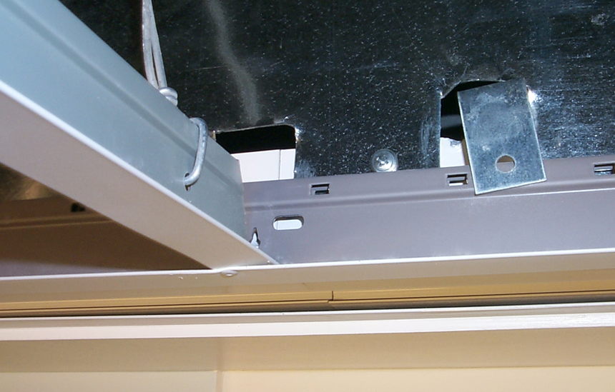
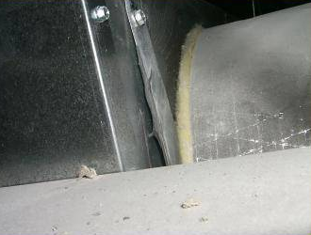
System Leakage Locations
Slot Diffuser
Box
VAV
Box
Supply
Duct
T-Bar
VAV
Box
Leaks
Leak
Notes:
Although little is known about the leakage characteristics of duct system components in existing buildings, three characteristics are notable. One is that the thousands of field-assembled joints between duct sections and duct-mounted accessories (e.g., VAV boxes) create numerous opportunities for system air leakage. The size and distribution of these leaks depends on duct construction materials and on the installation workmanship. Leakage testing of representative duct sections is necessary to verify that the installed system meets design specifications. Visual inspection is not a practical or reliable method of finding all of the leaks.
Currently, industry-wide methods for assessing “duct” leakage are based on duct pressurization tests, and focus on “high pressure” duct sections (i.e., those upstream of VAV box inlet dampers). Even though “low pressure” ducts can be a large fraction of the system and tend to be leaky, few guidelines or construction specifications require testing these ducts.

Slide 23
“System” Leakage - Pressurization Results
cfm/100 ft² per in.w.c.^{0.65} / 710 = L/(s·m²) per Pa^{0.65}
Notes:
Some of the duct pressurization test data that researchers have collected over the past several years in several U.S. large commercial buildings are shown here. These data include VAV, CAV, and dual-duct systems, and both “high-pressure” (“main”) and “low-pressure” (“branch”) duct sections. For VAV systems, the data include fan-powered boxes (“VAV Fan”) and cooling-only boxes. Most of the systems supply air through rectangular diffusers, but some use slot diffusers.
There is a wide range of leakage; branches are three times leakier than mains on average (branches usually are not pressure tested); the main sections might be tighter because of testing. Most sections are leakier than ASHRAE suggests for unsealed ducts. Building 2 (B2) appears leaky, but actually is tight (as shown in the next slide based on “measured” whole-system airflows). Dual duct systems have more ducts and more leakage. Slot diffuser plenums are leaky and operate at higher pressures than other diffusers.

Slide 24
Leakage Flow Fractions – 10 Systems
L/s x 2.119 = cfm
Notes:
Pressurization test procedures focus on determining component airtightness (e.g., for ductwork located upstream of terminal box inlet dampers). One must also then estimate system pressures during system operation to determine leakage airflows. Determining the location of every leak and the pressure difference across each leak is practically impossible for most systems and can cause significant uncertainty in leakage airflow estimates using this approach.
Measured leakage flows from ten large commercial duct systems at operating conditions are shown here. Three had low leakage (less than 5%), and seven had substantial leakage (9 to 26%). By comparing these flows with leakage flows estimated using the industry method, it is clear that the latter method by itself is not always a reliable indicator of whole-system leakage flow, and that leakage flows need to be “measured” to properly commission a duct system when pressurization tests indicate significant leakage.
In particular, the estimated fraction for Building 1 is seven times greater than the measured fraction. This estimate is not useful to show compliance with design specifications, and could lead to adversarial relations between designers, installers, and test and balance contractors.
There is better agreement for systems that are tighter (e.g., Building 8 after sealing). In this case, the estimated leakage flow fraction agrees well with the “measured” fraction for the “sealed” case. Small estimated leakage fractions are good indicators of a tight system; the converse is not true for large fractions that indicate a system is leaky.

Slide 25
ASHRAE Standard 215-2018
Specifies field MOT to determine leakage airflow and fractional leakage of operating HVAC air distribution systems, and uncertainty of the test results
Essentially a subset of normal TAB activities:
Limited for now to single-duct supply (CAV and VAV)
systems, and independent exhaust air systems
Does not replace pressurization-based leakage testing
Notes:
To eliminate the uncertainty associated with estimating pressure differences across leaks, Standard 215 provides a method of test for determining leakage airflows, either for the whole system or for selected parts. Flows into and out of the section being tested are measured at a repeatable reference operating condition: the difference is the leakage flow. The operating condition is not necessarily the design operating condition, but corresponds to the greatest system inlet flow (outlet flow for exhaust systems) possible without being detrimental to the occupants of the building, the building structure, or to the HVAC mechanical components, while maintaining the duct static pressure set point (where applicable) specified in design documents.
Standard 215 does not mandate a calibration method for any instrument, nor does it dictate that the user employ a specific flow measurement technique. Informative Annex A provides a general discussion of airflow measuring instrument technologies and their capabilities. Informative Annex B provides recommended airflow measuring instrument calibration and verification procedures.

Slide 26
ASHRAE Standard 215-2018
Reference operating condition:
Greatest inlet flow possible for supply systems
(outlet flow for exhaust systems)
Maintain design duct static pressure set point
(where applicable)
Not detrimental to occupants, building structure,
& HVAC components
Can be used on VAV systems with DDC- or pneumatically-controlled terminal boxes
Notes:
DDC Box Setup Procedure: VAV terminal unit controls are overridden so that each terminal unit is set to its design maximum airflow. Then, with the system supply fan operating at the greatest speed possible without being detrimental to the occupants of the building, the building structure, or to the HVAC mechanical components, if the duct static pressure at its control location is less than the maximum duct static pressure design set point, each terminal unit’s airflow is uniformly reduced by the same percentage of the terminal unit’s design maximum airflow until the maximum duct static pressure design set point is achieved. If instead the duct static pressure at its control location is greater than the maximum duct static pressure design set point, the fan speed is reduced until the maximum duct static pressure design set point is achieved.
Pneumatic Box Setup Procedure: Each VAV terminal unit is set to its design maximum airflow by setting the thermostat to its minimum setting (e.g., 17°C, 55°F). Then, with the system supply fan operating at the greatest speed possible (with the same caveats as above), if the duct static pressure at its control location is less than the maximum duct static pressure design set point, starting at the zone located closest to the primary fan, override every other terminal box to its minimum airflow set point by setting the thermostat to its maximum setting (e.g., 35°C, 95°F) until the maximum duct static pressure design set point is achieved or just exceeded. For example: Box 1 is at minimum, Box 2 is at maximum, Box 3 is at minimum, Box 4 is at maximum, and so on. If instead the duct static pressure at its control location is greater than the maximum duct static pressure design set point, then the fan speed is reduced until the maximum duct static pressure design set point is achieved.

Slide 27
Std 215: Example Leakage Uncertainty
L/s x 2.119 = cfm
Notes:
The term n_{j} in the leakage calculation accounts for the compensating effects of positive and negative precision errors in measurements at multiple grilles or diffusers (as opposed to compensating errors for a single grille or diffuser). In particular, the precision error at each grille/diffuser, which can be assumed to be normally distributed, will be randomly dispersed about the central mean value that is measured. Sometimes, the error will be positive and sometimes it will be zero or negative. When airflow measurements are made at several grilles/diffusers, Monte Carlo statistical analyses can be used to show that the errors will tend to reduce the overall precision error of the sum of the grille/diffuser flows, with the reduction approximating 1/sqrt(n_{j}). In the example here, 3.0% / sqrt(18) = 0.7%.
Due to this compensating effect, if the inlet and outlet flow measurement instruments have similar precision errors, the inlet flow precision error will dominate the overall standard uncertainty for Q_{leak,std}. Therefore, it is imperative to measure the inlet flow of a supply system or the outlet flow of an independent exhaust system with the greatest possible precision to minimize the uncertainty when determining the leakage flow and leakage fraction.

Slide 28
Presentation Outline
  Describe system characteristics and use them
  to estimate system efficiency & input power at
  full- and part-load
  Estimate frequency distribution of system part-load operating hours, average efficiency, and average power
  TAB/Cx Opportunity: Use ASHRAE Standard 215 to determine system airflows (inlet, outlet) & leakage
  Understand impacts of system air leakage and duct static pressure reset on energy performance

Slide 29

Field Experiments: Test Building System
Notes:
About 15 years ago, two experiments were carried out in a 1 million ft² (90,000 m²) 25-storey LEED Platinum office building located in Sacramento, CA. The building uses a separate single-duct VAV system on each floor, each with two supply AHUs, two relief fans, and 34 VAV boxes. The perimeter zones are served by 14 parallel-fan-powered boxes with reheat. The interior zones are served by 20 non-powered boxes without reheat. The air distribution system is located in a ceiling return plenum.
The experiments involved two separate studies during cooling seasons:
2001-2002: System leakage impact on fan power.
2005: Duct static pressure reset impact on fan power.
In each experiment, minute-by-minute airflows, pressures, temperatures, relative humidities, and fan power were measured on two floors (intervention and control, ~400 points total). The collected data arguably represent the most detailed published information on air-handling system performance related to these two issues in large commercial buildings.

Slide 30
Fan Power: As Found Leakage
System Leakage
Average: 5% of 10,700 cfm
215P: 4% of 24,400 cfm
cfm / 2119 = m³/s
Notes:
Supply and VAV box fan power trends over a typical day are shown here and on the next slide for the “as found” and “added” HVAC system air leakage cases, respectively. Relief fan power is not shown, because no correlation was found between relief fan power and leakage.
Note that the average and Standard 215 system leakage fractions are slightly different here (and more so on the next slide), because the supply fan airflows and downstream leakage airflows on which they are based differ. For average operating conditions in the “as found” case, the average supply fan airflow is 10,700 cfm (5.05 m³/s) and leakage is 340 cfm (0.16 m³/s) upstream and 245 cfm (0.12 m³/s) downstream of the VAV box inlet dampers (585 cfm, 0.28 m³/s total). In the “added leakage” case, the average supply fan airflow is 14,100 cfm (6.65 m³/s) and leakage is 1,738 cfm (0.82 m³/s) upstream and 1,042 cfm (0.49 m³/s) downstream (2,780 cfm, 1.31 m³/s total).
For the Standard 215 test conditions (not normal operation, but repeatable), the supply fan is operated at full speed (24,400 cfm, 11.52 m³/s). The VAV box inlet dampers are uniformly opened to achieve the design duct static pressure set point (250 Pa, 1.0 in.w.c.). Because the upstream pressure is the same for test and average operating conditions, upstream leakage also remains the same relatively in each case. However, downstream and total leakage increases in each case: 567 cfm (0.27 m³/s) downstream (907 cfm, 0.43 m³/s total) in the “as found” case and 1,507 cfm (0.71 m³/s) downstream (3,244 cfm, 1.53 m³/s total) in the “added leakage” case.

Slide 31
Fan Power: Added Leakage
System Leakage
Average: 20% of 14,100 cfm 215P: 13% of 24,400 cfm
● Sealing added leakage saves
27% supply fan energy
● 20% net savings due to 76%
more VAV box fan operation
cfm / 2119 = m³/s
Notes:
Weather normalization was used on the added leakage data (20% combined upstream and downstream leakage at average operating conditions). That is, normalization techniques that compare the variable of interest on the control and intervention floors were used to estimate what the average airflows and fan power on the intervention floor would be if the system ran with that leakage, but during the base case weather period instead.
The average supply fan power for the base case (5% combined upstream and downstream leakage at average operating conditions) was 5.4 kW (3am to 6 pm). If the system were to operate with 20% leakage over the same time period, it was estimated that the average supply fan power in this case would be 7.4 kW. The increase in average supply fan power due to the added leakage was 37%. Conversely, sealing the added leakage would save 27% of the supply fan energy.
On average during the base case, the VAV box fans ran 72% of the time from 3am to 6 pm. With 20% leakage over the same time period, it was estimated that the box fan operating time would decrease by 43 points to 41%. It is important to recognize that, conversely, sealing the added leakage would almost double the box fan operating time (increase by a factor of 1.76).
The increase in supply fan power for the 20% leakage case is thus tempered by the decrease in VAV box fan operating time, resulting in a net increase in combined supply fan and induction fan power of 25%. Conversely, sealing the added leakage would save 20% of the combined fan energy.

Slide 32
Duct Static Pressure Reset Diagnostic
Pa / 249 = in.w.c.
m³/s x 2119 = cfm
Notes:
California Title 24 and ASHRAE Standard 90.1 already require duct static pressure reset (SPR) for new buildings with VAV systems that include zone-level direct-digital controls (DDC). However, buildings without zone level DDC, which may be at least half of the existing building stock, are not required to use SPR. Unfortunately, DDC systems with reset capability suffer from: a) inaccurate, open-loop position measurement; b) failures at terminal boxes; and c) limited bandwidth and limited programming capabilities. Also, many existing systems have pneumatic terminal controls, so conventional DDC-based reset cannot be used.
A widely-applicable diagnostic-based duct-static-pressure control strategy for VAV systems is available to solve these problems. In this strategy, a correlation between duct pressure and flow is determined from data obtained by measuring these two parameters at multiple duct pressures over the fan’s operating range, while the terminal box dampers attempt to control flow in response to an approximately constant thermostat set point. The goal is to define the regions where all terminal boxes are “in control” (dampers modulating) and where the boxes are “starved” (one or more dampers are wide open). The control region correlation can be implemented within an existing direct-digital-control (DDC) system or, when pneumatic controls are present, in a control system overlay. The system can then operate with the terminal box dampers as wide open as possible while still maintaining thermal control.

Slide 33
Duct Static Pressure Test: Pressure
Reset between
100 and 250 Pa
(0.4 and 1.0 in.w.c.)
cfm / 2119 = m³/s
Pa / 249 = in.w.c.
Notes:
In the second field experiment, data from implementing the diagnostic-based duct static pressure reset strategy were analyzed. In this strategy, the linear correlation that was used to determine the duct static pressure set point at each operating point has the form as shown by the equation in the white box near the top right of the slide.

Slide 34
Duct Static Pressure Test: Fan Power
Fan energy savings: 30% supply, 43% relief, 11% VAV boxes, 26% total
Notes:
The two figures here show the fan power variations for sample days, before and after implementing SPR, respectively. Comparing the two figures shows that not only is supply fan power reduced significantly, but so also is relief fan power and VAV box fan power. Implementing SPR reduced average supply fan energy about 30% (largely because of fan pressure rise reductions). Total fan energy was reduced slightly less: about 26%. The fractional changes are based on weather-normalized average values.
Tempering this assessment, however, is that cooling and heating coil loads were observed to increase or decrease significantly depending on the time window used. Their impact on cooling and heating plant power needs to be addressed in future studies; without translating the coil loads to plant equipment energy use, it was not possible to judge the net impact of this SPR technology on whole-building energy use.

Slide 35
Air Distribution System Hybrid Model
Notes:
Modeling is needed to understand the impacts of air-handling system improvements throughout the building stock over an entire year, because measuring all of the parameters affected by changes to fan systems is too expensive and difficult, even for a single building. To that end, Wray and Matson (2003) used a hybrid DOE-2/TRNSYS sequential simulation approach to model the energy use of a VAV terminal-reheat system with six system air leakage configurations (tight to leaky) in nine prototypical large office buildings (representing three construction eras in three California climates where these types of buildings are common). The VAV system that was simulated had perfectly insulated ducts, and maintained constant static pressure in the ducts upstream of the VAV boxes and a constant supply air temperature at the air-handler. Further evaluations of duct leakage impacts should be carried out in the future after methodologies are developed to deal with duct surface heat transfer effects, to deal with airflows entering VAV boxes from ceiling return plenums (e.g., to model parallel fan-powered VAV boxes), and to deal with static pressure reset and supply air temperature reset strategies.
Later modeling by Wray in 2010 using a more integrated simulation approach (with EnergyPlus) produced results that differ from these earlier simulations and from field measurements. The leakage model there needs further review and likely more extensive validation to determine the causes for discrepancies.

Slide 36
Office Building Modeling Results
3 building construction eras (1980s, 1990s, 2005)
3 California climates (Oakland, Pasadena, Sacramento)
6 upstream + downstream supply leakage cases:
  from 5% to as much as 19% at design conditions
  from 5% to as much as 30% at operating conditions
Results (maximum leakage cases):
  Fan energy up 40 to 50%
  HVAC system annual operating costs up 9 to 18% ($7,400 to $9,500) [year 2000 prices]
  Simple payback period for sealing: about 1.3 years
Notes:
Based on Wray and Matson’s (2003) analyses of 54 cases, the largest effect of system air leakage was to increase fan energy consumption. The increase in annual fan energy was estimated to be 40 to 50% for a system with a total leakage of about 19% at design conditions compared to a “tight” system with 5% leakage. Note that the average system leakage at operating conditions is greater than at design conditions, because fan flows are reduced and upstream leakage flows remain constant at operating conditions.
Using year 2000 average commercial sector energy prices for California, the energy increases in the maximum leakage cases result in 9 to 18% ($7,400 to $9,500) increases in HVAC system annual operating costs. Normalized by duct surface area, the increases in annual operating costs are 0.14 to 0.18 $/ft² (1.5 to 1.9 $/m²). Using a suggested one-time duct sealing cost of 0.20 $/ft² (2.2 $/m²) of duct surface area, these results indicate that sealing these leaky VAV systems has a simple payback period of about 1.3 years. Even with total leakage rates as low as 10%, sealing is still cost effective. This suggests that sealing should be considered at least for VAV systems with 10% or more leakage.

Slide 37
Conclusion: What We Know Now
System curves are not just a simple function of flow
  Large errors can occur for pressure rise estimates
Component and system efficiencies vary non-linearly
  Do not assume full-load efficiencies apply at part-load
Systems should be designed to achieve minimum average input power at part-load conditions
System air leakage can now be measured reliably
Duct static pressure reset can be implemented
using diagnostic method
Whole-system view can save substantial energy

Slide 38
Conclusion: What’s Still Needed?
Simple, reliable diagnostic/analysis “tools”
Measurement device calibration standards
Field tests of combined retrofit opportunities
  Reduce system flows/leaks/pressures
  Improve component efficiencies and sizing
Computer models: validate, extend test results
“Low power” system specs & install procedures
(ultimately eliminate in-situ testing?)
Air-handling system commissioning guidelines

Slide 39
Bibliography
Sherman, M.H. and C.P. Wray. 2010. “Parametric System Curves: Correlations between Fan Pressure Rise and Flow for Large Commercial Buildings”. Lawrence Berkeley National Laboratory Report, LBNL-3542E.
Wray, C.P. 2010. “EnergyPlus Engineering Reference: Component Fan Model”. Board of Trustees of the University of Illinois and Regents of the University of California through the Ernest Orlando Lawrence Berkeley National Laboratory, October 2010. pp. 675-691.
Krukowski, A. and C. Wray. 2013. “Standardizing Data for VFD Efficiency”. ASHRAE Journal, Vol. 55, No. 6, 2013.
Wray, C.P., R.C. Diamond, and M.H. Sherman. 2005. “Rationale for Measuring Duct Leakage Flows in Large Commercial Buildings”. Proceedings - 26th AIVC Conference, Brussels, Belgium, September. LBNL-58252.
ASHRAE. 2018. Standard 215: Method of Test to Determine Leakage of Operating HVAC Air-Distribution Systems.
Diamond, R.C., C.P. Wray, D.J. Dickerhoff, N.E. Matson, and D.M. Wang. 2003. “Thermal Distribution Systems in Commercial Buildings”. Lawrence Berkeley National Laboratory Report, LBNL-51860.
Wray, C.P. and N.E. Matson. 2003. “Duct Leakage Impacts on VAV System Performance in California Large Commercial Buildings”. Lawrence Berkeley National Laboratory Report, LBNL-53605.

Slide 40
Bibliography (continued)
Modera, M.P., C.P. Wray, and D.J. Dickerhoff. 2014. “Low Pressure Air-Handling System Leakage in Large Commercial Buildings: Diagnosis, Prevalence, and Energy Impacts”. ASHRAE HVAC&R Research Journal, Vol. 20, Issue 5, July.
Haves, P., C. Wray, D. Jump, D. Veronica, and C. Farley. 2014. “Development of Diagnostic and Measurement and Verification Tools for Commercial Buildings”. Lawrence Berkeley National Laboratory Report to California Energy Commission, CEC-500-2015-001.
Wray, C.P. , M.H. Sherman, I.S. Walker, D.J. Dickerhoff, and C.C. Federspiel. 2008. “Heating, Ventilating, and Air-Conditioning: Recent Advances in Diagnostics and Controls to Improve Air-Handling System Performance”. Book chapter. Melville, New York, NY: American Institute of Physics, Physics of Sustainable Energy - Using Energy Efficiently and Producing It Renewably. Berkeley, CA, 1-2 March. pp 149-162. LBNL-317E.
Lorenzetti, D.M and C.P. Wray. 2014. “Air-Handling System Modeling in EnergyPlus: Recommendations for Meeting Stakeholder Needs”. Lawrence Berkeley National Laboratory Report, LBNL-6863E.

Slide 41
Questions?
Craig Wray
pharmeng@shaw.ca

