Slide 1

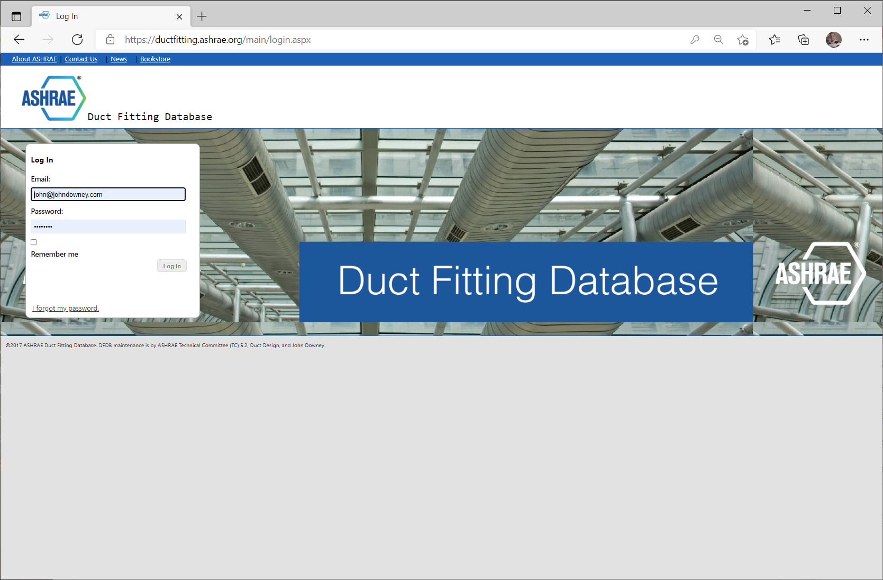
ASHRAE DUCT FITTING
Web Site Update
June 15, 2021

Slide 2

SUMMARY
Expected completion: July
Majority (80%) of the programming is complete.
Testing & Approval is in-progress by Technical Committee
Workflow and communication have improved
New Features have been added or in-process

Slide 3

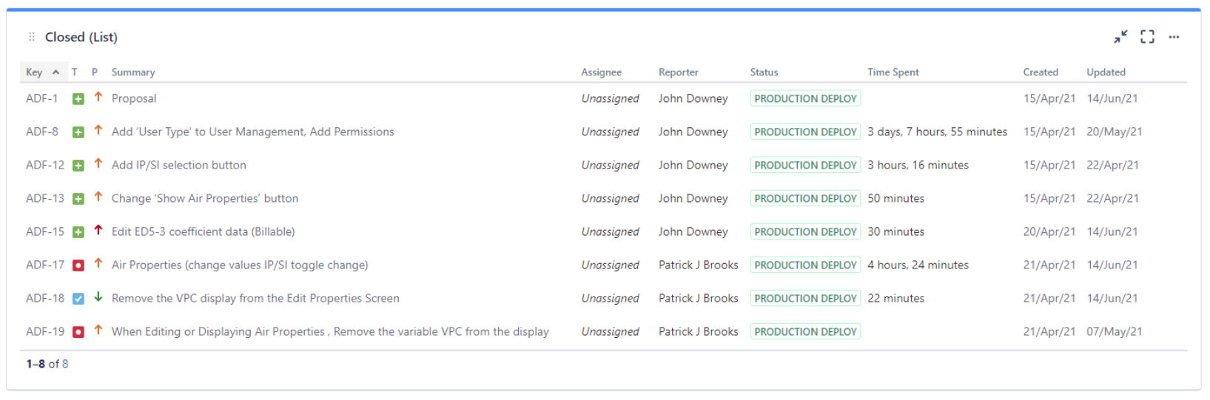
RECENTLY COMPLETED
7 items have been completed

Slide 4
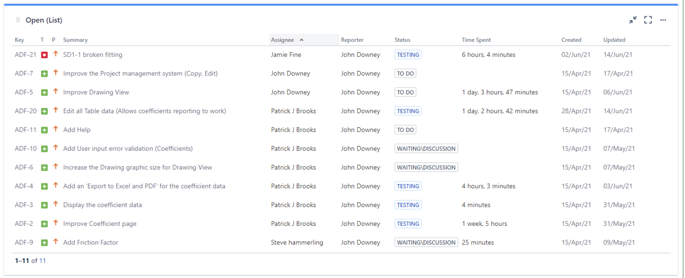
OPEN
11 items remain open

Slide 5
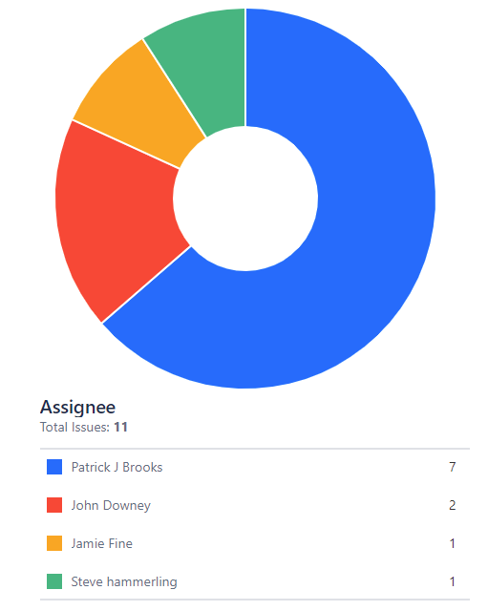
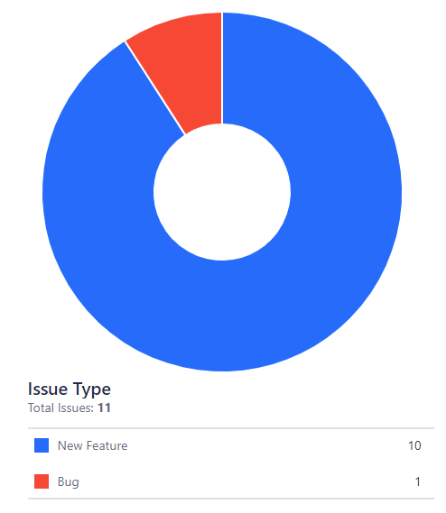
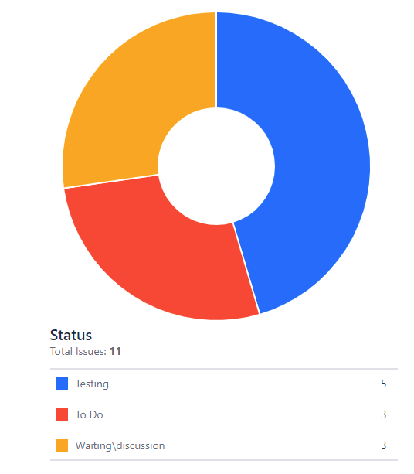
OPEN
by Assignee by Issue Type by Status

Slide 6
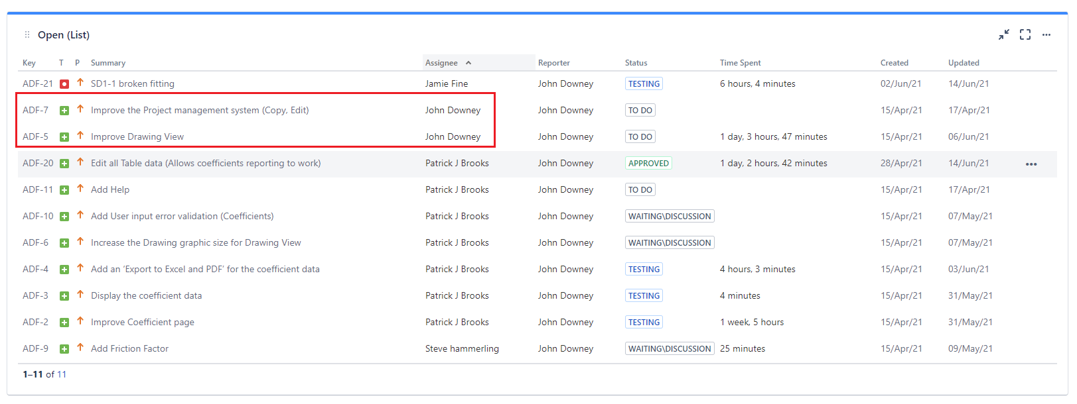
OPEN IN-PROGRESS
Two weeks remaining to complete programming for these 2 items.

Slide 7
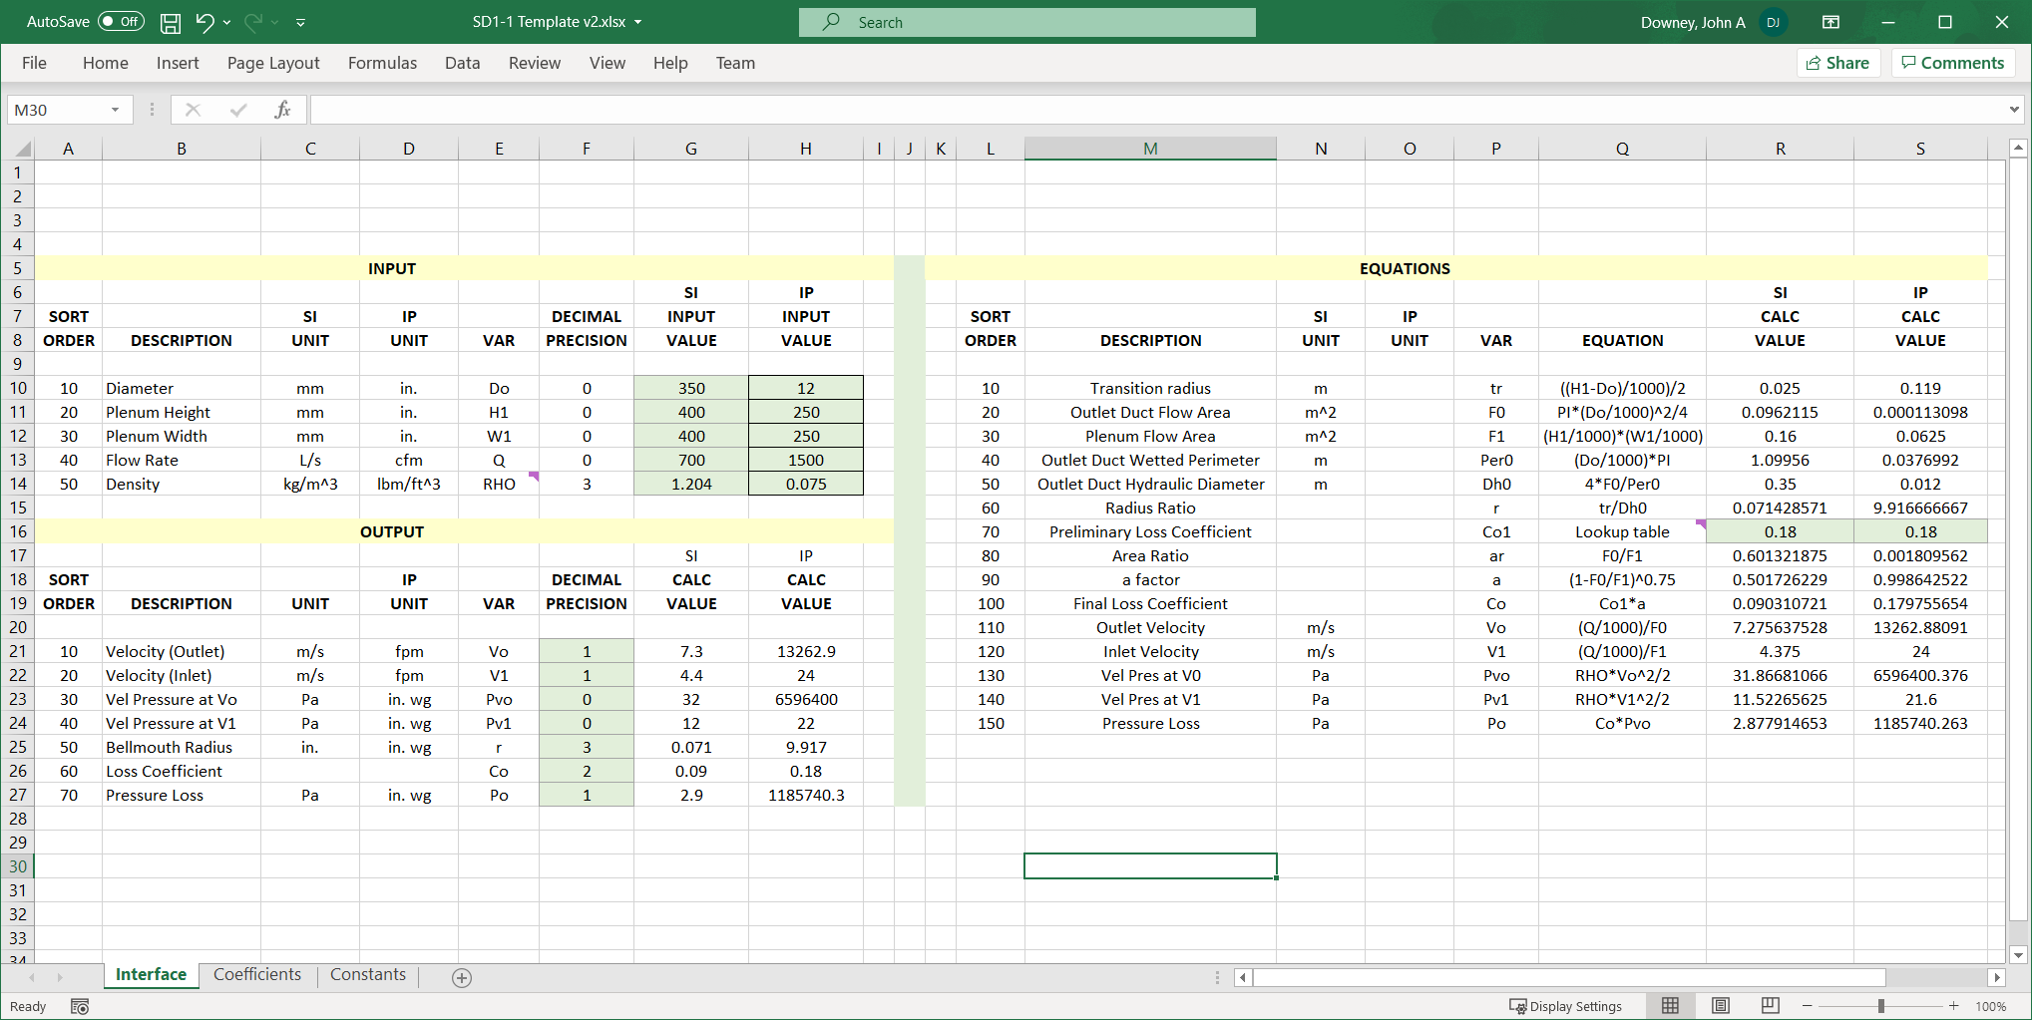
WORK FLOW
Provided excel sheet to Technical Committee to assist with data management

Slide 8
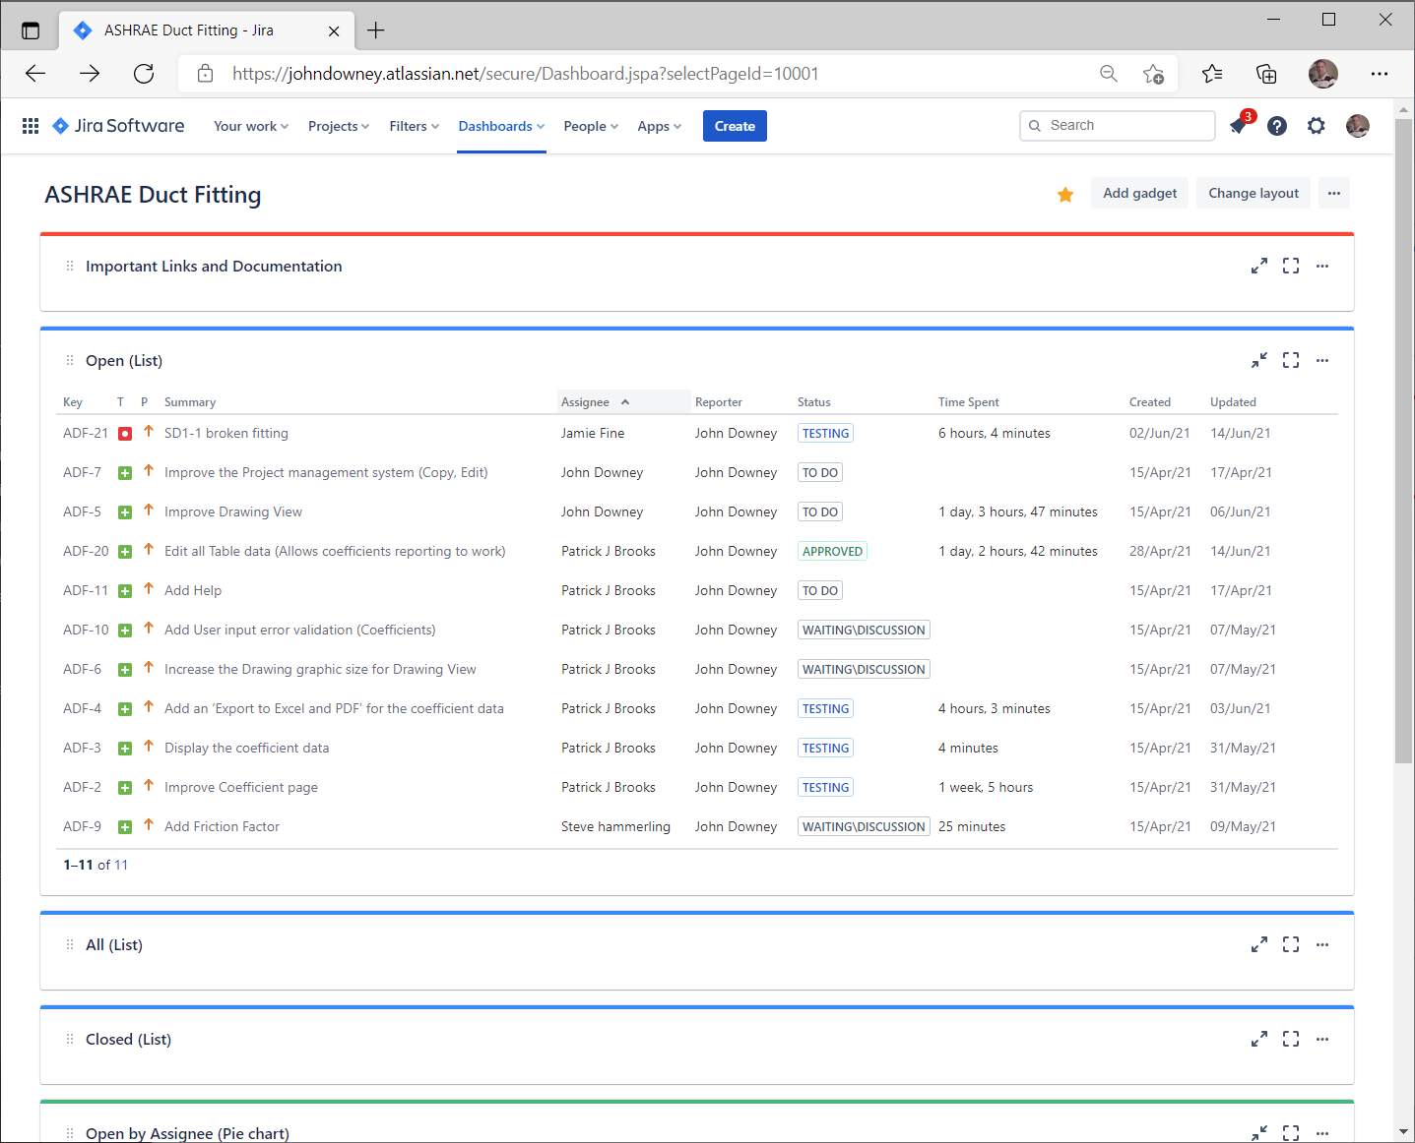
WORK FLOW
Provided Dashboard to track items and allow improved velocity and communication
Dashboard updates every 15 minutes
Web Link is available to all
Allows review and approval by Technical Committee
ASHRAE Internal staff have shown an interest in using for day-to-day items

Slide 9
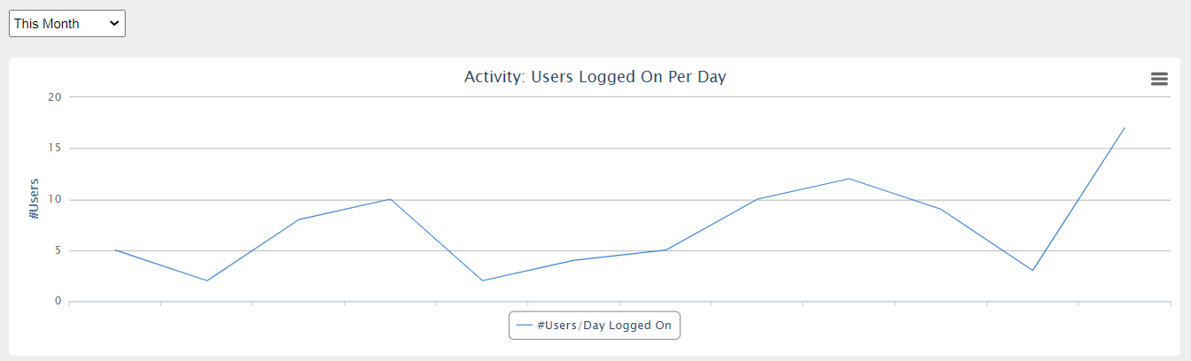
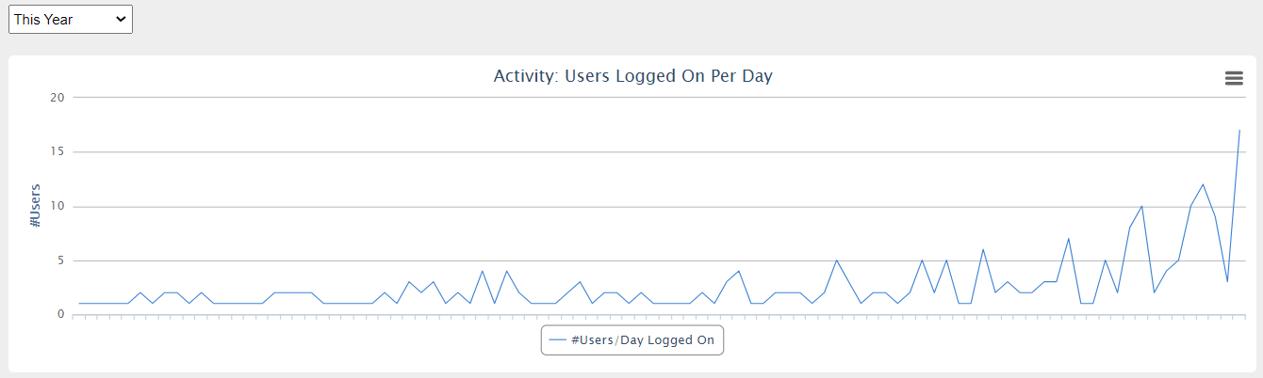
USERS

Slide 10

THANK
YOU!
John Downey
Phone
662-473-3113
Email
john@johndowney.com

