Slide 1
TC 8.2 Vapor Compression Cooling and Heat Pump Chillers – Main Meeting
Annual- Austin Hybrid Meeting
TC 8.2 Main Committee [Hybrid]: Monday, June 29, 2026, 3:00 – 5:00 PM CDT
In Person Location: JW Marriott Austin, JW - 307 - L3
Trent Hunt is inviting you to a scheduled Zoom meeting.
Join Zoom Meeting
https://us06web.zoom.us/j/85280579521?pwd=mCFejbCD8bNezbVBcYLBfsktb6aMfP.1
Meeting ID: 852 8057 9521
Passcode: 538351

Slide 2
Call to Order & ASHRAE Value Statement
In ASHRAE meetings, we will act with honesty, fairness, courtesy, competence, inclusiveness and respect for others, which exemplify our core values of excellence, commitment, integrity, collaboration, volunteerism and diversity, and shall avoid all real or perceived conflicts of interest. Our culture is one of inclusiveness, acknowledging the inherent value and dignity of each individual. We celebrate diverse and inclusive communities, understanding that doing so fuels better, more creative and more thoughtful ideas, solutions and strategies for the Society and the communities our Society serves. We respect and welcome all.

Slide 3
Agenda Review – T. Hunt
Introductions- please note what type of member you are & if you are a YEA &/or International Member for TC Activity Form (or write on sign-in sheet)
Quorum check – T. Abruzzo & Sean Gao
TC 8.2 Mission Statement & Scope – T. Hunt
Reviewed/Approve Winter Las Vegas 2026 Meeting Minutes – T. Hunt
Subcommittee Reports:
  Program – M. Rogan (Bruno)
  Research – D. Showalter
  Handbook – J. Medina
  Standards – P. Johnson
MTG Low GWP Liaison Update – P. Johnson

Slide 4
Agenda
Membership & Transition – T Abruzzo
Web Master – D. Kemper
Honors and Awards – R. Good
Chair’s Breakfast Report – T. Abruzzo
Old Business – T. Hunt
New Business – T. Abruzzo
For the Good and Wellbeing ….
Adjourn

Slide 5
Quorum Check – T Abruzzo
Voting Members
Trent Hunt
Tiffany Bates Abruzzo
Scott MacBain (to be replaced by Sean Gao)
Phillip Johnson
Jethro Medina
Mark Rogan
Daryl Showalter
Dan Kemper
Ray Good
Mike Dallon
Chris Miller
Mike Perevozchikov
Tom Watson
James Spalding (to be replaced by Peter Meece)
Voting Members in attendance in person or online
X Out of 14
(Bruno & Bill Bickford added for 16 for 2026-27 year)
Notes:
Updated 6/27

Slide 6
TC8.2 Vapor Compression Cooling and
Heat Pump Chillers Mission Statement
The Mission Statement of Technical Committee 8.2, Vapor Compression Cooling and Heat Pump Chillers is to provide world class technical expertise on all aspects of centrifugal refrigeration machines.
This committee is a resource to industry, academia, and others following society protocols through seminars, standards, technical papers/articles and other presentations.
The Scope of TC 8.2 is concerned with cooling and heat pump chillers that involves centrifugal or positive displacement compressors, including those with heat exchangers, drivers, controls, split evaporators and condensers, and other accessories.
Approved/ reaffirmed

Slide 7
Review and Approve Previous Meeting Minutes
2026 Winter Vegas Hybrid Meeting Minutes- see TC 8.2 website
Documents | ASHRAE 8.2 Vapor Compression Cooling and Heat Pump Chillers
Approved? Notes?

Slide 8
Program Subcommittee Report – Mark Rogan to Bruno (chair)
Combined TC 8.02/8.01 Program Subcommittee Report
Subcommittee Meeting: June 22nd, 12-2 pm PST
Attendees:

Slide 9
Program Subcommittee Report – Mark Rogan to Bruno (chair)
Future Program Ideas – Beyond Austin
Electrification of Heating Chapter 2: Industrial and Healthcare Markets as well as Heat Recovery Applications – Chris Miller possible chair.(should have good jobsite data by June) Good candidate for Track # 6; Heat Pumps, Refrigerants, and Decarbonization.
Electrification of various Heating Applications and the challenges of capacity modulation using different compressor types: Which applications can be served by electrification today and which ones cannot. Rick Heiden as a potential chair. Good candidate for Track # 6: Heat Pumps, Refrigerants and Decarbonization
Application Issues with New Refrigerants and Indoor Chillers: Does Standard 15 (equipment room design) properly cover the flammability issue? Phil Johnson as a potential chair. Good candidate for Track # 2: HVAC Systems and Equipment
Decarbonization and District Cooling / Heating – Tiffany Abruzzo possible chair. Good candidate for Track # 6; Heat Pumps, Refrigerants, and Decarbonization.
Applying Centrifugal Compressors to all Chiller Types. Oil Free Centrifugal Compressors increasing efficiency of Air-Cooled Chillers. Mark Rogan possible chair. Possible speakers mentioned: Ray Good, Tom Watson, Phil Johnson. Good candidate for Track # 2: HVAC Systems and Equipment.
Technologies for Data Center Cooling – Air-Cooled vs Water-Cooled : Possible Cosponsors 9.9, 8.1?
Service, Maintenance, & Troubleshooting of compressors including Scroll, Screw, Centrifugal, and Reciprocating Proposed by Joe Sanchez in SubCommittee meeting
  Co-sponsored seminar from TC 1.2 on the history of the 41 series and uncertainty calculation/quantification with Jim Douglas as chair for Las Vegas.
Oil-free chillers, bearing technologies for oil free compressors
Any other topic ideas? Open to the floor
Next Meeting

Slide 10
Program Subcommittee Report – Mark Rogan to Bruno (chair)
  For 2027 Winter Conference in Chicago, IL (Deadline Aug, 3rd)
    Track 1: Fundamentals and Applications (Track Chair: Jon Cohen | jonjcohen1@gmail.com)
    Track 2: HVAC&R Systems and Equipment (Track Chair: Richard Gunpat | richard.gunpat@gmail.com)
    Track 3: Refrigeration & Refrigerants (Track Chair: Anuj Gupta | anuj@design2occupancy.com)
    Track 4: Research Summit (Track Chair: Haotian Liu | Haotian.liu@okstate.edu)
    Track 5: Residential HVAC Research and Demonstration (Track Chair: Vinod Venugopàl | vinodpvgopal@gmail.com)
    Track 6. Thermal Network Systems and Energy Storage (Track Chair: Dennis Alejandro | denzjac@yahoo.com)
    Track 7. Nexus of Real and Artificial Intelligence (Track Chair: Joshua Vasudevan, joshuavasudevan2011@gmail.com)
    Track 8. Decarbonization Retrofits (Track Chair: Kevin Brown | kevin@kbsquared.net)
    Track 9. Application Notes in Professional Practice (NA)

Slide 11
Research Subcommittee Report – Daryl Showalter (chair)
  1879-RP – Foamability properties of LGWP refrigerants
  1716-RP Oil Concentration of Field Installed Liquid Chillers with Flooded Type Evaporators.”
  RP1851 – Dielectric Properties of Lower GWP Refrigerants
  [Ready for Review] - TC 8.1 & 8.2 Effects of sub-atmospheric operation with low GWP, low ambient heat pumps. Leak rates and design suggestions (Matt / Daryl to follow up)
    System Contaminants
    Refrigerant breakdown
    Possibility of electrical arching in a vacuum
    Potential for combustion in the presence of oil
Notes:
Updated 6/28

Slide 12
Research Subcommittee Report – Daryl Showalter (chair)
  New RTAR ideas:
    TC8.2 with 8.1 Decarb in heating mode discussed
    TC8.2 What is the limit of high temperature heat pump vs. vapor recompression? (Bruno)
    TC 8.1 Davide & Craig submitting - Assessment of Extrapolation Capabilities and Uncertainty Quantification of Multi-Refrigerant Semi-Empirical Compressor Models TC 8.1
    TC 8.1 Extrapolation of performance mapping of multi refrigerants compressor models
      Davide to follow up
Notes:
Updated 6/28

Slide 13
TC 8.1 & 8.2 Handbook – Jethro Medina (Chair)
TC 8.1:
  Refrigeration: Chapter 8 - Factory Dehydrating, Charging & Testing
    2022 Last Publication: MacBain, Sanchez, Perevozchikov
    2026 – Vote to approve updates at TC 8.1 Meeting
      Scott MacBain, Florian Simon, Andreas Josef Hoess, Haotian Liu, Jethro Medina
TC 8.1 & 8.2:
  2024 HVAC Systems & Equipment: Chapter 38 and 43 – Compressors & Liquid Chilling Systems
    Chapter 38: Compressors | Chapter 43: Liquid-Chilling Systems (Robert Tucker, Andreas Hoas, & David Bradshaw will help)
    2028 Next Revision – Updates due in July 2027
  Volunteers for reviewing Chapters? Contact Jethro Medina (jethro.medina@chemours.com)

Slide 14
Standards Report
TC 8.2 Standards Subcommittee – Phil Johnson (chair)
TC 8.2 is the cognizant TC for:
  ASHRAE Standard 30-2025 Method of Testing Liquid Chillers
    [TC 8.2 is lead; TC 8.5 is co-cognizant]
  ASHRAE Standard 184-2020 Method of Test for Field Performance of Liquid-Chilling Systems
TC 8.2 also monitors activity for the following standards of interest to members:
  ASHRAE Guideline 22-2025 Instrumentation for Monitoring Central Chilled-Water Plant Efficiency
    [TC 9.1 is cognizant]
  ASHRAE Standard 23-2022 Methods for Performance Testing Positive Displacement Refrigerant Compressors and Compressor Units
  [TC 8.1 is cognizant]
ASHRAE Standard 90.1-2025 Energy Standard for Buildings Except Low-Rise Residential Buildings
    [TC 7.6 is cognizant]
ASHRAE Standard 196P Method of Test for Measuring Refrigerant Leak Rates
    [TC 3.1 is cognizant]
  ASHRAE Standard 205-2023 Representation of Performance Data for HVAC&R and Other Facility Equipment
    [TC 4.7 is cognizant]
  ASHRAE Standard 225-2020 (R2025) Method for Performance Testing Centrifugal Refrigerant Compressors and Condensing Units
  [TC 8.1 is cognizant]
  AHRI Standards 550/590|551/591-2023 Performance Rating of Water-chilling and Heat Pump Water‑heating Packages using the Vapor Compression Cycle
  AHRI Standard 1520-2022 Performance Rating of Centrifugal Refrigerant Compressors
  ISO TC 86 / SC 4 Testing and rating of refrigerant compressors (ISO/AWI 18501, 18483, 18976)

Slide 15
Standards Report
ASHRAE Standard 30-2025 (Nick Zupp, Chair SSPC30)
2025 edition published! (incorporates Addenda a, b, c, d, f, h, i to the 2019 edition).
Now developing addenda to ASHRAE Standard 30-2025 “Method of Testing Liquid Chillers” (designated as continuous maintenance)
2025-Jun-23 SSPC 30 meeting:
  AHRI has a test plan to collect test data for air sampler temperature array versus air sampler with aspirating psychrometer (for developing ‘Addendum e’, for the next edition). Contract in process. Test data collection pending.
  Voted in Orlando to recommend a seminar in Phoenix for ‘what’s new’ in Standard 30-2025.
SSPC 30 not meeting in Las Vegas (2026-Feb)
Next meeting: potentially a joint meeting with AHRI Chillers STC; waiting for air sampling array test data to schedule next meeting
Addendum a. Published in May 2020. Mainly clean-up including a requirement to test based on defined operating mode set points.
Addendum b. Published in April 2020. Mainly clean-up including clarification of Δp_{adj}. Republished to add missing calibration workbook (.xlsx).
Addendum c. Addition of adiabatic, free-cooling, and 4-pipe chillers by introduction of hybrid operating modes. APR1 Nov 2020. PPR1 public review May~Jul 2024. Published December 2024.
Addendum d. Published March 2024. Update to steady-state criteria.
Addendum e (for next edition). Harmonization with AHRI 550/590, Section 4. Addition of air sampling arrays. PPR1 public review possible in late 2025 after AHRI research data collection.
Addendum f. Published January 2023. Inclusion of AHRI 550/590, water pressure drop calculation tool.
Addendum g. Nomenclature to use for temperature differences (keep as-is or change). Advisory Public Review Jun~Jul 2024. Only 1 comment. SSPC30 decision to not change.
Addendum h. Miscellaneous changes, harmonization with AHRI 550/590. PPR1 public review Nov29~Dec 29 2024. One public comment received and resolved; will publish soon.
Addendum i. TPS changes, water to liquid. PPR1 public review Oct25~Nov24 2024. No public comments received. Published December 2024.
Notes:
Updaetd 6/27

Slide 16
Standards Report
ASHRAE Standard 184-2020 (Mark Rogan, Chair SPC 184)
Standard 184-2020 was published in November under periodic maintenance.
TC 8.2 decided and voted (7-0-0-1) in Tampa on 2023-Jun-26 to recommend forming a committee to revise the standard (e.g. additional work on the uncertainty calculator spreadsheet workbook). 5-year cycle would need to publish next edition by 2025 (-ish?), deadline to decide “withdraw, reaffirm, or revise” was 2023-Nov-30.
Periodic Maintenance Recommendation form submitted 2024-01-18. Standards Reaffirmation Subcommittee (SRS to StdC) approved recommendation. StdC approved ballot ending 2024-10-25.
Chair: M.Rogan. Initial SPC 184 roster approved by SPLS 2026-01-30, can now have a public call for members (can add more if needed).Planning to meet monthly between now and Austin conference.

Slide 17
Standards Report
ASHRAE Guideline 22-2025 (Daryl Showalter, Chair GPC22)
ASHRAE Guideline 22-2025 “Instrumentation for Monitoring Central Chilled Water Plant Efficiency” (designated as periodic maintenance)
New edition recently published, supersedes the 2012 edition

Slide 18
Standards Report
ASHRAE Standard 23 (Scott MacBain, past Chair SPC23)
Standard 23-2022 published “Methods for Performance Testing Positive Displacement Refrigerant Compressors and Compressor Units”.
TC 8.1 is cognizant. Currently there is no SPC 23. Intentions for 5 year cycle SRS form? (reaffirm, revise, withdraw).

Slide 19
Standards Report
ASHRAE Standard 225-2020 (R2025)
Staff (M.Weber) confirmed on 2025-06-12 that TC 8.1 is now the cognizant TC (again)
Standard 225-2020 was reaffirmed in 2025.

Slide 20
Standards Report
ASHRAE Standard 90.1-2025 (Rick Heiden)
Standard 90.1-2025 includes over 70 addenda to from the 2022 version. Publication expected in February.
New addenda (when published) are available at:
https://www.ashrae.org/technical-resources/standards-and-guidelines/standards-addenda
Addenda of interest (i.e. addenda to 2022 forming basis of 2025):
  L – net zero operational energy emissions (NZOEE), informative appendix that jurisdictions could adopt for buildings to achieve NZOEE over 1-3 code cycles. Includes chiller emission factors.
  AE – Unitary efficiency ratings; includes increased static and power from other operating modes and new metrics IVEC, IVHE, IVHE_{C}
  CN – Thermal Storage Energy Credits
    Added G010: HVAC Heating Energy Storage
    Added multipliers for heating and cooling unit type, Note: These should not be used as the sole criterion for system type selections!
  U – VAV Turndown – requires Multiple zone VAV airflow be capable of turning down to 15% without being limited by unit’s mechanical cooling, economizer or ventilation functions.
Discussion topics within the 90.1 Mechanical Subcommittee of interest to this committee
  Lower temperature heating water for heat pumps and boil

Slide 21
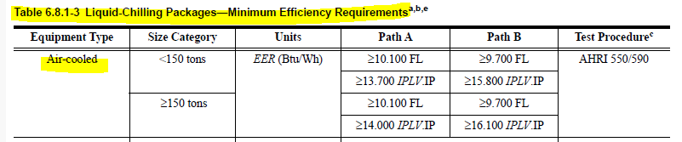
Standards Report
ASHRAE Standard 90.1-2028 (Rick Heiden)
Any update from TC 8.2 to 90.1 here?
Addenda when published are available at:
https://www.ashrae.org/technical-resources/standards-and-guidelines/standards-addenda
90.1 Mechanical Subcommittee Hydronics Working Group is developing 2028 work plan.
Requesting that TC 8.2 evaluate the potential for more stringent air-cooled minimum efficiencies.
  12 years since last update (2010 addenda into 2013 version)
  Current version, 90.1-2022 Table 6.8.1-3
  Experience of users/specifiers suggest industry opportunity to do better
  Leverage AHRI if possible
Any additional non-standard conditions deserving of new Kadj or rating segmentation
Notes:
TC 8.2 Vapor Compression Cooling and Heat Pump Chillers

Slide 22
Standards Report
ASHRAE Standard 196P (Phil Johnson, Chair SPC 196P)
Developing new document ASHRAE Standard 196 “Method of Test for Measuring Refrigerant Leak Rates”
As of 2023-Jun (Tampa), have reached consensus on resolving a fundamental question with the measurement method (under what range of conditions are ideal gas assumptions sufficiently valid), now need to implement the changes into the draft (and propagate changes into the examples in the informative appendices)
Committee expecting to have PPR1 around Q2 CY2026

Slide 23
Standards Report
AHRI Standard 1520 (Matt Cambio)
(Must finalize 225 1st )
AHRI Standard 1520-2022, Performance Rating of Centrifugal Refrigerant Compressors
This standard provides a rating method for centrifugal compressors and a calculation method to compare centrifugal compressors with positive displacement compressors.
A MatLab open-source tool is being created by Purdue for reading data and calculating performance as well as comparisons with positive displacement compressor 10 coefficient model
It is probable that a WG will be formed to review the standard to see how it’s working.
Would like to encourage use of the standard and participation in the next WG.
Additional Notes:
Reference to ASHRAE 225, Methods for Performance Testing Centrifugal Refrigerant Compressors and Condensing Units
Similar format to AHRI 540, Performance Rating of Positive Displacement Refrigerant Compressors and Compressor Units
AHRI Compressor Standards Technical Committee will maintain the standard (responsible for a total of 7 standards including 1520)

Slide 24
Standards Report
ISO/TC 86/SC 4 (Justin Prosser)
Key:
TC = Technical Committee
SC = SubCommittee
WG = Working Group
AWI = Approved Work Item
TC 86: Refrigeration and air-conditioning,
SC 4: Testing and Rating of refrigerant compressors
WG2: ISO 18501, Positive displacement refrigerant compressor (harmonizing: AHRI 540, EN 12900)
Published 2025-03
WG3: ISO 18483, Centrifugal refrigerant compressor (harmonizing: AHRI 1520)
Published 2025-04
WG4: ISO 18976, Testing of refrigerant compressors (harmonizing: ASHRAE 23 & 225, EN 13771-1, and withdrawn version of ISO 917)
Published 2026-01

Slide 25
TC8.2 Leadership Roles – T. Abruzzo July 1st 2026
Chair – Tiffany Bates Abruzzo
V Chair – Mark Rogan
Secretary – Sean Gao
Handbook – Jethro Medina
Programs – Bruno Carvalho
Standards – Phil Johnson
Research – Daryl Showalter
Webmaster – Dan Kemper
Honors and Awards – Ray Good
MTG. LowGWP Liaison – Phil Johnson
MTG. LowGWP Alternate – Ray Good
Effective starting 2026 Annual Summer – Austin, TX
Notes:
Updated 6/27

Slide 26
Membership – Sean & Tiff https://tpc.ashrae.org/Membership?cmtKey=83a02e09-1a12-4ee1-bbf8-3ba74490dec7
Updated 4/2026- PLEASE keep your bio updated & let us know if you want to get more involved
How to Import Your TC Roster Information into MS-Outlook - http://www.ashrae.org/TCs
Annual Meeting Attendance in Vegas =
Voting Membership:

Slide 27
Webmaster – Dan Kemper
Needs to be Updated
General updates and maintenance
  Meeting time, current power point agenda and links posted
  Past agenda, minutes, and power point posted
  Updated scope and verbiage throughout website to reflect accordingly
Please send documents from 2025 & 26 seminars so they can be added to the presentations section of the website
https://tc0802.ashraetcs.org
Notes:
Updated 6/28

Slide 28
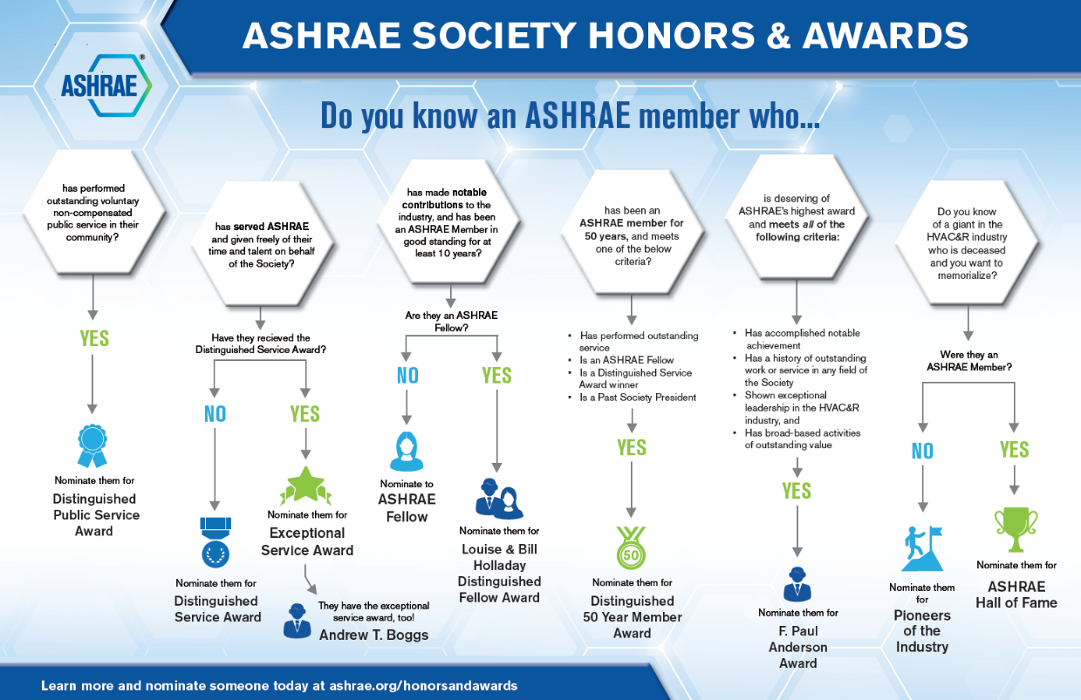
Honors and Awards Flowchart
Notes:
Flowchart is posted on the H&A webpage (www.ashrae.org/Honors) and available in printouts.

Slide 29
Honors and Awards – Ray Good Continued
Current Activities:
Encourage all members to update their ASHARE bios in an effort to qualify for additional honors and awards recognition
Consider others who may qualify as a Fellow or other awards

Slide 30
TC Chairs Breakfast Report – T. Abruzzo & M Rogan

Slide 31
Old Business – T. Hunt
Continue to update roster & send programs & RTAR ideas to leadership please.

Slide 32
New Business – T. Hunt

Slide 33
For the Good and Wellbeing & Action Items
Have a wonderful safe winter & spring full of safe travel, grandkids, weddings, & CRC’s
Action Items:
Update slides & get to Tiffany if you have not done so already
If your membership level needs to be changed- let Tiffany know
If you need help applying for DSA/ESA/or Fellow- reach out to Ray & Tiff
If you want to speak in Chicago let Bruno/Mark & Tiffany know ASAP. Chair must confirm speakers, provide overall abstract & quiz questions, each speaker must provide bio and title & abstract of section

Slide 34
Adjourn
THANK YOU ALL FOR ALL YOU DO FOR ASHRAE!!

