Slide 1
DASH DATABASE DEVELOPMENT: A Status Report
ASHRAE Winter Meeting – Dallas, TX
January 2013
Bruce D. Hunn
ASHRAE

Slide 2
DASH
Database for Analysis of Sustainable and High Performance Buildings
To provide consistent set of protocols for collection, benchmarking, and reporting of measured performance data
Began in 2004; ASHRAE (TC 7.6) co-managed development with Green Building Alliance since 2008

Slide 3
DASH DESCRIPTION
National repository of measured building performance information
Standard collection, benchmarking, and reporting formats and protocols for four sets of metrics:
  Building/site features
  Operational data (energy, water, and IEQ)
  Real estate and financial information
  Occupant-based metrics (productivity, performance, and health)
Web-based reporting tools: benchmarking and dynamic queries

Slide 4
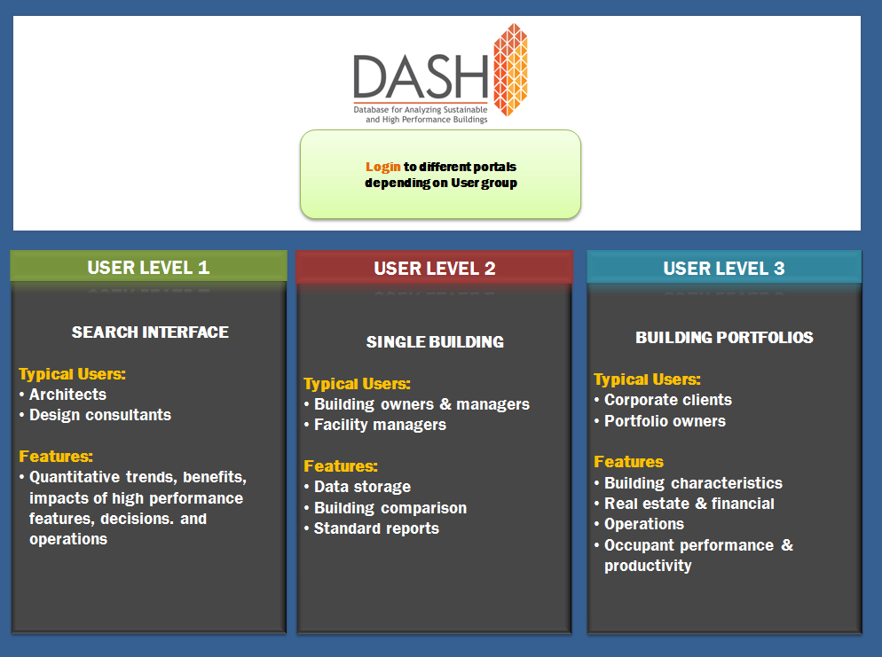

Slide 5
NIST Project: Evidence-Based Benefits of Building Commissioning and Performance Monitoring
  Conducted 2010-2012 by ASHRAE and GBA: final report submitted Oct. 31, 2012
  Tasks
    - 1A: Establish DASH measure lists and data protocols
    - 1B: Identify sources of before- and after- commissioning performance data
    - 1C: Develop DASH web interface
    - 1D: Populate DASH with Cx cost-benefit data

Slide 6
DASH Task 1A
(Measure lists and protocols)
Re-organize and refine 4-component DASH measure lists and align with ASHRAE Performance Measurement Protocols levels 1 (<15 measures), 2 (20-30 measures), and 3 (>30 measures)
Cx data included in operational data
Import Cx cost/benefit information and structure from LBNL studies and IEA Annex 47 into DASH Cx module

Slide 7
DASH Task 1B
(Identify Cx data sources)
Sources of Cx cost/benefit data:
  Calif. Cx Collaborative
  LBNL Cx studies
  ASHRAE TC 7.9
Input forms based on procedure of Std 0.2P (Existing Buildings Commissioning) and survey data collection forms of IEA Annex 47
Reviewed by ASHRAE DASH Working Group and TC 7.9

Slide 8
DASH Task 1C
(Develop web interface)
Subtask managed by GBA with subcontractor Agile Oak
Guided by focus groups
Functionality includes comparison by performance statistics, e.g. building type, floor area, geographic region
Special attention to ease of data intake, proprietary data, account management
Translated measure list to web context

Slide 9
DASH Task 1D
(Populate with Cx cost/benefit data)
California Cx Collaborative – 16 buildings
California State University – 2 buildings
Dometech Engineering – 1 building
Facility Dynamics Engineering – 1 building
Minnesota Center for Energy and Envr.- 1 building
Montana Dept of Envr. Quality – 4 buildings
Oregon Department of Energy – 5 buildings
Idaho Energy Division – 2 buildings
Washington Dept of Gen. Administration – 12 buildings
PECI – 3 buildings
Texas A&M University – 5 buildings
Puget Sound Energy – 2 buildings

Slide 10
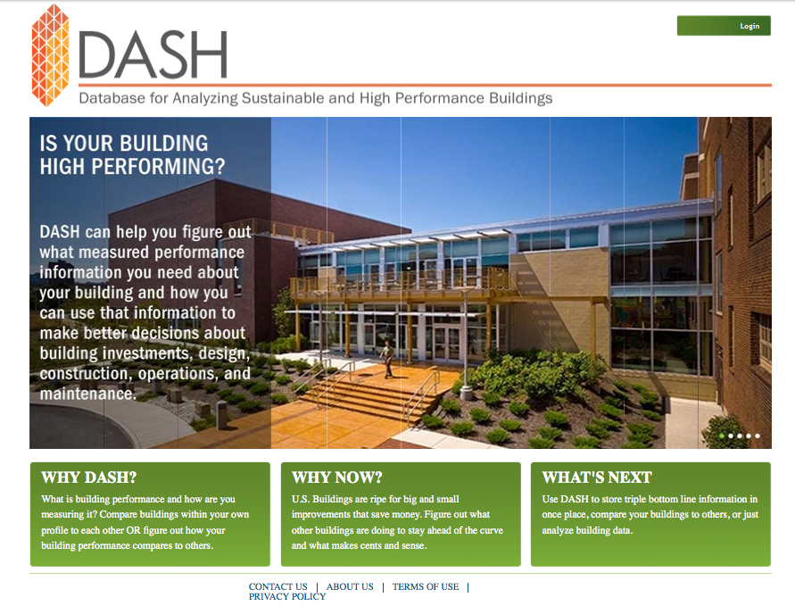
Landing page: www.dashbuildings.com

Slide 11
Review Dashboard
Describe: facility description, basic features
Fund: real estate/financial
Design: design practices, envelope, systems
Operate: energy, water, IEQ, waste
Occupy: occupant productivity/performance
Maintain: maintenance, building and site
Support: space, grounds, document mgmt
Commission: Cx processes, benefits, costs

Slide 12
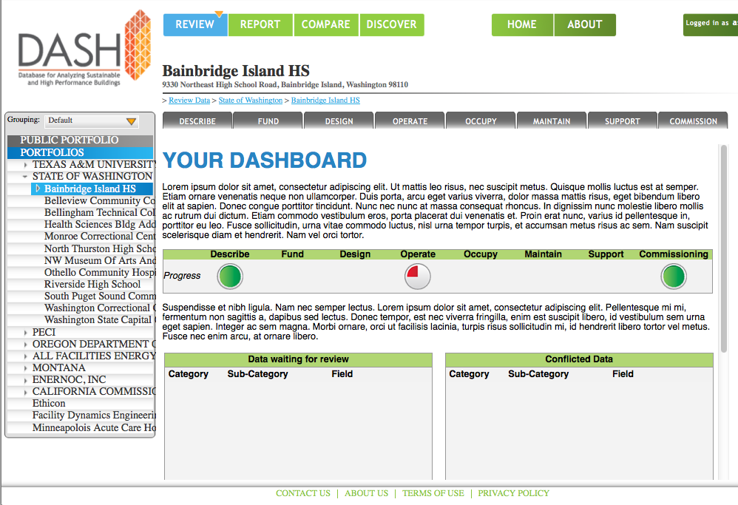
Review Dashboard

Slide 13
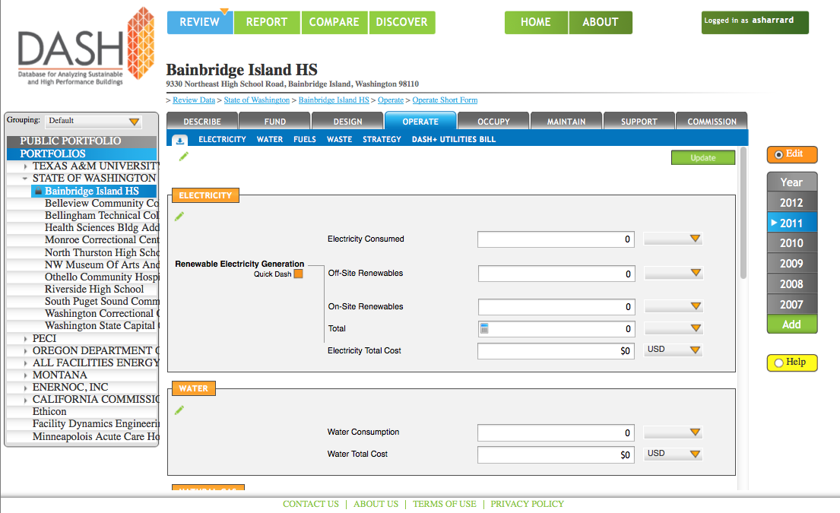
Operate Tab

Slide 14
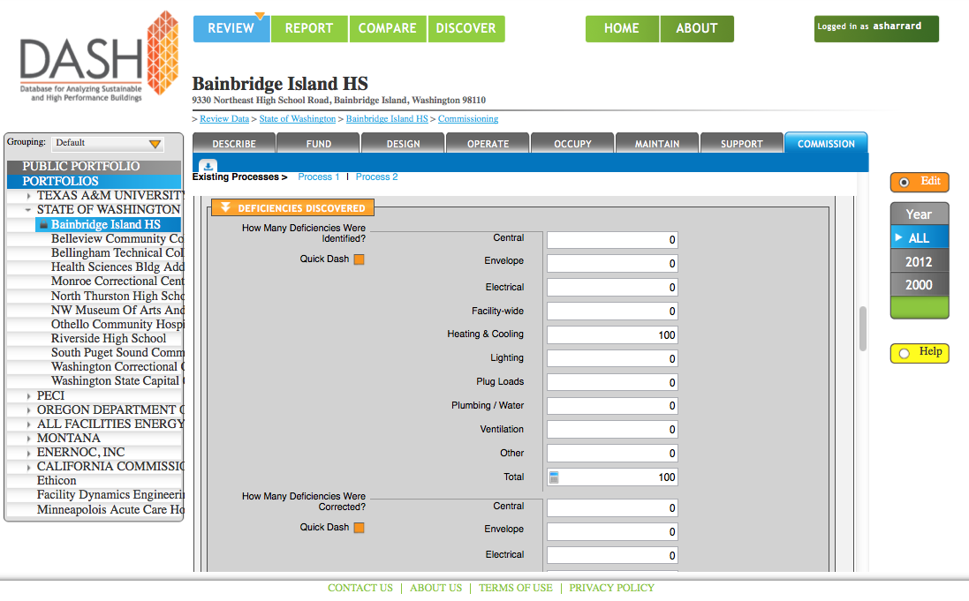
Commission Tab

Slide 15
Reports, Comparisons, Queries
REPORT: standard reports
  Global Cx (DASH and Cx module averages)
  Single-Building Cx (DASH, Cx aver. vs. your bldg)
  Single-Building (your building compared to DASH)
  Portfolio Comparison (portfolio compared to DASH)
COMPARE:
  Dynamic comparison of DASH database min, max, averages to your building
DISCOVER
  Dynamic query using user-defined filters (e.g., building size, type, location, vintage)

Slide 16
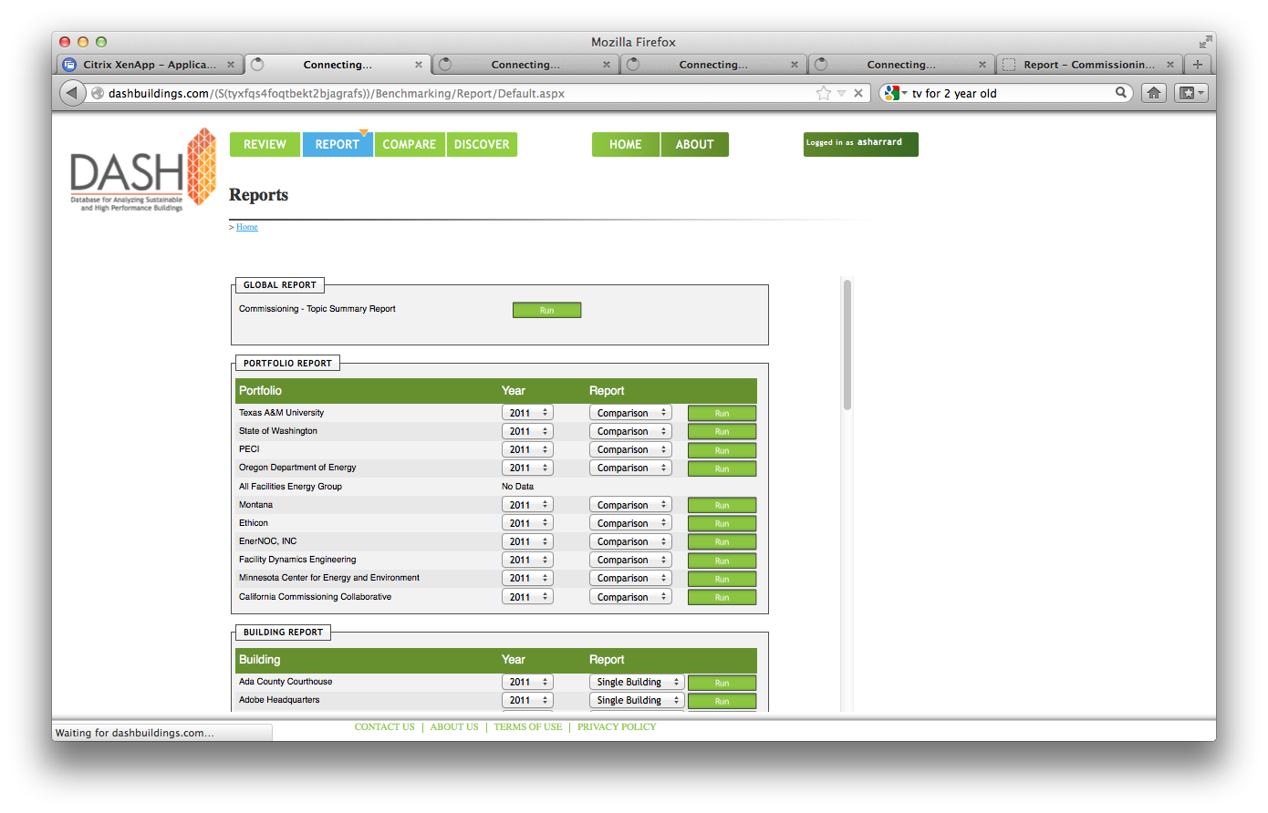
Reports

Slide 17
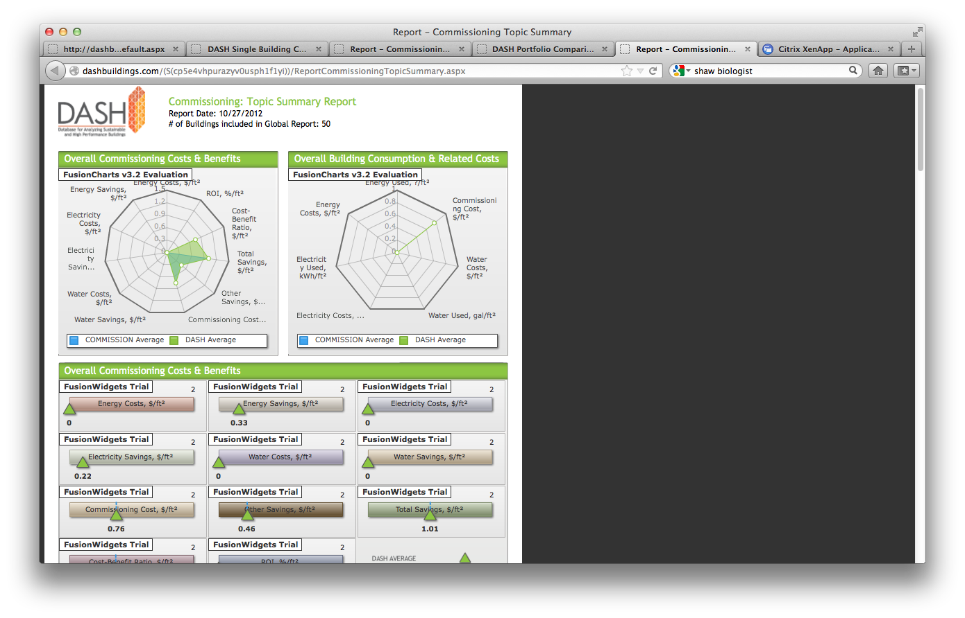
Global Commissioning Report

Slide 18
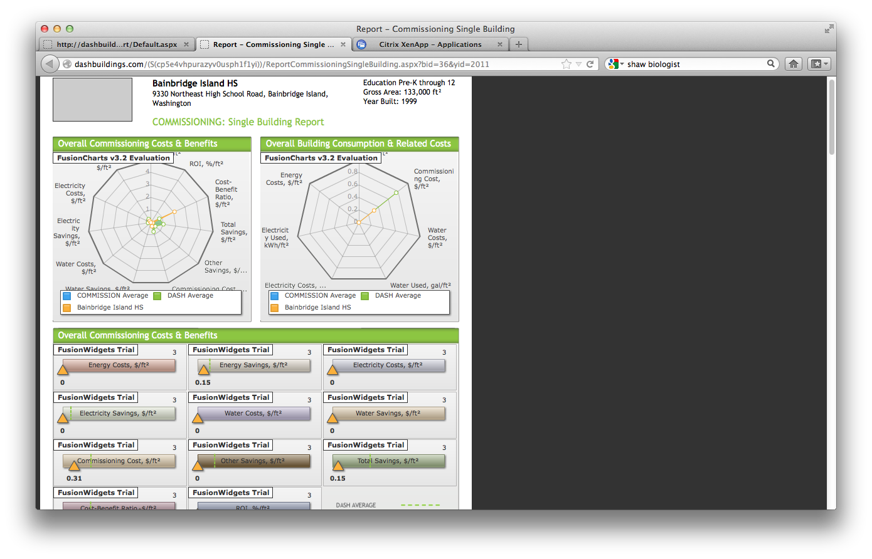
Single-Bldg Commissioning Report

Slide 19
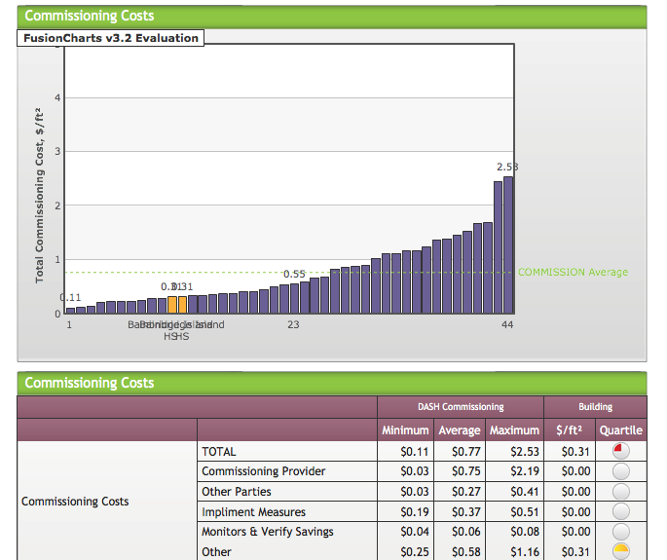

Slide 20
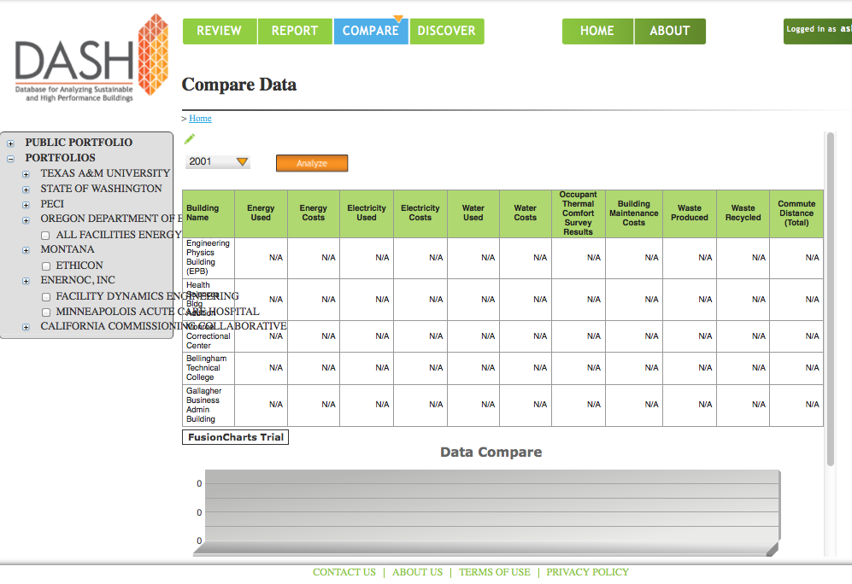
Compare Function

Slide 21
What’s Next?
GBA will manage continuing development
Alpha testing (internal) has begun at GBA, with TC 7.6 participating
Beta testing (external) of 25 buildings to follow
ASHRAE Role:
  Co-sponsor with GBA
  Active participants in testing and evaluation
  Technical resource for protocol development
  Active users for benefit of ASHRAE members
  Propose ASHRAE research as needed

