Slide 1
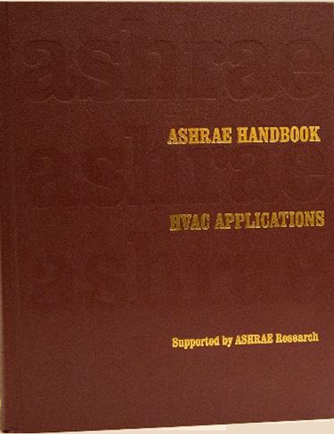
ASHRAE HANDBOOK
“Applications”
Moved to Chapter 20 in 2019 Publication
“Data Centers & Telecommunication Facilities”

Slide 2
NEXT UPDATE
2023 “Applications” Handbook
TC9.9 Responsible for Chapter 20
Revision Due Date: June 2022 Summer Meeting
  Approved at HQ
Approval by TC Board At or Before Toronto Meeting
Means Draft Revisions Completed by April 1, 2022

Slide 3
REVIEW PLAN
Each Topic in Each Chapter Section Has Been Reviewed
24 Authors & Reviewers Assigned To Date
  Several Have Already Started or Completed Their Edits
  Most Have Confirmed Access to ASHAE “Authoring Portal”
    Still Need Writers for Several Topics
    Need Secondary “Reviewers” for Many Topics
    May Also Need Writers for Those Remaining Unconfirmed

Slide 4
REVIEW PLAN

Slide 5
REVIEW PLAN

Slide 6
REVIEW PLAN

Slide 7
REVIEW PLAN

Slide 8
REVIEW PLAN

Slide 9
REVIEW PLAN

Slide 10
REVIEW PLAN
“Air Distribution” Presently Divided Into:
  Underfloor Air Delivery
  Overhead Air Delivery
Changing To:
  Underfloor Air Delivery
  Non-Raised Floor Air Delivery to Incorporate:
    Overhead Air Systems
    In-Row Cooling
    Side Wall Air Delivery

Slide 11
TOPICS NEEDING AUTHORS
ANSI/ASHRAE Std. 1360-2017
Printing & Tape Environmental Conditions
Table 3 – Workload Types

Slide 12
FINAL REVIEW PROCESS
Requesting Assistance in Reviewing Suggestions
  Will Want Subject Matter Experts to Review Selected Topics
  Asking for Two Board Members to Expedite Board Approval
  Asking Don Beatty for Final “Relevance” Review

Slide 13
UPDATE METHOD
Revisions Made Via ASHRAE “Authoring Portal”
  Now Works on ALL Browser Platforms Including MAC
    Contributors Must Be Registered by ASHRAE
    Can Work Simultaneously
      Most Recent “Save” Will Be Seen by Others
    All Work Must Use “Track Changes”
    New or Revised Illustrations are Submitted Separately
      Written Permissions Are Mandatory!!

Slide 14
VOLUNTEER PROCESS
  Topic Spreadsheet Posted on TC9.9 Website
    http://tc0909.ashraetcs.org/
    “TC 9.9 2022 Winter Meeting Presentations & Information”
  Select Review Topics by Spreadsheet Line Number
    Email to Bob McFarlane for Edit Permission:
    rmcfarlane@smwllc.com
  Include Name, Company and Email Address
  You Will Receive “SharePoint On Line” Email from ASHRAE
    Check Spam, Clutter, Promotions, & All Other “Junk Mail” Folders
    Confirm to Bob McFarlane You Have Received “SharePoint” Email

Slide 15

PLEASE SEND REQUESTS TO ME
AGAIN
  Please Advise Bob McFarlane
    For Edit Permission
    For Subject Matter Reviews
    rmcfarlane@smwllc.com
  QUESTIONS?

