Slide 1
TC 8.2 Vapor Compression Cooling and Heat Pump Chillers – Main Meeting
Las Vegas Winter- Hybrid Meeting
TC 8.2 Main Committee [Hybrid]: Monday, February 2,
2026, 2:15 – 4:15 PM PST
In Person Location: Caesars Palace Pompeian I (P)
If you are joining virtually, please use this link:
Join Zoom Meeting
https://us06web.zoom.us/j/88243353128?pwd=BWutbUJ3e8pgbypMVYMubRFhd2b7c1.1

Slide 2
Call to Order & ASHRAE Value Statement
In ASHRAE meetings, we will act with honesty, fairness, courtesy, competence, inclusiveness and respect for others, which exemplify our core values of excellence, commitment, integrity, collaboration, volunteerism and diversity, and shall avoid all real or perceived conflicts of interest. Our culture is one of inclusiveness, acknowledging the inherent value and dignity of each individual. We celebrate diverse and inclusive communities, understanding that doing so fuels better, more creative and more thoughtful ideas, solutions and strategies for the Society and the communities our Society serves. We respect and welcome all.

Slide 3
Agenda Review – T. Hunt
Introductions- please note what type of member you are & if you are a YEA &/or International Member for TC Activity Form (or write on sign-in sheet)
Quorum check – T. Abruzzo & Scott MacBain
TC 8.2 Mission Statement & Scope – T. Hunt
Reviewed/Approve Annual PHX 2025 Meeting Minutes – T. Hunt
Subcommittee Reports:
  Program – M. Rogan
  Research – D. Showalter
  Handbook – J. Medina
  Standards – P. Johnson
MTG Low GWP Liaison Update – P. Johnson

Slide 4
Agenda
Membership & Transition – T Abruzzo
Web Master – D. Kemper
Honors and Awards – R. Good
Chair’s Breakfast Report – T. Abruzzo
Old Business – T. Hunt
New Business – T. Hunt
For the Good and Wellbeing ….
Adjourn

Slide 5
Quorum Check – T Abruzzo
Voting Members
Trent Hunt
Tiffany Bates Abruzzo
Scott MacBain
Phillip Johnson
Jethro Medina
Mark Rogan
Daryl Showalter (virtual)
Dan Kemper (virtual)
Ray Good
Mike Dallon
Chris Miller
Mike Perevozchikov
Tom Watson
James Spalding (absent- replace with Peter Meece?)
Voting Members in attendance in person or online
13 Out of 14
Notes:
Updated 6/27

Slide 6
TC8.2 Vapor Compression Cooling and
Heat Pump Chillers Mission Statement
The Mission Statement of Technical Committee 8.2, Vapor Compression Cooling and Heat Pump Chillers is to provide world class technical expertise on all aspects of centrifugal refrigeration machines.
This committee is a resource to industry, academia, and others following society protocols through seminars, standards, technical papers/articles and other presentations.
The Scope of TC 8.2 is concerned with cooling and heat pump chillers that involves centrifugal or positive displacement compressors, including those with heat exchangers, drivers, controls, split evaporators and condensers, and other accessories.
Approved/ reaffirmed

Slide 7
Review and Approve Previous Meeting Minutes
2025 Annual PHX Hybrid Meeting Minutes- see attachment, basecamp, & TC 8.2 website
Documents | ASHRAE 8.2 Vapor Compression Cooling and Heat Pump Chillers
Approved? Notes?

Slide 8
Program Subcommittee Report – Mark Rogan (chair)
Combined TC 8.02/8.01 Program Subcommittee Report
2026 Winter Meeting, Las Vegas, NV
Subcommittee Meeting: January 26th, 3:00 pm -5:00 pm EST
Attendees: Mark Rogan, Tiffany Abruzzo, Daryl Showalter, Mathew Cambio, Justin Prosser, Michael Perevozchikov, Craig Bradshaw, Dan Kemper, Alex Schmig, Tiffany Abruzzo, Phillip Johnson, Farhan Jurati, Riley Barta, Jethrow Medina, Nicholas Zupp, Margaret Mathison, Erik Anderson, Yintao Wang, Bruno de Carvalho, Kalen Gabel, Andreas Hoess, Peter Meece, Sugun Tej Inampudi

Slide 9
Program Subcommittee Report – Mark Rogan (chair)
Future Program Ideas – Beyond Las Vegas
Electrification of Heating Chapter 2: Industrial and Healthcare Markets as well as Heat Recovery Applications – Chris Miller possible chair.(should have good jobsite data by June) Good candidate for Track # 8; Building Decarbonization.
Electrification of various Heating Applications and the challenges of capacity modulation using different compressor types: Which applications can be served by electrification today and which ones cannot. Rick Heiden as a potential chair. Potential speakers or chairs mentioned were Michael P and Matt Cambio. Good candidate for Track # 8: Building Decarbonization.
Application Issues with New Refrigerants and Indoor Chillers: Does Standard 15 (equipment room design) properly cover the flammability issue? Phil Johnson as a potential chair. Doing this program as a Panel was discussed and seems to make very good sense. Potential speakers? Good candidate for Track # 2: HVAC&R Systems and Equipment.
Decarbonization and District Cooling / Heating – Tiffany Abruzzo possible chair. Good candidate for Track # 8; Building Decarbonization. This potential program had a lot of discussion. Trent suggested possibly doing a case study around a new construction project called “Croix” in Salt Lake City. He mentioned that “Croix” is the developer and the engineer. It’s a small city I believe designed for district cooling. Jay Egg with Iatmo and Drew Turner were mentioned as possible speakers. Drew has done a similar project in Europe. It was also mentioned that it might be good timing because a new Standard 245P was just released covering district cooling design.
Applying Centrifugal Compressors to all Chiller Types. Oil Free Centrifugal Compressors increasing efficiency of Air-Cooled Chillers. Mark Rogan possible chair. Possible speakers mentioned: Ray Good, Tom Watson, Phil Johnson. Good candidate for Track # 2: HVAC&R Systems and Equipment.
Technologies for Data Center Cooling – Air-Cooled vs Water-Cooled : Possible Cosponsors 9.9, 8.1? Good candidate for Track # 2: HVAC&R Systems and Equipment
Service, Maintenance, & Troubleshooting of compressors including Scroll, Screw, Centrifugal, and Reciprocating Proposed by Joe Sanchez in SubCommittee meeting. Good candidate for Track # 4: Workforce Development
Update on ASHRAE Standard 30 – 2025. Proposed by Phil Johnson and potential chair or speaker. It’s also good timing since this standard was just updated and released in 2025. Other potential speakers? Good candidate for Track # 2: HVAC&R Systems and Equipment
Any other topic ideas? Open to the floor
Next Meeting
Subcommittee will meet via conference call in early June 2026

Slide 10
Program Subcommittee Report – Mark Rogan (chair)
2026 Annual Summer Meeting/Conference Austin, TX June 27th – July 1st :
Important dates:
Wednesday February 25th - Program Proposals Due
TBD - Program accept/reject notifications
2026 Summer Meeting/Conference Program Tracks Austin, TX
  Track 1 - Fundamentals and Applications
  Track 2 - HVAC&R Systems and Equipment
  Track 3 – Research Summit
  Track 4 – Workforce Development
  Track 5 – Ground Source Heat Pumps
  Track 6 – Hot Climate Building System Design, Operation, and Resilience
  Track 7 – AI in Building Design and Construction
  Track 8 – Building Decarbonization

Slide 11
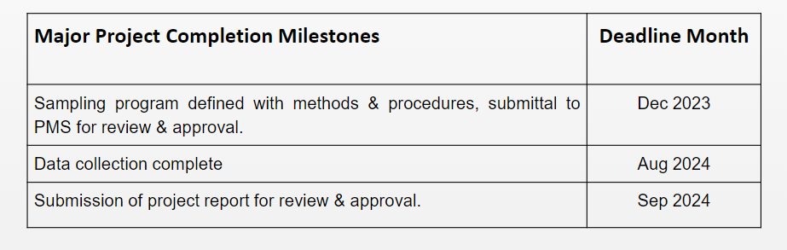
Research Subcommittee Report – Daryl Showalter (chair)
Current Activities
Research Subcommittee online meeting was held Feb 3rd,
Project update waiting on status
Project Status
1716 - Oil concentration of field-installed liquid chillers with flooded type evaporators.
  Project has been awarded. Philip Johnson is the chair.
  Project is stalled waiting on update from the project team.
  Of the 8 Chillers only on was found for testing.
  Project is Not Moving forward – ASHRAE Research has reached out no word back
Notes:
Updated 6/28

Slide 12
Research Subcommittee Report – Daryl Showalter (chair)
1793 - Development of Method of Test for Motor Component Thermal Conductivity
  TC8.1 is taking the lead on this one and will resubmit from the comments.
  This is now Dead and will be removed next time.
  This RTAR was paused by TC8.1 to prioritize AHRI Std 540.
1879 – Foamability properties of LGWP Refrigerant and Oil Mixtures
  Sponsored by TC3.4 and Co-Sponsored by TC8.1
  Craig Bradshaw was the PI – Matt Cambio reported
Notes:
Updated 6/28

Slide 13
Research Subcommittee Report – Daryl Showalter (chair)
  New RTAR ideas:
    TC8.2 Decarb in heating mode discussed
      Joe Sanchez also mentioned high temperature heat pumps – modeling- (RTAR initiated)
    TC8.2 What is the limit of high temperature heat pump vs. vapor recompression? (Bruno)
      Other novel architectures?
      What application 100, 150, 200C temperatures?
    TC 8.1 Davide & Craig submitting - Assessment of Extrapolation Capabilities and Uncertainty Quantification of Multi-Refrigerant Semi-Empirical Compressor Models TC 8.1
    TC 8.1 & 8.2 Effects of sub-atmospheric operation with low GWP, low ambient heat pumps. Leak rates and design suggestions (Matt / Daryl to follow up)
      System Contaminants
      Refrigerant breakdown
      Possibility of electrical arching in a vacuum
      Potential for combustion in the presence of oil
Notes:
Updated 6/28

Slide 14
TC 8.1 & 8.2 Handbook – Jethro Medina (Chair)
TC 8.1:
  Refrigeration: Chapter 8 - Factory Dehydrating, Charging & Testing
    2022 Last Publication: MacBain, Sanchez, Perevozchikov
    2026 – Vote to approve updates at TC 8.1 Meeting
      Scott MacBain, Florian Simon, Andreas Josef Hoess, Haotian Liu, Jethro Medina
TC 8.1 & 8.2:
  2024 HVAC Systems & Equipment: Chapter 38 and 43 – Compressors & Liquid Chilling Systems
    Chapter 38: Compressors | Chapter 43: Liquid-Chilling Systems (Robert Tucker, Andreas Hoas, & David Bradshaw will help)
    2028 Next Revision – Updates due in July 2027
  Volunteers for reviewing Chapters? Contact Jethro Medina (jethro.medina@chemours.com)

Slide 15
Standards Report
TC 8.2 Standards Subcommittee – Phil Johnson (chair)
TC 8.2 is the cognizant TC for:
  ASHRAE Standard 30-2025 Method of Testing Liquid Chillers
    [TC 8.2 is lead; TC 8.5 is co-cognizant]
  ASHRAE Standard 184-2020 Method of Test for Field Performance of Liquid-Chilling Systems
TC 8.2 also monitors activity for the following standards of interest to members:
  ASHRAE Guideline 22-2025 Instrumentation for Monitoring Central Chilled-Water Plant Efficiency
    [TC 9.1 is cognizant]
  ASHRAE Standard 23-2022 Methods for Performance Testing Positive Displacement Refrigerant Compressors and Compressor Units
  [TC 8.1 is cognizant]
ASHRAE Standard 90.1-2025 Energy Standard for Buildings Except Low-Rise Residential Buildings
    [TC 7.6 is cognizant]
ASHRAE Standard 196P Method of Test for Measuring Refrigerant Leak Rates
    [TC 3.1 is cognizant]
  ASHRAE Standard 205-2023 Representation of Performance Data for HVAC&R and Other Facility Equipment
    [TC 4.7 is cognizant]
  ASHRAE Standard 225-2020 (R2025) Method for Performance Testing Centrifugal Refrigerant Compressors and Condensing Units
  [TC 8.1 is cognizant]
  AHRI Standards 550/590|551/591-2023 Performance Rating of Water-chilling and Heat Pump Water‑heating Packages using the Vapor Compression Cycle
  AHRI Standard 1520-2022 Performance Rating of Centrifugal Refrigerant Compressors
  ISO TC 86 / SC 4 Testing and rating of refrigerant compressors (ISO/AWI 18501, 18483, 18976)

Slide 16
Standards Report
ASHRAE Standard 30-2025 (Nick Zupp, Chair SSPC30)
2025 edition published! (incorporates Addenda a, b, c, d, f, h, i to the 2019 edition).
Now developing addenda to ASHRAE Standard 30-2025 “Method of Testing Liquid Chillers” (designated as continuous maintenance)
2025-Jun-23 SSPC 30 meeting:
  AHRI has a test plan to collect test data for air sampler temperature array versus air sampler with aspirating psychrometer (for developing ‘Addendum e’, for the next edition). Contract in process. Test data collection pending.
  Voted in Orlando to recommend a seminar in Phoenix for ‘what’s new’ in Standard 30-2025.
SSPC 30 not meeting in Las Vegas (2026-Feb)
Next meeting: potentially a joint meeting with AHRI Chillers STC; waiting for air sampling array test data to schedule next meeting
Addendum a. Published in May 2020. Mainly clean-up including a requirement to test based on defined operating mode set points.
Addendum b. Published in April 2020. Mainly clean-up including clarification of Δp_{adj}. Republished to add missing calibration workbook (.xlsx).
Addendum c. Addition of adiabatic, free-cooling, and 4-pipe chillers by introduction of hybrid operating modes. APR1 Nov 2020. PPR1 public review May~Jul 2024. Published December 2024.
Addendum d. Published March 2024. Update to steady-state criteria.
Addendum e (for next edition). Harmonization with AHRI 550/590, Section 4. Addition of air sampling arrays. PPR1 public review possible in late 2025 after AHRI research data collection.
Addendum f. Published January 2023. Inclusion of AHRI 550/590, water pressure drop calculation tool.
Addendum g. Nomenclature to use for temperature differences (keep as-is or change). Advisory Public Review Jun~Jul 2024. Only 1 comment. SSPC30 decision to not change.
Addendum h. Miscellaneous changes, harmonization with AHRI 550/590. PPR1 public review Nov29~Dec 29 2024. One public comment received and resolved; will publish soon.
Addendum i. TPS changes, water to liquid. PPR1 public review Oct25~Nov24 2024. No public comments received. Published December 2024.
Notes:
Updaetd 6/27

Slide 17
Standards Report
ASHRAE Standard 184-2020 (Mark Rogan, Chair SPC 184)
Standard 184-2020 was published in November under periodic maintenance.
TC 8.2 decided and voted (7-0-0-1) in Tampa on 2023-Jun-26 to recommend forming a committee to revise the standard (e.g. additional work on the uncertainty calculator spreadsheet workbook). 5-year cycle would need to publish next edition by 2025 (-ish?), deadline to decide “withdraw, reaffirm, or revise” was 2023-Nov-30.
Periodic Maintenance Recommendation form submitted 2024-01-18. Standards Reaffirmation Subcommittee (SRS to StdC) approved recommendation. StdC approved ballot ending 2024-10-25.
Chair: M.Rogan. Initial SPC 184 roster approved by SPLS 2026-01-30, can now have a public call for members (can add more if needed).Planning to meet monthly between now and Austin conference.

Slide 18
Standards Report
ASHRAE Guideline 22-2025 (Daryl Showalter, Chair GPC22)
ASHRAE Guideline 22-2025 “Instrumentation for Monitoring Central Chilled Water Plant Efficiency” (designated as periodic maintenance)
New edition recently published, supersedes the 2012 edition

Slide 19
Standards Report
ASHRAE Standard 23 (Scott MacBain, past Chair SPC23)
Standard 23-2022 published “Methods for Performance Testing Positive Displacement Refrigerant Compressors and Compressor Units”.
TC 8.1 is cognizant. Currently there is no SPC 23. Intentions for 5 year cycle SRS form? (reaffirm, revise, withdraw).

Slide 20
Standards Report
ASHRAE Standard 225-2020 (R2025)
Staff (M.Weber) confirmed on 2025-06-12 that TC 8.1 is now the cognizant TC (again)
Standard 225-2020 was reaffirmed in 2025.

Slide 21
Standards Report
ASHRAE Standard 90.1-2025 (Rick Heiden)
Standard 90.1-2025 includes over 70 addenda to from the 2022 version. Publication expected in February.
New addenda (when published) are available at:
https://www.ashrae.org/technical-resources/standards-and-guidelines/standards-addenda
Addenda of interest (i.e. addenda to 2022 forming basis of 2025):
  L – net zero operational energy emissions (NZOEE), informative appendix that jurisdictions could adopt for buildings to achieve NZOEE over 1-3 code cycles. Includes chiller emission factors.
  AE – Unitary efficiency ratings; includes increased static and power from other operating modes and new metrics IVEC, IVHE, IVHE_{C}
  CN – Thermal Storage Energy Credits
    Added G010: HVAC Heating Energy Storage
    Added multipliers for heating and cooling unit type, Note: These should not be used as the sole criterion for system type selections!
  U – VAV Turndown – requires Multiple zone VAV airflow be capable of turning down to 15% without being limited by unit’s mechanical cooling, economizer or ventilation functions.
Discussion topics within the 90.1 Mechanical Subcommittee of interest to this committee
  Lower temperature heating water for heat pumps and boil

Slide 22
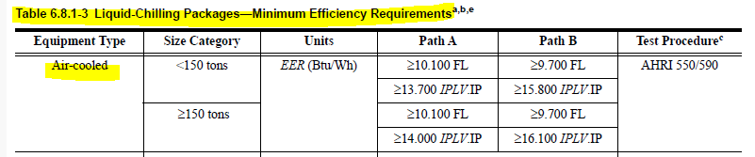
Standards Report
ASHRAE Standard 90.1-2028 (Rick Heiden)
Any update from TC 8.2 to 90.1 here?
Addenda when published are available at:
https://www.ashrae.org/technical-resources/standards-and-guidelines/standards-addenda
90.1 Mechanical Subcommittee Hydronics Working Group is developing 2028 work plan.
Requesting that TC 8.2 evaluate the potential for more stringent air-cooled minimum efficiencies.
  12 years since last update (2010 addenda into 2013 version)
  Current version, 90.1-2022 Table 6.8.1-3
  Experience of users/specifiers suggest industry opportunity to do better
  Leverage AHRI if possible
Any additional non-standard conditions deserving of new Kadj or rating segmentation
Notes:
TC 8.2 Vapor Compression Cooling and Heat Pump Chillers

Slide 23
Standards Report
ASHRAE Standard 196P (Phil Johnson, Chair SPC 196P)
Developing new document ASHRAE Standard 196 “Method of Test for Measuring Refrigerant Leak Rates”
As of 2023-Jun (Tampa), have reached consensus on resolving a fundamental question with the measurement method (under what range of conditions are ideal gas assumptions sufficiently valid), now need to implement the changes into the draft (and propagate changes into the examples in the informative appendices)
Committee expecting to have PPR1 around Q2 CY2026

Slide 24
Standards Report
AHRI Standard 1520 (Matt Cambio)
(Must finalize 225 1st )
AHRI Standard 1520-2022, Performance Rating of Centrifugal Refrigerant Compressors
This standard provides a rating method for centrifugal compressors and a calculation method to compare centrifugal compressors with positive displacement compressors.
A MatLab open-source tool is being created by Purdue for reading data and calculating performance as well as comparisons with positive displacement compressor 10 coefficient model
It is probable that a WG will be formed to review the standard to see how it’s working.
Would like to encourage use of the standard and participation in the next WG.
Additional Notes:
Reference to ASHRAE 225, Methods for Performance Testing Centrifugal Refrigerant Compressors and Condensing Units
Similar format to AHRI 540, Performance Rating of Positive Displacement Refrigerant Compressors and Compressor Units
AHRI Compressor Standards Technical Committee will maintain the standard (responsible for a total of 7 standards including 1520)

Slide 25
Standards Report
ISO/TC 86/SC 4 (Justin Prosser)
Key:
TC = Technical Committee
SC = SubCommittee
WG = Working Group
AWI = Approved Work Item
TC 86: Refrigeration and air-conditioning,
SC 4: Testing and Rating of refrigerant compressors
WG2: ISO 18501, Positive displacement refrigerant compressor (harmonizing: AHRI 540, EN 12900)
Published 2025-03
WG3: ISO 18483, Centrifugal refrigerant compressor (harmonizing: AHRI 1520)
Published 2025-04
WG4: ISO 18976, Testing of refrigerant compressors (harmonizing: ASHRAE 23 & 225, EN 13771-1, and withdrawn version of ISO 917)
Published 2026-01

Slide 26
TC8.2 Leadership Roles – T. Abruzzo July 1st 2026
Chair – Tiffany Bates Abruzzo
V Chair – Mark Rogan
Secretary – Scott MacBain
Handbook – Jethro Medina
Programs – Bruno Carvalho
Standards – Phil Johnson
Research – Daryl Showalter
Webmaster – Dan Kemper
Honors and Awards – Ray Good
MTG. LowGWP Liaison – Phil Johnson
MTG. LowGWP Alternate – Ray Good
Effective starting 2026 Annual Summer – Austin, TX
Notes:
Updated 6/27

Slide 27
Membership – Scott MacBain https://tpc.ashrae.org/Membership?cmtKey=83a02e09-1a12-4ee1-bbf8-3ba74490dec7
Updated 1/2026- PLEASE keep your bio updated & let us know if you want to get more involved
How to Import Your TC Roster Information into MS-Outlook - http://www.ashrae.org/TCs
Annual Meeting Attendance in PHX = 35 in room & 8 Virtual
Voting Membership:
Name | Voting Status | Committee Position | # Voting
Trenton Hunt | Voting | Chair | 1
Tiffany Abruzzo | Voting | Vice Chair | 2
Scott MacBain | Voting | Secretary | 3
Raymond Good | Voting | Mtg.lowgwp Alternate | 4
Phillip Johnson | Voting | Stds Subcom Chair | 5
Mark Rogan | Voting | Program Subcom Chair | 6
Jethro Medina | Voting | Hndbk Subcom Chair | 7
Daryl Showalter | Voting | Resrch Subcom Chair | 8
Dan Kemper | Voting | Webmaster | 9
Christopher Miller | Voting | Member | 10
Michael Perevozchikov | Voting | Member | 11
Michael Dallon | Voting | Member | 12
James Spalding | Voting | Member | 13
Thomas Watson | Voting | Member | 14

Slide 28
Webmaster – Dan Kemper
Needs to be Updated
General updates and maintenance
  Meeting time, current power point agenda and links posted
  Past agenda, minutes, and power point posted
  Updated scope and verbiage throughout website to reflect accordingly
Please send documents from 2025 seminars so they can be added to the presentations section of the website
https://tc0802.ashraetcs.org
Notes:
Updated 6/28

Slide 29
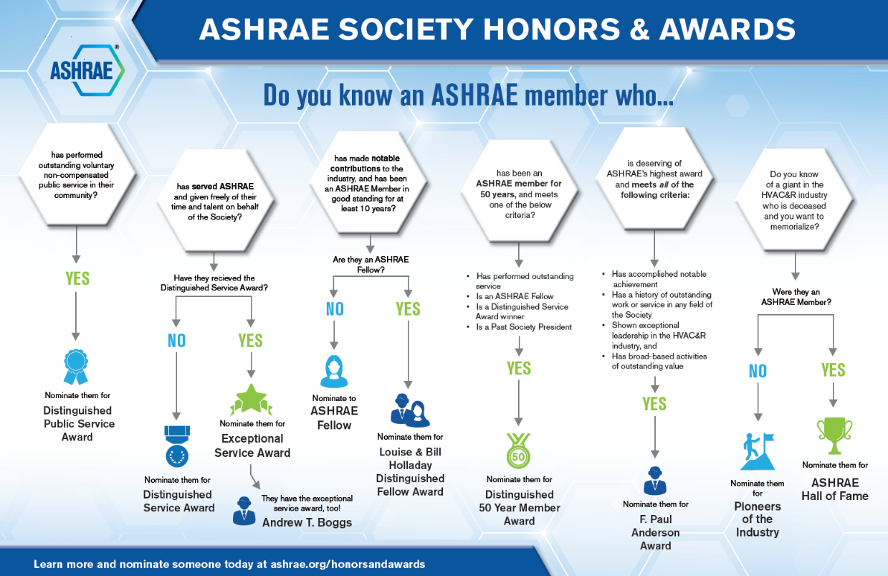
Honors and Awards Flowchart
Notes:
Flowchart is posted on the H&A webpage (www.ashrae.org/Honors) and available in printouts.

Slide 30
Honors and Awards – Ray Good Continued
Current Activities:
Encourage all members to update their ASHARE bios in an effort to qualify for additional honors and awards recognition
Consider others who may qualify as a Fellow or other awards

Slide 31
TC Chairs Breakfast Report – T. Abruzzo
Section 8 head- Kashif Nawaz (absent, Oakridge Nat. Lab)- Fill Out Activity Form
DEI- Devin Abellon- Belonging- Welcome/foster engagement of new members, be aware of unconscious bias, stronger together
Corey Metzger- Special Projects- funds for fast track/ special funding, keep relevant TCs involved
RAP- Chris Wilins & Roland Chauneux- RP strategic plan 2/3 mil/year & 100-350K/project, 40/50 I parallel, largest program by tech society in world, need to coordinate w/ Society SP- engagement survey- share link
Stanley Lee Global Committee- ISO map to TC’s/ ASHRAE- 5 US Tags
CEC- Kristen Cetin- new virtual papers- all ears for feedback/ content/ etc ~50% abstracts approved, Tues TC Program training- 11-12 Salerno
Alice Yates- GAC DC- what you do matters- thank you!
Jason Atleinson- Update Rosters by March 6th
Steve Hammerling- no more rooms at annual & winter for subcommittees- must do virtual- case by case if disagree- use basecamp & reach out to staff

Slide 32
Old Business – T. Hunt
None- continue to update roster & send programs & RTAR ideas to leadership please.

Slide 33
New Business – T. Hunt
Peter Meece- super critical & transcritical chiller info,
AHRI needs help, assumptions? Should it be an RTAR? Daryl to discuss- RTAR or seminar
Bruno- talk with 10.2

Slide 34
For the Good and Wellbeing & Action Items
Have a wonderful safe winter & spring full of safe travel, grandkids, weddings, & CRC’s
Action Items:
Update slides & get to Tiffany if you have not done so already
If your membership level needs to be changed- let Tiffany know
If you need help applying for DSA/ESA/or Fellow- reach out to Ray & Tiff
If your company can help with Air Source Chiller KW/ton & COP vs Ambient info- please fill out AHRI survey for 90.1 updates
If you want to speak in Austin let Mark & Tiffany know ASAP. Chair must confirm speakers, provide overall abstract & quiz questions, each speaker must provide bio and title & abstract of section

Slide 35
Adjourn
Adjourned at 4:15PM
THANK YOU ALL FOR ALL YOU DO FOR ASHRAE!!

