Slide 1
Energy Management
Executive Summary
Richard J. Pearson, P.E., ASHRAE Fellow
1
Notes:
Thank you very much. This presentation, first delivered at the Winter Meeting in January 2010, was prepared with help from TC committee.
This presentation is available in abridged version 1 hour for presentation at ASHRAE chapter meetings.
It is based on a three-hour version developed and presented at ASHRAE meetings and conferences.
We have updated slides that refer to DoE data, some details and screen shots of ENERGY STAR Portfolio Manager and several of the course examples and confirmed that web references are still validdicd.
1

Slide 2
Introduction to Energy Management
ENERGY STAR Guidelines for Energy Management
www.energystar.gov
!
Accountability
Notes:
The Jerry Eaton story makes the case for showing the Accountability Loop—between the executive or manager making the commitment and the person reporting on progress.
If you want a strong clue to whether management has made an effective commitment to energy management: find out who is ACCOUNTABLE for reviewing energy use and improving perfomance.
If NO ONE is accountable, then energy policy statements and other signs of management intent are preliminary.

Slide 3
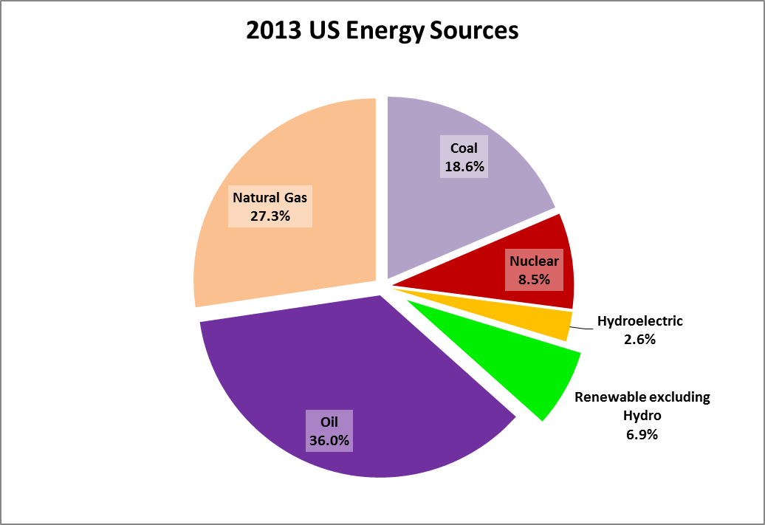
Renewables as an
Environmental Solution?
Why Commit to Energy Management?
Notes:
Here are the sources of energy in 2008 in the US. You can see at a glance that renewable energy is a small piece of the Energy Pie.
(source: Table 1.3 ”Primary Energy Consumption by Source, 1949-2009” Annual Energy Overview, http://www.eia.doe.gov/emeu/aer/overview.html)
The three largest components are fossil fuels, which when burned produce not only energy but greenhouse gases like carbon dioxide, CO2.
Fossil fuels dominate the present. Fossil fuels will dominate the next 20 years.
In this breakdown, Renewables excluding Hydro, is dominated by biomass, not PV and wind, the usual sources we think about when we hear the term “renewables.”
Renewables will not, in the short term, have much impact on climate and other environmental issues.
The mix of energy sources is not expected to change radically over the next few years.

Slide 4
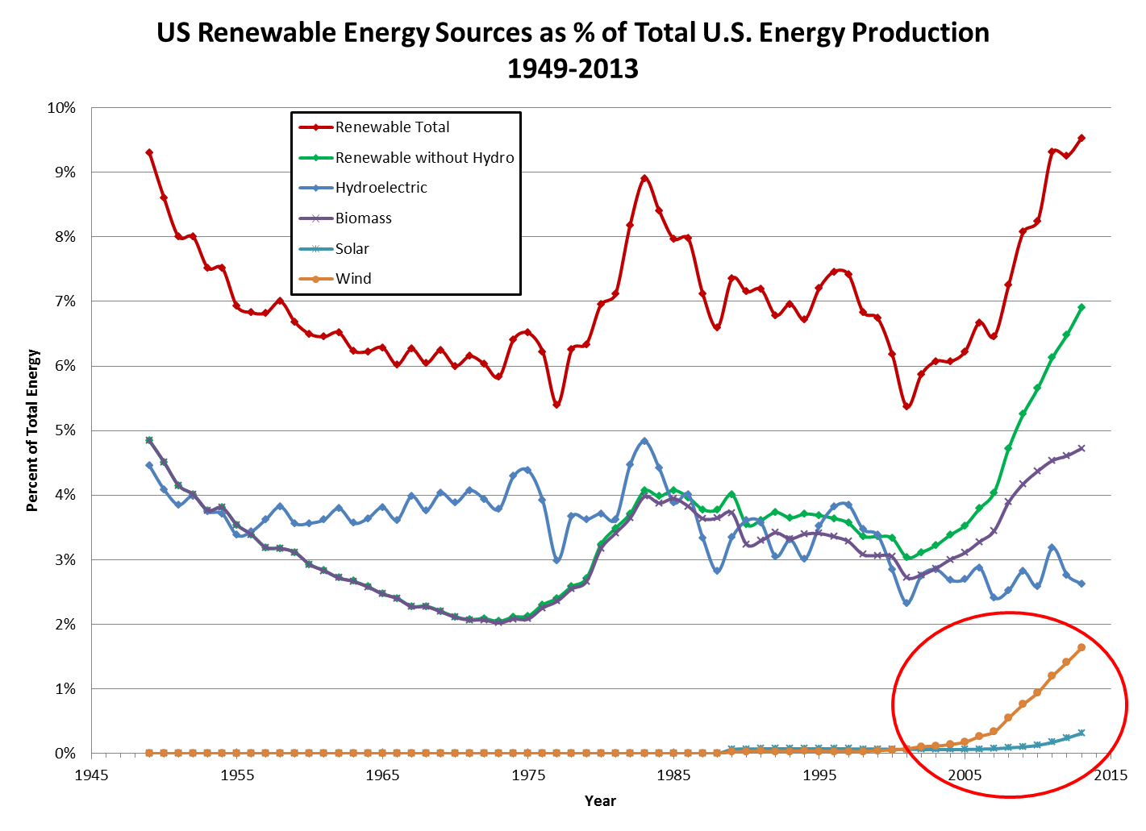
Renewable Energy Sources

Slide 5
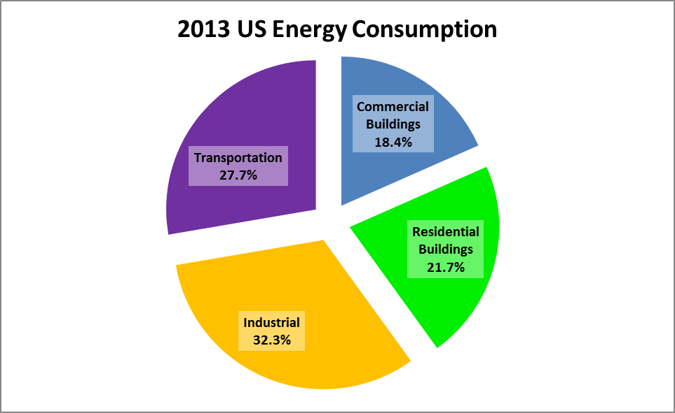
Where Do We Use Energy?
Why Commit to Energy Management?
Notes:
In this seminar, we are going to tackle energy use in buildings, there are also energy management opportunities in transportation and industrial sectors.
Source: 2008 Annual Energy Review, http://www.eia.gov/FTPROOT/multifuel/038408.pdf Figure 1.0

Slide 6
Why Commit to Energy Management?
Energy Management Potential
Buildings consume 41% of US energy
33% reduction of building energy is possible
This can save 14% of US energy
Notes:
We believe it is economically feasible to reduce energy use by 33% , not every building but in a portfolio of buildings, on average.
33% reduction of 39% of U.S. Energy= 13% savings potential FOR RESIDENTIAL AND COMMERCIAL.
The arithmetic in this slide derives from 2006 statistics. The near term forecasts do not change the story.

Slide 7
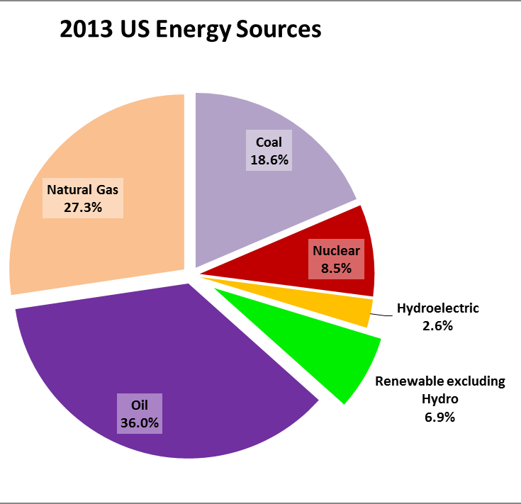
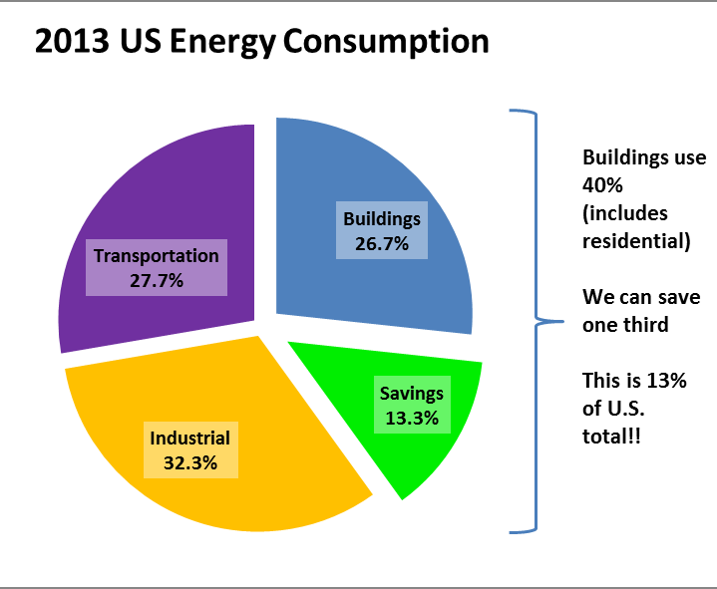
Why Commit to Energy Management?
Energy Management is the Quickest, Cheapest, Cleanest Way to Extend World Energy Supplies
Energy management can provide 2.5X
the environmental impact of renewable energy
Notes:
If you pull the information in the previous slides together, we get to this conclusion:
Energy Management is the Quickest, Cheapest, Cleanest Way to Extend World Energy Supplies.
Comparing the savings with renewable energy, the most effective thing we can do is attack wasted energy and save.
We are not denigrating renewable energy but rather observing that we have tremendous potential in the buildings we have.
Energy management implies you will learn how to use energy more intelligently in your buildings, reducing waste and assuring that changes to procedures and equipment yield their potential.
The 14% national impact provides an achievable percentage of energy savings from work with existing buildings, derived from our estimate of 33% savings in building energy use—though there are diminishing returns as you tackle opportunities (the first 5% is usually less costly than the last 5%).
Another way to look at the same figures: if you make more effective use of energy derived from fossil fuel, the % of the energy pie contributed by renewables goes up, even if no more renewable production is added. Reducing the use of fossil fuels increases the relative impact of renewables.

Slide 8
Why Commit to Energy Management?
Greener Pastures with Energy Savings
Emissions Reduction at Madison Area Technical College
Energy | Usage FY 01/02 | Usage FY 06/07 | Usage FY 10/11 | Annual Reduction!
Electricity | 23,000,000 kWh | 18,000,000 kWh | 14,700,000 kWh | 8,300,000 kWh
Natural Gas | 900,000 therms | 645,000 therms | 443,000 therms | 457,000 therms
Emissions | Emissions FY 01/02 | Emissions FY 06/07 | Emissions FY 10/11 | Annual Reduction!
Carbon Dioxide | 25,000 tons | 19,000 tons | 15,000 tons | 10,000 tons
Sulfur Oxides | 58 tons | 45 tons | 37 tons | 21 tons
Nitrogen Oxides | 30 tons | 23 tons | 18 tons | 12 tons
Source: Madison College Engineering Manager – Wesley Marquardt – wmarquardt@madisoncollege.edu
For 50 state emissions online calculator, refer to Leonardo Academy ‘s webpage:
http://www.cleanerandgreener.org/resources/pollutioncalculator.html
Easier than ever to do these calculations!
Notes:
This slide illustrates the conversion of energy savings into environmental impact.
You can convert savings of energy into emissions using factor tables produced by the EPA and the Department of Energy.
The calculations of emissions in this slide come from Emissions Factors and Energy Prices for the Cleaner and Greener Environmental Program
http://www.cleanerandgreener.org/download/efactors.pdf which has emissions factors by state.
Also, the EPA eGRID program has similar information, on a state by state and power plant basis, http://www.epa.gov/cleanenergy/energy-resources/egrid/index.html
ENERGY STAR’s Portfolio Manager on-line program will calculate the emissions for your buildings automatically so you can let ENERGY STAR do the emissions arithmetic for you! We’ll discuss the Portfolio Manager tool later this morning.
The impact on environmental emissions is impressive, equivalent to more than 800 kW of PV production in the upper Midwest.
MANAGEMENT NOTE: Wes reduced the energy use in the face of increased program demand and increased square footage.

Slide 9
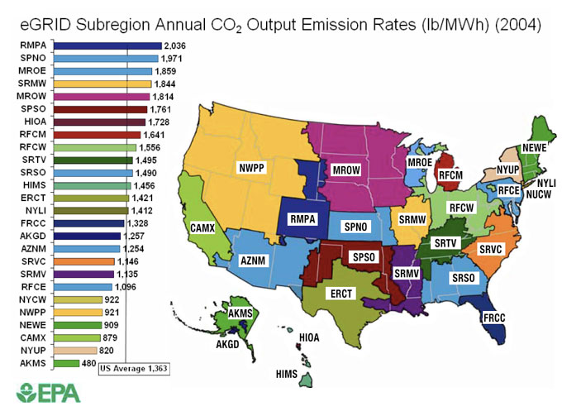
Why Commit to Energy Management?
Carbon Emission eGrid Regions
EnergyStar – Carbon Emissions from Building Energy Use http://www.energystar.gov/index.cfm?c=evaluate_performance.bus_portfoliomanager_carbon

Slide 10
Why Commit to Energy Management?
AK, WA, WI Comparison
State | Associated eGrid Region | CO₂ Emission Rate (lb/MWh) | Power Generation Notes
WI | MROE | 1,859 | >50% coal generation
WA | NWPP | 921 | 75% hydro
AK | AKMS | 480 | 60% natural gas, 20% hydro
Reducing electric usage in WI can have a much greater impact on decreasing CO₂ emissions than similar reduction measures in other parts of the country!!

Slide 11
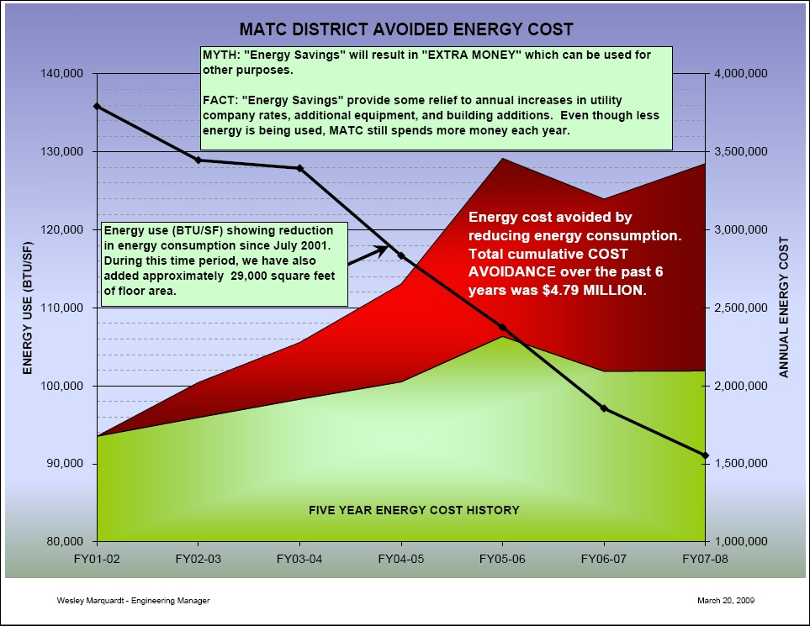
Used with permission
Notes:
This is a key slide for your understanding. The MYTH described by facilities manager Wes Marquardt is believed by many people and can be a huge source of argument and disappointment. You need to understand the difference between “extra money” and “avoided costs.”
Your energy savings may not yield extra dollars to spend--the savings may only have avoided even higher bills.
You see the EUI (kBTU s/f) dropping steadily across the six year period. Energy bills (green shaded area) keep rising!
Over the six year period, energy costs per BTU rose about 40%.
Cost Arithmetic
Electric Utility rate 2001: .0508 dollars per kWh
Electric Utility rate 2006: .0747 dollars per kWh (source Madison Gas & Electric Company rate sheets)
Natural gas prices:
2001/2 average 0.60 dollars per therm
2006/7 average 1.0 dollars per therm
(source http://tonto.eia.doe.gov/dnav/ng/hist/n3020wi3m.htm )
Energy prices increased close to 40% over four years.
In the analysis, current dollars were used. Adjusting for inflation (putting all dollars on the same basis) can help make financial analysis more meaningful.

Slide 12
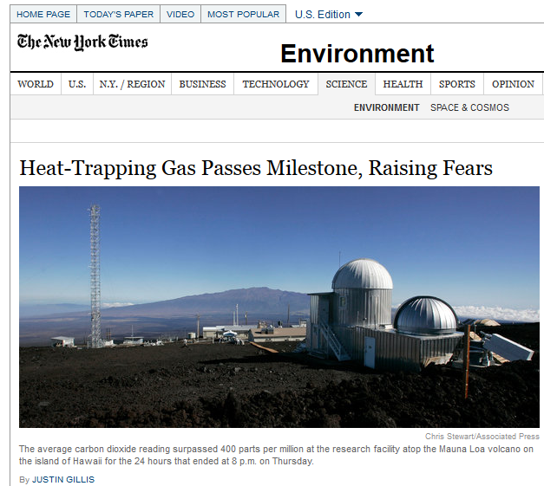
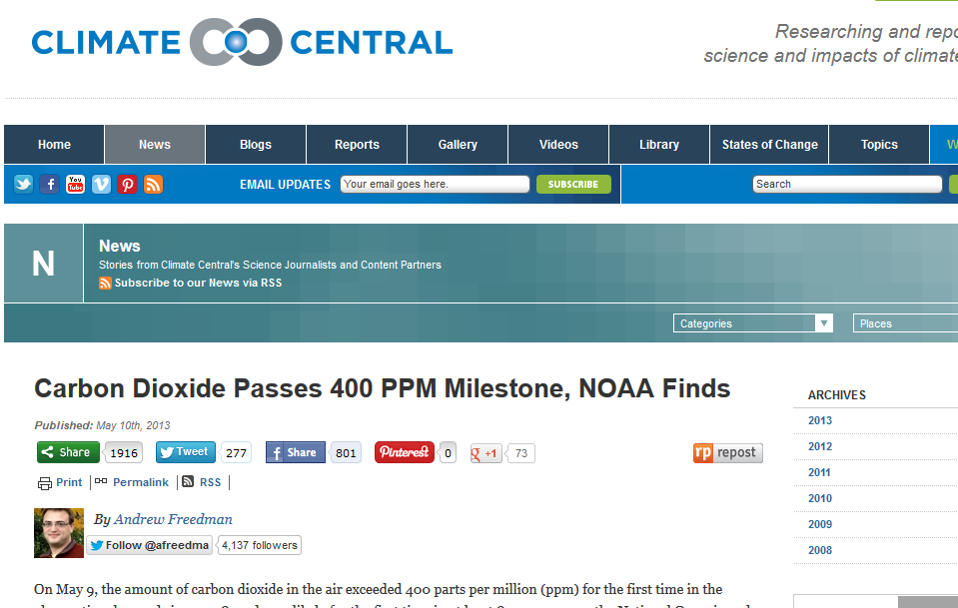
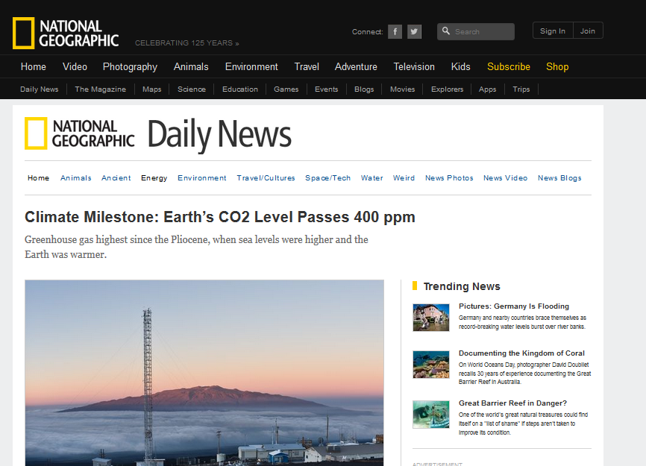
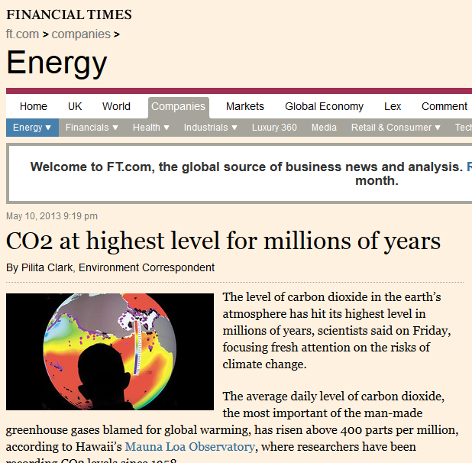
Global CO₂ Levels Exceed 400 ppm

Slide 13
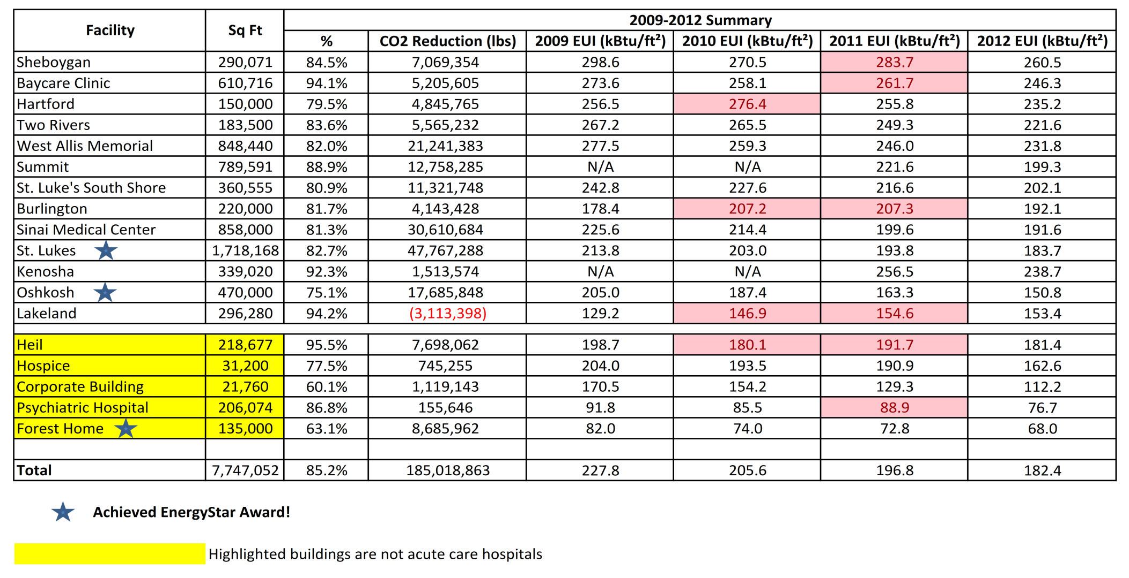
Evaluating Progress
Aurora Health Care 2009-2012 Utility Summary
NEW
Savings:
14.8% reduction in energy usage
185,018,863 lbs. reduction in CO₂ emissions

Slide 14
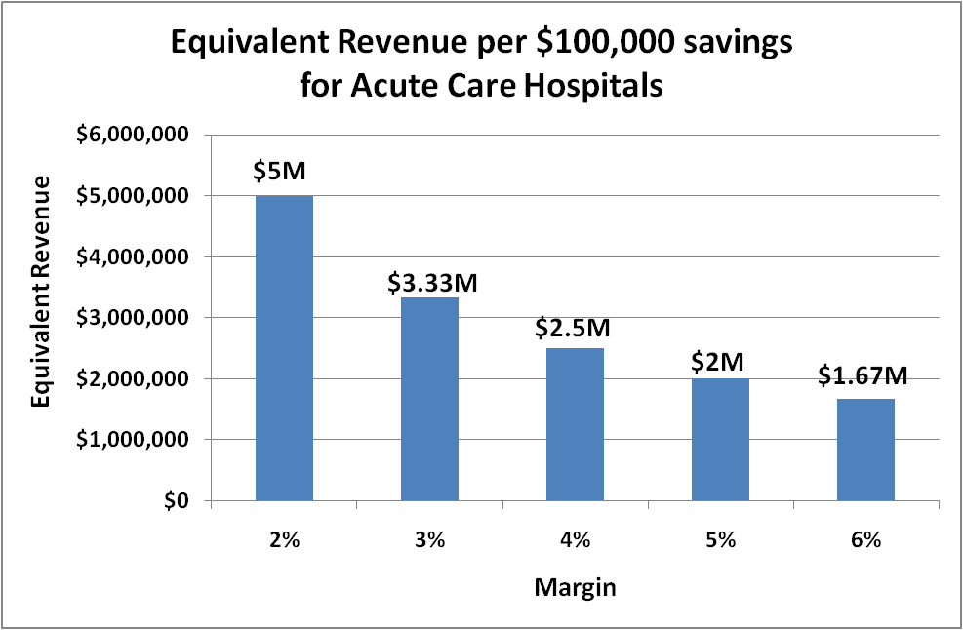
Evaluating Progress
Source: Corporate Realty, Design, & Management Institute

Slide 15
Aurora Health Care Equivalent Revenue Using a 4% margin
Evaluating Progress
2009 – 2012 Total Energy Savings (weather-normalized)
Total Savings = $8,665,000
$8,665,000 ÷ 0.04 (margin) =
$216,625,000 equivalent revenue
$216,625,000 ÷ 4 years =
$54,156,250 equivalent revenue per year

Slide 16

Re-cap and Send-off
Remember to Monitor!!
Notes:
Our final word: Buildings are like small children: if you don’t watch them, they will wind up doing the strangest things!
So monitor performance—you have learned the basic elements of monitoring performance today and we expect to hear great things from you about your accomplishments!

