Slide 1

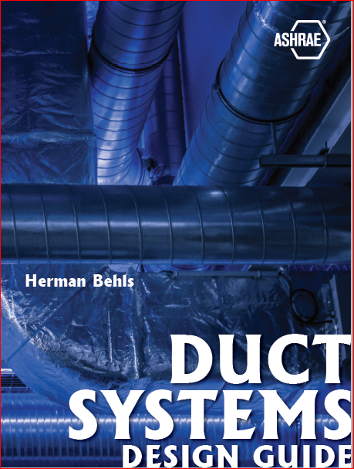

Presenter: Larry Smith, P.E.
Notes:
Welcome to our 1-hour program introducing the soon to be published Duct Systems Design Guide
During this presentation we will give you a brief introduction to materials and a deep dive into fundamentals
Please enter any questions you have to the meeting moderator, and if we have time, we will respond at the end of the presentation or by return email.

Slide 2

Herman Behls
Notes:
The primary author for the Duct Design Guide is Herman Behls to whom this design guide is dedicated
This design guide is the embodiment of Herman’s quest for knowledge and his legacy was his willingness to share his expertise with anyone who wanted to learn from a true teacher, friend, and mentor

Slide 3
The information detailed in this guide is useful for entry-level engineers and designers who are first learning about duct design fundamentals and serves as a tool for more experienced engineers and design professionals wishing to refresh their design knowledge.
Notes:
In one of the many iterations of the duct design guide Herman struggled to determine the audience the duct design guide should address
Herman believed the future of ASHRAE was the young engineers within the ASHRAE organization and felt a need to focus on that particular audience
The final product is not the Duct Design Guide for Dummies, however, it is structured in a manner that both the beginner engineer and a seasoned professional can gain a broader and deeper insight to the art and science of good duct design

Slide 4
Table of Contents
Preface
Introduction
Duct Design Fundamentals
Duct Design Considerations
Duct Design – Equal Friction
Duct Design – Static Regain
Duct Design – Local Exhaust Systems (Constant Velocity)
Fan-Duct Interaction
Duct System Materials and Construction
Duct System Acoustics
Notes:
The Duct Design Guide is broken down into eight individual chapters
For the more advanced engineer, Chapter 8 on Duct System Acoustics, contains a compendium of information in a well organized and logical manner for good duct design or solving an existing noise issue
For the inexperienced engineer Duct Design Fundamentals would be a logical place to start.

Slide 5

Structural
Thermal
Acoustical
Conveyed Substances
Environmental
Visual
Fibrous Glass
Phenolic Foam
Flexible Ducts
Textile Air Dispersion Systems
Notes:
Chapter 7 is broken down into 10 sections of which I am only going to touch on a single topic you will not find anywhere in the realm of good duct design!

Slide 6
Functional requirements limiting the allowable deflections, material stresses, objectionable self-generated noise and vibration, air leakage, dimensional stability, and other construction considerations are the underlying basis for various available duct construction standard.
Notes:
ALL duct construction standards are base on functional requirements so that the duct systems performs as one would expect
In simple terms you would not want the duct to burst under the operating pressure and leak a large volume of air.

Slide 7
Duct specifications delegate design to one or more standards or references. Designers should familiarize themselves with the specifics and limitations of any reference they cite.
How do you resolve?
Specifications are often inadequate for nonstandard applications and multiple references may contradict each other.
References can also conflict with the specifications and drawing notes and/or details.
Notes:
As a good duct designer you will reference several different duct construction standards, however, chaos may prevail when one standard conflicts with another, your specifications, or drawing notes.
For special applications the existing construction standards may be insufficient to provide the necessary guidance for a delegated design.
CLICK
HOW DO YOU RESOLVE?

Slide 8
Specify which portion of a reference applies to a project, as the references usually cover a broad range of application
Clearly specify that the more stringent requirement must be provided!
Notes:
The more difficult path to take is to specify only the portion, or portions of the referenced standard, that applies to your specific project, or
CLEARLY SPECIFY THAT THE MORE STRINGENT REQUIREMENT MUST BE PROVIDED!

Slide 9

Notes:
I will now turn the presentation over to Dr. Steve Idem to discuss Duct Design Fundamentals.

