Slide 1
Seminar 53: HVAC&R Novel Measurement Techniques:
The Next Generation
Brian M. Fronk, PhD, PE (OR)
Oregon State University
Brian.Fronk@oregonstate.edu
CP 71: Exploring the Potential of Distributed Fiber Temperature Sensing in HVAC&R Applications

Slide 2
Learning Objectives
Objective 1: After attending this session, the attendees will be able to...
Explain high level operating principles of fiber optic temperature measurement techniques
Objective 2: After attending this session, the attendees will be able to...
Understand currently used and new techniques to determine average and local air-side heat transfer coefficients
Objective 3: After attending this session, the attendees will be able to...
Obtain an understanding of the different measurement methods that can be used for refrigerant and oil charge measurements
Objective 4: After attending this session, the attendees will be able to...
Explain the relationship between the measured capacity and the void fraction

Slide 3
Acknowledgements
Tabeel A. Jacob – Oregon State University

Slide 4
Outline
Motivation
Principles of Operation
Review of Related Applications
Experimental Demonstration
Challenges and Conclusions

Slide 5
Motivation
Temperature sensing critical for HVAC&R research
Distributed temperature provide value
  Duct air flow (cross section)
  Temperature along a pipe
  Surface temperature evaporator/condenser coil
  Compressor, tubing, etc.
Sensors limited by space and cost
Replace many thermocouples with single fiber optic sensor!

Slide 6
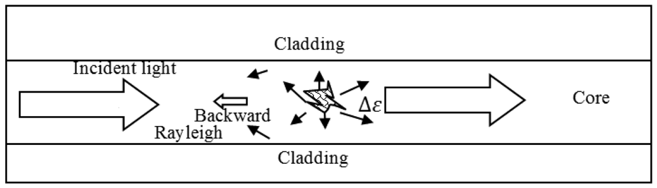
Principles of Operation
Bao and Chen (2012)
Commercial, silica glass fibers used as sensor
Rayleigh backscatter due to intrinsic scattering (elastic)

Slide 7
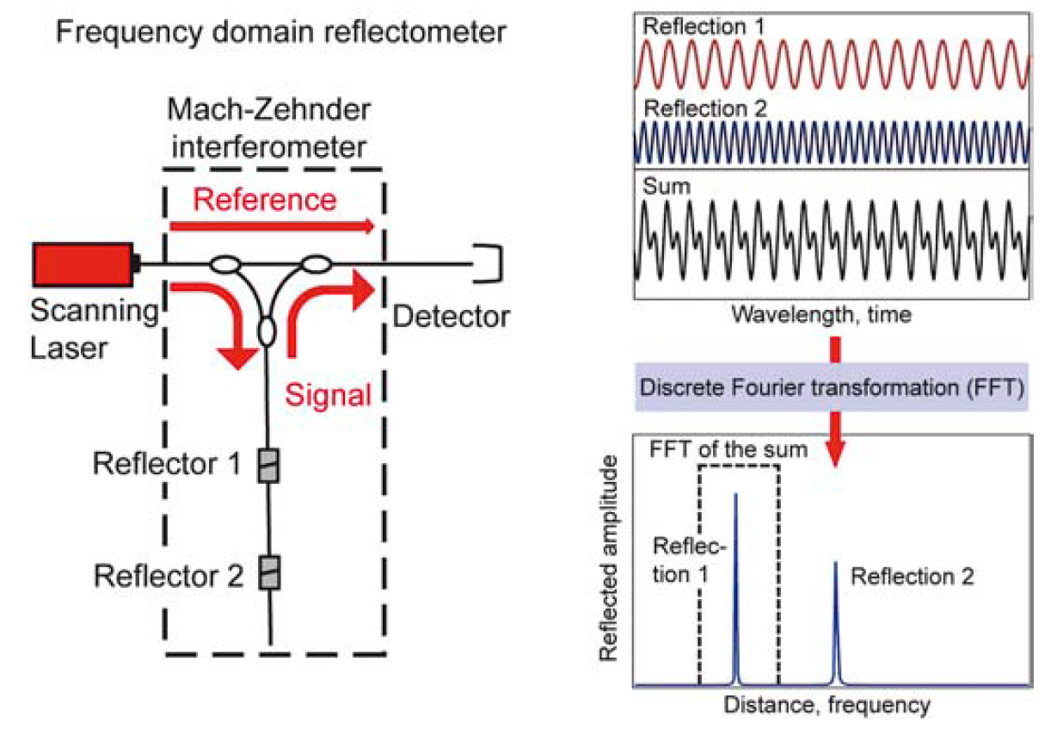
Principles of Operation
Samiec (2012)

Slide 8
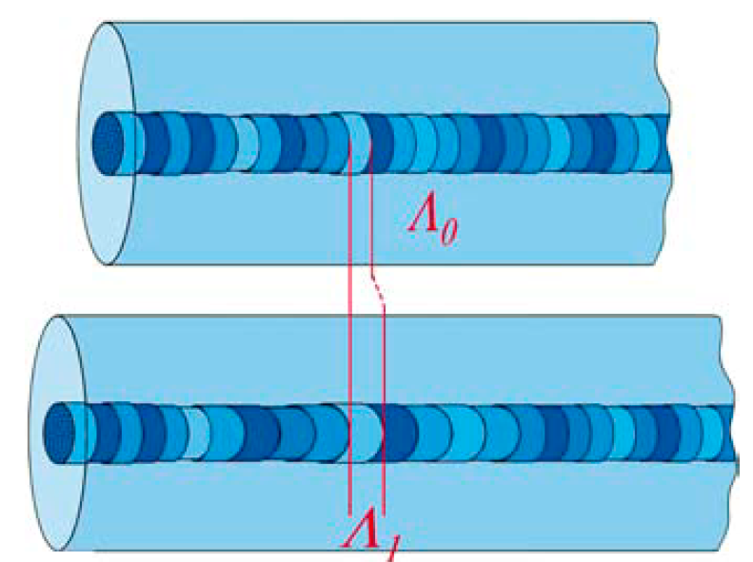
Principles of Operation
Samiec (2012)
As temperature increase, scatter sites move apart and detected interference frequency change
New FFT compared to baseline (at known temperature)
Maximum resolution correlated to wavelength range of laser

Slide 9
Related Applications - Strain
Strain is directly measured parameter
  Concrete
  Structures
  Flow structure interaction
Must isolate mechanical and thermal strain

Slide 10
Related Applications - Temperature
1 m = 1000 mm
1 m = 3.28 ft
mm
mm
mm
mm
mm
Lomperski et al. (2012)
40 m long sensor (16 rows 51 mm apart)
Map temperature of mixing air jets for nuclear power
Uncertainty due to vibrations (dynamic strain) and humidity

Slide 11
Related Applications - Temperature
All dimensions in mm
Lomperski et al. (2017)
Methods to reduce vibration:
  Decrease sensor and/or gauge length
  Add support structures
  House in rigid capillary
Difficulty in calibration (in-situ point calibration)

Slide 12
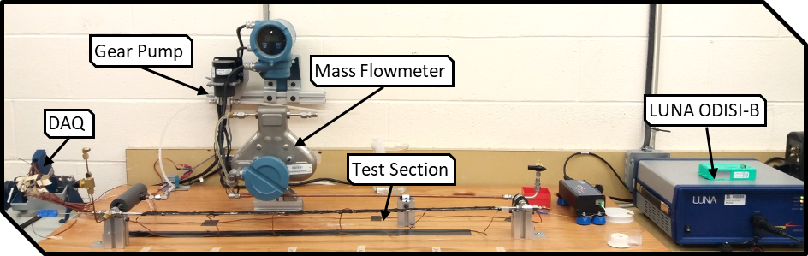
Experimental Demonstration – Surface Temperature
Optical Interrogatorl
Spatial Resolution | 0.65 mm | 0.0256 in
Temperature Resolution | 0.1 °C | 0.18 °F
Range | -40 °C to 220 °C | -40 °F to 428 °F
Repeatability of each sensor | ±0.06% | -

Slide 13
Experimental - Demonstration Surface Temperature
3.28 ft
104 °F
86 °F
3.28 ft
122 °F
104 °F
3.28 ft
140 °F
122 °F

Slide 14
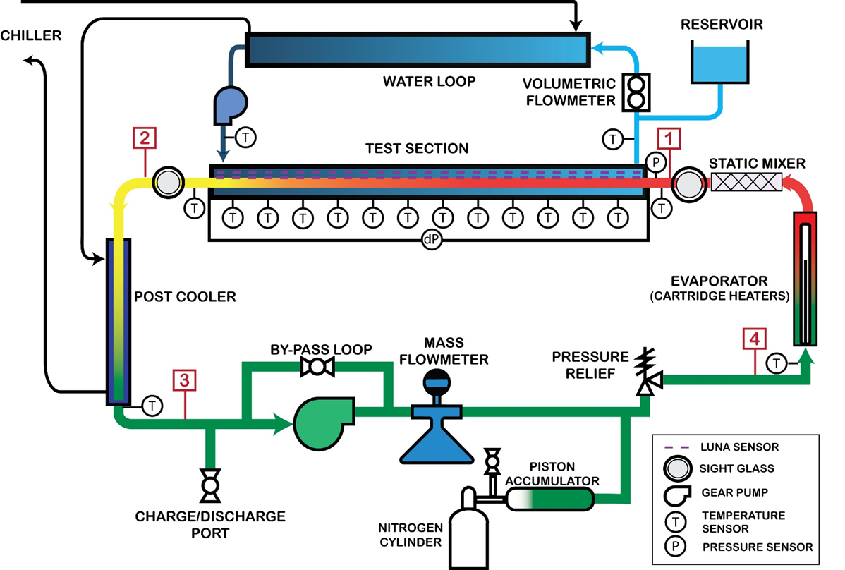
Experimental Demonstration – Coolant Temperature

Slide 15
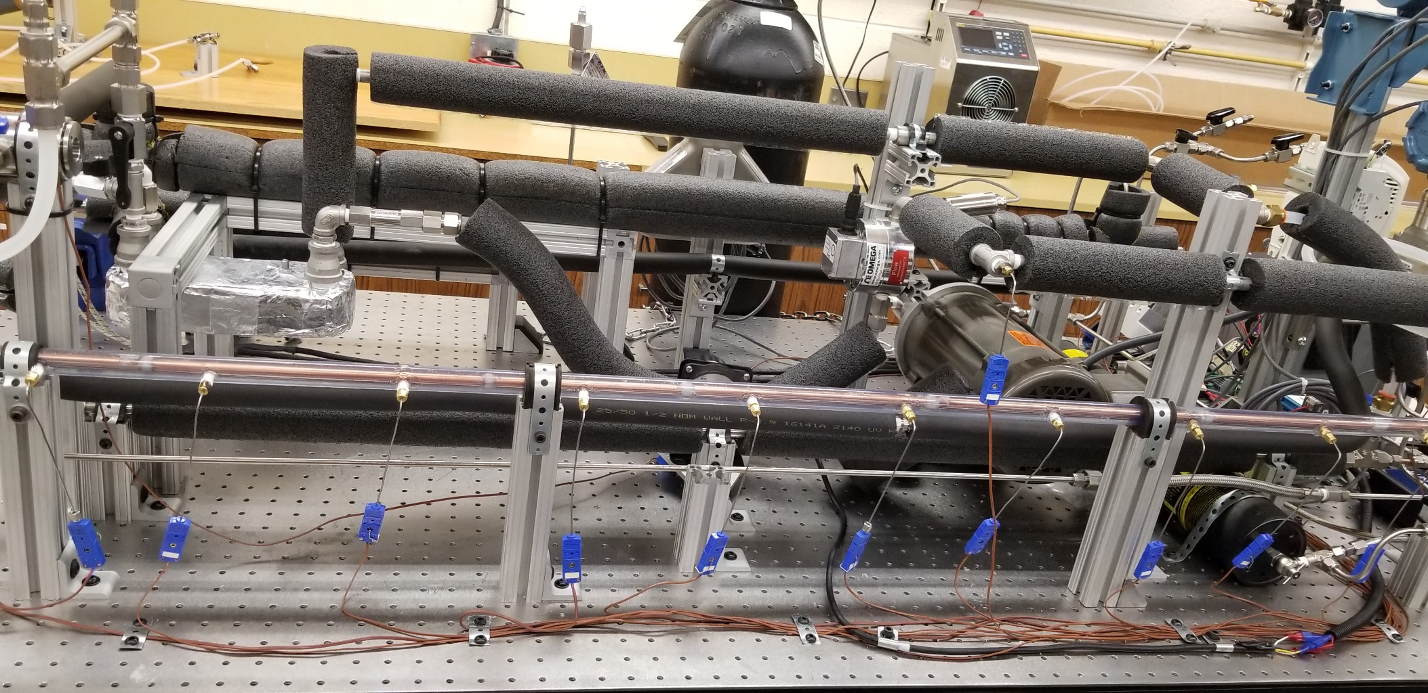
Experimental Demonstration – Coolant Temperature

Slide 16
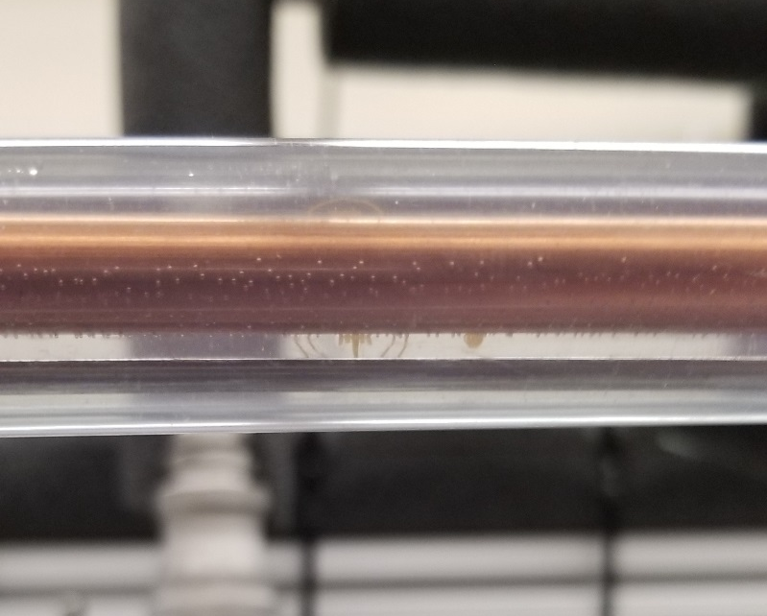
Experimental Demonstration – Coolant Temperature
FIBER SENSOR

Slide 17
Experimental Demonstration – Coolant Temperature
86 °F
86 °F
32 °F
32 °F
4.92 ft
4.92 ft

Slide 18
Conclusion
Fiber sensors offer intriguing possibilities for HVAC&R
Need to manage sources of uncertainty
  Vibrations (flow, equipment other)
  Isolate thermal/mechanical strain
  Humidity/other chemical interactions
Must work on calibration/uncertainty analysis
Ongoing work to apply to condensing zeotropic flows

Slide 19
Bibliography
Bao, X. and Chen, L. 2012. Recent progress in distributed fiber optic sensors. Sensors, 12(7):8601-8639.
Lomperski, S., Bremer, N. and C. Gerardi. 2017. Distributed temperature sensing inside a 19-rod bundle. Nuclear Engineering and Design, 319:201–209.
Lomperski, S., Gerardi, C., and W. D. Pointer. 2015. Fiber optic distributed temperature sensor mapping of a jet-mixing flow field. Experiments in Fluids, 56(3):1–16
Samiec, D., 2012. Distributed fiber-optic temperature and strain measurement with extremely high spatial resolution. Photonik 2012, pp.10–13.

Slide 20
Questions?
Brian M. Fronk
Brian.Fronk@oregonstate.edu

