Slide 1

Welcome!
Welcome to the ASHRAE TC 9.9 Hybrid In-Person/Virtual Meeting!
No need to say hello, we will begin promptly at 2:30 pm CST
High Level Agenda
  Welcome
  Hybrid Meeting Etiquette
  Introductions
  Membership
  Title, Purpose & Scope
  Liaison Reports
  Research
  IT Subcommittee
  Publications Work Session
Housekeeping
Audio
Attendees are muted upon entry
Do not un-mute your line
If you are joining via computer and phone line, ensure both are muted
Video
We encourage you to keep your video off
If you do enable your video, be mindful that you are on display! Turn off your video when needed.
Q&A
Use the chat function to ask questions
Our moderator will share questions throughout the presentation with the speaker to answer.
If you need to speak, please use the Raise Hand button and the moderator will enable your microphone.
Attendance
Please complete the attendance form found at the URL at the bottom of this slide or use the QR code below.
1/22/2024
Content Copyright TC 9.9. All Rights Reserved.
Attendance: https://forms.gle/wjboSPgW6yQecKsW8
‹#›
Notes:
Make this statement at the very beginning and re-state every minute or so until the meeting begins.
Hello and welcome to the ASHRAE ____________________ Meeting. My name is ____________ and I am the Facilitator for this meeting. We will begin the meeting promptly at 12:05pm. While you are waiting, please read our housekeeping announcements on this slide. If you have any questions or technical difficulties, please use the chat function.
Make this statement at meeting start time.
Hello and welcome to the ASHRAE ____________________ Meeting. My name is ____________ and I am the Facilitator for this meeting. It is now 12:05pm, so let’s being our meeting.

Slide 2

Mission Critical Facilities, Data Centers, Technology Spaces and Electronic Equipment
ASHRAE Winter Conference 2024
Main Meeting
Hybrid In-Person/Virtual
1/22/2024
Content Copyright TC 9.9. All Rights Reserved.
Attendance: https://forms.gle/wjboSPgW6yQecKsW8
‹#›

Slide 3
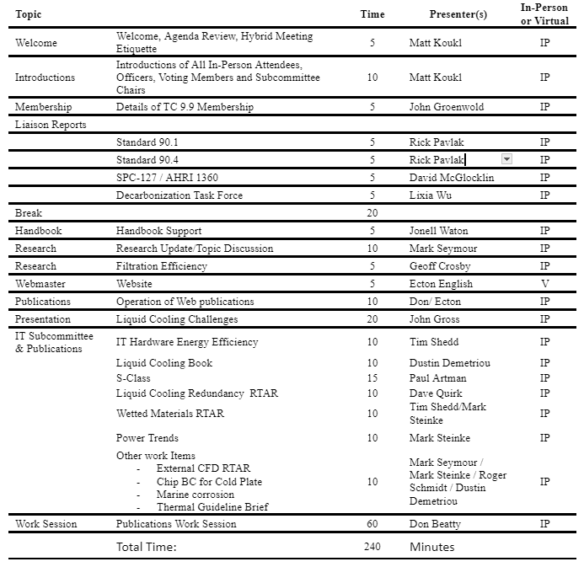
Agenda
1/22/2024
Content Copyright TC 9.9. All Rights Reserved.
Attendance: https://forms.gle/wjboSPgW6yQecKsW8
‹#›

Slide 4
Virtual Meeting Etiquette
Do not share your video due to the high number of virtual participants.
Prior to speaking individuals should state their name so that others know who is speaking and speak into a microphone.
Virtual participants should keep yourself muted unless giving permission to speak by the Host via chat.
Please do not attempt to share your screen without being asked to do so by the Host or Co-Host.
In-person participants are discouraged from joining the virtual meeting due to wireless bandwidth constraints.
1/22/2024
Content Copyright TC 9.9. All Rights Reserved.
Attendance: https://forms.gle/wjboSPgW6yQecKsW8
‹#›

Slide 5
Virtual Meeting Housekeeping
Virtual Host: Vice Chair - Mark Steinke
Monitor the chat thread for questions and comments.
Mute and Unmute Virtual Participants and Guests.
Manage discussions and voting.
Manage screen-sharing and in-person presentation
Virtual Co-Host: Secretary - John Gross
Monitor time and keep the meeting on schedule.
Record the event.
Produce meeting minutes.
Will repeat the attendance link multiple times during the meeting and upon chat request.
Respond to audio problems.
1/22/2024
Content Copyright TC 9.9. All Rights Reserved.
Attendance: https://forms.gle/wjboSPgW6yQecKsW8
‹#›

Slide 6
In Person Setup
Video projector that displays the presentation being shared virtually.
Be aware that chat comments sent to the Host may be seen by those in-person in addition to general chat comments.
There are audio speakers in the room but unmuted virtual commentators may not be immediately connected. Please be patient.
1/22/2024
Content Copyright TC 9.9. All Rights Reserved.
Attendance: https://forms.gle/wjboSPgW6yQecKsW8
‹#›

Slide 7
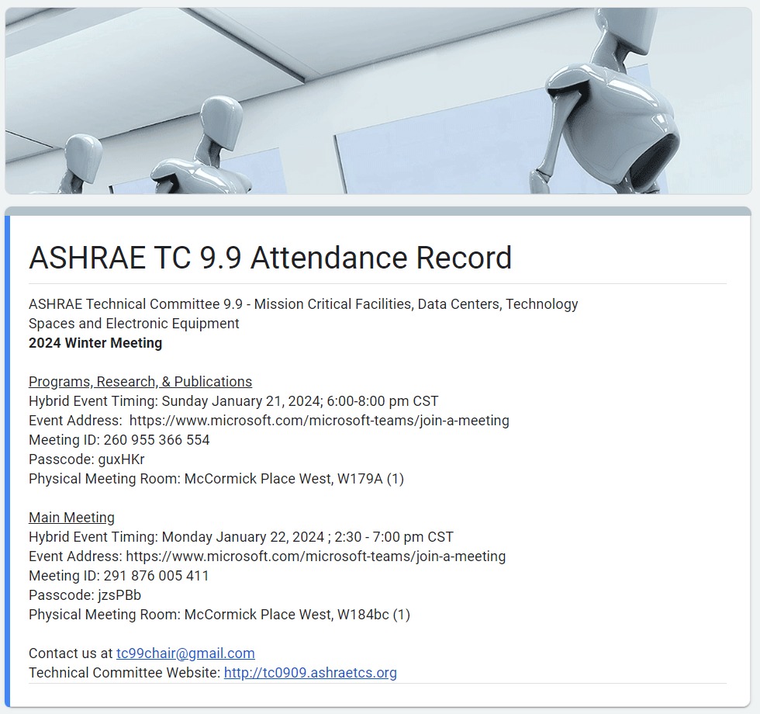

Attendance
Attendance is being recorded using a Google Form. Please make sure you complete the form at:
https://forms.gle/wjboSPgW6yQecKsW8
Or use the QR Code below:
1/22/2024
Content Copyright TC 9.9. All Rights Reserved.
Attendance: https://forms.gle/wjboSPgW6yQecKsW8
‹#›

Slide 8
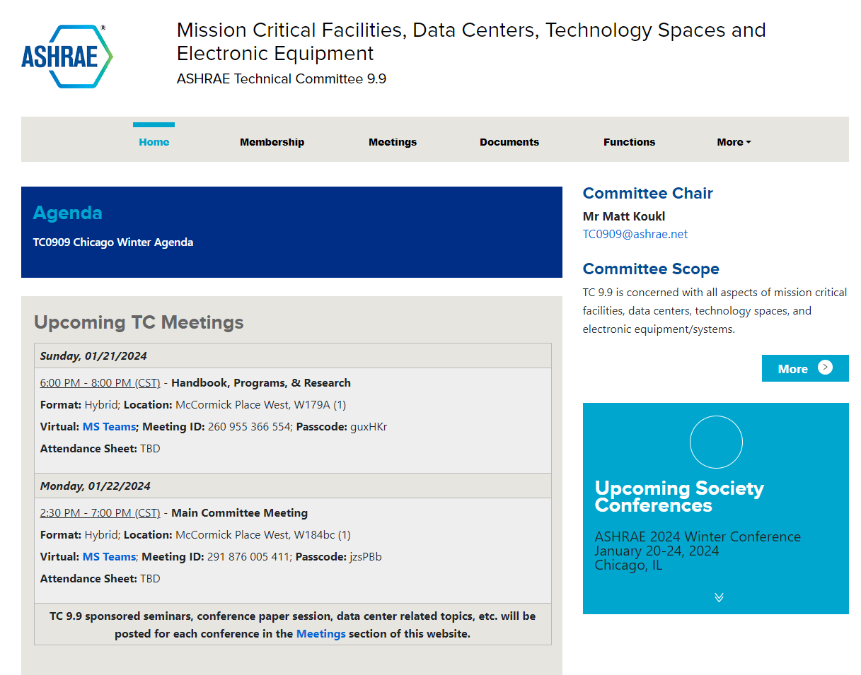
TC 9.9 Webpage
http://tc0909.ashraetcs.org
1/22/2024
Content Copyright TC 9.9. All Rights Reserved.
Attendance: https://forms.gle/wjboSPgW6yQecKsW8
‹#›

Slide 9
ASHRAE TC 9.9 Overview
Title
  Mission Critical Facilities, Data Centers, Technology Spaces, and Electronic Equipment
Purpose
  To be recognized by ALL areas of the datacom industry as the UNBIASED engineering leader in HVAC and an effective provider of technical datacom information.
Scope
  All things datacom facilities: datacom refers to data processing and communication facilities. It includes rooms or closets used for communication, computers, or electronic equipment
1/22/2024
Content Copyright TC 9.9. All Rights Reserved.
Attendance: https://forms.gle/wjboSPgW6yQecKsW8
‹#›

Slide 10
Introductions
In Room Only
  Name
  Business Title
  TC Membership Status:
    Voting Member
    Corresponding Member
    Provisional Corresponding Member
    Guest
  TC Leadership & Subcommittee Membership
    Subcommittee Chair
    Liaison
    Subcommittee membership
1/22/2024
Content Copyright TC 9.9. All Rights Reserved.
Attendance: https://forms.gle/wjboSPgW6yQecKsW8
‹#›

Slide 11
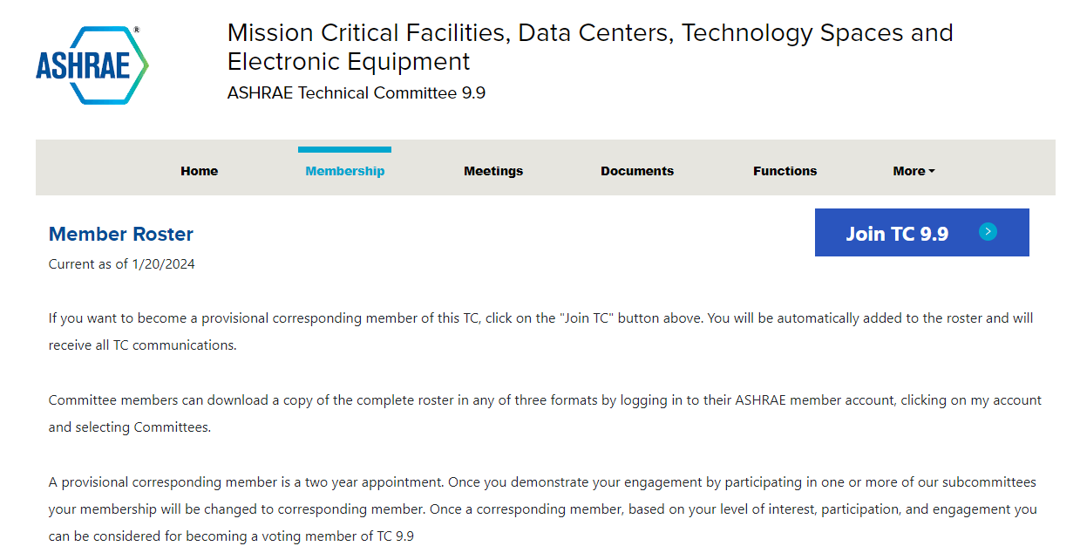
Join TC 9.9
http://tc0909.ashraetcs.org/membership.php
1/22/2024
Content Copyright TC 9.9. All Rights Reserved.
Attendance: https://forms.gle/wjboSPgW6yQecKsW8
‹#›

Slide 12
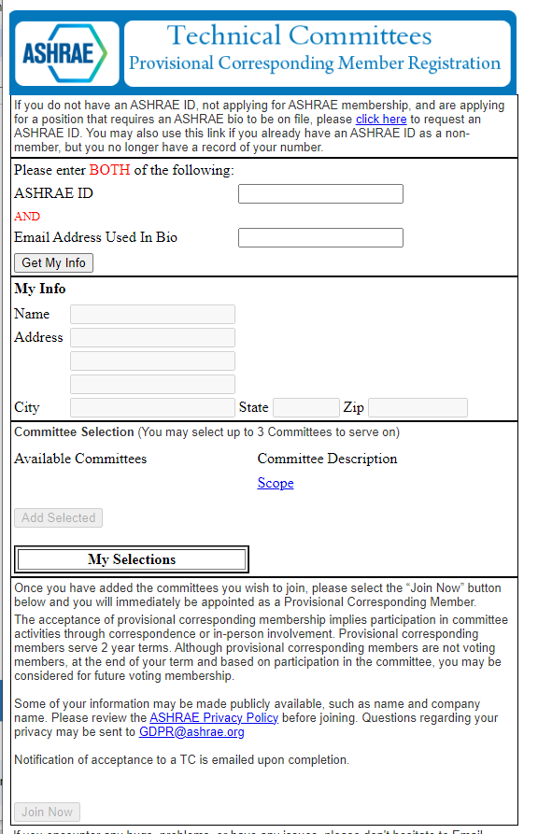
Join TC 9.9
https://eweb.ashrae.org/eweb/TS_ProvisionalSignup.html
1/22/2024
Content Copyright TC 9.9. All Rights Reserved.
Attendance: https://forms.gle/wjboSPgW6yQecKsW8
‹#›

Slide 13
Membership
Provisional Corresponding Members
  Additions to Roster between roster update cycles.
  Roster update always due Tuesday following main meeting during Winter Conference.
  Usually at the request of someone wanting to participate.
  If no action by TC leadership dropped from Roster after 2 years.
Corresponding Members
  Expected to participate in TC activities.
  Attend Meetings when possible.
  May serve as Vice-Chair or Secretary of TC if they attend meetings regularly.
  Can be Voting Members.
  Can serve as a subcommittee chair.
Keep Your ASHRAE
Profile Updated!
1/22/2024
Content Copyright TC 9.9. All Rights Reserved.
Attendance: https://forms.gle/wjboSPgW6yQecKsW8
‹#›
Notes:
Important to fill out attendance form.
Use attendance to promote from Provisional Corresponding Members to Corresponding
Use attendance to remove Corresponding Members that are not participating.

Slide 14
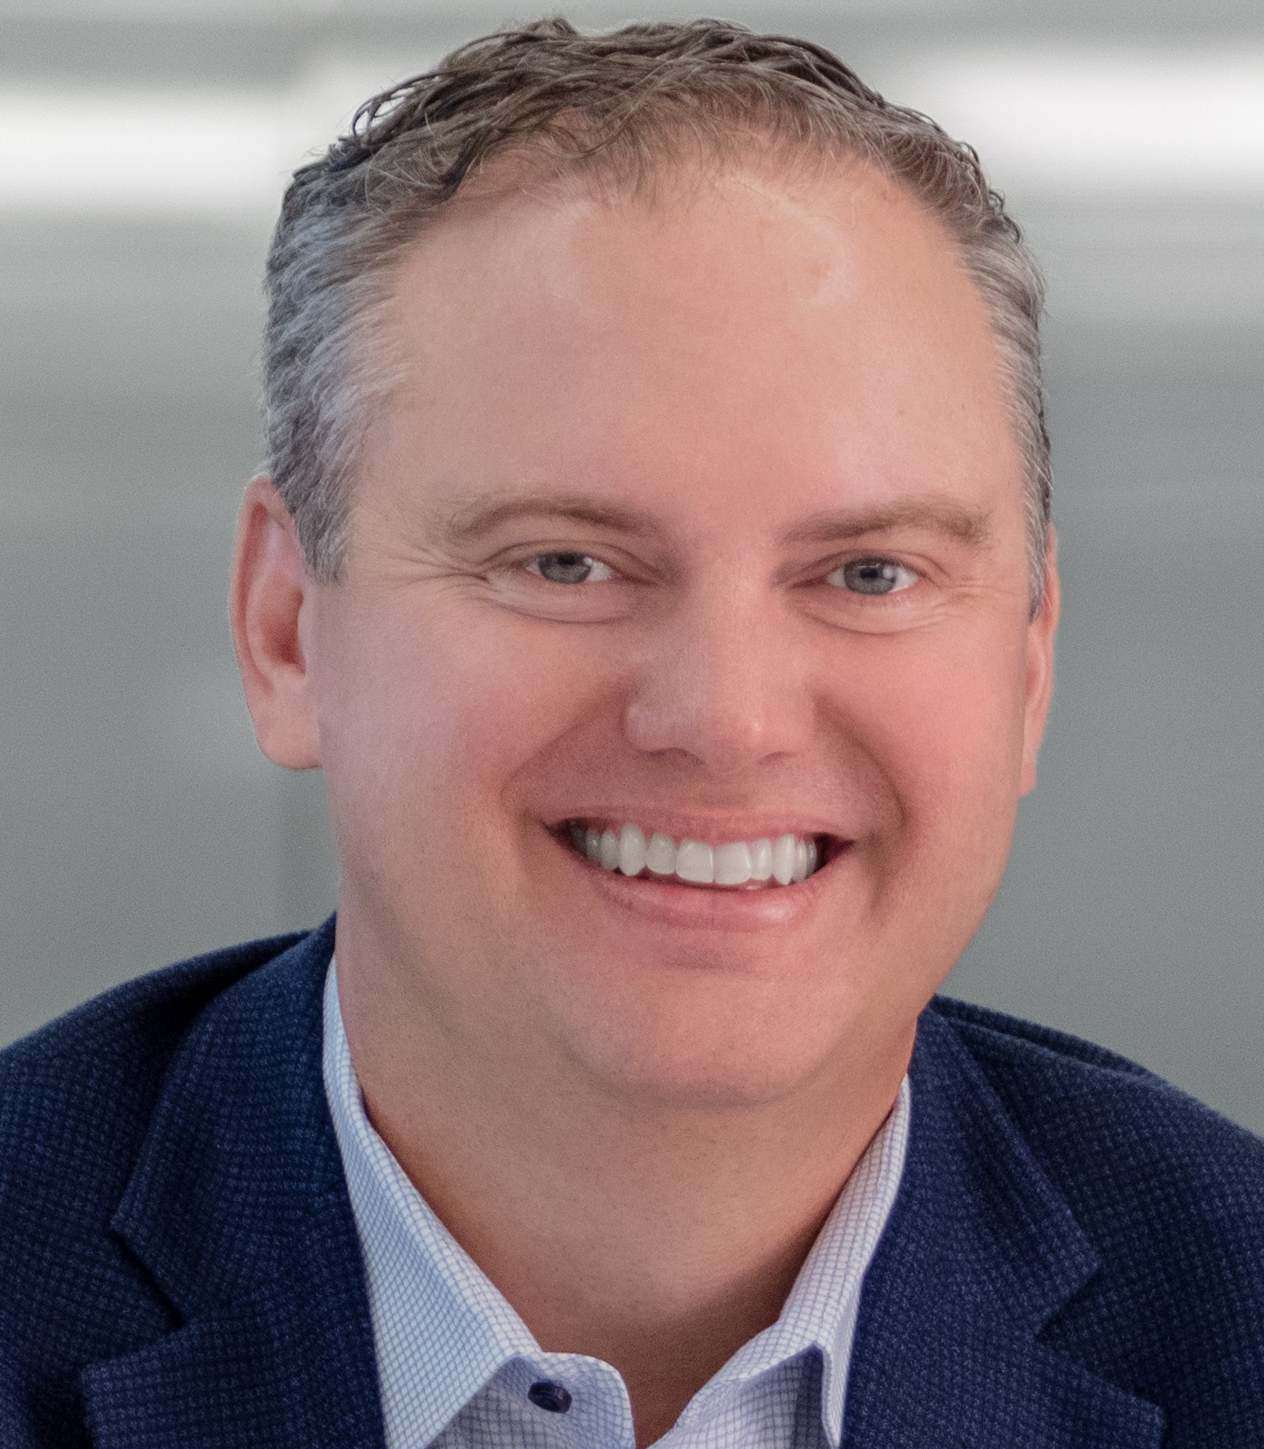


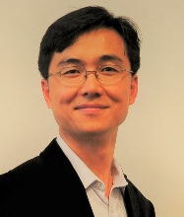
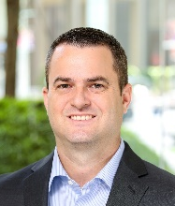



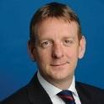


TC 9.9 Officers
Chair
Matt Koukl
Affiliated Engineers, Inc.
Standard Subcommittee Chair
Rick Pavlak
Heapy Engineering, Retired
Vice-Chair
Mark Steinke
NVIDIA
Programs Chair
Eric Yang
Vantage Data Centers
Secretary
John Gross
J. M. Gross Engineering
Handbook Chair
Robert McFarlane
Shen Milsom & Wilke, LLC
Publications Chair
Don Beaty
Retired Founder/CEO of DLB Assoc.
Webmaster
Ecton English
U.S. Department of Defense
Research Chair
Mark Seymour
Cadence
Marketing Subcommittee Chair
Paul Finch
KAO Data
ITE Subcommittee Chair
Dr. Roger Schmidt
IBM Fellow Emertius & Syracuse U.
Membership Chair
John Groenewold
Vantage Data Centers
1/22/2024
Content Copyright TC 9.9. All Rights Reserved.
Attendance: https://forms.gle/wjboSPgW6yQecKsW8
‹#›
Notes:
Succession planning for chair positions.

Slide 15
Voting Members
John Groenewold, Vantage Data Centers
Matt Koukl, Affiliated Engineers, Inc.
Mark Monroe, Retired
Rick Pavlak, Heapy- Retired
Mark Steinke, NVIDIA
Paul Finch, KAO Data
Mark Seymour, Cadence Design Systems
Jason Matteson, Iceotope Technologies
David Quirk, DLB Associates
Joe Prisco, IBM
Bob McFarlane, Shen Milsom & Wilke
Lixia Wu, Cushman & Wakefield
1/22/2024
Content Copyright TC 9.9. All Rights Reserved.
Attendance: https://forms.gle/wjboSPgW6yQecKsW8
‹#›

Slide 16
Membership
Membership | Quantity
Board & Chairs | 12
Corresponding Members | 365
Provisional Corresponding Members | 123
Total | 500
1/22/2024
Content Copyright TC 9.9. All Rights Reserved.
Attendance: https://forms.gle/wjboSPgW6yQecKsW8
‹#›

Slide 17
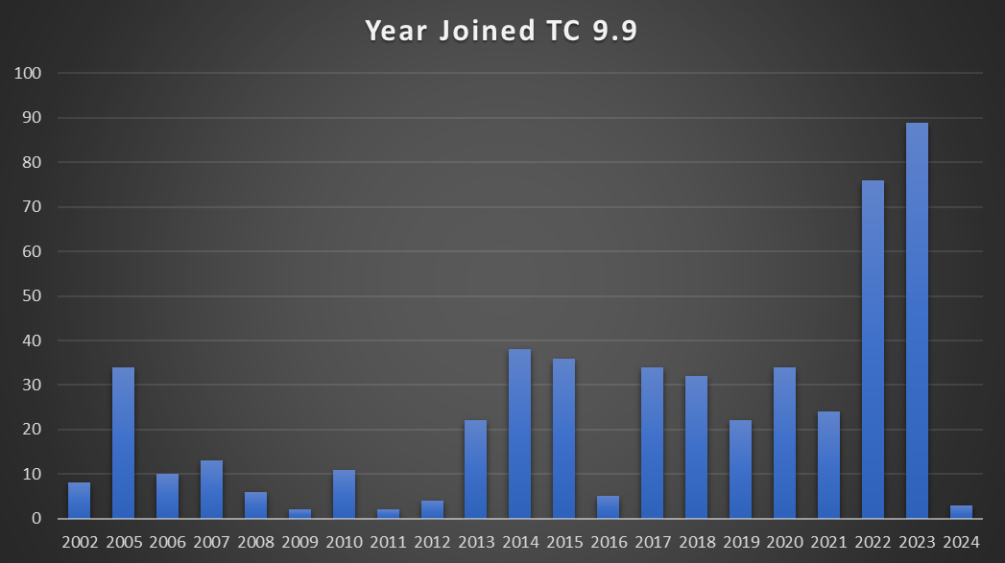
Membership- Year Joined TC 9.9
1/22/2024
Content Copyright TC 9.9. All Rights Reserved.
Attendance: https://forms.gle/wjboSPgW6yQecKsW8
‹#›

Slide 18
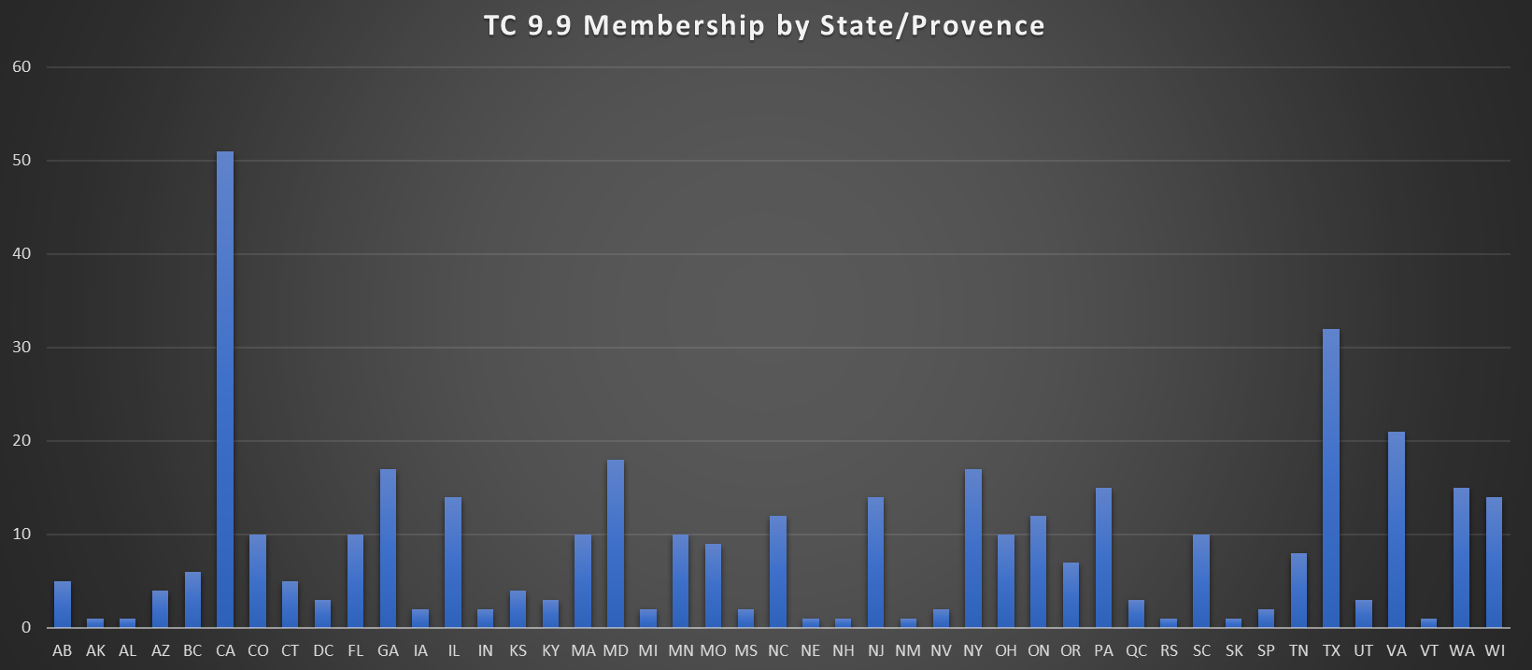
Membership- Member Location
1/22/2024
Content Copyright TC 9.9. All Rights Reserved.
Attendance: https://forms.gle/wjboSPgW6yQecKsW8
‹#›

Slide 19
TC 9.9 Liaisons
Standard 90.1: Rick Pavlak
Standard 90.4:
Standard 127: David McGlocklin
AHRI 1360: David McGlocklin
Standard 300, Guideline 1.6: Terry Rodgers
Decarbonization Task Force: Lixia Wu
1/22/2024
Content Copyright TC 9.9. All Rights Reserved.
Attendance: https://forms.gle/wjboSPgW6yQecKsW8
‹#›

Slide 20
2023 Votes
Vote | Date | Approved
Adoption of 2023 Winter Meeting Minutes | 07/21/2023 | Yes
Adoption of 2023 Summer Meeting Minutes | 07/31/2023 | Yes
Special Publication Approval: 3rd edition of Datacom Book 4: Liquid Cooling Guidelines for Datacom Equipment Centers | 09/25/2023 | Yes
Vote on TC 9.9 sponsoring a Work Statement titled, "Study of the Corrosion Impact on Information Technology Equipment in Data Centers Located in Coastal Regions with High Sea Salt Concentration" | 12/07/2023 | Yes
1/22/2024
Content Copyright TC 9.9. All Rights Reserved.
Attendance: https://forms.gle/wjboSPgW6yQecKsW8
‹#›

Slide 21
Thank You
TC 9.9 Website
tc0909.ashraetcs.org
1/22/2024
Content Copyright TC 9.9. All Rights Reserved.
Attendance: https://forms.gle/wjboSPgW6yQecKsW8
‹#›

Slide 22
90.1 Liaison Report
Rick Pavlak
1/22/2024
Content Copyright TC 9.9. All Rights Reserved.
Attendance: https://forms.gle/wjboSPgW6yQecKsW8
‹#›

Slide 23
Relationship Between ICC code cycle and Standard 90.1
1/22/2024
Content Copyright TC 9.9. All Rights Reserved.
Attendance: https://forms.gle/wjboSPgW6yQecKsW8
‹#›

Slide 24
While the ICC codes update on a 3 year cycle (the same as ASHRAE code cycle). Standard 90.1 runs two years behind the ICC Codes due to the length of time it takes in the ICC Code adoption process.
ASHRAE makes an effort to get the advancements in 90.1 adopted into the International Energy Conservation Code. Thus the IECC could be ahead of the referenced ASHRAE 90.1 Standard ( and thus more stringent than) the referenced 90.1 Standard.
Example: the IECC 2024 will reference Standard 90.1-2022
Example: the IECC 2021 references Standard 90.1-2019.
Example: the IECC 2018 references Standard 90.1-2016.
APPLICATION TO DATA CENTER ENERGY CODE COMPLIANCE
Standard 90.1-2022 references Standard 90.4-2019
Standard 90.1-2019 references Standard 90.4-2016
1/22/2024
Content Copyright TC 9.9. All Rights Reserved.
Attendance: https://forms.gle/wjboSPgW6yQecKsW8
‹#›

Slide 25
Future of 90.1 and other energy code standards including 90.4
Decarbonization and the path to net zero energy.
SSPC 90.1 has issued addenda l for 2 advisory public reviews. This addenda has requirement that effects source energy in addition to energy conservation. The implantation of resource compliance will require a change to the 90.1 Standard’s Title Purpose and Scope. This also holds true for Standard 90.4.
1/22/2024
Content Copyright TC 9.9. All Rights Reserved.
Attendance: https://forms.gle/wjboSPgW6yQecKsW8
‹#›

Slide 26
90.4 Liaison Report
Rick Pavlak
1/22/2024
Content Copyright TC 9.9. All Rights Reserved.
Attendance: https://forms.gle/wjboSPgW6yQecKsW8
‹#›

Slide 27
SSPC 127 & AHRI 1360
David McGlocklin
1/22/2024
Content Copyright TC 9.9. All Rights Reserved.
Attendance: https://forms.gle/wjboSPgW6yQecKsW8
‹#›

Slide 28
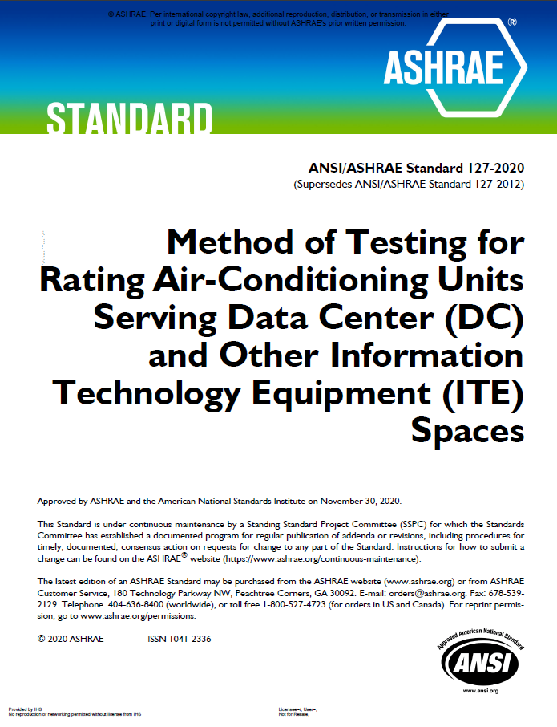
SSPC 127
Method of Testing for Rating Cooling Equipment Serving Data Center and Other Information Technology Equipment Spaces
Purpose: The purpose of the standard is to establish a uniform method of test requirements for rating cooling equipment that is applied in data center (DC) and other information technology facilities, spaces, and equipment..
Scope: This standard applies to classes of cooling equipment that are used to remove thermal loads in data center (DC) and other information technology facilities, spaces, and equipment.
2024 January Update & Plans:
We have formed and have been operating as new subcommittees:
- Air Subcommittee – Chair Dave McGlocklin, Secretary Dave Meadows
- Liquid Subcommittee - Chair Dr. Tim Shedd, Vice Chair John Gross, Secretary Dustin Demetriou
Air Sub has formed joint monthly meetings with AHRI1360 committee and are continuing with our work on the overall harmonization of 127 with AHRI 1360 standard, and ASHRAE 37 – making very good progress.
Liquid Sub has spent much of last half year working on definitions and classifications for the unique equipment in the liquid cooling space. We are first focusing on the MoT for a Liquid to Liquid CDU and will continue to work on this during the SSPC 127 meeting here in Chicago.
Meeting Tuesday Jan 23rd 1-5pm (McCormick Place West – W176B (1st floor))
1/22/2024
Content Copyright TC 9.9. All Rights Reserved.
Attendance: https://forms.gle/wjboSPgW6yQecKsW8
‹#›

Slide 29
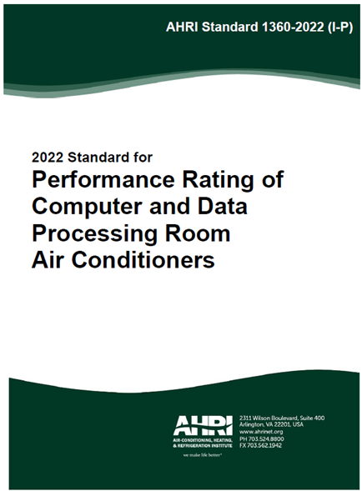
AHRI 1360
Performance Rating Standard for Datacom Air-Conditioning Units
Purpose: To establish for Computer and Data Processing Room Air Conditioners (CDPR): definitions; classification; test requirements; rating requirements; minimum data requirements for Published Ratings; marking and nameplate data; and conformance conditions.
Scope: This standard applies to all CDPR units and is intended for the guidance of the industry, including manufacturers, engineers, installers, contractors, users, and regulators.
Chair – Dave Kelley, Program Engineer - Jerry Yeh
2024 January Update & Plans:
Committee has been having monthly joint meetings with SSPC 127 Air Subcommittee as we continue to work on harmonization of 127 and AHRI1360 along with ASHRAE 37.
We have completed harmonization work through revisions of AHRI 1360-2022 and are turning towards revisions of 127-2020 at the next joint meeting in February.
We are also committed to working with SSPC127 Liquid Sub on liquid cooling ratings when the sub is ready.
1/22/2024
Content Copyright TC 9.9. All Rights Reserved.
Attendance: https://forms.gle/wjboSPgW6yQecKsW8
‹#›

Slide 30
Decarbonization Building Task Force
Lixia Wu
1/22/2024
Content Copyright TC 9.9. All Rights Reserved.
Attendance: https://forms.gle/wjboSPgW6yQecKsW8
‹#›

Slide 31
TFBD Successes
Task Force for Building Decarbonization: (TFBD) successes
TFBD Successes
Worked with TAC to improve communication and coordination with interest functional groups
Worked with the White House to define “Zero-Emissions Building”
Published our Building Performance Standards Technical Resource Guide in February in conjunction with the U.S. Department of Energy
Six additional decarbonization guides are under development, anticipated to be completed in the next 12 months
Coordinated work with our standards project committees to address GHG emissions
Assisting the Planning Committee to add building decarbonization goal to the ASHRAE Strategic Plan
Collaborated joint building decarb initiatives with other organizations
Developed decarbonization web content for the ASHRAE website
1/22/2024
Content Copyright TC 9.9. All Rights Reserved.
Attendance: https://forms.gle/wjboSPgW6yQecKsW8
‹#›

Slide 32
Task Force for Building Decarbonization: (TFBD) successes
Worked with TAC to improve communication and coordination with interest functional groups
Worked with the White House to define “Zero-Emissions Building”
Published our Building Performance Standards Technical Resource Guide in February in conjunction with the U.S. Department of Energy
Six additional decarbonization guides are under development, anticipated to be completed in the next 12 months
Coordinated work with our standards project committees to address GHG emissions
Assisting the Planning Committee to add building decarbonization goal to the ASHRAE Strategic Plan
Collaborated joint building decarb initiatives with other organizations
Technical Advisory Panel has provided valuable global feedback on our initiatives
Developed decarbonization web content for the ASHRAE website
1/22/2024
Content Copyright TC 9.9. All Rights Reserved.
Attendance: https://forms.gle/wjboSPgW6yQecKsW8
‹#›

Slide 33
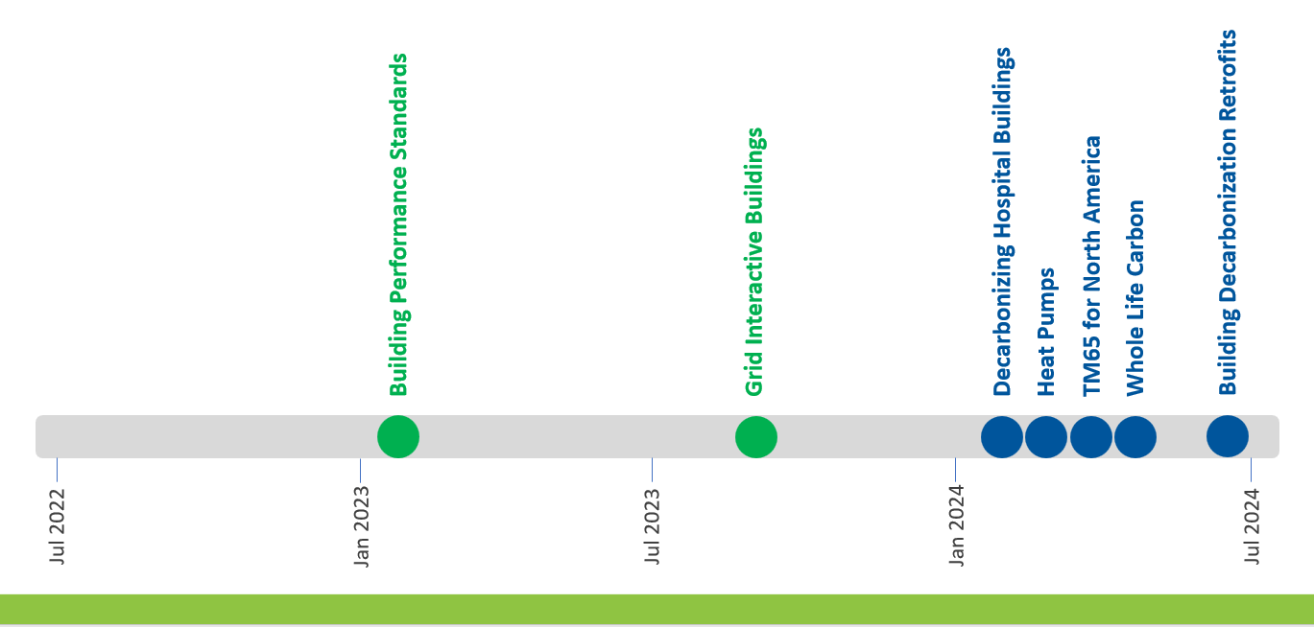
Technical Guide Series Schedule
1/22/2024
Content Copyright TC 9.9. All Rights Reserved.
Attendance: https://forms.gle/wjboSPgW6yQecKsW8
‹#›

Slide 34
2024 Center of Excellence for Building Decarbonization (CEBD)
It is proposed that the Center of Excellence for Building Decarbonization (CEBD) report to the ASHRAE Board of Directors Executive Committee
Members Council, Technology Council, and Publishing and Education Council will each appoint a Council Decarbonization Lead to facilitate Council coordination and drive operational execution. These individuals will serve as liaisons to the CEBD.
Operational activities will be led by one or more relevant councils, committees, or Decarbonization Task Groups (DTGs) across the global ASHRAE organization. The CEBD will take a supporting role in these activities. These activities will be coordinated by ASHRAE staff, with further assistance provided by CEBD members as needed.
1/22/2024
Content Copyright TC 9.9. All Rights Reserved.
Attendance: https://forms.gle/wjboSPgW6yQecKsW8
‹#›

Slide 35
Organization Structure
It is proposed that the Center of Excellence for Building Decarbonization (CEBD) report to the ASHRAE Board of Directors Executive Committee
Members Council, Technology Council, and Publishing and Education Council will each appoint a Council Decarbonization Lead to facilitate Council coordination and drive operational execution. These individuals will serve as liaisons to the CEBD.
1/22/2024
Content Copyright TC 9.9. All Rights Reserved.
Attendance: https://forms.gle/wjboSPgW6yQecKsW8
‹#›

Slide 36
Organization Structure
It is proposed that the Center of Excellence for Building Decarbonization (CEBD) report to the ASHRAE Board of Directors Executive Committee
Members Council, Technology Council, and Publishing and Education Council will each appoint a Council Decarbonization Lead to facilitate Council coordination and drive operational execution. These individuals will serve as liaisons to the CEBD.
Dr. Lixia Wu, member of TFBD Operational Carbon WG, ASHRAE TFBD retrofit guide WG, CDP subcommittee, TFBD Liaison for TC9.9. Lixia.Wu@Cushwake.com
1/22/2024
Content Copyright TC 9.9. All Rights Reserved.
Attendance: https://forms.gle/wjboSPgW6yQecKsW8
‹#›

Slide 37
Attendance
Attendance is being recorded using a Google Form. Please make sure you complete the form at:
https://forms.gle/wjboSPgW6yQecKsW8
Or use the QR Code below:
1/22/2024
Content Copyright TC 9.9. All Rights Reserved.
Attendance: https://forms.gle/wjboSPgW6yQecKsW8
‹#›

Slide 38
Welcome!
Welcome to the ASHRAE TC 9.9 Hybrid In-Person/Virtual Meeting!
No need to say hello, we will begin promptly at 2:30 pm CST
High Level Agenda
  Welcome
  Introduction
  Membership
  Purpose & Scope
  Reorganization
  Liaison Reports
  Research
  IT Subcommittee
  Work Sessions
Housekeeping
Audio
Attendees are muted upon entry
Do not un-mute your line
If you are joining via computer and phone line, ensure both are muted
Video
We encourage you to keep your video off
If you do enable your video, be mindful that you are on display! Turn off your video when needed.
Q&A
Use the chat function to ask questions
Our moderator will share questions throughout the presentation with the speaker to answer.
If you need to speak, please use the Raise Hand button and the moderator will enable your microphone.
Attendance
Please complete the attendance form found at the URL at the bottom of this slide or use the QR code below.
1/22/2024
Content Copyright TC 9.9. All Rights Reserved.
Attendance: https://forms.gle/wjboSPgW6yQecKsW8
‹#›
Notes:
Make this statement at the very beginning and re-state every minute or so until the meeting begins.
Hello and welcome to the ASHRAE ____________________ Meeting. My name is ____________ and I am the Facilitator for this meeting. We will begin the meeting promptly at 12:05pm. While you are waiting, please read our housekeeping announcements on this slide. If you have any questions or technical difficulties, please use the chat function.
Make this statement at meeting start time.
Hello and welcome to the ASHRAE ____________________ Meeting. My name is ____________ and I am the Facilitator for this meeting. It is now 12:05pm, so let’s being our meeting.

Slide 39
Research Update
Mark Seymour
1/22/2024
Content Copyright TC 9.9. All Rights Reserved.
Attendance: https://forms.gle/wjboSPgW6yQecKsW8
‹#›

Slide 40
Website Update
Ecton English
1/22/2024
Content Copyright TC 9.9. All Rights Reserved.
Attendance: https://forms.gle/wjboSPgW6yQecKsW8
‹#›

Slide 41
Operation of Web Publications
Don Beaty/ Ecton English
1/22/2024
Content Copyright TC 9.9. All Rights Reserved.
Attendance: https://forms.gle/wjboSPgW6yQecKsW8
‹#›

Slide 42
Liquid Cooling Challenges
mini-Presentation
John Gross
1/22/2024
Content Copyright TC 9.9. All Rights Reserved.
Attendance: https://forms.gle/wjboSPgW6yQecKsW8
‹#›

Slide 43
Motivation
Liquid cooling rapidly gaining acceptance in mainstream applications
Historically liquid cooling reserved for non-critical HPC
Rapidly evolving market adds confusion for end users, engineers, and operators
How to design a 30+ year asset with an unknown roadmap?
How to extend the life of an existing data center with the rapidly evolving landscape?
1/22/2024
Content Copyright TC 9.9. All Rights Reserved.
Attendance: https://forms.gle/wjboSPgW6yQecKsW8
‹#›

Slide 44
Outline/Agenda
Why is liquid cooling utilization expanding?
Liquid Cooling Topologies
  Rapidly evolving market
  Close-coupled cooling
  Door Heat Exchanger
  Immersion
  Direct Liquid Cooling
Challenges in deploying in existing data centers
  Heat transport and rejection
  Weight of solution
1/22/2024
Content Copyright TC 9.9. All Rights Reserved.
Attendance: https://forms.gle/wjboSPgW6yQecKsW8
‹#›

Slide 45
Outline/Agenda
Which cooling solution will “win”?
MEP Challenges
Opportunities for improved efficiency
I can eliminate my chillers, right?
Opportunities for Heat Reuse
Paradigm shift in engineer/client interactions
1/22/2024
Content Copyright TC 9.9. All Rights Reserved.
Attendance: https://forms.gle/wjboSPgW6yQecKsW8
‹#›

Slide 46
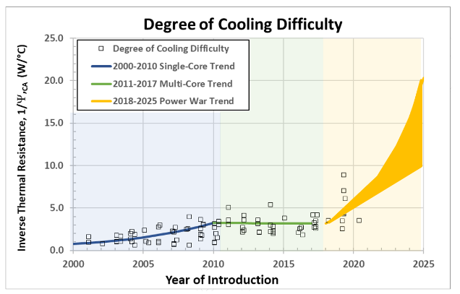
Why Liquid Cooling?
Processor power war escalation
Chip TDPs are exceeding projections
Air is an insulator
Emergence and Expansion of Liquid Cooling in Mainstream Data Centers, ASHRAE, 2021
1/22/2024
Content Copyright TC 9.9. All Rights Reserved.
Attendance: https://forms.gle/wjboSPgW6yQecKsW8
‹#›

Slide 47
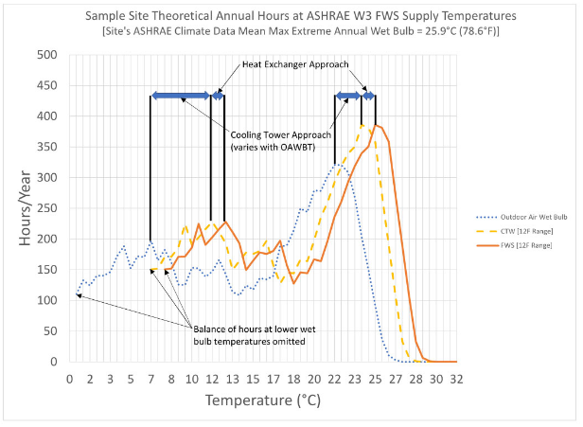
Why Liquid Cooling?
Improved thermal efficiency enables more efficient cooling plants
Significant reduction in PUE
Significant reduction in WUE
Emergence and Expansion of Liquid Cooling in Mainstream Data Centers, ASHRAE, 2021
1/22/2024
Content Copyright TC 9.9. All Rights Reserved.
Attendance: https://forms.gle/wjboSPgW6yQecKsW8
‹#›

Slide 48
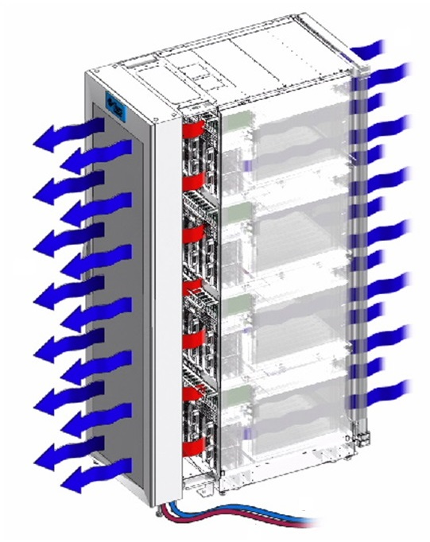
Liquid Cooling Topologies
Close-coupled cooling
  Door heat exchanger
  Active or Passive
  Front or Rear door
  Considered by ASHRAE to be air-cooling
    Often discussed as a liquid cooling technology
    Method of Test under current ASHRAE 127 for air cooling
1/22/2024
Content Copyright TC 9.9. All Rights Reserved.
Attendance: https://forms.gle/wjboSPgW6yQecKsW8
‹#›

Slide 49
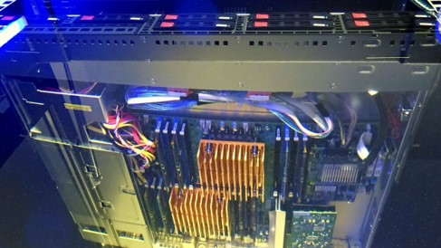
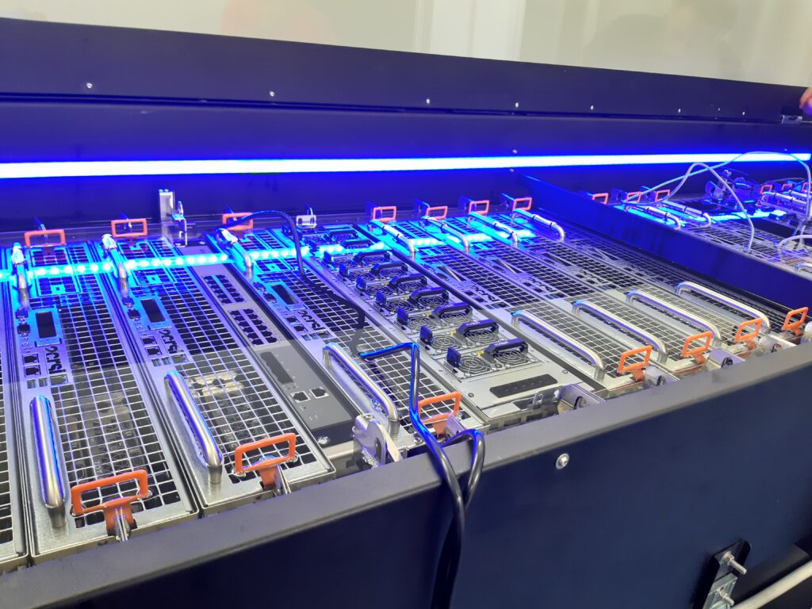
Liquid Cooling Topologies
Immersion
  Dielectric liquids in direct contact with electronics
  Single phase
    Tank-style
    Chassis-style
  Two phase
  Hybrid approaches
  Captures 100% of server heat into dielectric
    DOES NOT MEAN 100% of heat transported to TCS
1/22/2024
Content Copyright TC 9.9. All Rights Reserved.
Attendance: https://forms.gle/wjboSPgW6yQecKsW8
‹#›

Slide 50
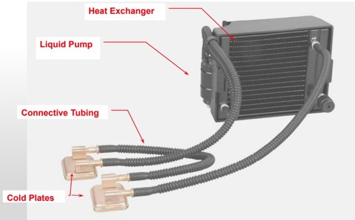
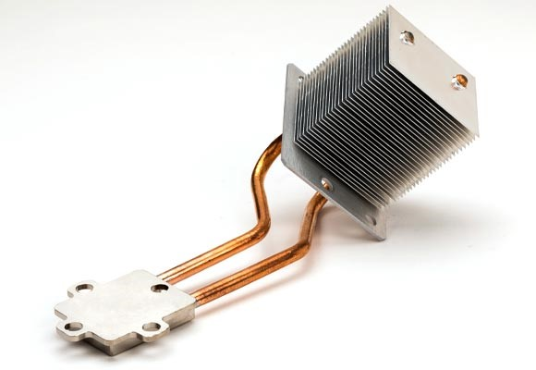
Liquid Cooling Topologies
Direct Liquid Cooling
  Cooling media directed at server heat sources
  TCS fluid never touches electronics – utilizes “cold plates” for heat transfer
  Single phase
  Two phase
  Heat capture ratio well below 100%, resulting in hybrid solutions
1/22/2024
Content Copyright TC 9.9. All Rights Reserved.
Attendance: https://forms.gle/wjboSPgW6yQecKsW8
‹#›

Slide 51
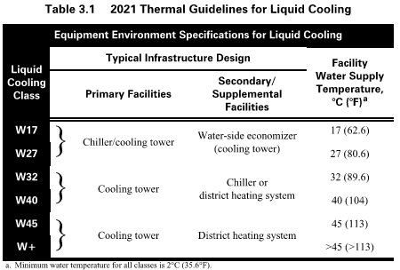
Challenges in Deployment
Rack power density can be significantly higher
  Higher concentration of power distribution and cooling demand
  Is there enough distribution infrastructure to efficiently deploy?
Existing DX air-cooled data centers don’t have a liquid cooled plant. What do I do?
  Liquid cooling means using liquid to remove heat from the chip, not how it gets outside
  Air-assisted liquid cooling
  Liquid-to-air CDUs
Liquid cooling loop compatibility
  Temperature
  Working fluid
  Compatibility
Thermal Guidelines for Data Processing Environments, ASHRAE, 2021
1/22/2024
Content Copyright TC 9.9. All Rights Reserved.
Attendance: https://forms.gle/wjboSPgW6yQecKsW8
‹#›

Slide 52
Challenges in Deployment
Structural
  Weight of solution relative to structure
    Varies widely depending on solution and IT stack
    Raised access floor is still potentially viable
    Structural analysis should be performed
    Adjusting room layout can reduce floor loading
    Larger pipes due to increased density
Architectural
  Overhead clearances
    Tank immersion solutions require space to pull servers out vertically
    Removal of servers may require rigging equipment due to weight
  Need to consider pathways to IT enclosure
    Size of elevators
    Turning around corners
1/22/2024
Content Copyright TC 9.9. All Rights Reserved.
Attendance: https://forms.gle/wjboSPgW6yQecKsW8
‹#›

Slide 53
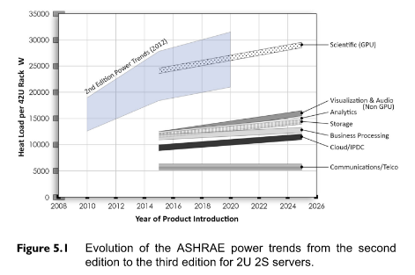
Which Cooling Solution Will “Win”
None of them
  Different optimal solution depending on IT stack, workload, location, etc
Liquid Cooled Data Centers will need to support multiple cooling technologies
  Need to consider physical topologies of IT spaces
IT Equipment Power Trends – Third Edition, ASHRAE, 2018
1/22/2024
Content Copyright TC 9.9. All Rights Reserved.
Attendance: https://forms.gle/wjboSPgW6yQecKsW8
‹#›

Slide 54
MEP Challenges
What topology do I design to support?
  Understand client roadmap
  Recognize hybrid environment demands flexibility
Concurrent Maintainability in liquid cooling
  How many segmentation valves on the TCS loop?
Densification of IT means densification of MEP/IT infrastructure
  Space/utility adjacencies
  Routing of MEP utilities
  Coordination with structural
1/22/2024
Content Copyright TC 9.9. All Rights Reserved.
Attendance: https://forms.gle/wjboSPgW6yQecKsW8
‹#›

Slide 55
MEP Challenges
30MW Datacenter Example @ 10kW/rack
  3000 racks
  6000 circuits (@ 2N)
  3000 telecom targets
  No piping to racks, each pipe tap covers 100’s of kW of cooling, contained in Mech
30MW Datacenter Example @ 40kW/rack
  750 racks
  1500 circuits (@ 2N)
  750 telecom targets (higher bandwidth)
  Piping to each rack, each pipe tap covers 40kW of cooling, distributed to floor
  ~30% reduction in data hall floor space
  Substantial reduction in data hall perimeter area
1/22/2024
Content Copyright TC 9.9. All Rights Reserved.
Attendance: https://forms.gle/wjboSPgW6yQecKsW8
‹#›

Slide 56
Opportunities for Improved Efficiency
Lower TDP applications suitable for higher TCS temperatures
Pending guidance from ASHRAE TC9.9 regarding TCS temperatures for servers
Water-side economization opportunities
Heat Reuse becomes viable
  Design like a district heating system
  Sell heat to hosts
  Reduces load on cooling plant
  Reduces heat island effect
  Reduces both data center and heat host carbon footprint
Thermal Guidelines for Data Processing Environments, ASHRAE, 2021
1/22/2024
Content Copyright TC 9.9. All Rights Reserved.
Attendance: https://forms.gle/wjboSPgW6yQecKsW8
‹#›

Slide 57
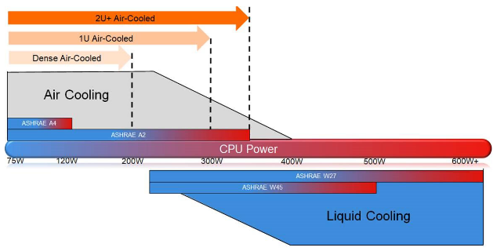
I Can Eliminate Chillers, Right?
BE CAREFUL!
Many current workloads and ITE support elevated temperatures
Trend from silicon manufacturers is higher TDP and lower on-chip temperatures
Provide provisions for future chillers
Consider thermal storage
Emergence and Expansion of Liquid Cooling in Mainstream Data Centers, ASHRAE, 2021
1/22/2024
Content Copyright TC 9.9. All Rights Reserved.
Attendance: https://forms.gle/wjboSPgW6yQecKsW8
‹#›

Slide 58
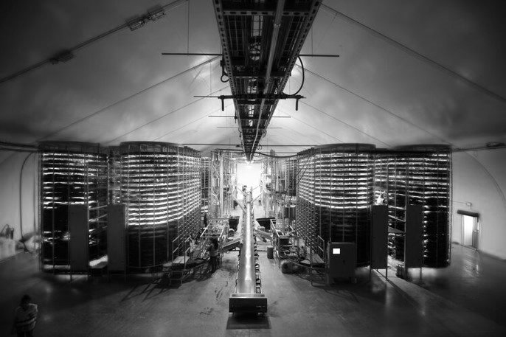
Heat Reuse Options
Depends on operating temperatures
Align quality of heat produced with that host requires
Heat pumps can be used to increase heat quality
Load matching
  Align with host utilizing a process load
  HVAC loads not optimal
Some locations now requiring Heat Reuse
1/22/2024
Content Copyright TC 9.9. All Rights Reserved.
Attendance: https://forms.gle/wjboSPgW6yQecKsW8
‹#›

Slide 59

Paradigm Shift in Engineer/Client Interaction
Can no longer design data centers around “kW/rack” or “W/SF”
Liquid cooling opens doors of opportunity but requires better collaboration
Understanding of end user “pain points” with liquid deployments is crucial
Facility Operations must be involved in design
Rapidly evolving landscape demands better research and education on solutions
No one can be an expert in facilities AND IT, but need to educate and communicate to set and deliver reasonable expectations.
1/22/2024
Content Copyright TC 9.9. All Rights Reserved.
Attendance: https://forms.gle/wjboSPgW6yQecKsW8
‹#›

Slide 60
Workshop Discussion Topics
Heat capture ratio – I can remove all my air-cooling equipment, right?
Can we eliminate pipe insulation on these elevated temperature systems?
TCS loops require RO or DI water treatment, correct?
Suitability of raised floors in liquid cooling. Do I have to remove my existing Raised Access Floor?
Can I deploy liquid cooling in an existing multi-story facility?
Which liquid cooling topology should I design the data center to support?
Liquid cooling is more expensive to deploy than air cooling, right?
We can eliminate chillers with transition to liquid cooling, right?
How do I locate a suitable heat host for reuse?
How do I deliver Concurrent Maintainability with liquid cooling?
1/22/2024
Content Copyright TC 9.9. All Rights Reserved.
Attendance: https://forms.gle/wjboSPgW6yQecKsW8
‹#›

Slide 61
Advancements in Liquid Cooling Applications for Data Centers
13 January 2024
Jason Matteson, Director of Product Strategy
Paul Artman, Fellow System Design
Tim Shedd, Engineering Technologist

Slide 62
Power Trends: No End in Sight for Power CAGR
CPUs
500+ W
400 W
280 W
205 W
145 W
2016 2018 2020 2022 2024
2P Total Power
More Power =
High energy costs: fan power is significant
Higher infrastructure cost
Extremely loud systems
Increased design cost
Limited configuration support
Liquid only SKUs
GPUs
1KW
700 W
1500+W
500 W
350 W
1250W
250 W
2016 2018 2020 2022 2024
1000W
Network
150? W
75 W
75W
750 W
40 W
25 W
2016 2018 2020 2022 2024
500 W
Memory
20+W
2016 2018 2020 2022 2024
17 W
15 W
12 W
10 W
2016 2018 2020 2022 2024
Note: Blue font indicates liquid cooling required

Slide 63
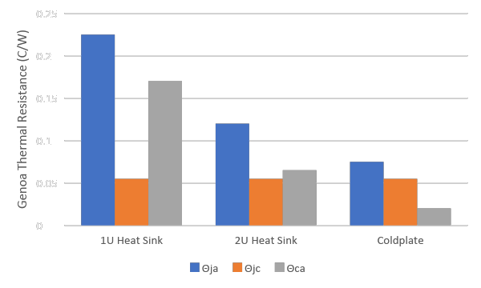
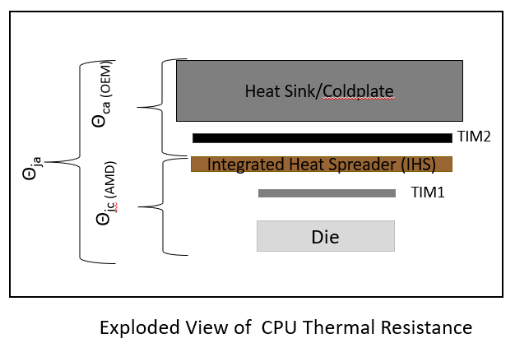
Power and Cooling Limits
>600W CPU TDP with be challenging for power air- cooling
Liquid cooling increases CPU power support: package thermal resistance becomes thermal limit
  Industry exploring improvements in Θ_{jc} for the CPU package

Slide 64
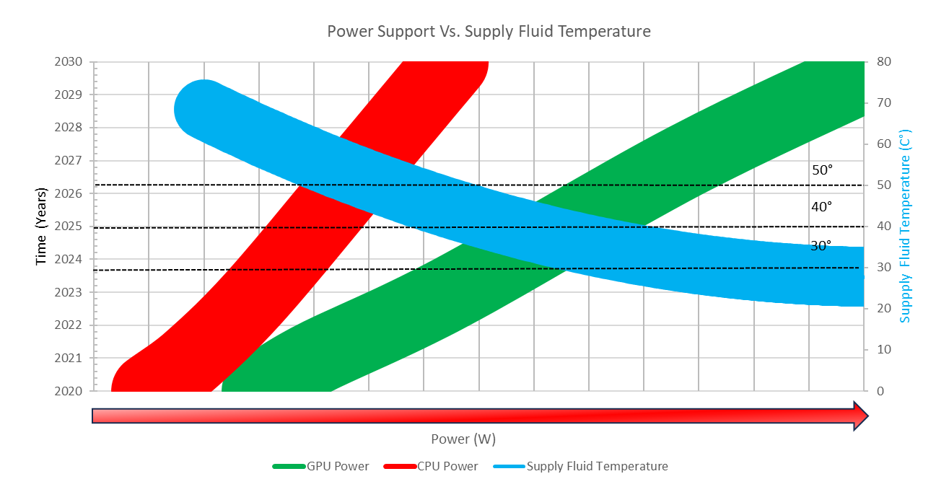
Component Power vs Supply Water Temperature

Slide 65
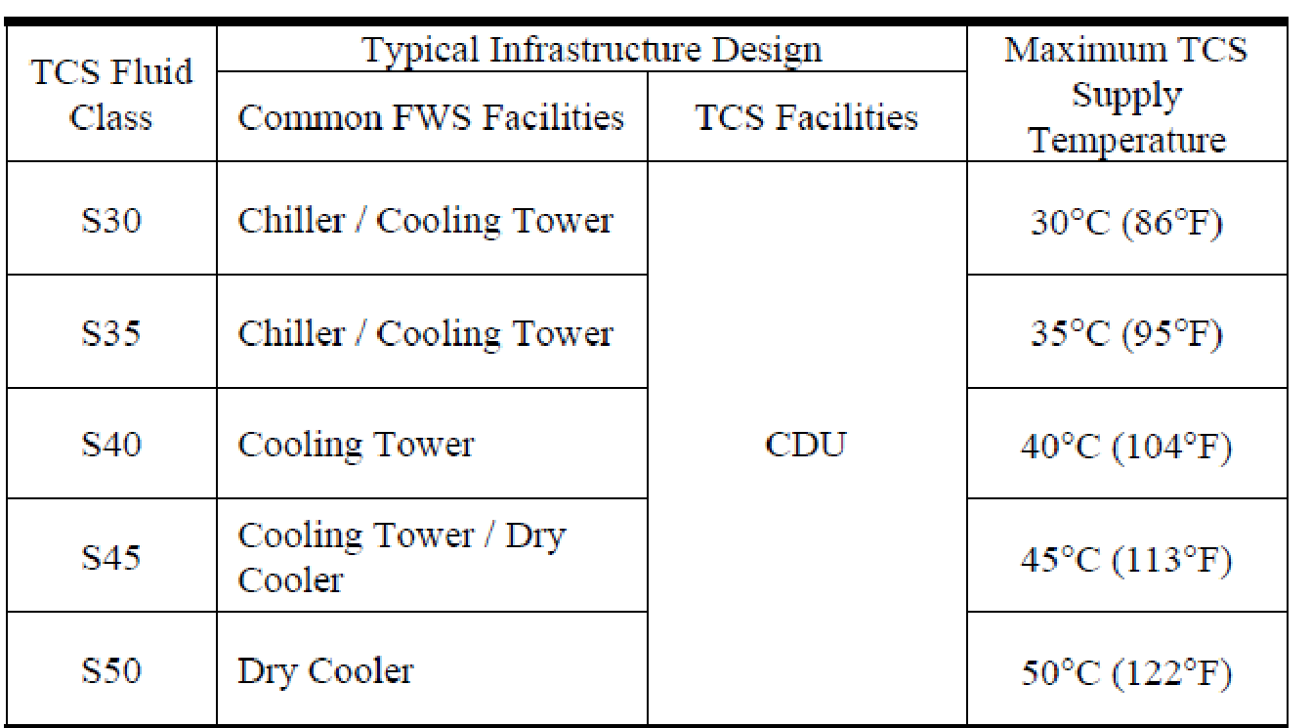
TCS Supply Temperatures

Slide 66
Mission Critical Facilities, Data Centers, Technology Spaces and Electronic Equipment
ASHRAE Winter Conference 2024
IT Subcommittee
Hybrid In-Person / Virtual
1/22/2024
Content Copyright TC 9.9. All Rights Reserved.
Attendance: https://forms.gle/wjboSPgW6yQecKsW8
‹#›

Slide 67
Agenda
IT Hardware Energy Efficiency (Tim Shedd)
Liquid Cooling Book (Dustin Demetriou)
S-Class (Paul Artman)
Liquid Cooling Redundancy RTAR (Dave Quirk)
Wetted Materials RTAR (Tim Shedd/Mark Steinke)
Power Trends (Mark Steinke)
Other work Items
  External CFD RTAR (Mark Seymour)
  Chip BC for Cold Plate (Mark Steinke)
  Marine corrosion (Roger Schmidt)
  Thermal Guideline Brief (Mark Seymour / Dustin Demetriou)
1/22/2024
Content Copyright TC 9.9. All Rights Reserved.
Attendance: https://forms.gle/wjboSPgW6yQecKsW8
‹#›

Slide 68
Liquid Cooling Book Status
Book approved by voting members in September
Over 200 comments addressed
Almost all graphics recreated
Book converted to online format
1/22/2024
Content Copyright TC 9.9. All Rights Reserved.
Attendance: https://forms.gle/wjboSPgW6yQecKsW8
‹#›

Slide 69
Acknowledgements
ASHRAE Technical Committee (TC) 9.9 would like to thank the following members for their significant contributions to further the understanding of liquid-cooling for the entire data center industry. These members contributed through content development, conference calls, writing/editing, and reviews:
Paul Artman, John Bean, David Moss, Roger Schmidt, Tim Shedd, Mark Steinke
A special thanks is due to the following individuals who served as subject matter experts and provided significant content to the publication.
Cibi Chakravarthy, Robert Curtis (ZT Systems), Ed Gutowski (D.E. Shaw Group), John Gross (J.M. Gross En-gineering), Ali Heydari (NVIDIA), Mark Mannex (Mannex Engineering), Jason Matteson (Iceotope), Jeff Rutt (DOD, retired)
ASHRAE TC 9.9 also wishes to thank the following people for their constructive comments on the draft of this edition:
Ed Gutowski, Ali Heydari, Jason Matteson, Robert McFarlane, David Moss, Justin Seter, Mark Seymour Roger Schmidt, and David Quirk.
1/22/2024
Content Copyright TC 9.9. All Rights Reserved.
Attendance: https://forms.gle/wjboSPgW6yQecKsW8
‹#›

Slide 70
Liquid Cooling Book Status
The third edition provides expanded and new information covering the following topics:
A discussion on the IT component power trends that are driving the need for liquid cooling to support the next generation of IT workloads.
A new set of environmental classes (S-Classes) for the supply temperature of the Technology Cooling System (TCS) coolant are introduced. These new guidelines provide a link to the Facility Water System (FWS) classes (W-Classes) to ensure both the facility and the datacom equipment are properly designed to support energy efficiency.
Expanded treatment of the differences in fluid quality requirements for the TCS and FWS loops.
Details are provided on the design characteristics of conductive cold plate cooling and immersion cooling systems.
Design guidance is added for air cooled facilities that are being upgraded to support liquid cooled datacom equipment.
1/22/2024
Content Copyright TC 9.9. All Rights Reserved.
Attendance: https://forms.gle/wjboSPgW6yQecKsW8
‹#›

Slide 71
Overview of Chapters
Chapter 1 states the purpose and objective of this book, defines key terminology associated with liquid cooling, and highlights the emerging trends driving the adoption of data center liquid cooling.
Chapter 2 provide the reader with an overview of the facility cooling system equipment and design considerations.
Chapter 3 provides detailed descriptions of the various liquid cooling implementations.
Chapter 4 describes the cooling distribution unit (CDU) function and design considerations.
Chapter 5 characterizes the facility cooling systems by providing guidelines on the interface requirements between the facility water system and the technology cooling system.
Chapter 6 introduces new technology cooling system (TCS) temperature guidelines (S-Classes) to ensure the IT equipment delivers full performance
1/22/2024
Content Copyright TC 9.9. All Rights Reserved.
Attendance: https://forms.gle/wjboSPgW6yQecKsW8
‹#›

Slide 72
Overview of Chapters
Chapter 7 describes the fluids and fluid quality considerations for both the Facility Water System and Technology Cooling System.
Chapter 8 describes the common components and their attributes that make up a conductive cooling (cold plate) liquid cooling solution for datacom equipment.
Chapter 9 describes different implementations of immersion cooling systems and considerations in their design.
Chapter 10 describes consideration for transitioning an air cooled data center to support liquid cooled datacom equipment.
Chapter 11 describes other considerations for liquid cooling environments such as monitoring/control, reliability and availability, commissioning, fire detection and suppression, and data center modeling.
Appendix A provides general characteristics of common fluid used in immersion cooling systems.
Appendix B provides guidance on considerations for commissioning liquid cooled datacom equipment.
1/22/2024
Content Copyright TC 9.9. All Rights Reserved.
Attendance: https://forms.gle/wjboSPgW6yQecKsW8
‹#›

Slide 73
Mission Critical Facilities, Data Centers, Technology Spaces and Electronic Equipment
ASHRAE Winter Conference 2024
IT Subcommittee
Hybrid In-Person / Virtual

Slide 74
Agenda
Liquid Cooling Book (Dustin Demetriou)
S-Class (Paul Artman)
Liquid Cooling Redundancy RTAR (Dave Quirk)
Wetted Materials RTAR (Tim Shedd/Mark Steinke)
Power Trends / Silicon Boundary Conditions (Mark Steinke)
Marine corrosion (Roger Schmidt)
Thermal Guideline Brief (Mark Seymour / Dustin Demetriou)

Slide 75
Liquid Cooling Book Status
Book approved by voting members in September
Over 200 comments addressed
Almost all graphics recreated
Book converted to online format
Seminar 63: Hot off the press! ASHRAE TC 9.9 Liquid Cooling Publication. Wednesday 11:00 am

Slide 76
Acknowledgements
ASHRAE Technical Committee (TC) 9.9 would like to thank the following members for their significant contributions to further the understanding of liquid-cooling for the entire data center industry. These members contributed through content development, conference calls, writing/editing, and reviews:
Paul Artman, John Bean, David Moss, Roger Schmidt, Tim Shedd, Mark Steinke, Sr. Manager, Thermal Engineering (AMD)
A special thanks is due to the following individuals who served as subject matter experts and provided significant content to the publication.
Cibi Chakravarthy, Robert Curtis (ZT Systems), Ed Gutowski (D.E. Shaw Group), John Gross (J.M. Gross En-gineering), Ali Heydari (NVIDIA), Mark Mannex (Mannex Engineering), Jason Matteson (Iceotope), Jeff Rutt (DOD, retired)
ASHRAE TC 9.9 also wishes to thank the following people for their constructive comments on the draft of this edition:
Ed Gutowski, Ali Heydari, Jason Matteson, Robert McFarlane, David Moss, Justin Seter, Mark Seymour Roger Schmidt, and David Quirk.

Slide 77
Liquid Cooling Book Status
The third edition provides expanded and new information covering the following topics:
A discussion on the IT component power trends that are driving the need for liquid cooling to support the next generation of IT workloads.
A new set of environmental classes (S-Classes) for the supply temperature of the Technology Cooling System (TCS) coolant are introduced. These new guidelines provide a link to the Facility Water System (FWS) classes (W-Classes) to ensure both the facility and the datacom equipment are properly designed to support energy efficiency.
Expanded treatment of the differences in fluid quality requirements for the TCS and FWS loops.
Details are provided on the design characteristics of conductive cold plate cooling and immersion cooling systems.
Design guidance is added for air cooled facilities that are being upgraded to support liquid cooled datacom equipment.

Slide 78
Overview of Chapters
Chapter 1 states the purpose and objective of this book, defines key terminology associated with liquid cooling, and highlights the emerging trends driving the adoption of data center liquid cooling.
Chapter 2 provide the reader with an overview of the facility cooling system equipment and design considerations.
Chapter 3 provides detailed descriptions of the various liquid cooling implementations.
Chapter 4 describes the cooling distribution unit (CDU) function and design considerations.
Chapter 5 characterizes the facility cooling systems by providing guidelines on the interface requirements between the facility water system and the technology cooling system.
Chapter 6 introduces new technology cooling system (TCS) temperature guidelines (S-Classes) to ensure the IT equipment delivers full performance

Slide 79
Overview of Chapters
Chapter 7 describes the fluids and fluid quality considerations for both the Facility Water System and Technology Cooling System.
Chapter 8 describes the common components and their attributes that make up a conductive cooling (cold plate) liquid cooling solution for datacom equipment.
Chapter 9 describes different implementations of immersion cooling systems and considerations in their design.
Chapter 10 describes consideration for transitioning an air cooled data center to support liquid cooled datacom equipment.
Chapter 11 describes other considerations for liquid cooling environments such as monitoring/control, reliability and availability, commissioning, fire detection and suppression, and data center modeling.
Appendix A provides general characteristics of common fluid used in immersion cooling systems.
Appendix B provides guidance on considerations for commissioning liquid cooled datacom equipment.

Slide 80
Liquid Cooling
Resiliency RTAR
David Quirk

Slide 81
Wetted Materials RTAR
Tim Shedd

Slide 82
The Problem
DLC fluids may fail by
  Enabling biological growth and subsequent fouling
  Material compatibility issues resulting extraction or precipitation and fouling
  Material compatibility issues resulting in corrosion
  Material compatibility issues resulting in dissolution an failure of polymers or elastomers
  Foaming
Current understanding is that 25% glycol in water is the most straightforward way to manage biology
Material compatibility must be managed with proprietary inhibitor packages

Slide 83
Enabling the industry
To enable the industry, there needs to be a standard method of test for compatibility of materials with coolants
  Allow for validation of metals, polymers and elastomers with current fluid offerings
  Allow for new fluids development while ensuring compatibility with current materials
  Allow for introduction of both new materials and fluids
Longer term challenge: A standard method of test for biological fouling resistance
  Allow for non-glycol based mixtures

Slide 84
Path forward
Based on feedback from fluid specialists:
  we don’t need to develop new methods of test
  We need to develop a new “package” of standardized tests specific to data center cooling equipment
Actions
  Define the problem
    Operating parameters, Normal and excursion
    Base list of materials
      CDUs, Manifolds, Cold plates, Rear Door Heat Exchangers, In-Row Coolers, etc.
  Work with fluids vendors and specialists to identify the package of existing ASTM tests that will adequately indicate complete material compatibility
  Develop standard chapter and roll into SPC 127

Slide 85
Longer view
Develop RTARs
  ASHRAE project to implement standard to develop publicly available validation of X fluids with Y materials for inclusion in our Handbook chapter
  ASHRAE project to develop method of test for biological fouling
  ASHRAE project to develop recommendations for erosion limits for coolant velocities

Slide 86
Power Trends Update
Mark Steinke

Slide 87
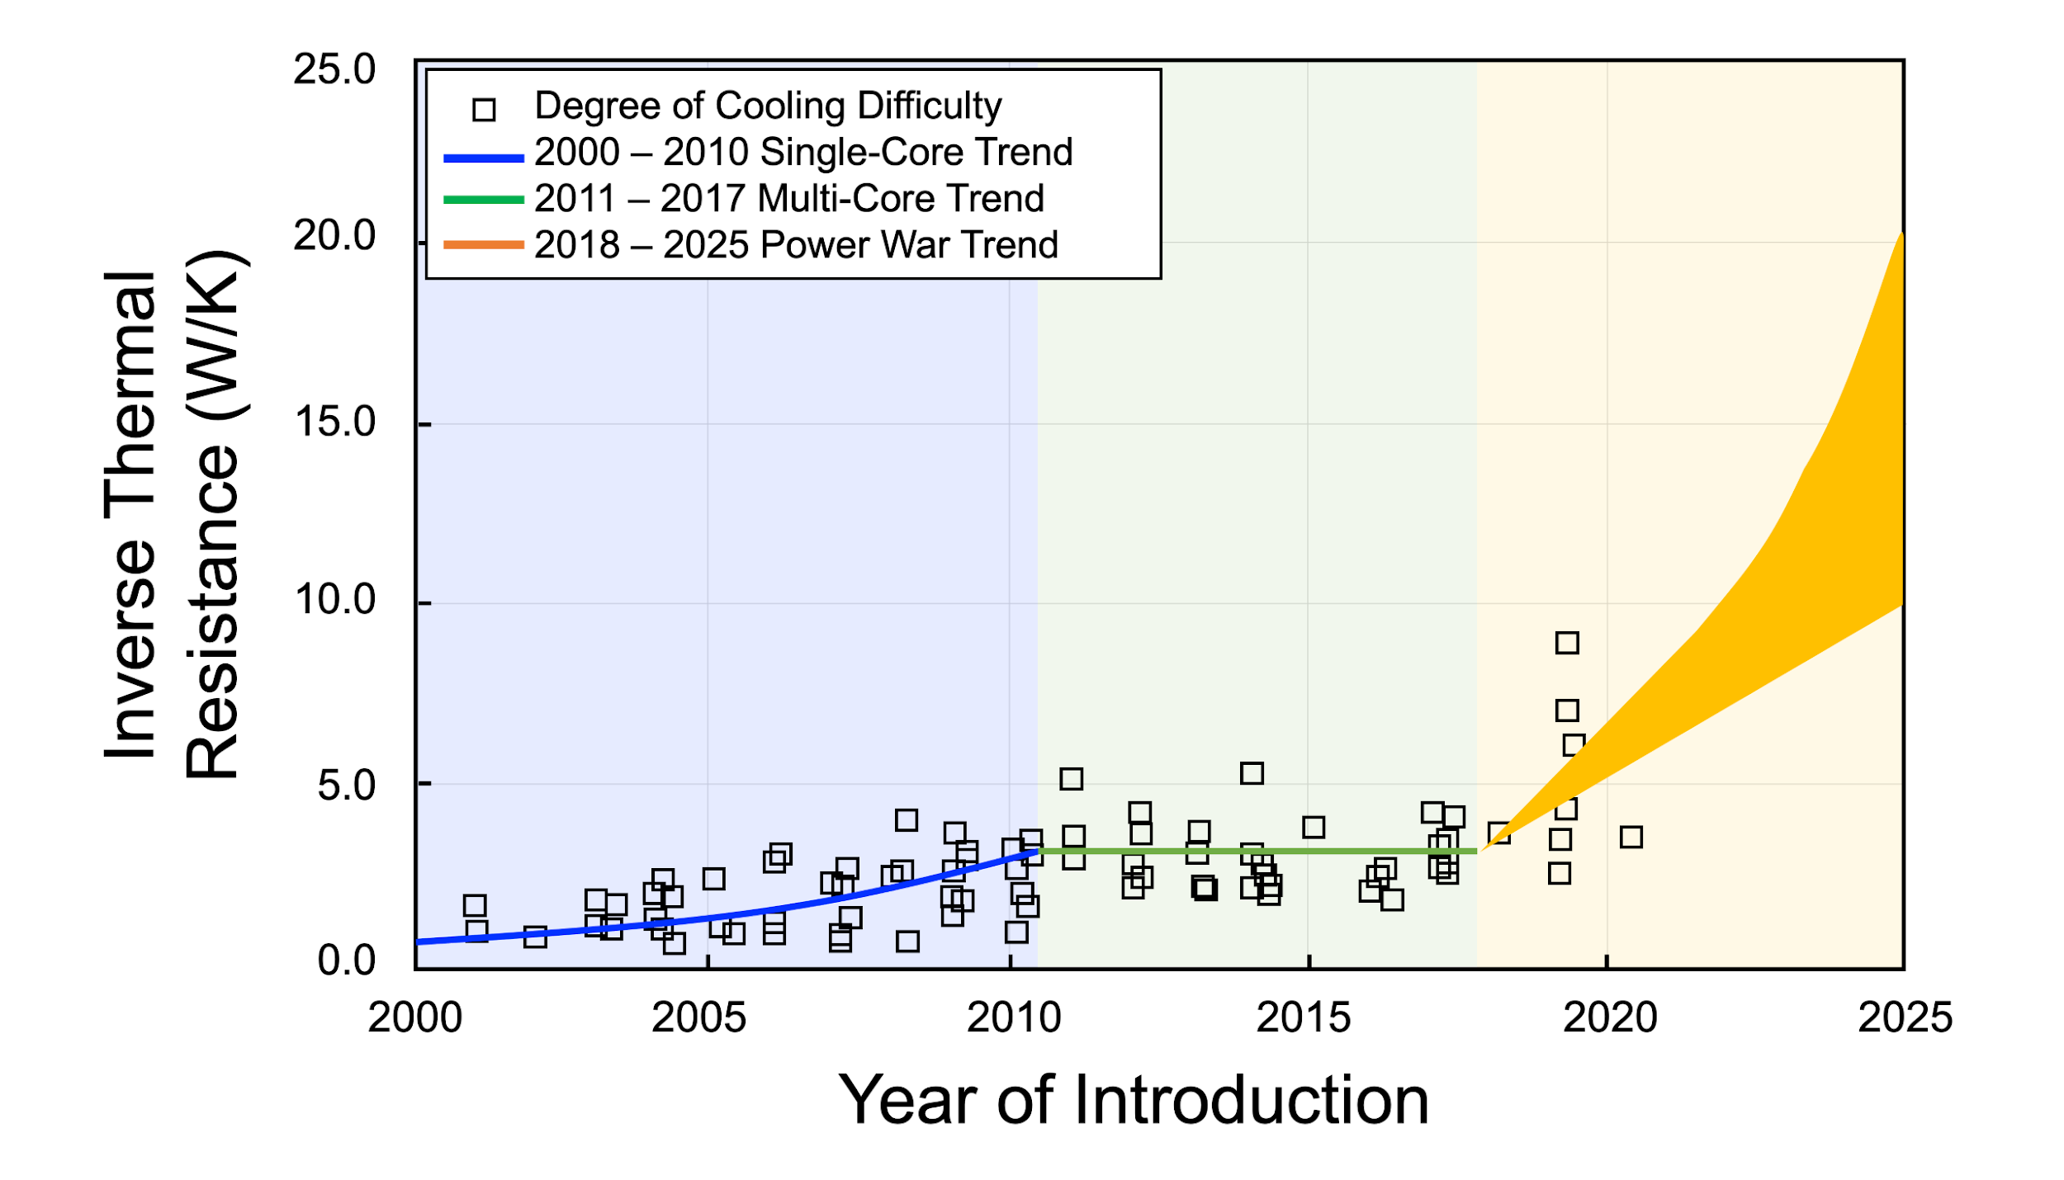
Silicon Boundary Conditions
Disruption of Silicon Power/Thermal Trends
  Silicon power/thermal trends exploding
  Further bifurcation between CPUs & GPUs
  GPU domination to overall trend
  Workloads now dominate (ML, Generative AI) and accelerate trend
  Silicon 3D package technology advancing
  Multiple silicon devices with different temp requirements now common
Next Steps
  Update the silicon roadmap trends chart
  Add additional detail around workloads and impact to silicon thermal BCs
  Update Rack Power trends
  Revise the Power Trends Book

Slide 88
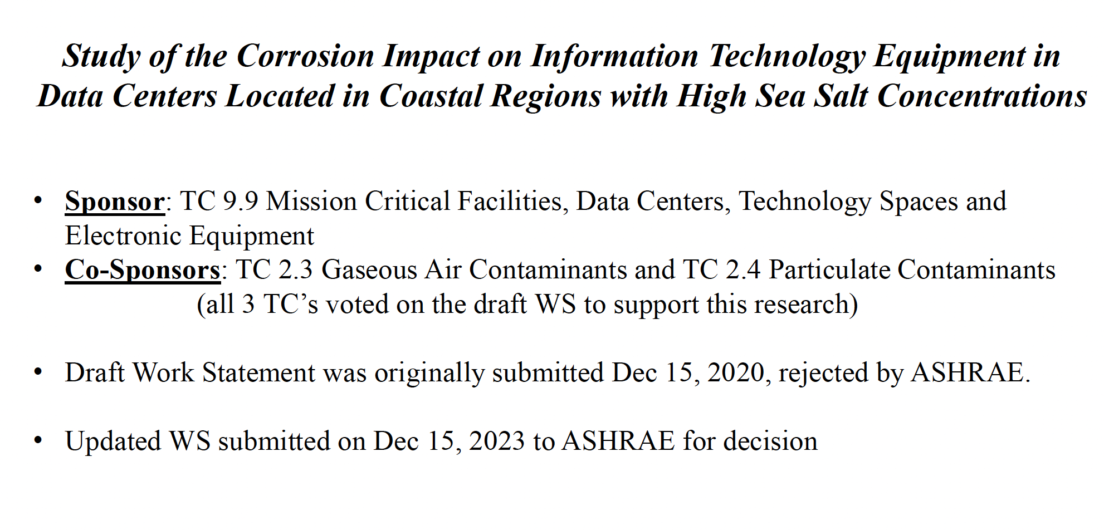

Slide 89
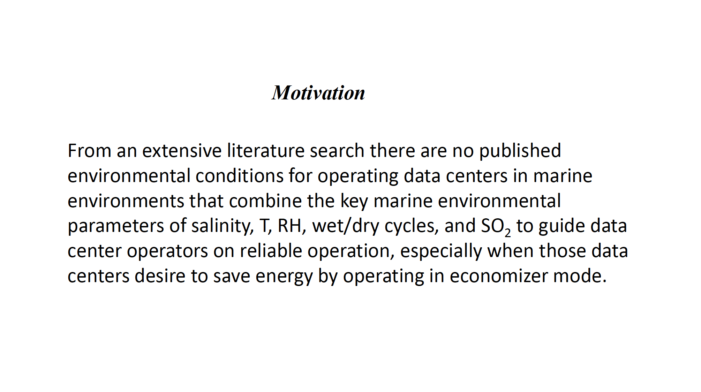

Slide 90
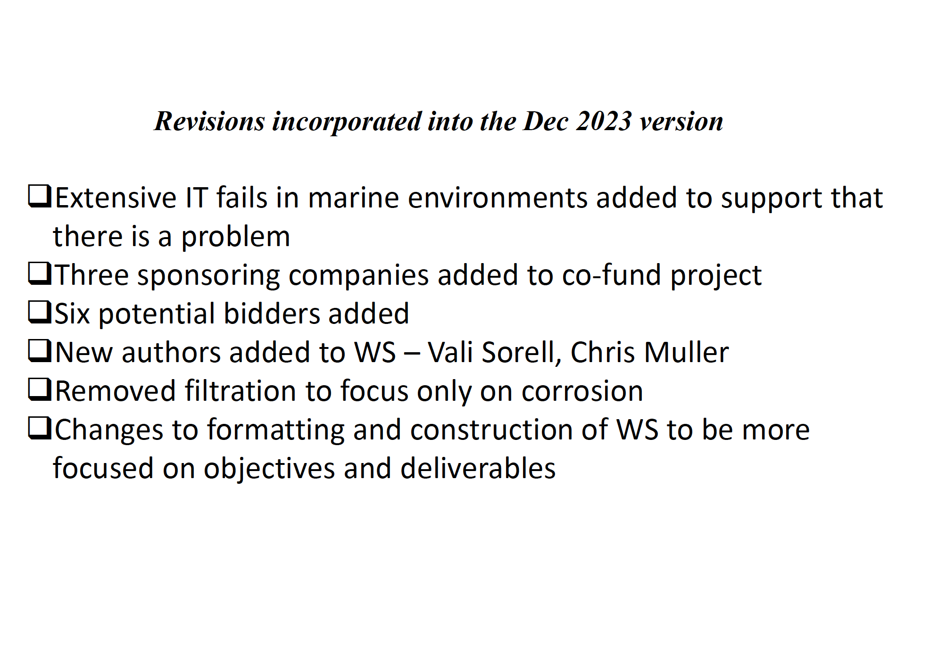

Slide 91
Thermal Guideline Brief
Dustin Demetriou

Slide 92
Thank You
TC 9.9 Website: tc0909.ashraetcs.org
1/22/2024
Content Copyright TC 9.9. All Rights Reserved.
Attendance: https://forms.gle/wjboSPgW6yQecKsW8
‹#›

Slide 93
Attendance
Attendance is being recorded using a Google Form. Please make sure you complete the form at:
https://forms.gle/wjboSPgW6yQecKsW8
Or use the QR Code below:
1/22/2024
Content Copyright TC 9.9. All Rights Reserved.
Attendance: https://forms.gle/wjboSPgW6yQecKsW8
‹#›

Slide 94
Publications Work Session
Don Beaty
1/22/2024
Content Copyright TC 9.9. All Rights Reserved.
Attendance: https://forms.gle/wjboSPgW6yQecKsW8
‹#›

Slide 95
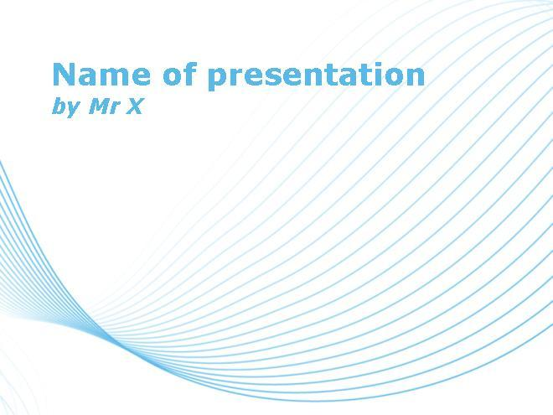
Physical Books Transition to Online Encyclopedia, Wiki, or Info Sys
Mission:
Provide timely updates about ITE changes impacting data center infrastructure.
Original Goals:
1.) Quicker content updates 2.) Greatly increase # of people accessing our content
Obstacle:
1.) Ashrae has no inhouse Wikipedia Platform expertise (have to outsource)
2.) Outsourcing would greatly increase online subscription cost
Solution: Use Sharepoint Platform instead
Reduces online subscription cost to hopefully $5 / month or less

Slide 96
Change in Concept
Original Concept:
Step 1 - Create Online version of Books 1, 3, & 4
Step 2 – Create Online version for another Books until all 14 Books Online
Revised Concept:
Step 1 – Same as Original Concept except use Book 3 as basis for Online ToC
Step 2 – Migrate content from other 11 Books reviewing EACH chapter for:
value, relevance, conciseness, still current . . . . .

Slide 97
Change in Navigation
User Navigation Options:
Option 1 – Multi-level Table of Contents Search
Option 2 – Index Search
Option 3 – Tradition Word / Phrase Generic Search of Entire Site

Slide 98
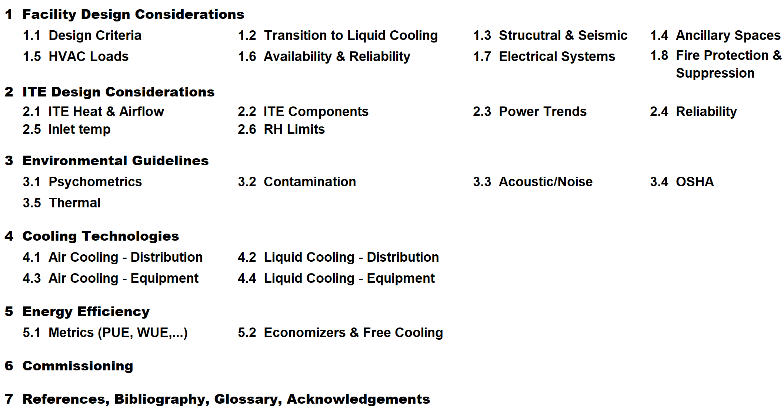
Table of Contents

Slide 99
Progress – Sharepoint Prep Activity (effort greater than 300 hours)
Converted 9 x 6 portrait books >> Dynamic size & orientation
Redesigned layout
Changed fonts
Reduced paragraph sizes
Adjusted or replaced images
Completed this effort on Books 1, 3, & 4

Slide 100
Progress – Sharepoint Activity (effort greater than 100 hours)
Setup & experimentation
Sharepoint research
Prototyping
Manual import of Books 1, 3, & 4 (piecemeal copy & paste format)
Formating, respacing, etc.

Slide 101
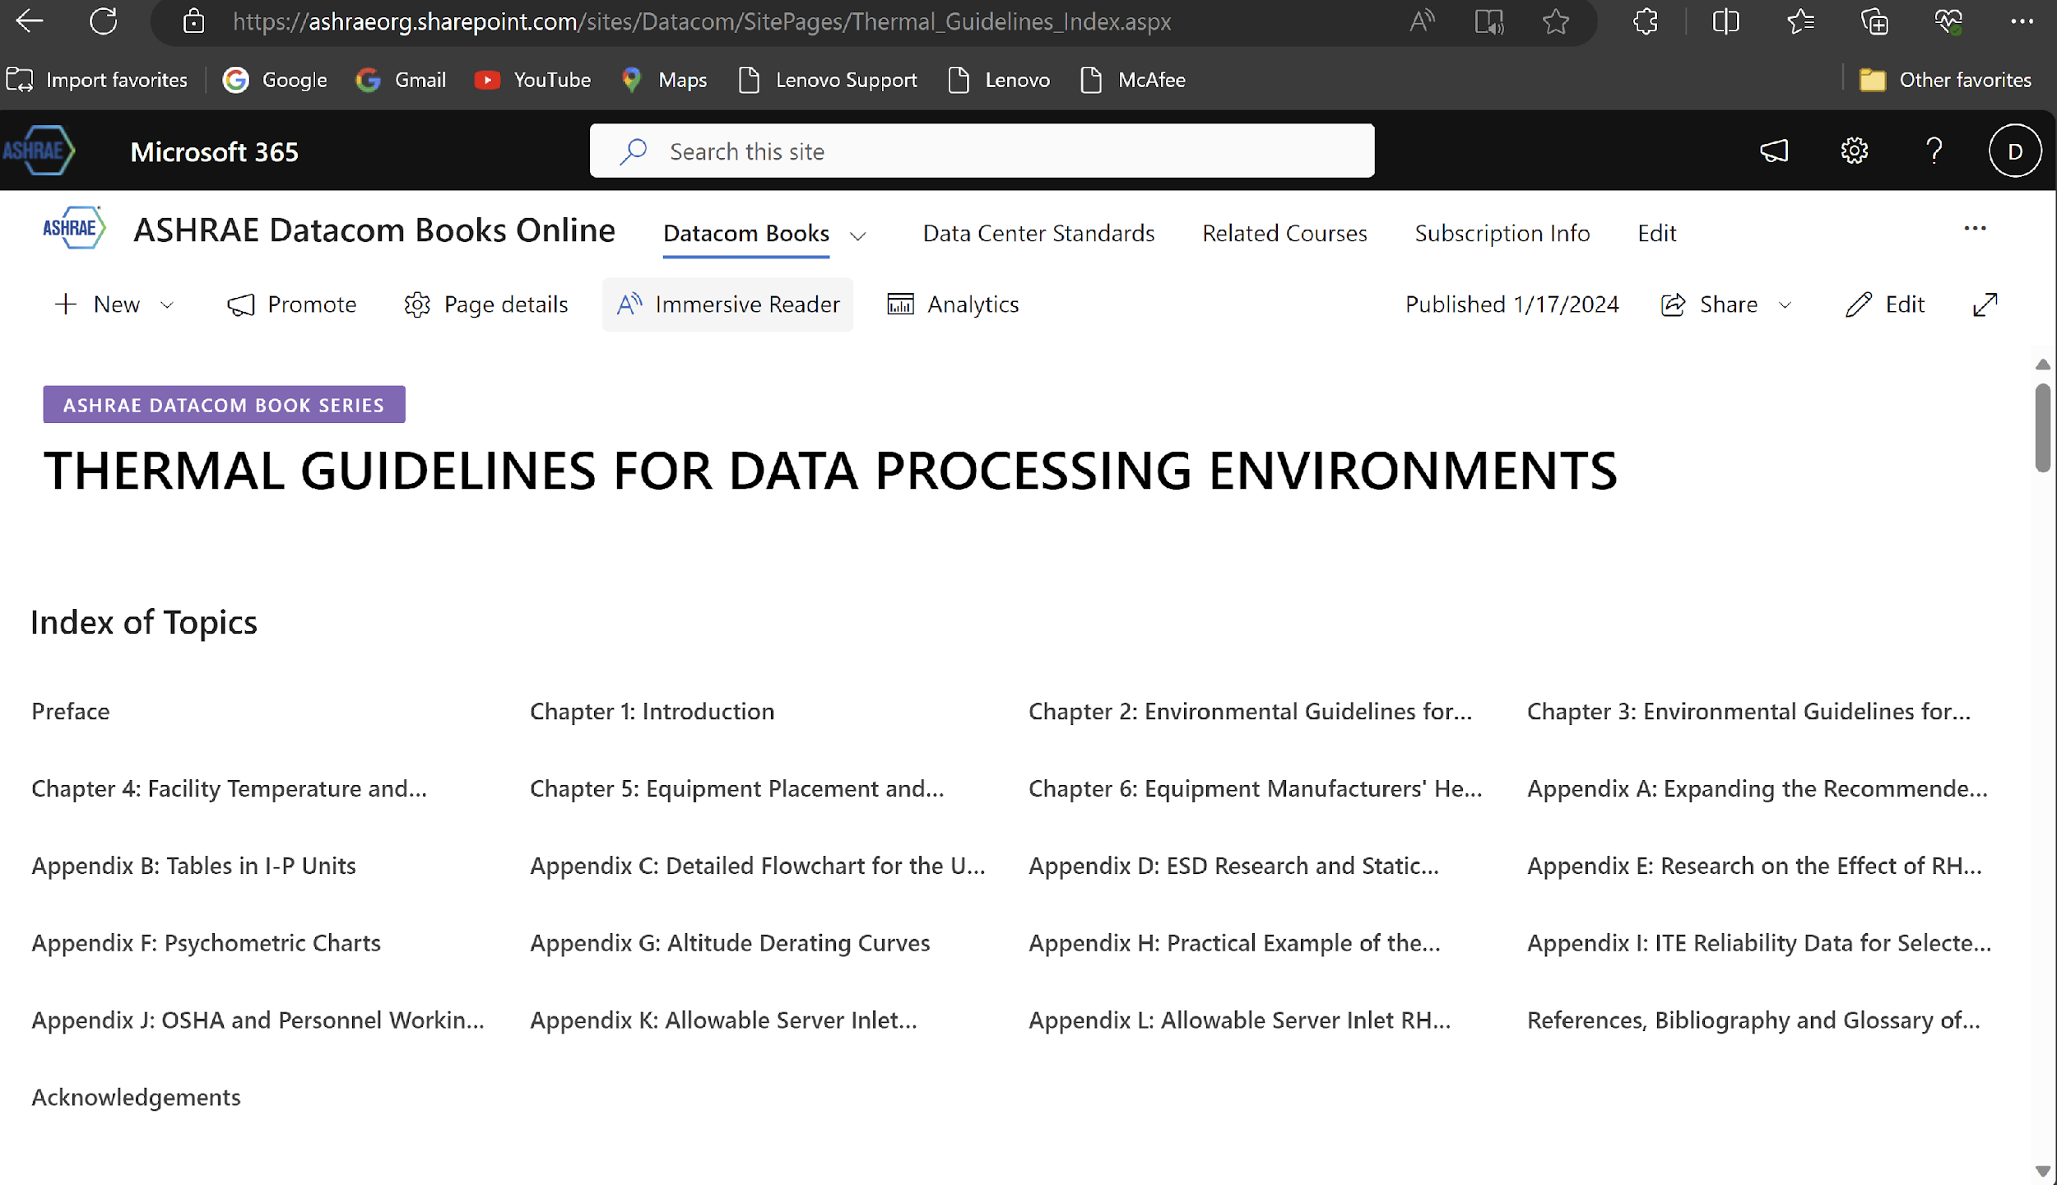
Progress – Sharepoint Site – Book

Slide 102
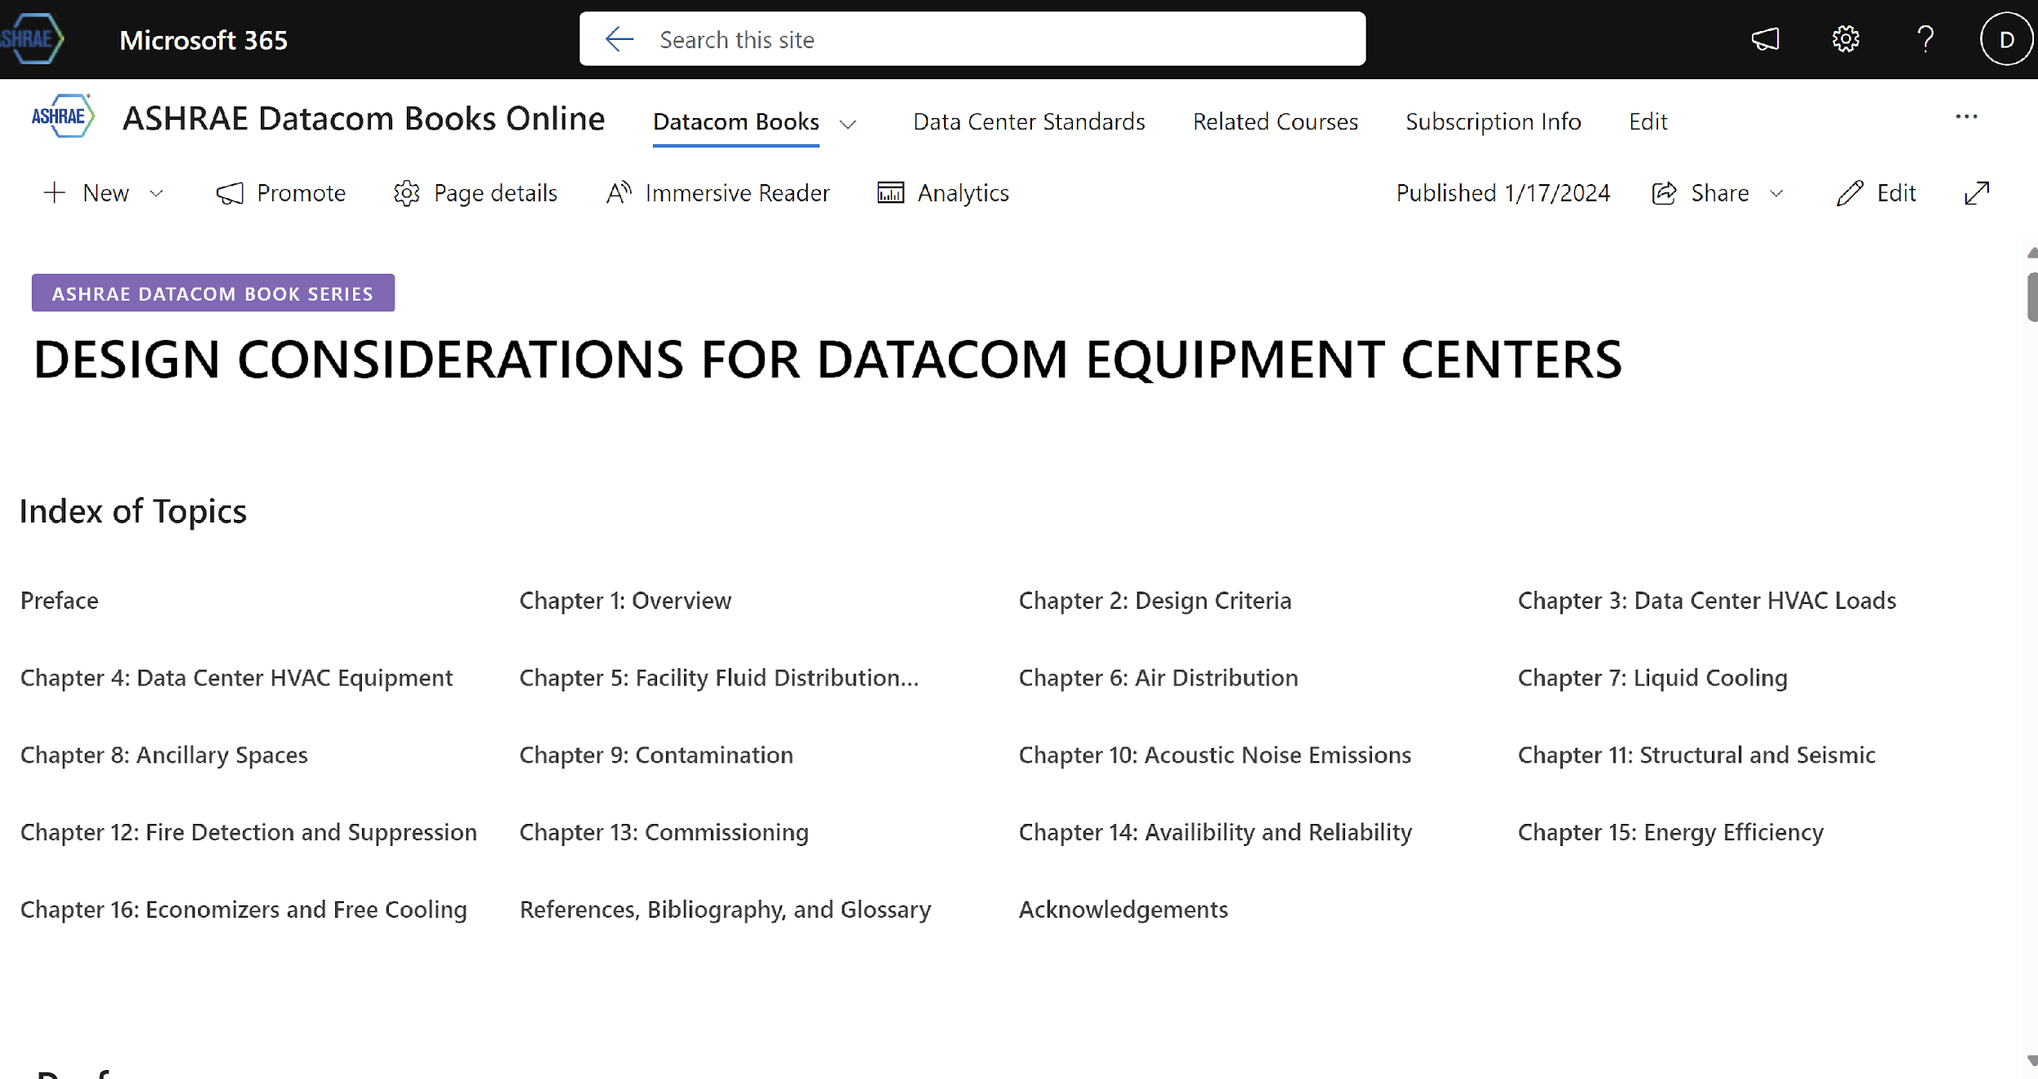
Progress – Sharepoint Site – Book

Slide 103
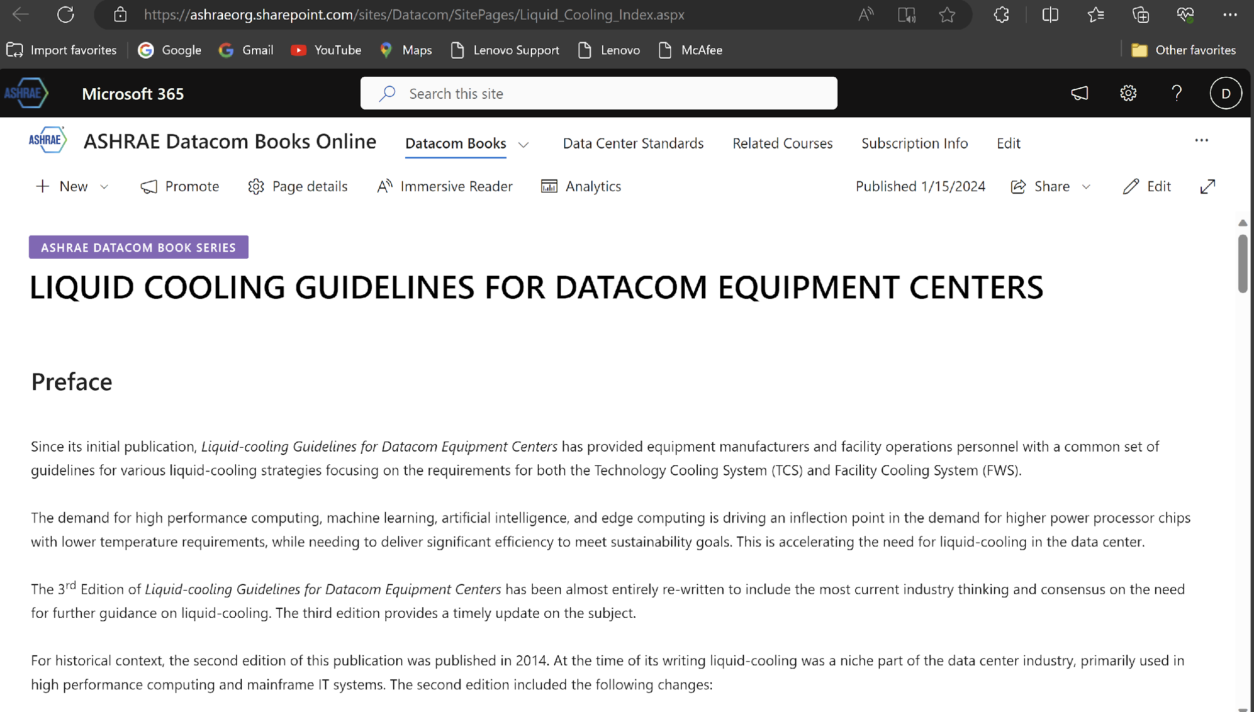
Progress – Sharepoint Site – Book

Slide 104
Table of Contents

Slide 105
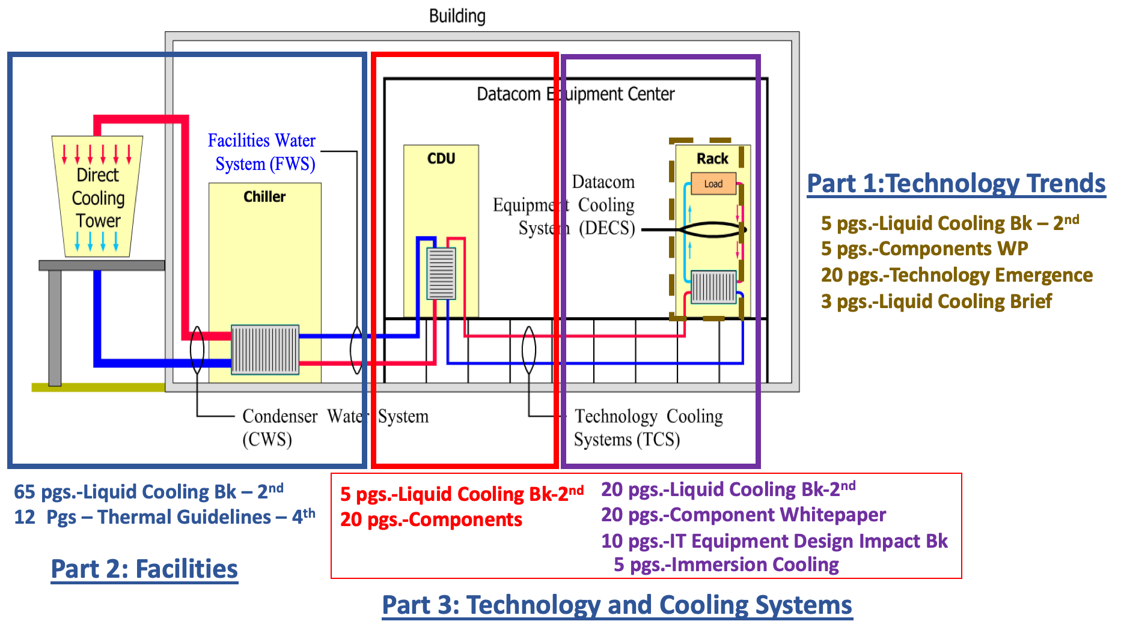
Liquid Cooling Book Status

Slide 106
Liquid Cooling Book Status
At winter meeting, it was reported that the “Facilities” and “IT” group efforts were merged.
Significant progress was made on completing a first draft since the winter meeting.
Special thanks to Paul Artman, Mark Steinke, Tim Shedd, John Bean, Roger Schmidt for bi-weekly meetings to further develop content, writing, editing, and reviewing..
First draft is 11 chapters, 169 pages and 2 Appendix

Slide 107
Liquid Cooling Book Status
The third edition provides expanded and new information covering the following topics:
A discussion on the IT component power trends that are driving the need for liquid cooling to support the next generation of IT workloads.
A new set of environmental classes (S-Classes) for the supply temperature of the Technology Cooling System (TCS) coolant are introduced. These new guidelines provide a link to the Facility Water System (FWS) classes (W-Classes) to ensure both the facility and the datacom equipment are properly designed to support energy efficiency.
Expanded treatment of the differences in fluid quality requirements for the TCS and FWS loops.
Details are provided on the design characteristics of conductive cold plate cooling and immersion cooling systems.
Design guidance is added for air cooled facilities that are being upgraded to support liquid cooled datacom equipment.

Slide 108
Overview of Chapters
Chapter 1 states the purpose and objective of this book, defines key terminology associated with liquid cooling, and highlights the emerging trends driving the adoption of data center liquid cooling.
Chapter 2 provide the reader with an overview of the facility cooling system equipment and design considerations.
Chapter 3 provides detailed descriptions of the various liquid cooling implementations.
Chapter 4 describes the cooling distribution unit (CDU) function and design considerations.
Chapter 5 characterizes the facility cooling systems by providing guidelines on the interface requirements between the facility water system and the technology cooling system.
Chapter 6 introduces new technology cooling system (TCS) temperature guidelines (S-Classes) to ensure the IT equipment delivers full performance

Slide 109
Overview of Chapters
Chapter 7 describes the fluids and fluid quality considerations for both the Facility Water System and Technology Cooling System.
Chapter 8 describes the common components and their attributes that make up a conductive cooling (cold plate) liquid cooling solution for datacom equipment.
Chapter 9 describes different implementations of immersion cooling systems and considerations in their design.
Chapter 10 describes consideration for transitioning an air cooled data center to support liquid cooled datacom equipment.
Chapter 11 describes other considerations for liquid cooling environments such as monitoring/control, reliability and availability, commissioning, fire detection and suppression, and data center modeling.
Appendix A provides general characteristics of common fluid used in immersion cooling systems.
Appendix B provides guidance on considerations for commissioning liquid cooled datacom equipment.

Slide 110
Remaining Work / Needs
Looking for Server OEMs to help provide data on the number of liquid cooled products since 2017.
Finalize TCS supply water temperature classification values and provide further guidance for their use.
Need a figure showing Wet Break quick disconnects
Need support from design or consulting engineers with experience in upgrade an air-cooled data center to liquid to enhance Chapter 10: Transitioning to Liquid Cooling
Need somebody experienced with commissioning to review Appendix B: Liquid Cooling System Commissioning Checklist

Slide 111
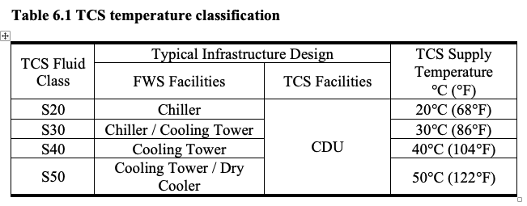
TCS Water Classes
The goal of the TCS temperature classification is to define a simple explanation of the relationship between the FWS and TCS such that the data center facility and ITE can be designed for interoperability across many generations of ITE. In addition, guidance is provided in the form of trends for maximum allowable TCS and FWS based on industry hardware power trends. The trend of maximum TCS fluid temperature can be translated to the maximum FWS water temperature using the CDU approach temperature.
DRAFT

Slide 112
Liquid Cooling Tech Brief
~10 pages of key points for those new to data center liquid cooling
A. Issues with Air cooling
1.CPU/GPU
2.Acoustics
3.Air flow
4. xxx
B. Server Liquid cooling designs
C. Facilities transition to Liquid cooling

Slide 113
Marine Corrosion Research
Motivation for Proposed Research
From an extensive literature search there are no published environmental conditions for operating data centers in marine environments that combine the key marine environmental parameters of salinity, T, RH, Wet/dry cycles, SO2, and particle size to guide data center operators on reliable operation, especially when those data centers desire to save energy by operating in economizer mode.

Slide 114
ASHRAE Work Statement Proposal
Study of the Corrosion Impact on Information Technology Equipment in Data Centers Located in Coastal Regions with High Sea Salt Concentrations and the Level of Filtration Required to Maintain Reliable Operation of this Equipment
Marine Corrosion Research
Work Statement rejected with the following areas for improvements:
          Split into 2 projects – one filtration and one corrosion
          Follow sea salt established testing stds
          Improve on design of testing apparatus
          Provide more data on the need of this research
          Expand on testing conditions to mimic server environments
          Support of IT Industry/Co-funding
      :
Sponsor: TC 9.9 Mission Critical Facilities, Data Centers, Technology Spaces and Electronic Equipment
Coordinated with: TC 2.3 Gaseous Air Contaminants and TC2.4 Particulate Contaminants
(all 3 TC’s voted unanimously on the draft WS to support this research)

Slide 115
Before updated Work Statement(WS) is submitted(targeted for end of this year)
1.Need 2 or 3 volunteers who have an interest in this subject to critically review updated WS and become co-authors
2.Need additional Data Center Operators/IT server manufacturers confirm reliability issues for data centers located in marine environments
3.Need some co-funding(in-kind or other) from those in the data center industry

Slide 116
Power Trends
Power Trends Update

Slide 117
Thermal Guidelines Tech Brief
Thermal Guidelines for Air Cooling
General Comments
These are guidelines and not a standard
They are developed from the best information that are gathered from IT manufacturers
They are updated periodically as new information is obtained – 5th update in 20 years
These guidelines are meant for operating data centers world-wide
Any data center can choose not to use these environmental guidelines and develop they own; the Thermal Guideline book offers a process by which to develop unique guidelines
Location conditions may permit improved reliability and energy efficiencies from operating in a different environmental envelope
If different environmental envelopes are used just be aware of the warranty requirements of the servers related to the environmental conditions

Slide 118

Current Work Items
General TC9.9 Work Items
 |  | Status | Expected Completion | Membership | Contact
Research | 1675-RP, Guidance for CFD Modeling of Data Centers | On-going | 3Q2021 | Closed | Mark Seymour mark.seymour@futurefacilities.com
Standards | SSPC 127, Method of Testing for Rating Computer and Data Processing Room Unitary Air Conditioners | On-going | Continuous | Open | John Bean jbean@grcooling.com
Standards | AHRI 1360, Performance Rating of Computer and Data Processing Room Air Conditioners | On-going | Continuous | Closed | David Kelley kelleydave9@gmail.com
Standards | ANSI/ASHRAE 90.1, Energy Standard for Buildings Except Low-Rise Residentail Buildings | SSPC | Continuous | Closed | Richard Pavlak rlpavlak@heapy.com
Standards | ANSI/ASHRAE 90.4, Energy Standard for Data Centers | SSPC | Continuous | Closed | David Kelley kelleydave9@gmail.com
Handbook | HVAC Applications, Chapter 20, Data Centers and Telecommunication Facilities | On-going | Continuous | Open | Bob McFarlane rmcfarlane@smwllc.com
IT Subcommittee
 |  | Status | Expected Completion | Membership | Contact
White Paper | Liquid Cooling Guidelines for Datacom Equipment Centers 3rd Edtion | On-going | 2023 | Open | Roger Schmidt c28rrs@us.ibm.com
Facilities Subcommittee
 |  | Status | Expected Completion | Membership | Contact
Datacom Book | Design Considerations for Datacom Equipment Centers, 2nd Edition | In Review | 4Q2021 | Open | John Gross john@jmgrossengineering.com
White Paper | Data Center Cooling Resiliency | On-going | 2022 | Open | Mark Mannex markm@mannex-eng.com

Slide 119
ICC-2024
UL/CSA 60335-2-40
ASHRAE Std. 15
Ben Dolcich

Slide 120
International
Don Beaty

Slide 121
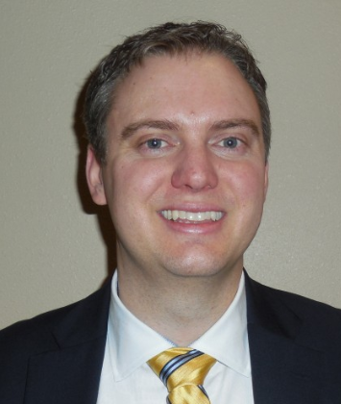

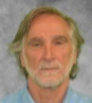
TC 9.9 Officers
Chair John Groenewold, Vantage Data Centers
Vice Chair Matt Koukl, Affiliated Engineers
Secretary Mark Steinke, AMD
Publications Chair Don Beaty, Retired Founder/CEO of DLB Associates
Research Subcommittee Chair Mark Seymour, Future Facilities
ITE Subcommittee Chair Dr. Roger Schmidt, IBM Fellow Emeritus
Syracuse University
Standards Subcommittee Chair Rick Pavlak, Heapy Engineering Retired
Program Subcommittee Chair Nick Gangemi, Northern Air Systems
Handbook Subcommittee Chair Robert McFarlane, Shen Milsom & Wilke, LLC
Webmaster Ecton English, Department of Defense
Marketing Subcommittee Chair Paul Finch, KAO Data

Slide 122
ASHRAE Research Policy Update
Budget increased to 350k ☺
However typical cost:
  2-year US$250k-330k ☺
  3-year US$350k-450k ☺
Therefore cost share can be required.
the suggestion is that co-funding can come from other organisations like DOE AHRI…
Not so much commercial…

Slide 123
Sea Salt
Justification from industry – Oil & gas industry, Telecom could provide support
Review of Work Statement – need reviewers
Co-funding – in-kind or financial. Could be organizational e.g. DOE, AHRI,…

Slide 124
Wetted Materials

Slide 125
External Flow
It appears there may already be a an RTAR in progress more generally on external flow for buildings
  Should we combine with that?
  Should we stick to more data center centric?
May be difficult to get second project funded by RAC.
Should we work independently to retain focus?
Can we have support statements and commercial funding to justify DC focus for additional RAC funding?

Slide 126
Other Research Ideas
Refrigerant ignition and flammability as applied to data centers – Rick Pavlak initiating potential RTAR. Currently exploring the topic
Other ideas?

Slide 128
ASHRAE Technical Cooling Systems Supply Coolant Temperature Classification
Paul Artman - Fellow System Design
1/22/2024
Content Copyright TC 9.9. All Rights Reserved.
Attendance: https://forms.gle/wjboSPgW6yQecKsW8
‹#›

Slide 129
Problem Statement
ASHRAE W Temperature Classes define Facility Water Supply Temperature (FWS) and not the inlet temperature to IT
Large CDU Approach Temperature ranges result in IT inlet temperatures 3-15°+ C higher than FWS
IT thermal requirement are based the inlet fluid temperature to the liquid loop: Not the FWS
For silicon and data center planning Technical Cooling Systems (TCS) Supply Coolant Temperature Classifications needs to be defined
1/22/2024
Content Copyright TC 9.9. All Rights Reserved.
Attendance: https://forms.gle/wjboSPgW6yQecKsW8
‹#›

Slide 130
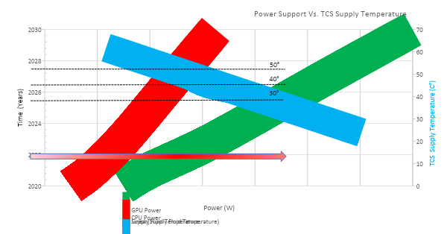
OCP TCS Supply Temperature Recommendations; AMD, Nvidia, Intel, MSFT, Equinix, Samsung
1/22/2024
Content Copyright TC 9.9. All Rights Reserved.
Attendance: https://forms.gle/wjboSPgW6yQecKsW8
‹#›

Slide 131
ASHRAE TCS Fluid Classes
1/22/2024
Content Copyright TC 9.9. All Rights Reserved.
Attendance: https://forms.gle/wjboSPgW6yQecKsW8
‹#›

