Slide 1
TC 8.2 Main Meeting
Chicago Winter – Hybrid Meeting
January 22nd, 2023
Notes:
Updated 1/31 7:15 with Research
Updated 1/31 8:27 with Webmaster
Updated 2/1 standards portion of agenda. Per phil Johnson
Updated 2/1 entire standards section per Phil Johnson
Updateed 2/1 9:20 90.1 from Phil J
Updated 2/1 Std 1520P with slide from Matt Cambio
2/1 Updated Honors and Awards based on Rick Heiden email.
Updated 2/1 Membership and Chairs breakfast updates – from Drew Turner’s email

Slide 2
Call to Order, Welcome, and Introductions
Welcome - Hybrid Meeting Format
Introductions (26 total):
  Officers (3)
  Members (14, 3 online)
  Liaisons
  Guests (6)
Notes:
Updated 6/27

Slide 3
Quorum Check – Trent Hunt
8 Voting Members/ 6 in attendance (1 online)
Scott MacBain – Currently listed on committee site as non-voting
Dan Kemper
Brandon Gill (absent)
Chris Miller
Michael Perevozchikov – Currently listed on committee site as non-voting
Nick Zupp (absent- present at virtual sub-committee meeting)
Drew Turner
Tiffany Bates Abruzzo
Notes:
Updated 6/27

Slide 4


In all your interactions at these meetings, please remember…
Code of Ethics
“As members of ASHRAE or participants in ASHRAE activities, we pledge to act with honesty, fairness, courtesy, competence, integrity and respect for others in our conduct.
We will avoid conflicts of interest and behavior that is discriminatory and/or harassing.”
https://www.ashrae.org/about/governance/code-of-ethics
Notes:
The Code of Ethics is the basis for which we interact with one another.

Slide 5
Agenda
Call to Order, D. Turner
Introductions
Quorum check – T. Hunt
ASHRAE Code of Ethics Commitment – D. Turner
Agenda Review – D. Turner
TC 8.2 Mission Statement & Scope & Vote to Re-affirm – D. Turner
Reviewed/Approve Summer 2023 Meeting Minutes – Basecamp – D. Turner
Reports:
  Program - M. Rogan
  Research – D. Showalter
  Handbook - S. MacBain
  Standards - P. Johnson (w/ supporting cast)
  MTG Low GWP Liaison Update – P. Johnson
  Membership & Transition – T. Hunt
  Web Master – D. Kemper
  Honors and Awards – R. Good
  Chair’s Breakfast Report – T. Bates Abruzzo
Old Business – D. Turner
New Business – D. Turner
For the Good and Wellbeing ….
Adjourn

Slide 6
TC8.2 Centrifugal Machines Scope
TC 8.2 is concerned with packaged equipment which involves centrifugal compressors, including those heat exchangers, drivers, controls and accessories, which are specific to packaged centrifugal equipment.
TC 8.2 is also concerned with the design and performance of centrifugal compressors, steam turbines and gas turbines for use in refrigerating applications.

Slide 7
TC8.2 Centrifugal Machines Mission Statement
The mission of Technical Committee 8.2, Centrifugal Machines, is to provide world class technical expertise on all aspects of centrifugal refrigeration machines.
This committee is a resource to industry, academia, and others following society protocols through seminars, standards, technical papers/articles and other presentations.

Slide 8
TC8.2 Centrifugal Machines Mission Statement
The mission of Technical Committee 8.2, Centrifugal Machines, is to provide world class technical expertise on all aspects of centrifugal refrigeration machines.
This committee is a resource to industry, academia, and others following society protocols through seminars, standards, technical papers/articles and other presentations.
Motioned & Voted to continue- do want to update 8.2 to Chillers & 8.1 to Compressors

Slide 9
Review and Approve Previous Meeting Minutes
2023 Summer (Tampa) Hybrid Meeting Minutes
Motioned & Voted to approve

Slide 10
Standards Report
Standards Subcommittee – Phil Johnson (chair)
TC 8.2 is the cognizant TC for:
  ASHRAE Standard 30-2019 Method of Testing Liquid Chillers
    [TC 8.2 is lead; TC 8.5 is co-cognizant]
  ASHRAE Standard 184-2020 Method of Test for Field Performance of Liquid-Chilling Systems
  ASHRAE Standard 225-2020 Method for Performance Testing Centrifugal Refrigerant Compressors and Condensing Units
TC 8.2 also monitors activity for the following standards of interest to members:
  ASHRAE Guideline 22-2012 Instrumentation for Monitoring Central Chilled-Water Plant Efficiency
    [TC 9.1 is cognizant]
  ASHRAE Standard 23-2022 Methods for Performance Testing Positive Displacement Refrigerant Compressors and Compressor Units
  [TC 8.1 is cognizant]
ASHRAE Standard 90.1-2022 Energy Standard for Buildings Except Low-Rise Residential Buildings
    [TC 7.6 is cognizant]
  ASHRAE Standard 205-2023 Representation of Performance Data for HVAC&R and Other Facility Equipment
    [TC 4.7 is cognizant]
  AHRI Standards 550/590|551/591-2023 Performance Rating of Water-chilling and Heat Pump Water‑heating Packages using the Vapor Compression Cycle
  AHRI Standard 1520-2022 Performance Rating of Centrifugal Refrigerant Compressors
  ISO TC 86 / SC 4 Testing and rating of refrigerant compressors (ISO/AWI 18501, 18483, 18976)

Slide 11
Standards Report
ASHRAE Standard 30-2019 (Nick Zupp, Chair SSPC30)
Developing addenda to ASHRAE Standard 30-2019 “Method of Testing Liquid Chillers” (designated as continuous maintenance)
Anticipate publication of a 2024 edition (definitely with Addenda a, b, f; possibly with Addendum d and/or Addendum c)
Updated errata sheet issued 2023-May-18
PPR2 for Addendum d during Nov-3 to Dec-3, please review! (https://osr.ashrae.org/)
2023-Oct-6 meeting:
  Will postpone PPR1 of Addendum c until after PPR2 of Addendum d.
  Reviewed the AHRI proposed test plan to collect test data for air sampler temperature array versus air sampler with aspirating psychrometer (Addendum e). Comments/feedback pending.
  On the issue of potential condensation during test (HP & HR), will incorporate proposed resolution as part of Addendum c.
Next meeting: Tue Nov 14
Addendum a. Published in May 2020. Mainly clean-up including a requirement to test based on defined operating mode set points.
Addendum b. Published in April 2020. Mainly clean-up including clarification of Δp_{adj}. Republished to add missing calibration workbook (.xlsx).
Addendum c. Addition of adiabatic, free-cooling, and 4-pipe chillers by introduction of hybrid operating modes. APR1 Nov 2020. PPR1 public review expected in early 2024.
Addendum d. Review of steady-state criteria. APR1 Nov 2020. PPR1 Jun/Jul 2023. PPR2 Nov/Dec 2023.
Addendum e. Harmonization with AHRI 550/590, Section 4. Addition of air sampling arrays. PPR1 public review expected in 2024.
Addendum f. Published January 2023. Inclusion of AHRI 550/590, water pressure drop calculation tool.
Notes:
Updaetd 6/27

Slide 12
Standards Report
ASHRAE Standard 184-2020 (Phil Johnson)
Standard 184-2020 was published in November under periodic maintenance.
TC 8.2 decided and voted (7-0-0-1) in Tampa to recommend forming a committee to revise the standard (e.g. additional work on the uncertainty calculator spreadsheet workbook). 5-year cycle would need to publish next edition by 2025 (-ish?), deadline to decide “withdraw, reaffirm, or revise” was 2023-Nov-30.
Periodic Maintenance Recommendation form submitted 2024-01-16, probably too late to be on Chicago agenda for Standards Reaffirmation Subcommittee (SRS to StdC).

Slide 13
Standards Report
ASHRAE Standard 184-2020 (Phil Johnson)
Recap of discussion points from Tampa (2023-Jun):
ASHRAE Standards staff provided a review of the standard
There is quite a list of issues that could be “cleaned up”, including out of date references, use of permissive language (need to better word-smith it), and inconsistent units of measure formatting
staff recommendation is “Revision”
P. Johnson found some errors in the example spreadsheet (part of Informative Appendix I), agrees with the recommendation, with the expectation that the work plan would limit the scope to correcting the issues from the staff review and any other “minor” changes identified

Slide 14
Standards Report
ASHRAE Standard 225-2020 (Phil Johnson)
Standard 225-2020 was published under periodic maintenance (5‑year cycle) SPC 225. SPC 225 has been disbanded.
Based on a TC 8.2 letter ballot passing, to accept being the cognizant TC, Mark Weber (staff liaison) confirmed on 2023-Jul-10 that the change was made.
TC 8.2 will need to decide if and when to form another committee to revise the standard. 5-year cycle would need to publish next edition by 2025, deadline to decide “withdraw, reaffirm, or revise” was 2023-Apr-13 (TC 8.1 was listed as cognizant at that time & notification went to TC 8.1). Notification with attachments received 2023-Jul-10.
Staff recommended revision due update references (and possibly to remove a 3 instances of permissive language). Scope of effort appears to be minimal.
Discussion: decision made to revise & make following motion

Slide 15
Standards Report
ASHRAE Standard 225-2020 (Phil Johnson)
Motion:
TC 8.2 recommends to form a SPC 225 to revise Standard 225-2020, and authorizes P. Johnson to fill out the form “Periodic Maintenance Recommendation to SRS” for D. Turner to review and approve with signature.
Vote tally: 6 for/ 2 absent

Slide 16
Standards Report
ASHRAE Guideline 22-2012 (Daryl Showalter, Chair GPC22)
Developing next edition of ASHRAE Guideline 22-2012 “Instrumentation for Monitoring Central Chilled Water Plant Efficiency” (designated as periodic maintenance)
PPR2 closed 1/15/24- supportive comments, finally wrapping up since 2015..

Slide 17
Standards Report
ASHRAE SPC 196 (Daryl Showalter)
Developing new document ASHRAE Standard 196 “Method of Test for Measuring Refrigerant Leak Rates”
From Tampa- Appear to have reached consensus on resolving a fundamental question with the measurement method (under what range of conditions are ideal gas assumptions sufficiently valid), now need to implement the changes into the draft (and propagate changes into the examples in the informative appendices)
Committee on target to have PPR1 sent out in Q1 2024

Slide 18
Standards Report
ASHRAE Standard 23 (Scott MacBain, past Chair SPC23)
Standard 23-2022 published “Methods for Performance Testing Positive Displacement Refrigerant Compressors and Compressor Units”.
There remains potential for either a future merger of 23 and 225, or perhaps harmonization activities.

Slide 19
Standards Report
ASHRAE Standard 90.1-2022 (Rick Heiden)
Standard 90.1-2022 published (December 2022)
New addenda to the 2022 edition (when published) will be available at:
https://www.ashrae.org/technical-resources/standards-and-guidelines/standards-addenda
Addenda status (*of interest to this committee):
  L – of general interest → net zero operational energy emissions (NZOEE), informative appendix that jurisdictions could adopt for buildings to achieve NZOEE over 1-3 code cycles.
  M – of interest for split chillers → hydronic and dx coils must be rated in accordance with AHRI 410-2023 (SI/I-P) Performance Rating of Forced-Circulation Air-Cooling and Air-Heating Coils
  Q – of interest for water cooled chiller systems → add pad-type (wetted media) adiabatic fluid coolers along with a minimum efficiency and the recently published CTI acceptance test code to Table 6.8.1-7 Heat Rejection Equipment. Technology being offered on some “free-cooling” air-cooled chillers https://www.thermalcare.com/adiabatic-fluid-coolers/
  V – of general interest → reference Std 169 Climate Data for Building Design Standards version 2021 instead of 2013, wrt US counties 85% no changes, 9% move to warmer zones, 3% to colder zones, 3% changes subzones (i.e. A, B, C)
Discussion topics of interest to this committee
  Fault Detection and Diagnostics prescriptive requirement
  >15 dT chilled water distribution requirements
  Chiller efficiency table updates in collaboration with related AHRI committee
Published | Publishing soon | In review | SSPC voting
bo, ca, cv, cw, a, b, d, f | h, i, j, m*, q* | e, al, cl, c, g, k, l*, n, p | r, s, t, u, v*, w, x, y

Slide 20
Standards Report
AHRI Standards 550/590|551/591 (Phil Johnson)
AHRI 550/590 (I-P) and 551/591 (SI) – 2023, Performance Rating of Water-Chilling and Heat Pump Water‑Heating Packages Using the Vapor Compression Cycle
2023 Editions of both standards are published as ANSI/AHRI. Include minor revisions to the 2020 editions. Include normative reference to ASHRAE 30 for method of test.
AHRI 1550P (proposed) Performance Rating of Liquid-Chilling and Heat Pump Water‑Heating Packages Using the Vapor Compression Cycle
Would replace 550/590 and 551/591, merge separate IP & SI edition into a single standard.
Project charter scope of revisions for next edition after that (circa 2025) includes the following items:
  Review tolerances and incorporate units with variable flow
  Continue to work toward harmonizing section 4 with ASHRAE 30
  Review uncertainty analysis reporting requirements
  Adiabatic cooled condensers
  Heat Pump Part-Load Metrics
  Review of rounding throughout documents
  Review Standard Rating Conditions
  Regional part load metrics
  Ratings for units with more than two heat exchangers

Slide 21
Standards Report
AHRI Standard 1520 (Matt Cambio)
AHRI Standard 1520-2022, Performance Rating of Centrifugal Refrigerant Compressors
This standard will provide a rating method for centrifugal compressors and a calculation method to compare centrifugal compressors with positive displacement compressors.
Published
New method is compressor performance specification (table format)
A tool is being created by Purdue for reading data and calculating performance as well as comparisons with positive displacement compressor 10 coefficient model
The tool is MatLab based and will be made available along with source code
Additional Notes:
Reference to ASHRAE 225, Methods for Performance Testing Centrifugal Refrigerant Compressors and Condensing Units
Similar format to AHRI 540, Performance Rating of Positive Displacement Refrigerant Compressors and Compressor Units
AHRI Compressor Standards Technical Committee will maintain the standard (responsible for a total of 7 standards including 1520)

Slide 22
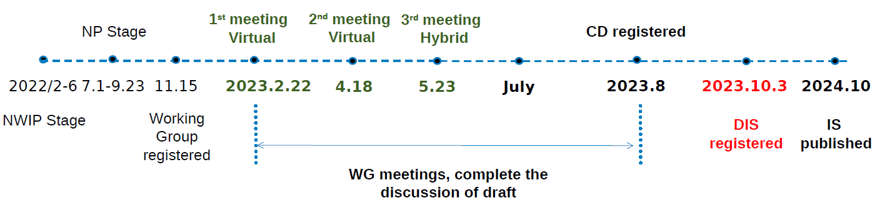
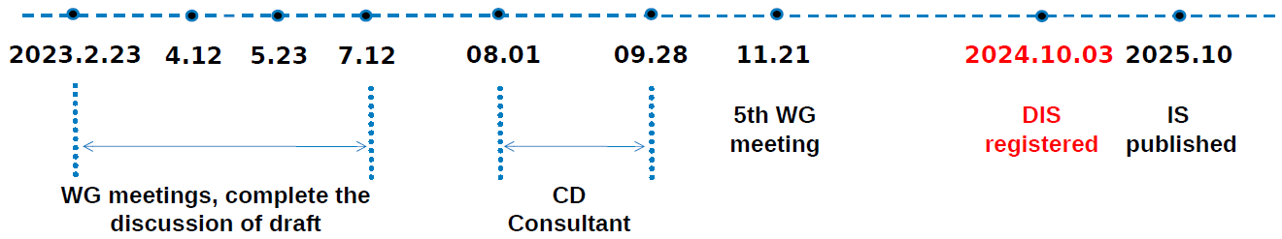
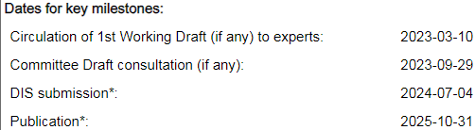
Standards Report
ISO/TC 86/SC 4 (Justin Prosser)
Key:
TC = Technical Committee
SC = SubCommittee
WG = Working Group
AWI = Approved Work Item
TC 86: Refrigeration and air-conditioning, SC 4: Testing and Rating of refrigerant compressors
WG2: ISO 18501, Positive displacement refrigerant compressor (harmonizing: AHRI 540, EN 12900)
WG3: ISO 18483, Centrifugal refrigerant compressor (harmonizing: AHRI 1520)
WG4: ISO 18976, Testing of refrigerant compressors (harmonizing: ASHRAE 23 & 225, EN 13771-1, and withdrawn version of ISO 917)

Slide 23
MTG.LowGWP Report (Phil Johnson, TC 8.2 Liaison)
The MTG met Sun Jan 21 and will meet again Wed Jan 24.
Program Subcommittee. Seeking programs from TCs for co‑sponsorship.
Codes & Standards Subcommittee meets Tue Jan 23.
Research Subcommittee, current activity at the PMS level.
Active research project: RP-1806. RP-1855 final report was published fall 2023. Monitoring a few projects sponsored by other TCs.

Slide 24
MTG.LowGWP Report (Phil Johnson, TC 8.2 Liaison)
Research project status.
RP-1806 “Flammable Refrigerants Post-Ignition Simulation and Risk Assessment Update”
  Start date: Jan-2017.
  Slow progress. PMS received revised Task 1 interim report Jan-2022.
  Original scope included updating AHRI risk assessments for 2L refrigerants in 5 types of equipment, including chillers (centrifugal & screw, machinery room).
  Project has re-allocated the budget (more to Task 1) and not yet clear what scope will be reduced (or if more funding will be requested to complete original scope).
  PMS will soon receive a pilot study that completes the Task 2 and Task 3 work for just a small subset of the original scope (reach-in coolers). Results will determine go/no-go/redirect for remainder of the project

Slide 25
MTG.LowGWP Report (Phil Johnson, TC 8.2 Liaison)
Research project status.
RP-1855 “Determination of the Impact of Combustion Byproducts Hydrogen Fluoride (HF) and Carbonyl Fluoride (COF2) on the Safe Use of Fluorinated Refrigerants”
  Start date: Jan-2020
  Final report approved by MTG.LowGWP via letter ballot conducted after the Tampa meeting in June 2023.
  Report is available via the ASHRAE Technology Portal.
https://technologyportal.ashrae.org/

Slide 26
MTG.LowGWP Report (Phil Johnson, TC 8.2 Liaison)
More detailed report document available for the meeting minutes.
Reconfirm the representatives from TC 8.2 (Primary: Phil Johnson, Alternate #1: Laurent Abbas Ray Good, Alternate #2:Trent Hunt).

Slide 27
Program Subcommittee Report – Mark Rogan (chair)
Combined TC 8.02/8.01 Program Subcommittee Report
2024 Winter Meeting, Chicago, IL
Subcommittee Meeting: January 16th, 1:00 pm -3:00 pm EST
Attendees: Mark Rogan, Drew Turner, Mathew Cambio, Justin Prosser, Michael Perevozchikov, Davide Ziviani, Craig Bradshaw, Dan Kemper, Alex Schmig, Tiffany Abruzzo, Phillip Johnson, Chris Miller, Farhan Jurati, Riley Barta, Jethrow Medina, Nicholas Zupp, Margaret Mathison, Erik Anderson, Yintao Wang, Bruno de Carvalho, Heinz Juergensen, Kalen Gabel, Andreas Hoess, James Spalding, Sugun Tej Inampudi, Rick Heiden
Chicago Meeting Approval Update: 2 Programs Approved with TC 8.1: Seminar 41(Natural Refrigerants), and Seminar 56(15-degree delta T)

Slide 28
Program Subcommittee Report – Mark Rogan (chair)
Current Approved Programs – Winter Meeting Chicago January 20th- 24^{th,} 2024
Seminar 56 – 15⁰ Chilled Water Delta T in Standard 90.1: It’s Impact on Design Practices and Equipment Ray Good(Danfoss) is chair of seminar. Sponsored by TC8.2 and cosponsored by TC8.1. Presenters: Steve Taylor(Taylor Engineers), Rick Heiden(Trane), and Gregory Touron(Danfoss). Wednesday, January 24th, 2024, 9:45 – 10:45 CST Marriott Marquis Chicago, 2nd Floor, Great Lakes B
Seminar 41 – Natural Refrigerants in Refrigeration: Regulations and Applications Davide Ziviani(Purdue University)is chair of seminar. Sponsored by TC8.1 and cosponsored by TC8.2. Presenters: Matthew Cambio(Trane), Riley Barta(Purdue), and Stephan Elbel. Tuesday January 23rd, 2024, 9:45 – 10:45 CST Marriott Marquis Chicago, 2nd Floor, Great Lakes C
Great Job to all involved!!!!!

Slide 29
Program Subcommittee Report – Mark Rogan (chair)
Future Program Ideas – Beyond Chicago
Electrification of Heating Chapter 2: Industrial and Healthcare Markets as well as Hybrid Applications – Chris Miller possible chair. Good candidate for Track # 5; Electrification: Possibilities and Pitfalls.
System Design & Controls on Heat Pump & Heat Recovery Applications – Trent Hunt as possible chair. Rick Heiden, Drew Turner, and Chris Miller have been discussed as speakers. Chris should have at least desuperheater data from Kaiser Baldwin Project but not sure about HR data off the steam boiler as that system may not be running yet. Good candidate for Track # 5; Electrification: Possibilities and Pitfalls.
Advanced Compressor Modelling & Analysis – Craig Bradshaw to chair. Was submitted for Chicago but not accepted so plan is to resubmit for Indianapolis. Good candidate for Track # 3; Research Summit
Electrification of various Heating Applications and the challenges of capacity modulation using different compressor types: Which applications can be served by electrification today and which ones cannot. Rick Heiden as a potential chair. Good candidate for Track # 5: Electrification: Possibilities and Pitfalls
Application Issues with New Refrigerants and Centrifugal Chillers: Does Standard 15 (equipment room design) properly cover the flammability issue? Phil Johnson as a potential chair. Good candidate for Track # 8: Legislation, Standards, Codes, and Guidelines
Any other topic ideas? Open to the floor
Next Meeting
Subcommittee will meet via conference call in early June 2024

Slide 30
Program Subcommittee Report – Mark Rogan (chair)
2024 Summer Meeting/Conference Indianapolis:
Important dates:
Monday February 26th - Program Proposals Due
Monday April 1st - Program accept/reject notifications
TBD Program submission deadline
2024 Summer Meeting/Conference Program Tracks Indianapolis
  Track 1 - Fundamentals and Applications – Track Chair: Atilla Biyikoglu
  Track 2 - HVAC&R Systems and Equipment – Track Chair: Ng Yong Kong
  Track 3 – Research Summit – Track Chair: Kristin Cetin
  Track 4 – Professional Development – Track Chair: Ahmed Abdelsalam
  Track 5 – Electrification: Possibilities and Pitfalls – Track Chair: Kevin Brown
  Track 6 – Artificial Intelligence and the Built Environment – Track Chair: Vinod Venugopal
  Track 7 – Building Life Cycle Assessment – Track Chair: Money Khanna
  Track 8 – Legislation, Standards, Codes, and Guidelines – Track Chair: Cindy Callaway

Slide 31
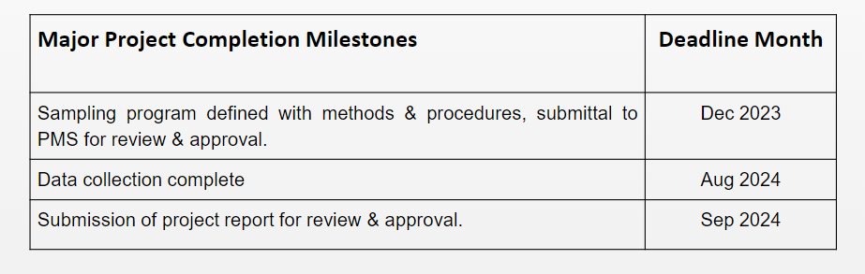
Research Subcommittee Report – Daryl Showalter (chair)
Research S/C Chair Breakfast notes of interest
Not attending, nothing to report.
Current Activities
Research Subcommittee online meeting was held June 20
Project Status
1716 - Oil concentration of field-installed liquid chillers with flooded type evaporators.
  Project has been awarded. Philip Johnson is the chair.
Notes:
Updated 6/28

Slide 32
Research Subcommittee Report – Daryl Showalter (chair)
1793 - Development of Method of Test for Motor Component Thermal Conductivity
  TC8.1 is taking the lead on this one and will resubmit from the comments.
  Waiting to hear back from TC8.1 chair but if we want to take this on happy to work on it.
1879 – Foamability properties of LGWP Refrigerant and Oil Mixtures
  Sponsored by TC3.4 and Co-Sponsored by TC8.1
  MORTS needs revised WS to rebid w/ Expanded Bidders list, new Budget Est. , Etc.
Future Activities
Decarb and heating mode how to get higher-temp heat pumps – willing to entertain a proposed Title for this if anyone wants to put one forward.
Notes:
Updated 6/28

Slide 33
TC 8.1 & 8.2 Handbook – Scott MacBain (Chair)
Agenda
TC 8.1:
  Refrigeration: Chapter 8 - Factory Dehydrating, Charging & Testing
    2022 Last Publication: MacBain, Sanchez, Perevozchikov
    2026 Next Up Revision: Scott MacBain, Joe Sanchez, Chris Seaton, Michael Perevozchikov (Looking for participants)
TC 8.1 & 8.2:
  2024 HVAC Systems & Equipment: Chapter 38 and 43 – Compressors & Liquid Chilling Systems
    Publication: Approved by TC8.1 & 8.2 Committees via mail ballot and submitted to ASHRAE Q423
    Davide Ziviani, Craig Bradshaw, Michael Perevozchikov, Rick Heiden, Scott MacBain
    2028 Next Revision
Authoring Portal: Confirm document access on authoring portal: https://authoring.ashrae.org/
  Contact Heather Kennedy(hkennedy@ashrae.org) if you have any issues with Microsoft login
Looking for new blood to participate as the Handbook Chair for 8.1 and 8.2! Jethro Medina Interested

Slide 34
TC8.2 Leadership Roles – Drew Turner
Chair – Drew Turner
V Chair – Trent Hunt
Secretary – Tiffany Bates Abruzzo (replacement- Scott MacBain?)
Handbook – Scott MacBain (replacement- Jethrow Medina?)
Programs – Mark Rogan
Standards – Phil Johnson
Research – Daryl Showalter
Webmaster – Dan Kemper
Honors and Awards – Ray Good
MTG. LowGWP Liaison – Phil Johnson
MTG. LowGWP Alternate – #1 Ray Good (#2 Trent Hunt)
Effective until this summer annual meeting
Notes:
Updated 6/27

Slide 35
Membership – T. Hunt https://tpc.ashrae.org/Membership?cmtKey=83a02e09-1a12-4ee1-bbf8-3ba74490dec7
Final modifications to TC membership –
  Deleted – 13 & request from Steve Duda to be removed
  6 attendees at Main Meeting not on Roster
Updated 2023-2024 roster attached
Action to get Scott & Michael changed from Non-Voting to Voting
Action to confirm attendance/ Voting w/ Nick & Brandon
How to Import Your TC Roster Information into MS-Outlook - http://www.ashrae.org/TCs

Slide 36
Webmaster – Dan Kemper
General updates and maintenance
  Meeting time, current power point agenda and links posted
  Past 2023 agenda, power point minutes posted
Please send documents from 2024 seminars so they can be added to the presentations section of the website
https://tc0802.ashraetcs.org
Notes:
Updated 6/28

Slide 37
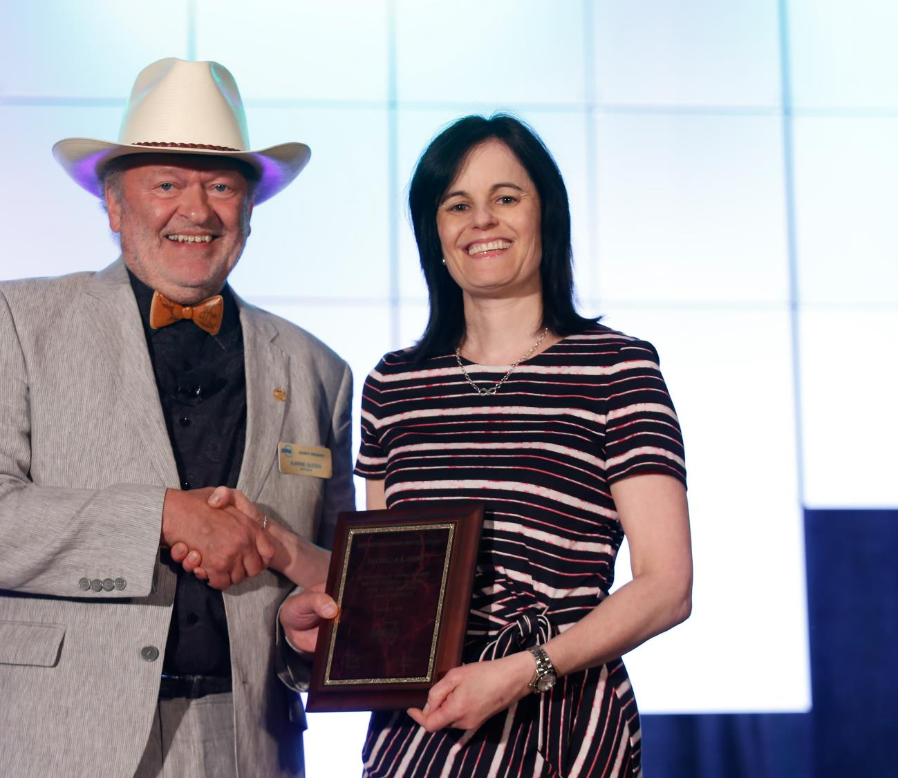
Personal Awards for
General Society Activities
Distinguished Service Award (DSA)
  Recognizes members who have served the Society faithfully and with distinction or otherwise given freely of their time and talent on behalf of the Society. A minimum of 15 points required on the point tally form.
  Nomination deadline: December 1
Exceptional Service Award (ESA)
  Similar to the DSA, except 45 points are required on the point tally form and the member must have been a Full Member for at least ten years.
  Nomination deadline: December 1
Developing Leader Award
  This award recognizes new members who have shown diverse involvement and commitment to ASHRAE withing five years of their Association Member join date.
  Recommended by the YEA Committee

Slide 38
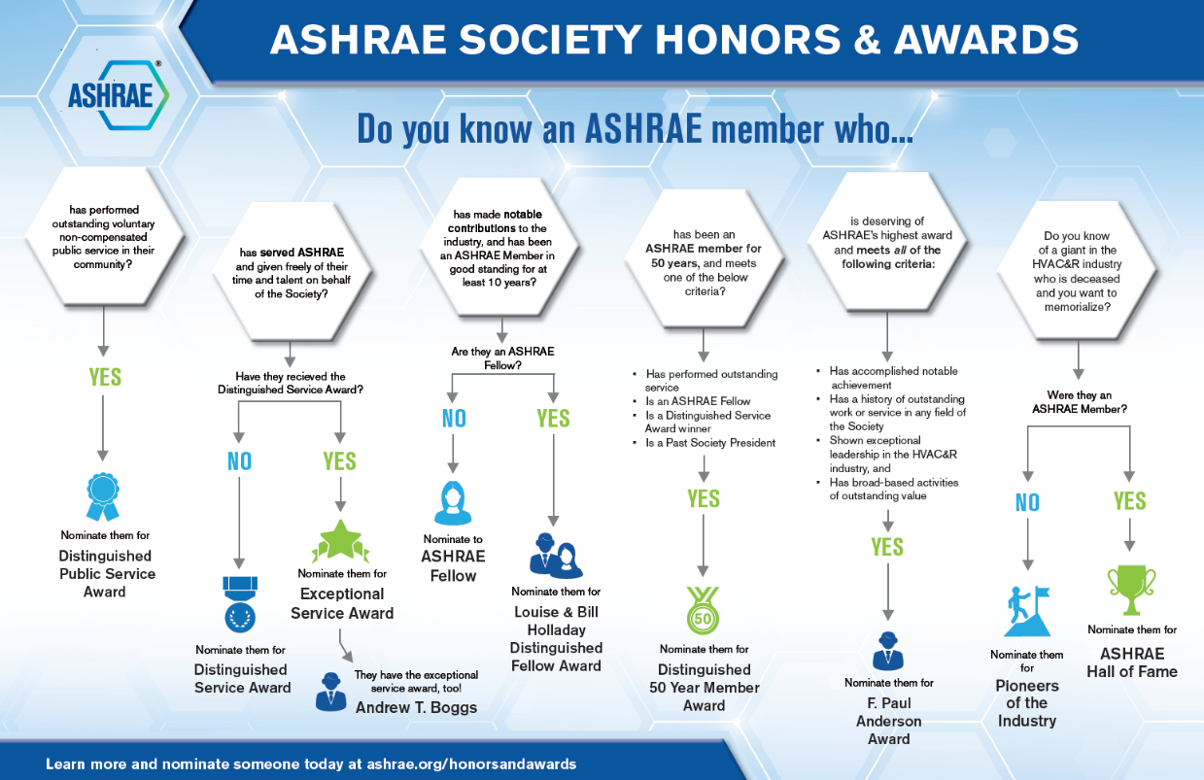
Honors and Awards Flowchart
Notes:
Flowchart is posted on the H&A webpage (www.ashrae.org/Honors) and available in printouts.

Slide 39
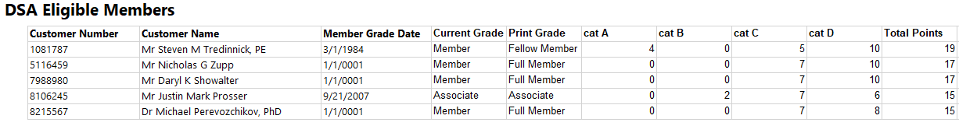
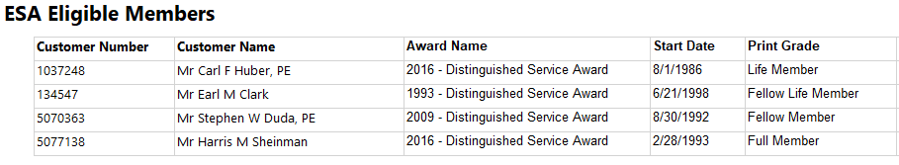
Honors and Awards – Ray Good Continued
TC8.2 Member DSA Qualifications (15 Points)
TC8.2 Member ESA Qualifications (45 Points)

Slide 40
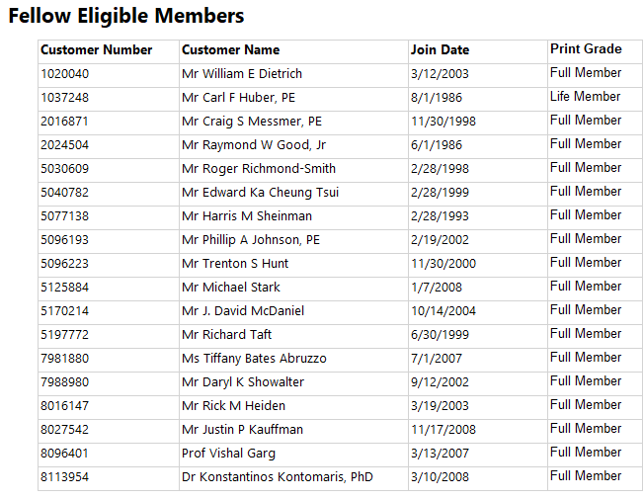
Honors and Awards – Ray Good Continued
TC8.2 Member Qualifications

Slide 41
Honors and Awards – Ray Good Continued
Current Activities:
Currently Exploring
  Phil Johnson for Standards Achievement Award
Encourage all members to update their ASHARE bios in an effort to qualify for additional honors and awards recognition
Consider others who may qualify as a Fellow or other awards
T Abruzzo & Ray Good to Coordinate on ESA/DSA & email out Fellow PP

Slide 42
TC Chairs Breakfast Report – T. Bates-Abruzzo
Global organization- GTIC & ISO involvement
Decarbonization task force- new platform Center of Excellence for Building Decarbonization (CEBD) & publications, focus on life cycle carbon footprint
Encouraging active participation and engaging with new members- explanation of different Programs at Conf
GAC Update- we are the resources for our politicians!
Hybrid virtual meetings are here to stay
Tracks for Indianapolis open/listed online
TAC training - Chair Breakfast Winter 2024.pptx (basecamp.com)

Slide 43
Old Business – D. Turner

Slide 44
New Business – D. Turner
New members (additions since summer meeting)
Esteban Baccini- present in person in Chicago
Dr Yintao Wang- present at virtual subcommittee meeting-
Andrew Hunter
Mingxia Hu
Ted Freeman
Dr Hanlong Wan
Attendees not on roster:
Robert Tucker Robert.tucker@atlascopco.com
Heath Whiddon heath.whiddon@danfoss.com
Sam Sills sam.sills.@tranetechnologies.com
Yecan Zhoy joel.chou@yeah.net
Heinz Juergeusen Heinz.juergeusen@bitzer.de
Brian Davis underwing1000@gmail.com

Slide 45
For the Good and Wellbeing

Slide 46
Adjourn

