Slide 1
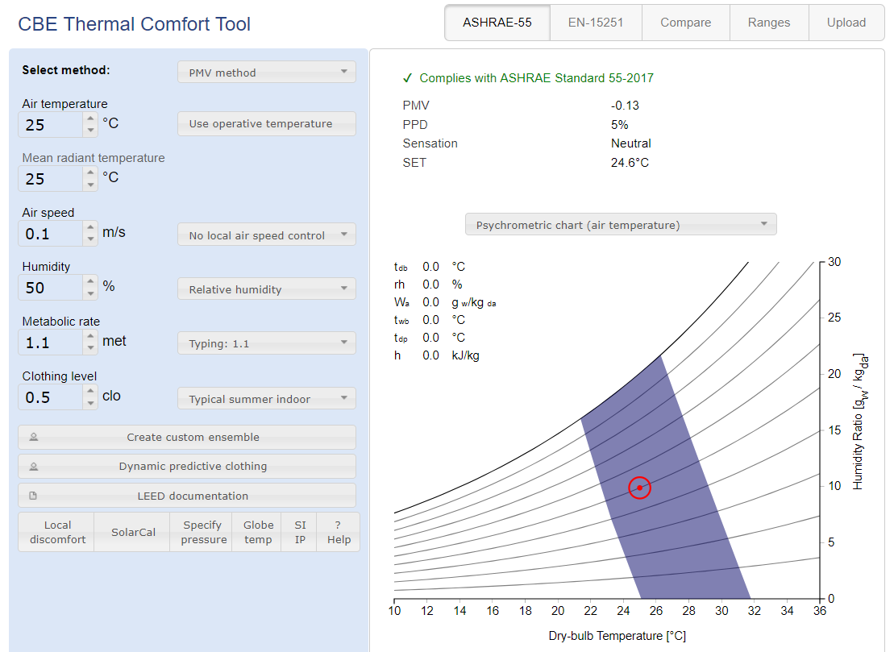
Hoyt Tyler & Schiavon Stefano et al. 2017, CBE Thermal Comfort Tool for ASHRAE-55. http://comfort.cbe.berkeley.edu/

Slide 2
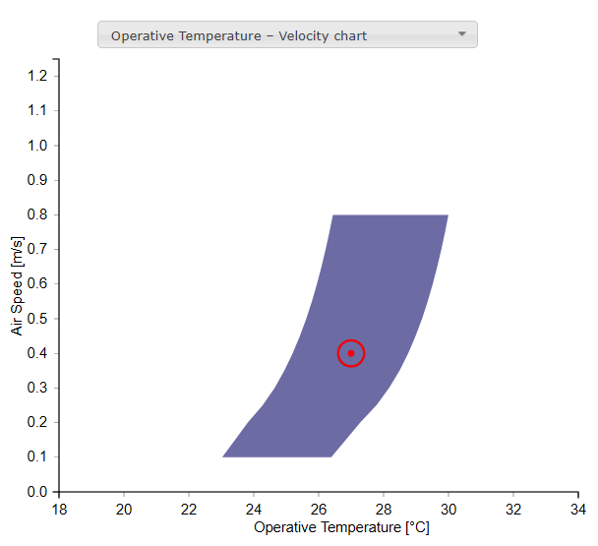
Thanks to Toby Cheung!

Slide 3
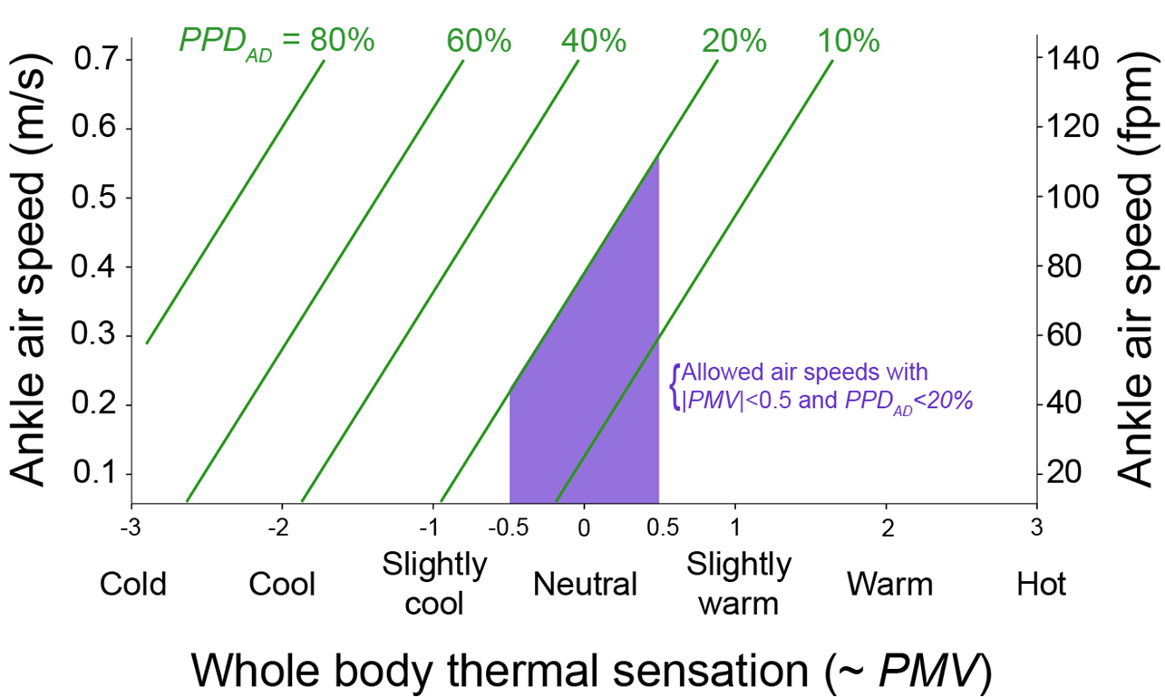
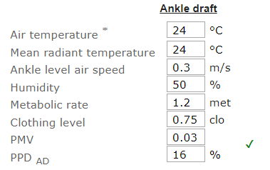
Ankle draft risk
Liu, Schiavon, Kabanshi, Nazaroff Predicted Percentage Dissatisfied with Ankle Draft Indoor Air

Slide 4
Percentage of commercial buildings showing at least 80% occupant satisfied with their thermal environment
Caroline Karmann, Stefano Schiavon, Ed Arens
CBE – UC Berkeley

Slide 5
Long-term occupant satisfaction survey
351 office in North America, 52980 occupants
Karmann C., Schiavon S., Arens E., 2018, Percentage of commercial buildings showing at least 80% occupant satisfied with their thermal comfort (submitted)

Slide 6
Long-term occupant satisfaction survey
Bar chart showing the distribution of temperature satisfaction votes
based on surveys from 52,980 occupants (in 351 office buildings)
Karmann C., Schiavon S., Arens E., 2018, Percentage of commercial buildings showing at least 80% occupant satisfied with their thermal comfort (submitted)

Slide 7
Long-term occupant satisfaction survey
Percentage of buildings meeting given percentages of occupants satisfied with temperature, based on surveys from 351 office buildings (52,980 occupants).
3 satisfaction criteria:
“-1 to +3”,
“0 to +3”,
“+1 to +3”
Karmann C., Schiavon S., Arens E., 2018, Percentage of commercial buildings showing at least 80% occupant satisfied with their thermal comfort (submitted)

Slide 8
LEED v4 EBOM EQc10
Intent: To assess building occupants’ comfort.
Performance: Administer at least one occupant comfort survey to collect anonymous responses regarding at least the following: acoustics; building cleanliness; indoor air quality; lighting; thermal comfort
Document survey results. Develop and implement a corrective action plan to address comfort issues if the results indicate that more than 20% of occupants are dissatisfied.
Perform at least one survey and implement corrective actions. At a minimum, perform one new survey at least once every 2 years.
Notes:
The responses must be collected from a representative sample of building occupants making up at least 30% of the total occupants.

Slide 9
WELL feature 86
In buildings with 10 or more occupants, the Occupant Indoor Environmental Quality (IEQ) Survey™ from the Center for the Built Environment at UC Berkeley (or approved alternative) is completed by a representative sample of at least 30% of occupants at least once per year unless otherwise noted
Notes:
The survey covers the following topics of occupant satisfaction: Acoustics; Thermal comfort, including humidity and air flow, at least twice a year (once during the cooling season and once during the heating season); Furnishings; Workspace light levels and quality; Odors, stuffiness and other air quality concerns; Cleanliness and maintenance; Layout.

Slide 10
ASHRAE Standard
“The purpose of this standard is to specify the combinations of indoor thermal environmental factors and personal factors that will produce thermal environmental conditions acceptable to a majority of the occupants within the space.”
“environment, acceptable thermal: a thermal environment that a substantial majority (more than 80%) of the occupants find thermally acceptable.”
“comfort, thermal: that condition of mind that expresses satisfaction with the thermal environment and is assessed by subjective evaluation.”
Notes:
Environment is assessed with right-now survey using Thermal sensation and Thermal acceptability, long term is Thermal satisfaciton

Slide 11
ASHRAE Standard
7.4.1 Evaluation Based on Survey Results
a. The probability of occupants satisfied shall be predicted from seven-point satisfaction survey scores by dividing the number of votes falling between -1 and +3 inclusive, by the total number of votes.

Slide 12
ASHRAE Standard – Appendix L
“An example thermal satisfaction survey is included in Figure L-2. It asks occupants to rate their satisfaction with their thermal environment (from “very satisfied” to “very dissatisfied”) on a seven-point satisfaction scale. Acceptability is determined in two ways: by the percentage of occupants who have responded “neutral” through “very satisfied” (0, +1, +2, or +3) with their environment or by taking a slightly broader view of acceptability, including the percentage who have responded (–1, 0, +1, +2, +3).”

Slide 13
ASHRAE Standard – Appendix L – Table 3
Measurement Method | Nature of Application
 | Short-Term Long-Term
 | Occupant Surveys | Right-Now/Point-in-Time Survey (must survey relevant times and population): Binning (TSENS scores) leads to % comfort exceedance during period of survey. Needs coincident temperature to extrapolate to full range of conditions (Used for research, problem diagnostics) | Occupant Satisfaction Survey: Survey scores give % dissatisfied directly. (‘dissatisfaction’ may be interpreted to start either below -1, or below 0) Time period of interest can be specified to survey takers. (Used for building management, commissioning, rating operators and real estate value, compliance with green building rating systems)
 | Environmental Measurements | Spot Measurements, Temporary (Mobile) Sensors (must select a relevant time to measure): Use measurements to determine PMV (Sections 5.3.1, 5.3.3) Use measurements to determine compliance with adaptive model (Section 5.4). (Used for real-time operation, testing and validating system performance) | Logging Sensors over Period of Interest, or Trend Data from Permanently Installed (BAS) Sensors: Exceedance hours: sum of hours over PMV or Adaptive Model limits. Binned exceedances may be weighted by their severity. Instances of excessive rate-of-temperature change or of local thermal discomfort can be counted (Used for evaluating system and operator performance over time)

Slide 14
ASHRAE Standard – Appendix L
Criteria for Passing
i. From neutral (0 scale unit) to +3. (Votes below this range generally comprise 40% of a building’s total votes in the CBE survey benchmark database [ASHRAE 2013]).
ii. Scale units –1 to +3. (Votes below this range generally comprise 20% of a building’s total votes in the CBE survey benchmark database).

