Slide 1

Welcome!
Welcome to the ASHRAE TC 9.9 Virtual Meeting!
No need to say hello, we will begin promptly at 6:00 pm CST
Agenda
  Introduction
  Programs
  Research
  Publications
Housekeeping
Audio
Attendees are muted upon entry
Do not un-mute your line
If you are joining via computer and phone line, ensure both are muted
Video
We encourage you to keep your video off
If you do enable your video, be mindful that you are on display! Turn off your video when needed.
Q&A
Use the chat function to ask questions
Our moderator will share questions throughout the presentation with the speaker to answer.
If you need to speak, please use the Raise Hand button and the moderator will enable your microphone.
Attendance
Please complete the attendance form found at the URL at the bottom of this slide
Notes:
Make this statement at the very beginning and re-state every minute or so until the meeting begins.
Hello and welcome to the ASHRAE ____________________ Meeting. My name is ____________ and I am the Facilitator for this meeting. We will begin the meeting promptly at 12:05pm. While you are waiting, please read our housekeeping announcements on this slide. If you have any questions or technical difficulties, please use the chat function.
Make this statement at meeting start time.
Hello and welcome to the ASHRAE ____________________ Meeting. My name is ____________ and I am the Facilitator for this meeting. It is now 12:05pm, so let’s being our meeting.

Slide 2

Mission Critical Facilities, Data Centers, Technology Spaces and Electronic Equipment
ASHRAE Winter Conference 2024
Programs, Research, & Publication
Hybrid In-Person / Virtual

Slide 3
Virtual Meeting Etiquette
Do not share your video due to the high number of virtual participants.
Prior to speaking individuals should state their name so that others know who is speaking.
Virtual participants should keep yourself muted unless giving permission to speak by the Host via chat.
Please do not attempt to share your screen without being asked to do so by the Host or Co-Host.
In-person participants are discouraged from joining the virtual meeting due to wireless bandwidth constraints.

Slide 4
Virtual Meeting Housekeeping
Virtual Host: Vice Chair - Mark Steinke
Monitor the chat thread for questions and comments.
Mute and Unmute Virtual Participants and Guests.
Manage discussions and voting.
Manage screen-sharing and in-person presentation
Virtual Co-Host: Secretary - John Gross
Monitor time and keep the meeting on schedule.
Record the event.
Produce meeting minutes.
Will repeat the attendance link multiple times during the meeting and upon chat request.
Respond to audio problems.

Slide 5
In Person Setup
Video projector that displays the presentation being shared virtually.
Be aware that chat comments sent to the Host may be seen by those in-person in addition to general chat comments.
There are audio speakers in the room but unmuted virtual commentators may not be immediately connected. Please be patient.

Slide 6
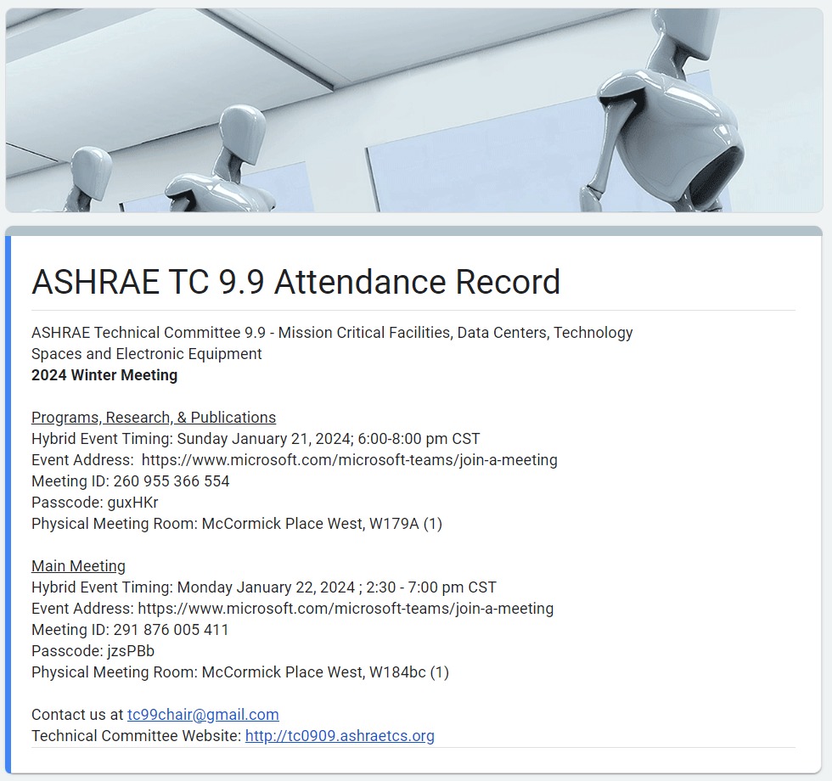

Attendance
Attendance is being recorded using a Google Form. Please make sure you complete the form at:
https://forms.gle/wjboSPgW6yQecKsW8
Or use the QR Code below:

Slide 7
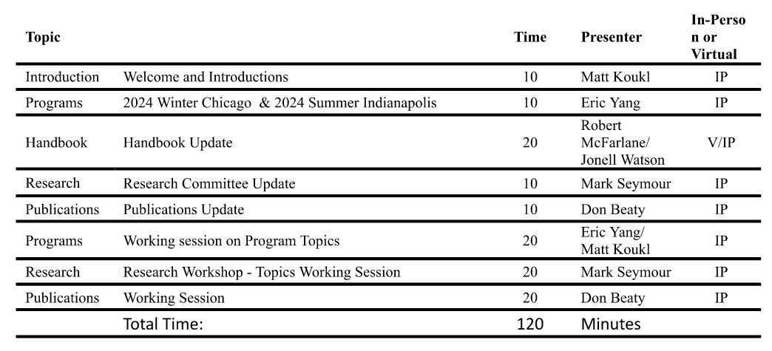
Agenda

Slide 8
Programs Update
ASHRAE 2024 Winter Meeting
Jan 20-Jan 24, 2024
Eric Yang, Program Chair

Slide 9
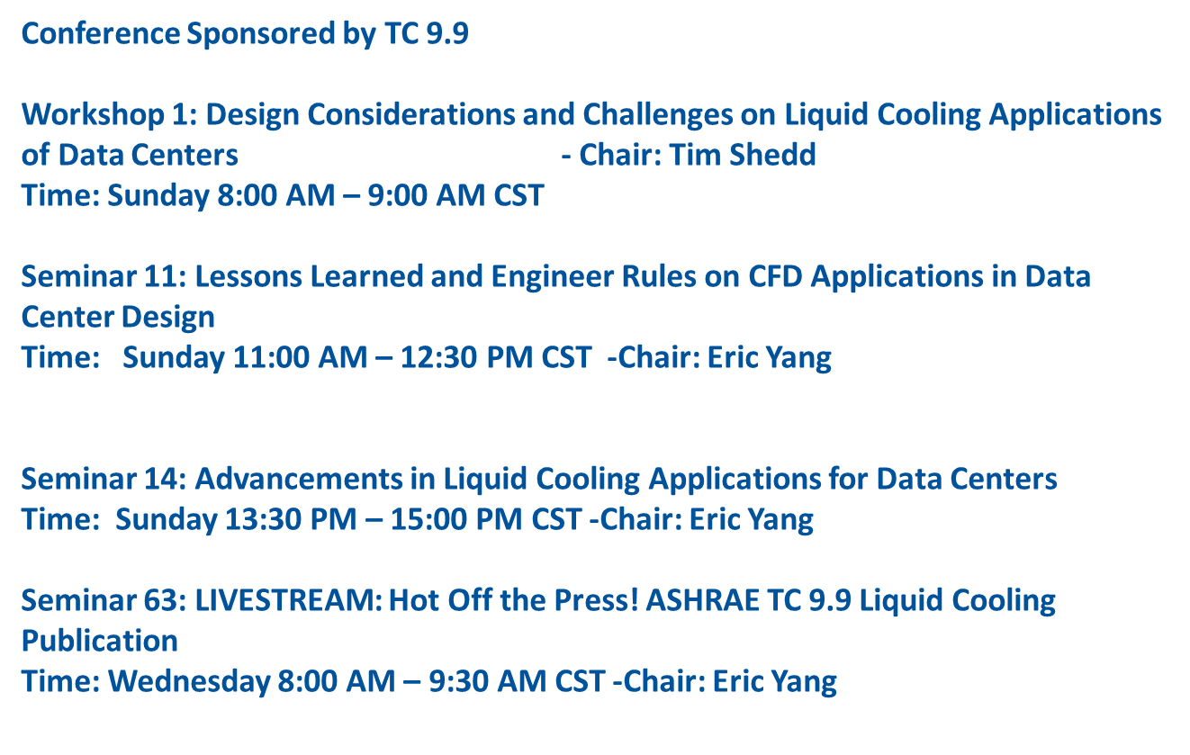
ASHRAE Winter Conference-Chicago

Slide 10
ASHRAE Annual Conference-Indianapolis
Overview of Conference Tracks:
Tracks
  Fundamentals and Applications
  HVAC&R Systems and Equipment
  Research Summit
  Professional Development
  Electrification: Possibility and Pitfalls
  Artificial Intelligence and the Built Environment
  Building Life Cycle Assessment
  Legislation, standard, codes and guidelines

Slide 11
Important Dates –Indianapolis
Monday, February 26, 2024| Debate, Panel, Seminar, Forum, Workshop, and Debate Proposals Due
Monday, April 1, 2024 | Conference Paper Accept/Revise/Reject Notifications
Orlando Programs

Slide 12
Program Types -Do not require Learning Objectives, Q&A
Panel Discussion
Feature a broad range of subjects and explore different perspectives on industry related topics.
This session format includes a panel of 3-6 speakers each addressing a facet of the session topic, followed by an interactive discussion lead by the session chair.
Debates
Highlight hot-button issues commonly faced by ASHRAE members. Industry experts, either on teams or as individuals, argue opposing sides of an issue, concluding with position summaries and audience feedback.
Forums (no recordings)
“Off-the-record” discussed held to promote a free exchange of ideas.
Allow individuals to speak confidently without concern of criticism.
There are no papers attached to forums.

Slide 13
Next Step
Contact me if you need to co-sponsorship from other TCs or other help to submit a program.
Contact Eric Yang (ericyangcem@gmail.com)

Slide 14
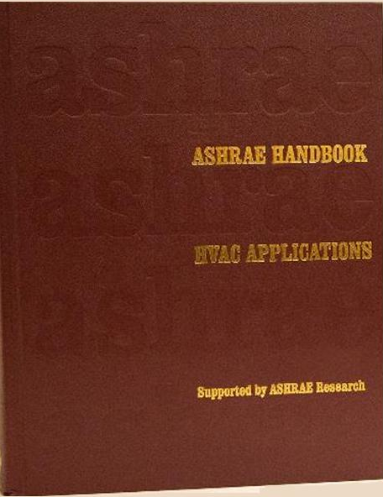
ASHRAE HANDBOOK
“Applications”
ASHRAE Handbook HVAC Applications
Chapter 20
“Data Centers & Telecommunication Facilities”

Slide 15
Agenda
Background
Discussion: Purpose
Current Status
Call for Volunteers
Review Plan
Next Steps
QA

Slide 16
Background
ASHRAE’s Applications Handbook:
  One of four ASHRAE Handbook publications (others are Fundamentals, Refrigeration, HVAC Systems and Equipment)
  Published on four-year cycle
TC9.9’s responsibilities include Writing Chapter 20 of the Applications Handbook: “Data Centers and Communications Facilities”
All revisions on a volunteer basis through TC9.9

Slide 17
Discussion: Purpose
Discussion: Purpose of Handbook Chapter
  Tutorial for New Engineers?
  Reference for Experienced Engineers?
  Design Guideline for Those New to Data Centers?
  To Alert to “What You Don’t Know”?
  To Suggest Retaining Subject Matter Experts?
  To Push Manufacturers to Standardization?

Slide 18
Current Status
The Applications Handbook last published 2023
The Handbook revision cycle restarts today!
Draft Revisions due April 1, 2026 to prep for 2027 republication
Initial draft complete
[Nov 15, 2025]
Approval by TC Board [Jun 27, 2026]
TODAY
Applications Handbook published [2023]
Revision Cycle Begins / Call for Volunteers [Jan 2024]
Draft Revisions Complete
[Apr 1, 2026]
Draft Revisions Submitted [Jul 19, 2026]
Applications Handbook published [2027]
2023 | 2024 | 2025 | 2026 | 2027

Slide 19
Who should volunteer?
Industry experts
New joiners
Less experienced, more experienced
Anyone!
You do not have to be a member of TC9.9 or ASHRAE to contribute!

Slide 20
Why Volunteer?
Contribute to The Society and support your industry
Be a role model for mentees and junior engineers
Experience developing industry text
Bragging rights
Major contributors* receive personalized Handbook and published recognition

Slide 21
How Can I Help?
Volunteer Roles
Primary reviewers
  Subject matter experts
Secondary reviewers
  Support to Primary
  Reviewing for clarity, consistency (removing duplicates, filling gaps), grammar, etc.
Tasks
Update technical understanding within your expertise (Primary)
Review texts for consistency:
  Within the chapter
  Across the Handbooks
  Across ASHRAE’s publications
  Across related industry standards and guidelines, etc.
Basic grammatical and spelling reviews (sanity checks)

Slide 22
Volunteer Commitment
All effort is on a volunteer basis
Level of effort per week varies based on level of support; estimates:
  Primary reviewers 3-5 hrs. per topic
  Secondary reviewers ~8 hrs. per topic
Commitment term is from initial volunteering (today) to completion of initial draft Nov 2025, and ad-hoc additional support to Apr 2026

Slide 23
How to Volunteer
Sign-Up on the Topic Spreadsheet in-person
Also Accessible via http://tc0909.ashraetcs.org/ under “TC 9.9 2024 Winter Meeting Presentations & Information”
Email us directly:
    Select Review Topics by Spreadsheet Line Number
    rmcfarlane@smwllc.com
    Jonell.watson@accenture.com
  Include Name, Company, and Email Address

Slide 24
Review Plan
Sign-up Sheet 1: Review Ch. 20 Content and Identify Authors & Reviewers for Each Topic
  Each Topic in Each Chapter Section Has Been Listed
  May Be Other Sub-Topics, or Topics to Add
  Also includes Figures, Tables, References, Definitions, and Bibliography
  Can We Reduce Subject Verbiage?
Sign-up Sheet 2: Cross-check Ch. 20 content with other Handbook chapters
  ASHRAE Wants To Reduce Duplication & Book Sizes
  May Need to Coordinate With Other TC’s to Ensure Proper Coverage

Slide 25
Sample Sign-up Sheet #1: Review Existing Ch. 20 Content
Ch20 content listed in chronological order
Suggestions for updates to the content (if any)
Include your name and contact to volunteer as a primary (SME) or secondary (support) reviewer
HANDBOOK APPLICATIONS CH 20 TOPICS
TOPICS | v2027 Comments | VOLUNTEER REVISORS
 |  | PRIMARY | SECONDARY
1. OVERVIEW & DEFINITIONS
OVERVIEW | Review
DEFINITIONS | Review
2. DATACOM EQUIPMENT, POWER TRENDS, AND ENVIRONMENTAL GUIDELINES
2.1 DATACOM EQUIPMENT WORKLOAD | Review
Load Characterization | Review
2.2 DATACOM EQUIPMENT RACKS | Review: Change title to Racks & Cabinets?
2.3 DATACOM EQUIPMENT (HARDWARE) | Review Intro
Server Classifications | Update?
Datacom Equipment Airflow | Add discussion wrt TOR Switch Extensions? (reverse installation of TOR switch for airflow configuration)
Liquid-Cooled Datacom Equipment | Review
Contamination | Review relative to latest Datacom Book & publications
Environmental Guidelines for Air-Cooled Equipment | Add discussion wrt Delta T? (e.g. mech calcs based on 20F ΔT and inlet air based on ASHRAE envelope guidelines)
Controlling Both Temperature and Moisture in a Datacom Environment to Maintain High Reliability | Add discussion wrt need for humidification?

Slide 26
Sample Sign-up Sheet #1: Review Existing Ch. 20 Content
Ch20 content listed in chronological order
Suggestions for updates to the content (if any)
Include your name and contact to volunteer as a primary (SME) or secondary (support) reviewer
HANDBOOK APPLICATIONS CH 20 TOPICS
TOPICS | v2027 Comments | VOLUNTEER REVISORS
 |  | PRIMARY | SECONDARY
1. OVERVIEW & DEFINITIONS
OVERVIEW | Review
DEFINITIONS | Review
2. DATACOM EQUIPMENT, POWER TRENDS, AND ENVIRONMENTAL GUIDELINES
2.1 DATACOM EQUIPMENT WORKLOAD | Review
Load Characterization | Review
2.2 DATACOM EQUIPMENT RACKS | Review: Change title to Racks & Cabinets?
2.3 DATACOM EQUIPMENT (HARDWARE) | Review Intro
Server Classifications | Update?
Datacom Equipment Airflow | Add discussion wrt TOR Switch Extensions? (reverse installation of TOR switch for airflow configuration)
Liquid-Cooled Datacom Equipment | Review
Contamination | Review relative to latest Datacom Book & publications
Environmental Guidelines for Air-Cooled Equipment | Add discussion wrt Delta T? (e.g. mech calcs based on 20F ΔT and inlet air based on ASHRAE envelope guidelines)
Controlling Both Temperature and Moisture in a Datacom Environment to Maintain High Reliability | Add discussion wrt need for humidification?

Slide 27
Sample Sign-up Sheet #2:
Cross-check Ch. 20 Against Handbooks
Ch20 content listed in chronological order
GREEN indicates content that may be covered in other Handbooks
GRAY indicates content most likely not addressed in other Handbooks
Section to write in which Handbook, Chapter, and governing TC are relevant
Include your name and contact to volunteer as a reviewer
Describe how other Handbook Ch content is related
HANDBOOK APPLICATIONS CH 20 TOPICS | OTHER LOCATIONS |  |  | REVIEWS
TOPICS | HANDBOOK | CH | TC | COMMENTS** | BY
1. OVERVIEW & DEFINITIONS
OVERVIEW
DEFINITIONS
2. DATACOM EQUIPMENT, POWER TRENDS, AND ENVIRONMENTAL GUIDELINES
2.1 DATACOM EQUIPMENT WORKLOAD
Load Characterization
2.2 DATACOM EQUIPMENT RACKS
2.3 DATACOM EQUIPMENT (HARDWARE)
Server Classifications
Datacom Equipment Airflow
Liquid-Cooled Datacom Equipment
Contamination
Environmental Guidelines for Air-Cooled Equipment
Controlling Temp. & Moisture in Datacom Environment for High Reliability
Environmental Guidelines for Liquid-Cooled Equipment
Datacom Equipment Nameplate Ratings and Manufacturers' Heat Release
Power Trends

Slide 28
NEXT STEPS
Signing up will get you access to ASHRAE “Authoring Portal” for review and revisions
  Requires Submitting Names & Emails and Confirming Access
  Now Works on ALL Browser Platforms Including MAC
  Can Work Simultaneously on the Same File
    Most Recent “Save” Will Be Seen by Others
  All Work Must Use “Track Changes”
  New or Revised Illustrations are Submitted Separately
    Written Permissions Are Mandatory!!
      Preference is “In Perpetuity”

Slide 29

ADDITIONAL QUESTIONS?
  Please advise Bob McFarlane or Jonell Watson
    rmcfarlane@smwllc.com
    Jonell.watson@accenture.com
  QUESTIONS?

Slide 30
Research Committee Update

Slide 31
Mission Critical Facilities, Data Centers, Technology Spaces and Electronic Equipment
ASHRAE Summer Conference 2023 Meeting
Hybrid In-Person / Virtual
Research

Slide 32
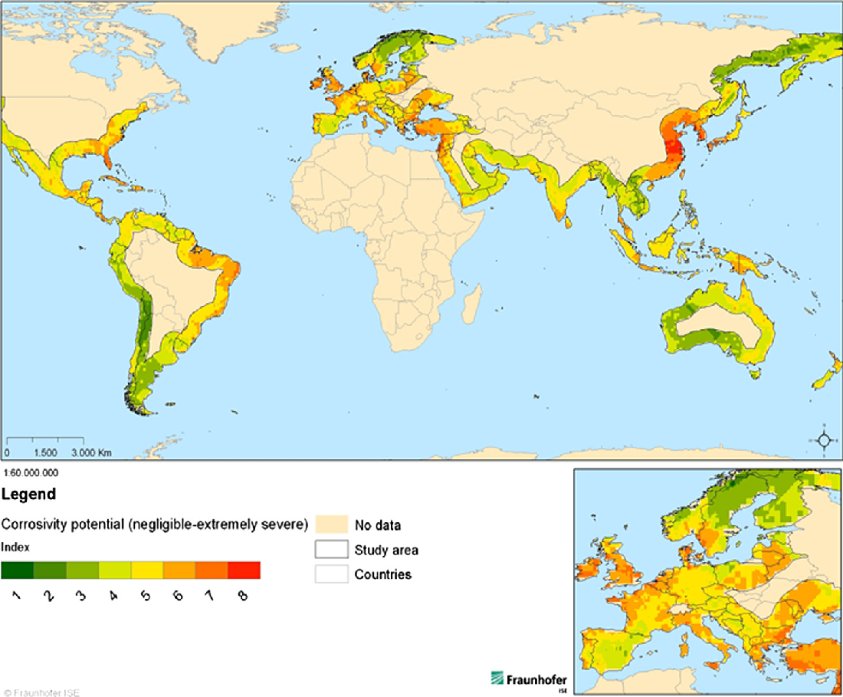
Sea Salt
Study of the Corrosion Impact on Information Technology Equipment in Data Centers Located in Coastal Regions with High Sea Salt Concentration
Motivation
  Electronic failures in marine environments occur – is sea salt important?
  Can the data center environmental envelopes be expanded if we know?
Notes:
Electronic fails in marine environments occur but there are no published environmental conditions for operating data centers in marine environments that combine the key marine environmental parameters of salinity, T, RH, Wet/dry cycles, and particle size to guide data center operators on reliable operation, especially when those data centers desire to save energy by operating in economizer mode.
Can the data center environmental envelopes be expanded for the purpose of reducing cooling energy consumption if the marine environmental conditions are better understood and controlled?

Slide 33
Sea Salt
Study of the Corrosion Impact on Information Technology Equipment in Data Centers Located in Coastal Regions with High Sea Salt Concentration
Previous work statement 1913 was rejected
Work statement resubmitted this meeting addressing:
  Breadth of work – filtration removed
  Industry justification – Examples of corrosion-based examples
  Support – Industry co-funding added
  Cost – Level of effort required, and purpose clarified
  Bidders - New bidders list given
Notes:
Electronic fails in marine environments occur but there are no published environmental conditions for operating data centers in marine environments that combine the key marine environmental parameters of salinity, T, RH, Wet/dry cycles, and particle size to guide data center operators on reliable operation, especially when those data centers desire to save energy by operating in economizer mode.
Can the data center environmental envelopes be expanded for the purpose of reducing cooling energy consumption if the marine environmental conditions are better understood and controlled?

Slide 34
Do commissioned buildings perform as design?
TC 7.9 proposed research
Use anonomized commissioned building data to understand performance
Examine downtime from extreme events
Data centre industry and health care facilities focus?
Break down into loss of power and other conditions
Continuous monitoring important aspect
TC 9.9 interested to co sponsor?
TC 7.9 contacts: Hendrikus Shank, Larry Ollice, Noelle Thornton and Bill Stump
Notes:
Resilience:
Commissioning participation: prove that systems are validated and operate effectively in commissioned buildings. Could we survey buildings commissioned versus not and find out how much downtime their life safety systems had in an extreme event? Data centre industry and health care facilities might have that data. Draw on the paragraph in the Performance Metrics research idea to divide commissioned from non-commissioned. Would then want to break this down into loss of power and other conditions you might be guarding against. Data would need to be anonymized to get participation. Continuous monitoring also an important aspect to consider in this. Hendrikus Shank willing to try drafting an RTAR on this. Aim for a draft 3-4 weeks from now. Dave will support with link to research page at ASHRAE and send a draft of a previous RTAR as an example. Larry Ollice, Noelle Thornton and Bill Stump interested in helping with review and support.

Slide 35
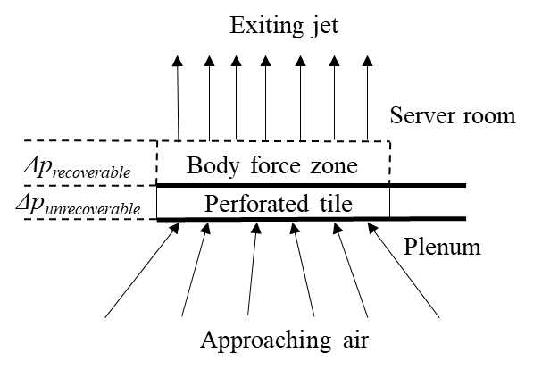
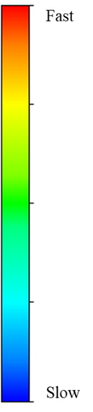
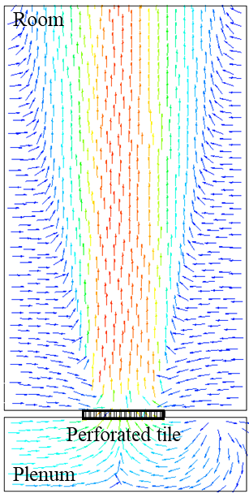
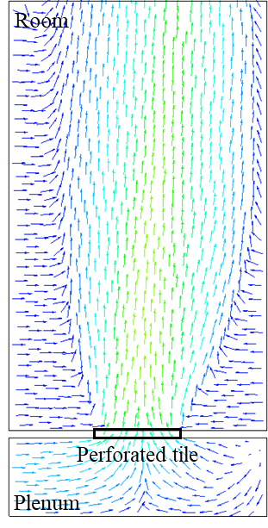
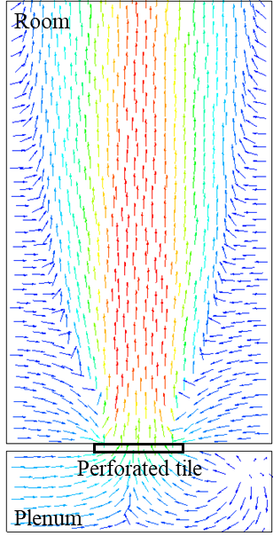
CFD Modeling Guidance For Flow Resistance
Resistances are common
  Tiles, perf doors, louvres…
  Previous research incomplete
  Implementation varied
Courtesy Hu, B
RP-1675
Explicit Geometry Model
Simplified Pressure Drop Model
Well-designed Compact Model

Slide 36
CFD Modeling Guidance For Flow Resistance
Resistances are common
  Tiles, perf doors, louvres…
  Previous research incomplete
  Implementation varied
TC 4.10 proposing research
  Jim VanGilder
  Duncan Phyfe
  Mark Seymour
TC 9.9 co-sponsor?
Simplified Pressure Drop Model
Well-designed Compact Model

Slide 37
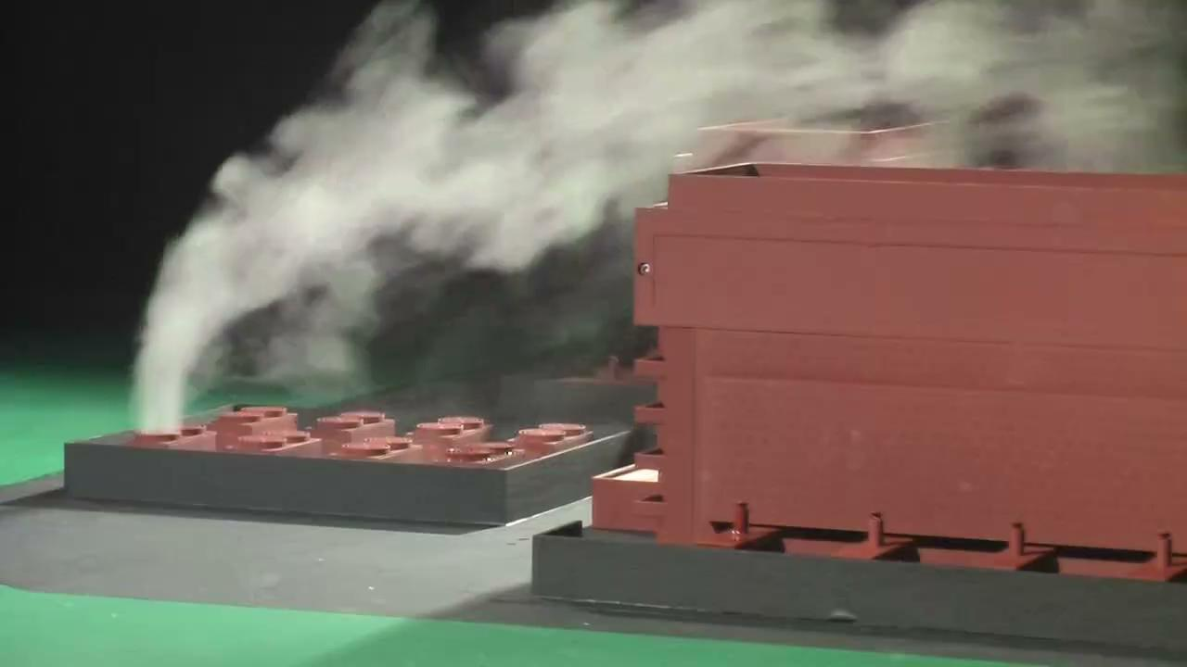
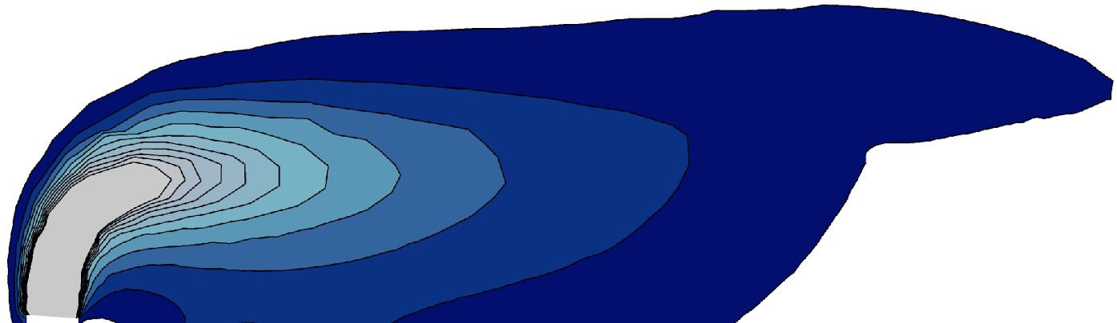
External Flow
Common application of CFD for data centers
Modeling quality variable
Energy use effectiveness impact high
Risk of significant under-prediction plume conc’s in this region
Risk of significant over- prediction of plume concentrations in this region

Slide 38
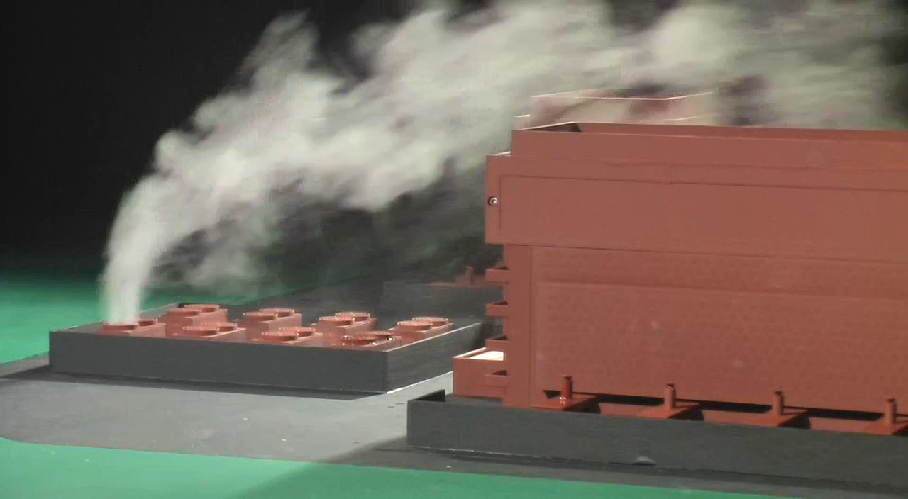
Concentration Predictions - Atmospheric Turbulence
Risk of significant under-prediction of plume concentrations in this region
Risk of significant over- prediction of plume concentrations in this region

Slide 39
Support for Refrigerant ignition and flammability
Hypothesis:
  Introduction of A2L rapid adoption
  Significant New Alternatives Policy (SNAP)
  “Mildly flammable” nature of A2L refrigerants, UL 60335-2-40 Standard
  Need for uniform code across NA to facilitate seamless adoption for data center
Call for action?
  Since ASHRAE is there a concern?
  After meeting feedback to: Rick Pavlak, Mukul Anand

Slide 40
Other Research Ideas
Other ideas?

Slide 41
Publications Committee Update

Slide 42

Physical Books Transition to Online Encyclopedia, Wiki, or Info Sys
Mission:
Provide timely updates about IT changes its impact on data center infrastructure.
Original Goals:
1.) Quicker content updates 2.) Greatly increase # of people accessing our content
Obstacle:
1.) Ashrae had no inhouse Wikipedia Platform expertise (have to outsource)
2.) Outsourcing would greatly increase online subscription cost
Solution: Use Sharepoint Platform instead
Reduces online subscription cost to hopefully $5 / month

Slide 43
Change in Concept
Original Concept:
Step 1 - Start with Books 1, 3, & 4
Step 2 –Another 3 or 4 Books, etc.
Revised Concept:
Step 1 – Start with the same Books 1, 2, & 4. Use the organizational structure of Book 3 & modify accordingly
Step 2 – Do not convert the other Books, consolidate, integrate & import remaining content

Slide 44
Change in Navigation
User Navigation Options:
Option 1 – Multi-level Table of Contents Search
Option 2 – Index Search
Option 3 – Tradition Word / Phrase Generic Search of Entire Site

Slide 45
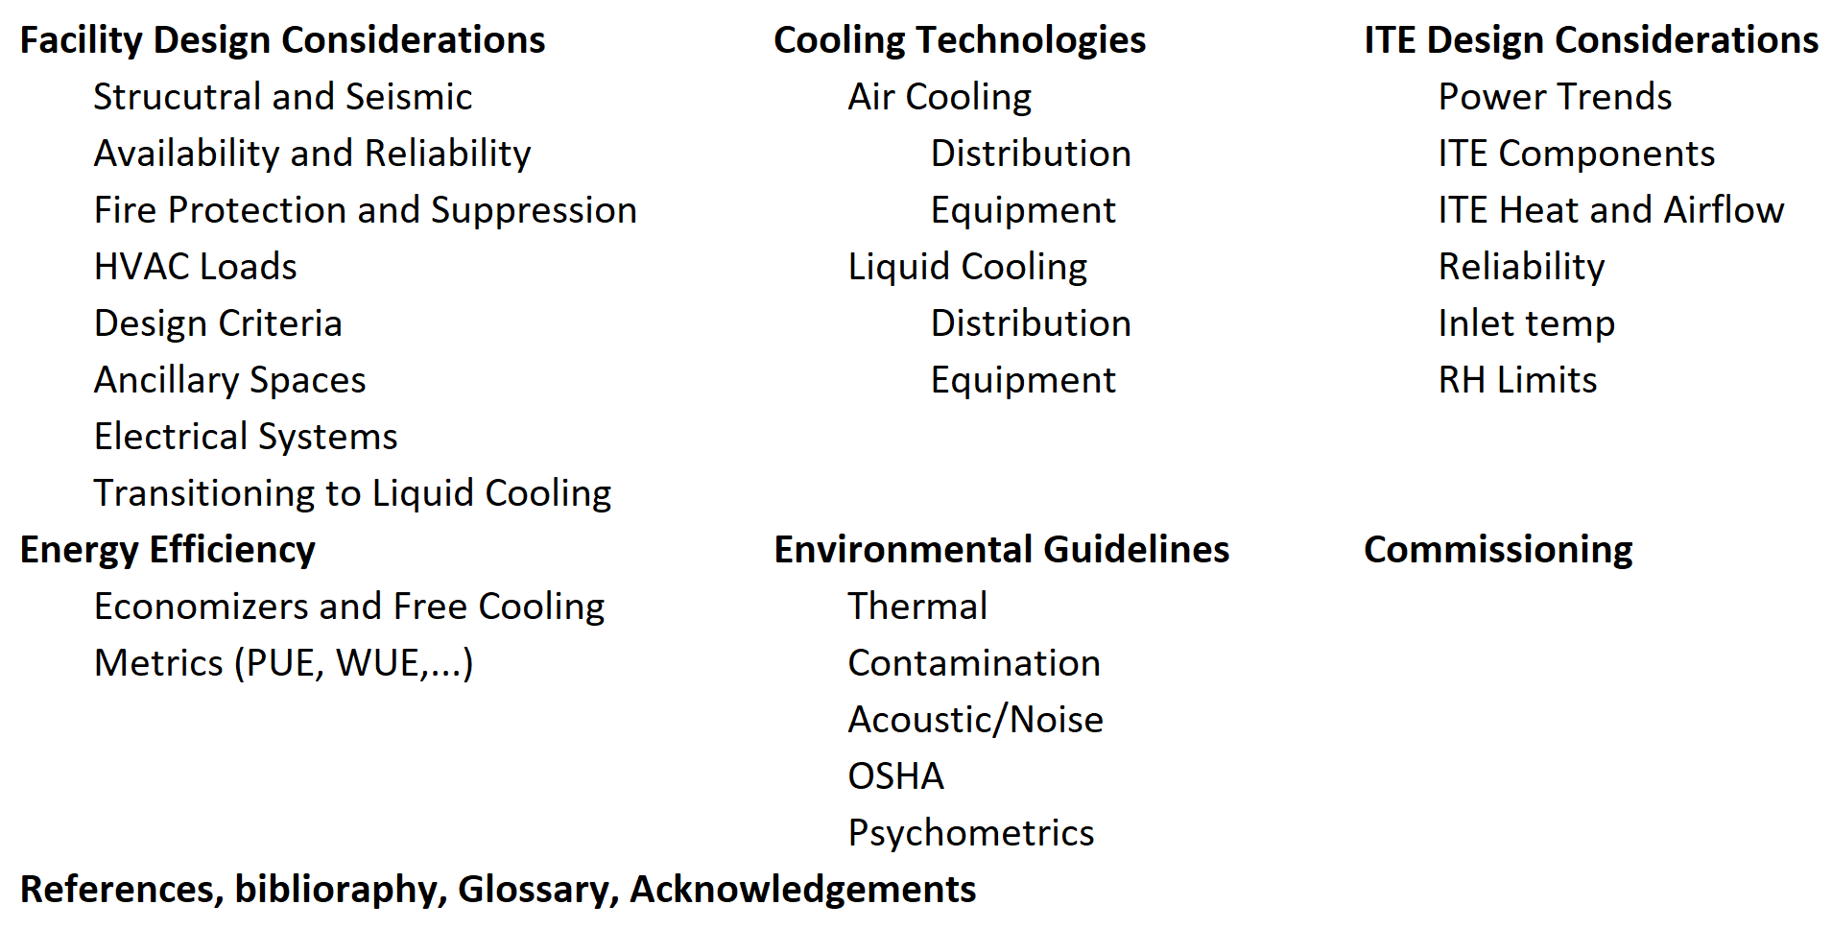
Table of Contents

Slide 46
Program Topics Working Session
Break into groups of 3-4 people
Write down 1-2 ideas for Program Topics
  Spend 10 minutes discussing in groups
Convene to note Program topics from groups
Topics will be noted for further follow-up

Slide 47
Thank You
TC 9.9 Website: tc0909.ashraetcs.org

Slide 48
Attendance
Attendance is being recorded using a Google Form. Please make sure you complete the form at:
https://forms.gle/wjboSPgW6yQecKsW8
Or use the QR Code below:

