Slide 1
TC 8.2 Main Meeting
Atlanta Winter – Hybrid Meeting
February 6th, 2023
Notes:
Updated 1/31 7:15 with Research
Updated 1/31 8:27 with Webmaster
Updated 2/1 standards portion of agenda. Per phil Johnson
Updated 2/1 entire standards section per Phil Johnson
Updateed 2/1 9:20 90.1 from Phil J
Updated 2/1 Std 1520P with slide from Matt Cambio
2/1 Updated Honors and Awards based on Rick Heiden email.
Updated 2/1 Membership and Chairs breakfast updates – from Drew Turner’s email

Slide 2
Call to Order, Welcome, and Introductions
Welcome - Hybrid Meeting Format
Introductions:
  Officers
  Members
  Liaisons
  Guests
Notes:
Updated 6/27

Slide 3
Quorum Check – Trent Hunt
7 Voting Members/1 VMNQ
Scott MacBain (present)
Dan Kemper (present)
Brandon Gill (present)
Chris Miller (present)
Michael Perevozchikov (present)
Nick Zupp
Drew Turner (present)
Jaime Yeh (to be confirmed in discussion)
K. Kontomaris (VMNQ)
Notes:
Updated 6/27

Slide 4



In all your interactions at these meetings, please remember…
Code of Ethics
“As members of ASHRAE or participants in ASHRAE activities, we pledge to act with honesty, fairness, courtesy, competence, integrity and respect for others in our conduct.
We will avoid conflicts of interest and behavior that is discriminatory and/or harassing.”
https://www.ashrae.org/about/governance/code-of-ethics
Notes:
The Code of Ethics is the basis for which we interact with one another.

Slide 5
Agenda
Call to Order, D. Turner
Introductions
Quorum check – T. Hunt
ASHRAE Code of Ethics Commitment – D. Turner
Agenda Review – D. Turner
TC 8.2 Mission Statement & Scope & Vote to Re-affirm – D. Turner
Reviewed/Approve Summer 2022 Meeting Minutes – Basecamp – D. Turner
Reports:
  Program - M. Rogan
  Research – D. Showalter
  Handbook - S. MacBain
  Standards - P. Johnson
    ASHRAE Standard 30 (cognizant TC) – J. Prosser
    ASHRAE Standard 184 (cognizant TC) – P. Johnson
    ASHRAE Standard 225 (cognizant TC) – P. Johnson
    ASHRAE Guideline 22 (monitoring) – D. Showalter
    ASHRAE Standard 23 (monitoring) – S. MacBain
    ASHRAE Standard 90.1 (monitoring) – P. Johnson
    AHRI Standard 550/590|551/591 (monitoring) – P. Johnson
    AHRI Standard 1520p (monitoring) – M. Cambio
  MTG Low GWP Liaison Update – P. Johnson
  Membership & Transition – T. Hunt
  Web Master – D. Kemper
  Honors and Awards – R. Good
  Chair’s Breakfast Report – T. Hunt
Old Business – D. Turner
New Business – D. Turner
For the Good and Wellbeing ….
Adjourn

Slide 6
TC8.2 Centrifugal Machines Scope
TC 8.2 is concerned with packaged equipment which involves centrifugal compressors, including those heat exchangers, drivers, controls and accessories, which are specific to packaged centrifugal equipment.
TC 8.2 is also concerned with the design and performance of centrifugal compressors, steam turbines and gas turbines for use in refrigerating applications.

Slide 7
TC8.2 Centrifugal Machines Mission Statement
The mission of Technical Committee 8.2, Centrifugal Machines, is to provide world class technical expertise on all aspects of centrifugal refrigeration machines.
This committee is a resource to industry, academia, and others following society protocols through seminars, standards, technical papers/articles and other presentations.

Slide 8
TC8.2 Centrifugal Machines Mission Statement
The mission of Technical Committee 8.2, Centrifugal Machines, is to provide world class technical expertise on all aspects of centrifugal refrigeration machines.
This committee is a resource to industry, academia, and others following society protocols through seminars, standards, technical papers/articles and other presentations.
Discussion and Vote to Continue, Merge, or Dissolve

Slide 9
Review and Approve Previous Meeting Minutes
2022 Summer (Toronto) Hybrid Meeting Minutes

Slide 10
Standards Report
Standards Subcommittee – Phil Johnson (chair)
TC 8.2 is the cognizant TC for:
  ASHRAE Standard 30-2019 Method of Testing Liquid Chillers
    [TC 8.2 is lead; TC 8.5 is co-cognizant]
  ASHRAE Standard 184-2020 Method of Test for Field Performance of Liquid-Chilling Systems
  ASHRAE Standard 225-2020 Method for Performance Testing Centrifugal Refrigerant Compressors and Condensing Units
TC 8.2 also monitors activity for the following standards of interest to members:
  ASHRAE Guideline 22-2012 Instrumentation for Monitoring Central Chilled-Water Plant Efficiency
    [TC 9.1 is cognizant]
  ASHRAE Standard 23-2022 Methods for Performance Testing Positive Displacement Refrigerant Compressors and Compressor Units
  [TC 8.1 is cognizant]
ASHRAE Standard 90.1-2022 Energy Standard for Buildings Except Low-Rise Residential Buildings
    [TC 7.6 is cognizant]
  AHRI Standards 550/590|551/591-2020 Performance Rating of Water-chilling and Heat Pump Water‑heating Packages using the Vapor Compression Cycle
  AHRI Standard 1520-2022 Performance Rating of Centrifugal Refrigerant Compressors
  ISO TC 86 / SC 4 Testing and rating of refrigerant compressors (ISO/AWI 18501, 18483, 18976)

Slide 11
Standards Report
ASHRAE Standard 30-2019 (Nick Zupp, Chair SSPC30)
Standard 30-2019
Addendum a. Published in May 2020. Mainly clean-up including a requirement to test based on defined operating mode set points.
Addendum b. Published in April 2020. Mainly clean-up including clarification of Δp_{adj}. Republished to add missing calibration workbook (.xlsx).
Addendum c. Addition of adiabatic, free-cooling, and 4-pipe chillers by introduction of hybrid operating modes. APR1 Nov 2020. PPR1 public review expected in 2023.
Addendum d. Review of steady-state criteria. APR1 Nov 2020. PPR1 public review expected in 2023.
Addendum e. Harmonization with AHRI 550/590, Section 4. Addition of air sampling arrays. PPR1 public review expected in 2023.
Addendum f. Inclusion of AHRI 550/590, water pressure drop calculation tool. No comments to PPR1 (Jun~Jul 2022). Addendum in galley proof review, will be published soon (early 2023).
Standard 30-2023 will consolidate of 2019 version with Addenda a, b, f, and maybe c.
Membership: Prosser rolled off, Zupp rolled on as new chair 7/1/2022. Balanced.
No action required by TC 8.2.
Notes:
Updaetd 6/27

Slide 12
Standards Report
ASHRAE Standard 184-2020 (Phil Johnson)
Standard 184-2016 was published under periodic maintenance (5‑year cycle) by SPC 184.
Disbanded in 2019 after December 2018 publication of Addendum a to Standard 184-2016.
In Orlando (January 2020) TC 8.2 voted to recommend reaffirmation of the standard. Recommendation was approved by SPLS & StdC, then ASHRAE staff merged the content of Addendum a into the standard and published as a new edition.
Standard 184-2020 was published in November under periodic maintenance.
TC 8.2 needs to decide if and when to form another committee, if there is interest to revise the standard (e.g. additional work on the uncertainty calculator spreadsheet workbook). 5-year cycle would need to publish next edition by 2025, deadline to decide “withdraw, reaffirm, or revise” will be 2024 but can act earlier.
Discussion: any action required?
I found some errors in the example spreadsheet (part of Informative Appendix I). Probably not worth revising the standard just for that.

Slide 13
Standards Report
ASHRAE Standard 225-2020 (Phil Johnson)
Standard 225-2020 was published under periodic maintenance (5‑year cycle) SPC 225. SPC 225 has been disbanded.
TC 8.2 will need to decide if and when to form another committee to revise the standard. 5-year cycle would need to publish next edition by 2025, deadline to decide “withdraw, reaffirm, or revise” will be 2024 but can act earlier.
Discussion: any action required?

Slide 14
Standards Report
ASHRAE Guideline 22-2012 (Daryl Showalter, Chair GPC22)
Guideline 22-2012 was published with editorial updates to references as revision to 2008 edition.
GPC 22 formed in 2016 and drafted an update. PPR1 during 2021 (Jul16-Aug30), received 26 comments from 5 commenters. Comment responses sent to commenters, draft revisions in process. Anticipate a PPR2 (perhaps PPR2 ISC) during 2023 to resolve comments.
Expect publication by end of 2023.

Slide 15
Standards Report
ASHRAE Standard 23 (Scott MacBain, Chair SPC23)
Not Updated
Standard 23.1-2019 published “Methods of Testing for Performance Rating Positive Displacement Refrigerant Compressors and Condensing Units That Operate at Subcritical Temperatures of the Refrigerant”
Standard 23.2-2019 published “Methods of Test for Rating the Performance of Positive Displacement Compressors that Operate at Supercritical Pressures of the Refrigerants”
Standard 23-2022 published “Methods for Performance Testing Positive Displacement Refrigerant Compressors and Compressor Units” combines and supersedes 23.1 & 23.2.
There remains potential for either a future merger of 23 and 225, or perhaps harmonization activities.

Slide 16
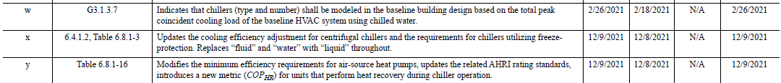
Standards Report
ASHRAE Standard 90.1-2022 (Phil Johnson)
Standard 90.1-2022 published (December 2022)
2022 edition includes & incorporates the following addenda (of TC 8.2 interest) to the 2019 edition: w, x, y, cj
New addenda to the 2022 edition (when published) will be available at:
https://www.ashrae.org/technical-resources/standards-and-guidelines/standards-addenda
SSPC 90.1 Mechanical Subcommittee has a new chair as of October 2022: Brandon Damas.
Ray Good to take over supporting

Slide 17
Standards Report
AHRI Standards 550/590|551/591 (Phil Johnson)
AHRI 550/590 (I-P) and 551/591 (SI) – 2020 (with Addendum 1), Performance Rating of Water-Chilling and Heat Pump Water‑Heating Packages Using the Vapor Compression Cycle
2020 Editions of both standards, with addendum dated 2022-Feb, are published as AHRI Standards (not with ANSI approval). Include normative reference to ASHRAE 30 for method of test.
Planned 2023 edition with minor changes (plan to obtain ANSI approval).
Project charter scope of revisions for next edition after that (circa 2025) includes the following items:
  Review tolerances and incorporate units with variable flow
  Continue to work toward harmonizing section 4 with ASHRAE 30
  Review uncertainty analysis reporting requirements
  Adiabatic cooled condensers
  Heat Pump Part-Load Metrics
  Review of rounding throughout documents
  Review Standard Rating Conditions
  Regional part load metrics
  Ratings for units with more than two heat exchangers

Slide 18
Standards Report
AHRI Standard 1520 (Matt Cambio)
AHRI Standard 1520-2022, Performance Rating of Centrifugal Refrigerant Compressors
This standard will provide a rating method for centrifugal compressors and a calculation method to compare centrifugal compressors with positive displacement compressors.
Published
New method is compressor performance specification (table format)
A tool is being created by Purdue for reading data and calculating performance as well as comparisons with positive displacement compressor 10 coefficient model
The tool is MatLab based and will be made available along with source code
Additional Notes:
Reference to ASHRAE 225, Methods for Performance Testing Centrifugal Refrigerant Compressors and Condensing Units
Similar format to AHRI 540, Performance Rating of Positive Displacement Refrigerant Compressors and Compressor Units
AHRI Compressor Standards Technical Committee will maintain the standard (responsible for a total of 7 standards including 1520)

Slide 19
Standards Report
ISO/TC 86/SC 4 (Justin Prosser)
TC 86: Refrigeration and air-conditioning
SC 4: Testing and Rating of refrigerant compressors
TC = Technical Committee
SC = SubCommittee
WG = Working Group
AWI = Approved Work Item

Slide 20
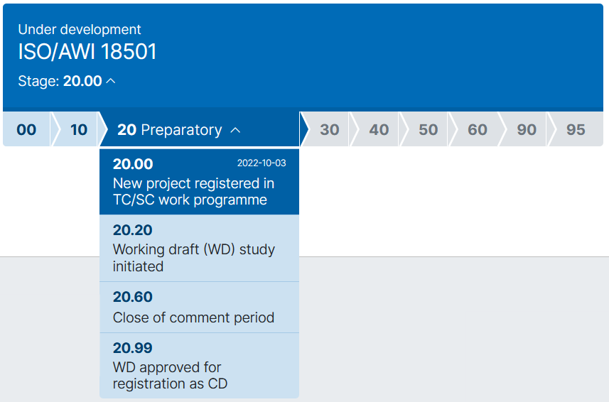
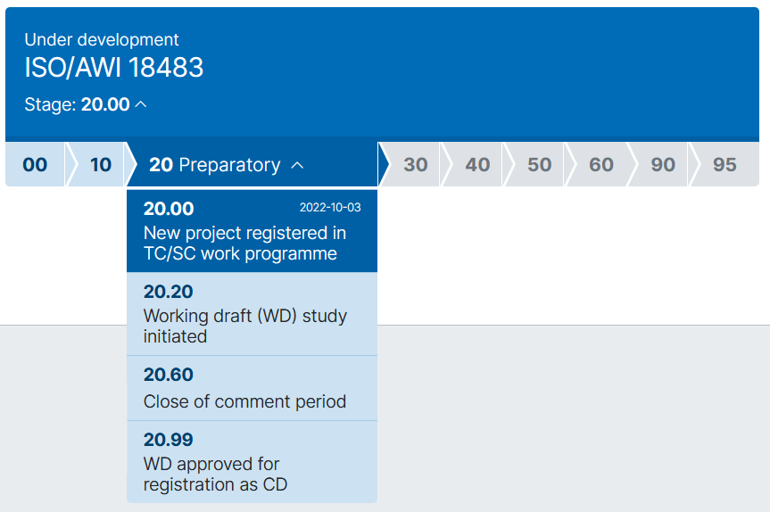
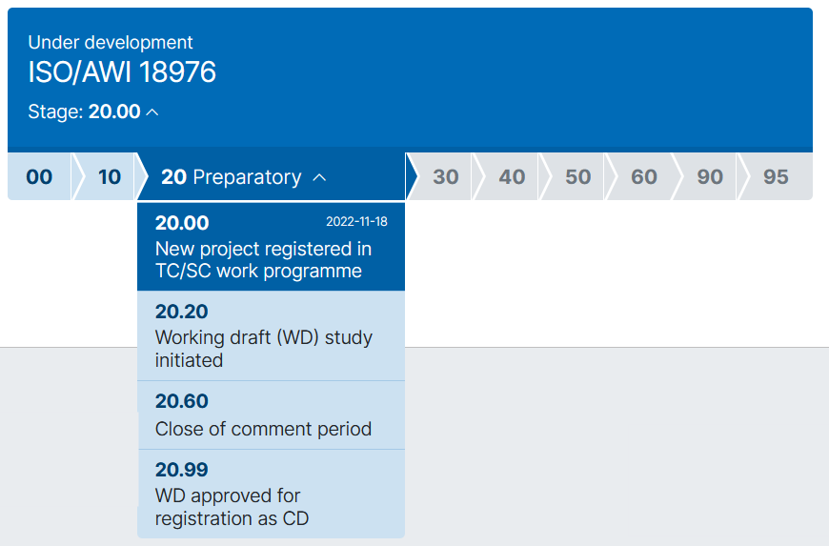
Standards Report
ISO/TC 86/SC 4 (Justin Prosser)
WG2, WG3, and WG4 will have in-person meetings May 23~25 in Zhuhai, China
https://www.iso.org/standard/85298.html
https://www.iso.org/standard/85297.html
https://www.iso.org/standard/85541.html
WG2 participants:
US, DE, CN, ES
WG3 participants:
US, DE, CN, ES
WG4 participants:
US, DE, CN

Slide 21
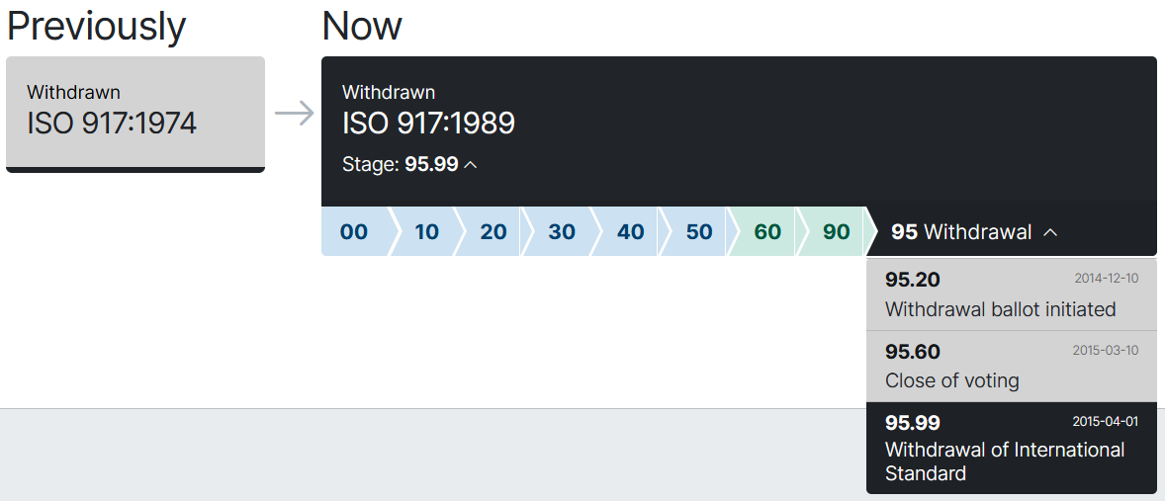
Standards Report
ISO/TC 86/SC 4 (Justin Prosser)
https://www.iso.org/standard/5327.html

Slide 22
MTG.LowGWP Report (Phil Johnson, TC 8.2 Liaison)
The MTG met 2022-Jun-26 and will meet again Wed Jun 29.
Program Subcommittee. Seeking programs from TCs for co‑sponsorship.
Codes & Standards Subcommittee meets Tue Jun 28 (now). Updated a chapter talking points document and a 2-page summary on transition to 2L refrigerants.
Research Subcommittee met 2022-Jun-13, current activity at the PMS level.
Research projects on-going include RP-1806 and RP-1855. Monitoring a few projects sponsored by other TCs.

Slide 23
MTG.LowGWP Report (Phil Johnson, TC 8.2 Liaison)
Research project status.
RP-1806 “Flammable Refrigerants Post-Ignition Simulation and Risk Assessment Update”
  Start date: Jan-2017.
  Slow progress. PMS received revised Task 1 interim report Jan-2022.
  Original scope included updating AHRI risk assessments for 2L refrigerants in 5 types of equipment, including chillers (centrifugal & screw, machinery room).
  Project has re-allocated the budget (more to Task 1) and not yet clear what scope will be reduced (or if more funding will be requested to complete original scope).
  PMS will soon receive a pilot study that completes the Task 2 and Task 3 work for just a small subset of the original scope (reach-in coolers). Results will determine go/no-go/redirect for remainder of the project

Slide 24
MTG.LowGWP Report (Phil Johnson, TC 8.2 Liaison)
Research project status.
RP-1855 “Determination of the Impact of Combustion Byproducts on the Safe Use of Flammable Fluorinated Refrigerants”
  Start date: Jan-2020
  Slow progress to finalize the report. PMS sent second round of requested revisions to contractor Dec-2021. Contractor sent revised report Mar-2022. PMS final review in process.

Slide 25
MTG.LowGWP Report (Phil Johnson, TC 8.2 Liaison)
More detailed report document available for the meeting minutes.
Reconfirm the representatives from TC 8.2 (Primary: Phil Johnson, Alternate #1: Laurent Abbas, Alternate #2: Ray Good).

Slide 26
Program Subcommittee Report – Mark Rogan (chair)
Combined TC 8.02/8.01 Program Subcommittee Report
2023 Winter Meeting, Atlanta
Subcommittee Meeting: January 31st, 1:00 pm -3:00 pm EST
Attendees: Mark Rogan, Drew Turner, Matt Cambio, Daryl Showalter, Justin Prosser, Margaret Matheson, Michael Perevozchikov, Davide Ziviani, Ray Good, Craig Bradshaw, Kris Crosby, Chris Seeton, Dan Kemper, Erik Anderson, Alex Schmig, Georgi Kazachki, Tiffany Abuzzo, Jamie Yeh, Hotian Liu, SA Sharif, Phil Johnson, John Neel, Eric Berg, Rupal Choksi, Brian Reynolds, Tom Watson
Atlanta Meeting Update: Program Approved: One for One Co-Sponsored with TC 8.1 for this meeting
Seminar 63 – Air Cooled vs Water Cooled Chillers - The Great Debate Ray Good is chair of seminar. Sponsored by TC8.2 and cosponsored by TC8.1. Presenters: Trent Hunt(Mechanical Products), Tiffany Bates Abruzzo(ClimaCool), Brandon Wallace(BRD), & Shawn Ameri(NSW).
Wednesday February 8th from 11:00-12:30 EST

Slide 27
Program Subcommittee Report – Mark Rogan (chair)
Current Programs – Winter Meeting Atlanta Feb. 4th- 8^{th,} 2023
Atlanta recommendations: Continue developing the Danger of Decoupling Efficiency and Decarbonization program for submission by the August 9th deadline.
The Risk of Decoupling Efficiency and Decarbonization: Drew Turner made this suggestion. Track 5(IAQ, Energy Use, Comfort and Health of Sustainable Buildings) wound up sponsored by 8.1 and cosponsored by us and both got approved in the same meeting, so strategy worked!
Back to the Basics: Air-Cooled vs Water-Cooled Chillers: Track 2(HVAC&R Systems and Equipment)
Done!!!!!!!! Special Thanks to all involved!!!!!

Slide 28
Program Subcommittee Report – Mark Rogan (chair)
Future Program Ideas – Beyond Atlanta
Standard 225 MOT for Centrifugal Compressors – Proposal is to wait until AHRI 1520P is released and commented on. Perhaps 2023 even though it seems the revised standard should be released soon.
Steam Turbines Applications in Centrifugal Chillers
District Cooling Plants; What effect will R-123 retiring have on systems: Co-Sponsor with District Cooling TC
Low Flow Tube Study – Proposal was to develop a program along side the Research Project by the same name
What Impact has 90.1-2019 had on Design Practices regarding a 15° ΔT?
Electrification of Heating Chapter 2: Industrial and Healthcare Markets as well as Hybrid Applications – Possible Track 4 (Pathways to Net Zero Energy and Decarbonization) or Track 5 (Future-Proofing the Built Environment) Chris Miller possible chair
System Design & Controls on Heat Pump & Heat Recovery Applications – Trent Hunt as possible chair
Next Meeting
Subcommittee will meet via conference call in early June 2023
Respectfully submitted by:
Mark R. Rogan, PE, CEM, CBCP, GBE
2RS Consulting Engineers
TC 8.02 Program Subcommittee Chairman
phone: 540-255-8110

Slide 29
Program Subcommittee Report – Mark Rogan (chair)
2023 Annual Meeting/Conference Meeting Tampa:
Important dates:
February 27th Program Proposals Due
April 14th Program accept/reject notifications
TBD Program submission deadline
2023 Annual Meeting/Conference Program Tracks Tampa
  Track 1 - HVAC&R Systems & Equipment
  Track 2 - Fundamentals and Applications
  Track 3 – Research Summit
  Track 4 – Pathways to Zero Energy Emissions and Decarbonization
  Track 5 – Future-Proofing the Built Environment
  Track 6 – Building Automation and Control
  Track 7 – Professional Development and Education

Slide 30
Research Subcommittee Report – Daryl Showalter (chair)
Research S/C Chair Breakfast notes of interest
Research Chairs breakfast is scheduled for February 6th from 6:30 – 9:15 AM. Will have an update for the main committee meeting.
Current Activities
Research Subcommittee online meeting was held with Handbook & Program on January 31st 1pm – 3pm
Project Status
1716 - Oil concentration of field-installed liquid chillers with flooded type evaporators.
  Went out for bid again – no bidders
  Committee – what would we like to do with this one? I hope to have some discussions with this at the research breakfast meeting.
  Per joint subcommittee discussion, pursue universities including international as potential research providers – Purdue, UofM/OTS, Tsinghua…thoughts?
1793 - Development of Method of Test for Motor Component Thermal Conductivity
  TC8.1 is taking the lead on this one and will resubmit from the comments.
  Planning to resubmit this one but not sure that happened yet.
Notes:
Updated 6/28

Slide 31
Research Subcommittee Report – Daryl Showalter (chair)
1879 – Foamability properties of LGWP Refrigerant and Oil Mixtures
  Sponsored by TC3.4 and Co-Sponsored by TC8.1
  MORTS needs revised WS to rebid w/ Expanded Bidders list, new Budget Est. , Etc.
Future Activities
Decarb and heating mode how to get higher-temp heat pumps – willing to entertain a proposed Title for this if anyone wants to put one forward.
Notes:
Updated 6/28

Slide 32
TC 8.1 & 8.2 Handbook – Scott MacBain (Chair)
Agenda
TC 8.1: Refrigeration: Chapter 8 - Factory Dehydrating, Charging & Testing
  2026 Next Revision
TC 8.1 & 8.2: 2024 HVAC Systems & Equipment: Chapter 38 and 43 (due May/July 2023)
  Davide Ziviani, Craig Bradshaw, Michael Perevozchikov, Rick Heiden, Scott MacBain, Fred Betz, Drew Turner, Trent Hunt, Steve Duda
  Confirm document access on authoring portal: https://authoring.ashrae.org/
  Contact Chris Walter (CWalter@ashrae.org) if any issues with Microsoft login
  Status at ASHRAE is carryover from January. Timing for their upload of 38 & 43 to portal delayed from March, May, July: Latest Est. TBD TODAY (6/23)!
Notes:
UPDTED 6/27

Slide 33
TC8.2 Leadership Roles – Drew Turner
Chair – Drew Turner
V Chair – Trent Hunt
Secretary – Tiffany Bates Abruzzio
Handbook – Scott MacBain
Programs – Mark Rogan
Standards – Phil Johnson
Research – Daryl Showalter
Webmaster – Dan Kemper
Honors and Awards – Ray Good
MTG. LowGWP Liaison – Phil Johnson
MTG. LowGWP Alternate – Ray Good
Effective until this summer annual meeting
Notes:
Updated 6/27

Slide 34
Membership – T. Hunt https://tpc.ashrae.org/Membership?cmtKey=83a02e09-1a12-4ee1-bbf8-3ba74490dec7
Not Updated
Final modifications to TC membership –
  Deleted – 13
  Delayed submitting final based on confirming Secretary and (if necessary) replacing current role
21-22 Roster Rollover - Current 2021-2022 roster for your TC, TG or MTG is in effect until after this meeting
How to Import Your TC Roster Information into MS-Outlook - http://www.ashrae.org/TCs

Slide 35
Webmaster – Dan Kemper
General updates and maintenance
  Meeting time, agenda and links posted
  Winter 2022 draft minutes posted
  Draft Winter 2023 agenda posted
ASHRAE website administration interface changed
  Much easier to make changes and more user friendly
Please send slides from 2022 seminars so they can be added to the presentations section of the website
Notes:
Updated 6/28

Slide 36
Honors and Awards – Ray Good
Members of TC8.2 may be qualified to receive many ASHRAE awards
  The following awards appear to be most closely relevant to TC8.2:
    Andrew T. Boggs Service
    Hightower
    Distinguished Service
    Exceptional Service
    Standards Achievement
Full list of ASHRAE Awards can be found at: https://www.ashrae.org/membership/honors-and-awards

Slide 37
Honors and Awards – Ray Good Continued
Current Activities:
Pursuing the Service to ASHRAE Research Award for Mark Adams.
  Confirmed that Mark Adam’s non-member ASHRAE status makes him ineligible for ASHRAE awards
Current Nominations:
  Matt Cambio for Standards Achievement Award
  Phil Johnson for Standards Achievement Award
Interested in additional nominations for members of TC8.2 who you believe qualify to receive any ASHRAE award
  Accepted in our meeting or at any time outside of it
  Contact Ray Good

Slide 38
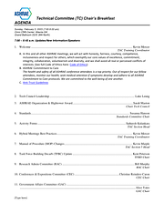
TC Chairs Breakfast Report – T. Hunt
Updated
Decarbonization task force looking for refrigerants experts
Encouraging active participation and engaging with new members
23-W1 activity form & capturing international participation
Hybrid virtual meetings are here to stay
All MTGs this year will – Disband, become an FG or create a new MTG
Tracks for Tampa open/listed online
TC Chairs Breakfast Agenda_Feb 2023.pdf

Slide 39
Old Business – D. Turner

Slide 40
New Business – D. Turner
New members intros

Slide 41
For the Good and Wellbeing

Slide 42
Adjourn

