Slide 1
Seminar 49 - Easier Said Than Done?
Controlling Air Movement in
High-Rise Multifamily Buildings
Craig Wray, P.Eng.
Consulting Engineer
Winnipeg, MB
Canada
pharmeng@shaw.ca
Suite Ventilation Characteristics of
Ten Existing Canadian Multi-Unit Residential Buildings

Slide 2
Learning Objectives
Discuss how to use building depressurization techniques, fan-compensated flow measurements, and differential tracer gas methods to assess component air leakage, ventilation system performance, and
inter-suite pollutant transport.
Describe effects of building configuration and mechanical system design intent as well as weather and occupant operational decisions on actual suite ventilation.
Discuss consequences of uncontrolled airflow in apartment buildings.
Explain opportunities to improve suite ventilation in existing buildings.

Slide 3
Acknowledgements
The author gratefully acknowledges contributions of principal collaborators on project: Peter Moffatt and Ian Theaker.
Appreciation also extended to building owners, designers, managers, and occupants who assisted project team during design reviews and testing. In particular, we thank the families who vacated their suites during field tests.
Finally, author acknowledges researchers who assisted project team during field tests across Canada: Donald Fast, Amanda Sinnige, Michelle Nokken, Jean Villeneuve, John Hockman, and Ted Lightly.
Disclaimer: This study was funded by and conducted for the Canada Mortgage and Housing Corporation under Part IX of the National Housing Act. The analysis, interpretations, and recommendations are those of the consultant and do not necessarily reflect the views of the Canada Mortgage and Housing Corporation or those divisions of the Corporation that assisted in the study and its publications.

Slide 4
Outline/Agenda
This presentation provides “snapshots” of suite ventilation in ten existing multi-unit residential buildings located across Canada (Moffatt et al. 1998). It addresses three questions:
1. What are the key parameters that characterize suite ventilation?
2. What field tests are required to determine these parameters?
3. Based on field tests, what are the suite ventilation characteristics?
Key findings will be discussed, including: corridor supply and suite exhaust airflows; suite-outdoors and suite-corridor pressure differentials; suite access door leakage; suite air exchange rates; and inter-suite transfer air fractions.
Need for improved system design, operation, and maintenance practices also will be discussed.

Slide 5
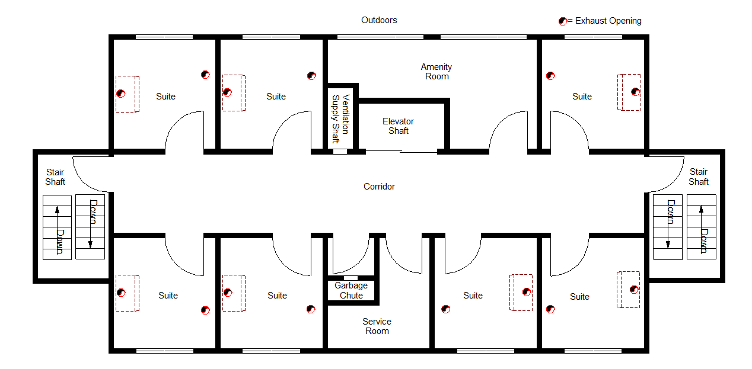
Schematic of Typical Storey
Notes:
The building envelope can be thought of as a shell enclosing one large compartment. It separates the conditioned interior of the building from outdoors. The envelope consists of the roof, exterior walls (including above- and below-grade walls), exterior windows, exterior doors, and lowest floor. Inside the building envelope, the interior is subdivided into many storeys, each with smaller compartments.
Suites are one type of compartment within the building. Other compartment types include: corridors between suites, service and amenity rooms, parking facilities, elevator and stair shafts, garbage chutes, and shafts containing ducts, pipes, and electrical wires. These other compartments are typically not occupied.
Typically, suites and other rooms on each storey surround the corridor, except where stair shafts are located on exterior walls. Access to suites, elevator shafts, and stair shafts is through openable doors. In this configuration, corridors act as plenums for air movement between various shafts, suites, and other rooms.
Vertical shafts connect corridors of each storey from the ground floor to the roof. Sometimes these shafts also extend down to the basement or parkade. However, for reasons of security or to prevent spread of fire, smoke, and vehicle exhaust, separate elevator and stair shafts often are used instead to access stories below the ground floor. For the same reasons, some shafts do not extend all the way to the roof from the ground floor or below.

Slide 6
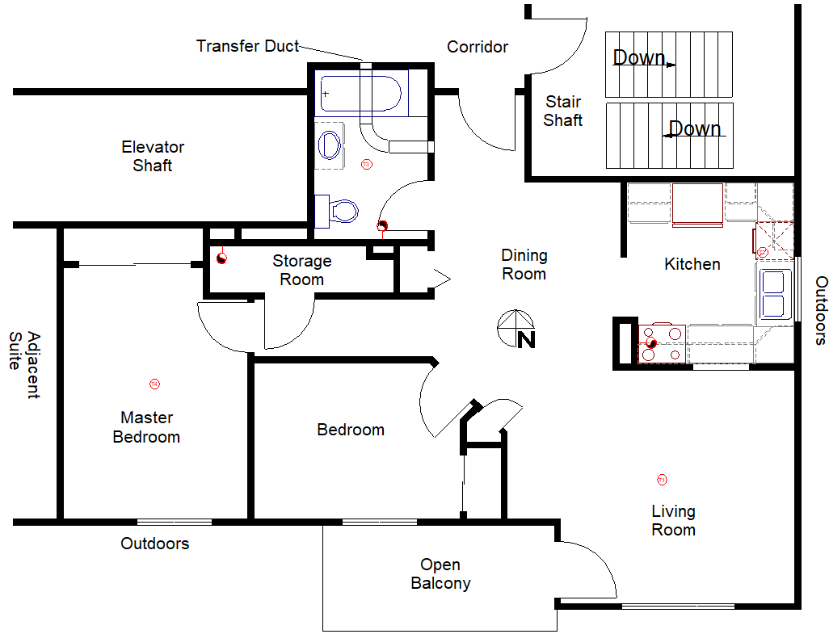
Example Suite Floor Plan (Building 8)
Notes:
Only Building 8 (of the ten tested) had a transfer duct between the test suite and adjoining corridor. This 200 mm x 150 mm rectangular duct (2.5 m length) was fitted with horizontal-louvered grilles on both ends. It was acoustically-lined and contained one 90° elbow and a fire damper. The ductwork provides a fixed and relatively large leakage area for flow between the corridor and suite. Its use is an indication that the corridor supply air system was intended to supply air to the suites in this building.
In the other nine buildings that were tested, the lack of an intentional fixed leakage area between the corridor and suites is consistent with the usual primary design intent of the corridor supply air system: to pressurize the corridor relative to these suites, rather than to supply air to the suites adjoining the corridor.
In particular, an informal survey that the project team conducted of 25 people that design mechanical ventilation systems for Canadian mid- and high-rise residential buildings indicated that mechanical air supply to these buildings typically involves supplying outdoor air to corridors for pressure control, with the intent of limiting the migration of contaminants between suites. Few designers intended that these systems ventilate suites surrounding the corridor. However, in practice, these systems can often inadvertently ventilate suites.

Slide 7
Key Parameters that Characterize Suite Ventilation
Suite leakage areas
Floor/wall/ceiling surface intersections
Suite corridor-access and room door gaps (sometimes intentional)
Plumbing/electrical service openings
Mechanical ventilation duct terminations
Openable exterior windows/doors
Pressure differences across leaks
Stack effects (temperature-induced buoyancy)
Wind effects (windward vs leeward surfaces)
Operation of mechanical ventilation equipment
Corridor supply airflows
Suite exhaust airflows
Intentional make-up air paths
(e.g., transfer ducts to corridor or outdoors)
Suite air exchange rates (and effectiveness)
Inter-suite transfer air fractions (compartmentation)
Notes:
Ventilating suites in mid- and high-rise residential buildings is a complex process, which is affected by many parameters. Leakage openings between the suite and corridor are especially important, because they are typically the only entry paths into the suite for outdoor air indirectly from the corridor supply air system.
Gaps around interior doors that separate rooms of each suite, suites from corridors, and corridors from vertical shafts include spaces between the door and its frame as well as deliberate door undercuts. These gaps and especially the larger bottom gap are sometimes weather-stripped. When there is weather-stripping, its type, amount, and condition can vary throughout the building, especially from suite to suite (due to occupant attempts at draft, noise, or odor control).

Slide 8
Pressure Differences – Stack Effect
Notes:
Indoor-outdoor temperature differences cause buildings to behave like a fireplace chimney or stack. For example, during winter, warm air inside the building is less dense than the cold air outside the building. This difference in density results in a lower pressure at the bottom of the building compared to the outdoors and a higher pressure at the top of the building compared to outdoors. The resulting indoor-outdoor pressure differences cause air to flow inward at the bottom of the building and outward at the top of the building through leakage openings in the building envelope. This phenomenon is called the stack effect.
Due to pressure losses through leakage openings within the building, actual pressure differences induced by stack effect are always less than or equal to the theoretical pressure differences determined using the equation shown above. The ratio of actual to theoretical stack-induced pressure difference is defined as the thermal draft coefficient (TDC). The magnitude of the TDC depends on the leakage of the building envelope relative to the combined leakage of interior separations. With several compartments per storey and with leaks between compartments, it is necessary to carry out a multi-compartment analysis of exterior and interior pressures to determine the indoor-outdoor and inter-suite pressure differences and flows. To carry out such a multi-compartment analysis, it is also necessary to know the leakage area distribution for each storey.
It is important to recognize that there can be several neutral pressure planes within a building. For example, one stair shaft usually has access to the roof through a door. In some buildings, there can be substantial leaks between the door and its frame or there may be a leaky vent in the roof of the shaft. As a result, a shaft with roof access is often taller and has a different vertical leakage distribution compared to the other stair shaft. In this case, the NPP in the shaft with roof access may be located higher than in the other stair shaft. Elevator shafts with penthouse mechanical rooms are another example where this phenomenon occurs.

Slide 9
Pressure Differences – Wind Effect
Notes:
When wind flows around a building, the local wind speeds and direction near the building are altered. This disturbance of the wind field produces a distribution of static pressures over these surfaces. Compared to the static pressure of the undisturbed wind region, surface static pressures are usually higher on windward faces of the building and lower on leeward faces and on the roof.
In the absence of other driving forces, static pressures inside the building are determined entirely by wind-induced surface pressures and by the nature of leakage openings in the building envelope and within the building. The analysis of wind-induced interior pressures is complex, however. As with the stack effect. it is necessary to carry out a multi-compartment analysis of exterior and interior pressures to determine the indoor-outdoor and inter-suite pressure differences and flows. To carry out such a multi-compartment analysis, it is also necessary to know the leakage area distribution for each storey.
It is important to recognize that wind effects can shift the neutral pressure plane location, because they alter the pressure regime within and around the building. Windward walls are pressurized from outdoors, which causes the windward edges of the NPP to rise for those walls. Leeward walls are depressurized from outdoors, which causes the leeward edges of the NPP to drop. As a result, the edges of the NPP do not necessarily form a horizontal plane.

Slide 10
Pressure Differences – Combined Effects
Note: airflows caused by separate driving forces acting upon a single leakage opening cannot be added algebraically.
Instead, airflows must be determined using typically non-linear relations that depend in part on leakage characteristics and on combined pressure difference across leakage opening, such as:
q = C (ΔP)^{n} (Equation 1)
where
q = actual airflow rate through leakage opening, m³/s,
C = flow coefficient for leakage opening, m³/(s·Pa^{n}),
ΔP = pressure difference across leakage opening, Pa, and
n = pressure exponent for leakage opening, dimensionless.
Notes:
The flow coefficient and pressure exponent in the equation shown above are parameters that characterize the size (leakage area) of opening. The magnitude of the pressure exponent also characterizes the type of flow through the leakage opening. This exponent is usually in the range of 0.5 (fully-turbulent flow) to 1.0 (fully-laminar flow).
The direction of actual flow through a leakage opening is determined by the relative magnitudes of pressures on either side of the leak. Specifically, flow is from the region of high pressure to the region of lower pressure. The resulting flow through any particular opening is not necessarily in the direction intended by designers, because designers typically do not account for all of the driving forces.

Slide 11
Inter-Suite Transfer Air Fraction
where
F_{t} = minimum transfer air fraction for suite of interest, dimensionless,
C_{eq} = equilibrium concentration in suite of interest, ppm by volume,
C_{o} = concentration of contaminant x in
outdoor air, ppm by volume, and
C_{t} = average concentration of contaminant x in other suites that have transfer airflows into the suite of interest, ppm by volume.
Notes:
Consider the use of carbon dioxide (CO₂) as an indicator of transfer airflows when CO₂ generation rates in the building are stable (e.g., at night when occupants are sleeping). An inter-suite transfer air fraction of 0% means that all of the air entering the suite of interest is at the outdoor CO₂ concentration. Therefore, air entering the suite of interest can be considered to be uncontaminated by passing through any significant number of other suites that have CO₂ concentrations higher than the suite of interest.
When the transfer air fraction is 100%, all of the air entering the suite of interest is at the flow-weighted average CO₂ concentration of other suites that have direct or indirect flows into the suite of interest. In this case, all of the air entering the suite of interest can be considered to be transfer air that has been contaminated by passing through one or more of the other suites. The CO₂ concentrations in the other suites can be lower, the same, or higher than the CO₂ concentration in the suite of interest.
It is important to recognize that a transfer air fraction based on CO₂ transfer only accounts for direct flows from occupied suites outside the suite of interest and for indirect flows from these suites through shafts and corridors into the suite of interest. It does not account for transfer air that did not pass through other occupied suites. Pollutants other than CO₂ may be contaminating some of this other transfer air.

Slide 12
Inter-Suite Transfer Air Fraction:
Uncertainty Analysis Based on ASHRAE Guideline 2 (1990a)
Outdoor CO₂ concentrations and time-varying CO₂ concentrations in test suite need to be measured within ± 10 ppm.
Non-linear regression used to determine equilibrium CO₂ concentration in test suite with accuracy of about ± 10 ppm. Accuracy of technique almost entirely dependent on accuracy in measuring initial CO₂ concentration in test suite at start of decay period.
Average CO₂ concentration of transfer air needs to be estimated within ± 100 ppm when transfer air fraction 50% or less and air change rate in test suite ≤ 1.5 ach. Higher transfer air fractions and higher air change rates require more accurate estimates (difficult to make), but transfer air fractions less important at higher air change rates, because suite more likely receiving outdoor air directly.
CO₂ concentration sample period of approximately 2 hours within decay period provides sufficient accuracy in determining transfer air fraction. Longer sample periods do not significantly improve uncertainty in calculating transfer fraction.
Notes:
The average CO₂ concentration of the inter-suite transfer air can be defined as: the sum (for all suites other than the test suite) of the CO₂ exiting each suite and entering the test suite, normalized by the total amount of air exiting all of these suites and entering the test suite. The amount of CO₂ exiting a suite is the concentration of CO₂ in the air exiting the suite multiplied by the amount of air exiting the suite.
It is practically impossible to measure all of the CO₂ concentrations in the other suites and the inter-suite airflow rates. However, it is possible to estimate the average concentration for the other suites using Equations 5 and 6 in Moffatt et al. (1998), several measured or calculated parameters, and two assumptions.
Specifically, the measured parameters were the CO₂ concentrations outdoors and in the corridor adjoining the test suite. The calculated parameters were the airflow rate through the suite access door of the test suite and the air change rate for the test suite. The first assumption is that each of the suites other than the test suite are occupied with two sleeping occupants, on average (based on the size of the suites). The second assumption is that the behavior of these other suites is similar to that of the test suite.
We expect that the average CO₂ concentration in these other suites can be estimated within ± 100 ppm. This estimate of the average is only a first approximation and is not precise, particularly in a building where the ventilation rates depend significantly on weather parameters. However, it provides a conservative estimate of the inter-suite transfer air fraction. In particular, if there are fewer than two occupants sleeping in each of the other suites on average, then the actual inter-suite transfer fraction will be higher than the calculated fraction.

Slide 13
Field Tests to Determine Key Parameters
Test Set 1: Normal and External Driving Forces
Locate leakage openings of test suite and building using visual inspection and smoke tube. Measure pressure differences (ΔP) across openings with suite operating normally. Together, location and ΔP data used to assess potential for outdoor air and transfer air to enter and exit suite (assuming constant corridor air supply). At top of building, measure wind speed, wind direction, and outdoor temperature. Weather data used to estimate relative magnitudes of stack- and wind-induced external driving forces.
Test Set 2: Pressure and Airflow Capabilities of Suite Exhaust Devices
Measure ΔP (suite to outdoors and suite to corridor) induced by operating exhaust devices separately and in combination within suite. Data used to quantify internal driving forces. Also, use blower door assembly to quantify “as installed” airflow capacity of each suite exhaust device while it’s operating against fixed indoor-outdoor ΔP of 20 Pa.

Slide 14
Field Tests to Determine Key Parameters
Test Set 3: Corridor Supply Airflow Rates
In corridor adjoining test suite, use fan-compensated flow capture hood to measure corridor supply airflows for three different corridor leakage and winter weather combinations: normal nighttime and normal daytime operation, and increased leakage between corridor and outdoors (during daytime operation). Airflows used to determine response of building’s corridor supply air system to external driving forces and leakage.
Test Set 4: Leakage Characteristics of Suite Access Doors
Use blower door assembly to determine leakage characteristics of test suite’s access door (expected primary leakage site between corridor and suite). Door leakage area used along with ΔP data from Test Set 1 to calculate range of airflow rates through doorway.

Slide 15
Field Tests to Determine Key Parameters
Test Set 5: Magnitudes and Uniformity of Suite Air Change Rates
Measure tracer gas concentrations simultaneously at four different locations in unoccupied test suite during overnight decay of tracer gas pulse (caused by one-time injection of refrigerant gas into suite). Data used to quantify magnitude and uniformity of air exchange within test suite.
Test Set 6: Inter-Suite Transfer Air Fractions
Measure CO₂ concentration at central location in unoccupied test suite during overnight decay of CO₂ pulse (caused by one-time injection of CO₂ into suite). Also, measure CO₂ concentrations outdoors, in corridor, and in vertical shafts adjoining corridor. Data used to quantify inter-suite transfer air fraction in ventilation air entering test suite.
Notes:
Refrigerant gas sampling sites were typically located in the kitchen, living room, master bedroom, and bathroom. Except in the kitchen, each sensor was located at approximately the middle of the occupied zone in each room. In the kitchen, the sensor was placed on an unused countertop to avoid damage. Tracer gas was injected at a constant flow rate into each room as its container was carried around the perimeter of every room and space within the suite, until the concentration in each sampled room was similar and typically between 500 to 1000 ppm (about 75 to 150 L of tracer gas at standard temperature and pressure for an average-sized suite).
The CO₂ sample point was located immediately adjacent to the refrigerant tracer gas sample site in the living room. CO₂ pulse injection throughout the suite occurred immediately after tracer gas injection and achieved a concentration of between 2000 and 3000 ppm of CO₂ in the living room.
Immediately following the injection of tracer gas and CO₂, a blower was carried throughout the suite to mix the gases. A mixing time of about 5 minutes was used. Observations of tracer gas concentrations in the pilot building indicated this period was sufficient to achieve good initial mixing in the small, open-plan suites that were tested (average volume of 149 m³). The mixing blower was turned off during the subsequent decay period.
In addition to measuring CO₂ concentrations within the test suite, CO₂ concentrations outdoors were measured for 15 minutes just prior to and just after the CO₂ decay test. Also, sequential spot measurements of CO₂ concentrations in several different indoor spaces were carried out over successive 5 minute periods just prior to the decay test: in the corridor adjoining the test suite and in selected vertical shafts adjoining the corridor. A shaft was selected for sampling if smoke tube tests in Test Set 1 indicated that airflow was into the corridor from the adjoining shaft.

Slide 16
Field Test Equipment Used to Determine Key Parameters
Pressure gauge (digital micro-manometer) and tubing.
Blower door assembly (combined fan and flow meter).
Fan-compensated flow capture hood (custom made).
Single-channel auto-zeroing CO₂ monitor with non-dispersive-infrared (NDIR) sensor, internal sampling pump and CO₂ scrubber, external temperature/RH probe, and data logger.
Four-channel auto-zeroing refrigerant gas monitor with remotely-located internally-heated tin-dioxide semiconductor sensors and data logger.
Roof-mounted weather station (shielded air dry-bulb temperature, wind speed, and wind direction sensors) with data logger.

Slide 17
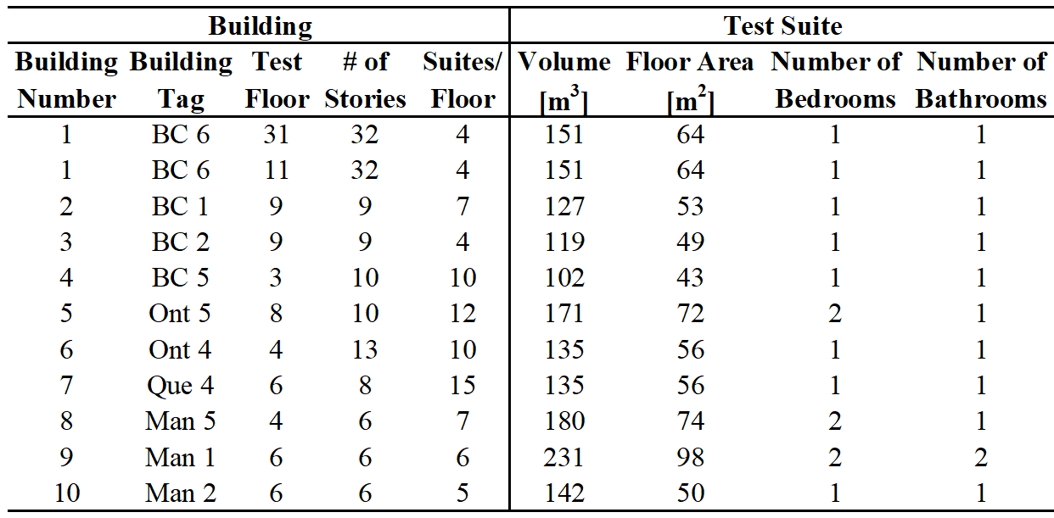
General Characteristics of Test Buildings and Suites
m³ x 35.3 = ft³
m² x 10.8 = ft²
Notes:
Ten test buildings were selected in the three Canadian climatic regions: four in a maritime climate (Vancouver, British Columbia); three in a western climate (Winnipeg, Manitoba); and three in a central climate (two in Toronto, Ontario and one in Montreal, Quebec). Seven of the test buildings were high-rise buildings (eight stories or more). The three test buildings in Winnipeg were classified as mid-rise (six stories). All of the buildings were built between 1990 and 1995.
All of the test suites were corner suites with two exterior walls, except for Buildings 4, 6, and 7, each of which had only one exterior wall.
Tests were carried out during late February and early March 1996. This specific period was selected, because daily temperature variations in most regions tend to be near winter maximums. As a result, the test buildings would likely be exposed to the largest variations in stack-induced pressure differences between night-time and day-time tests.
With the exception of Building 1 (the tallest building), only one suite in each building was tested due to budget limitations. A second suite in Building 1 was tested to examine the effect of differences in stack-induced pressures that were caused by different suite locations with respect to the neutral pressure plane.
Building 3 suites each had a makeup air duct from an outside wall to the space behind the refrigerator in the kitchen, ostensibly so that heat from the refrigerator could warm the makeup air when the compressor and suite exhaust fans were operating. Unfortunately, the outside termination for the duct had a backdraft damper that prevented inward flow (other than minor leakage around the closed damper). Also, unlike the apparent design intent, the duct acted as a leak for air to flow outwards at times when the air pressure was greater indoors than outdoors.

Slide 18
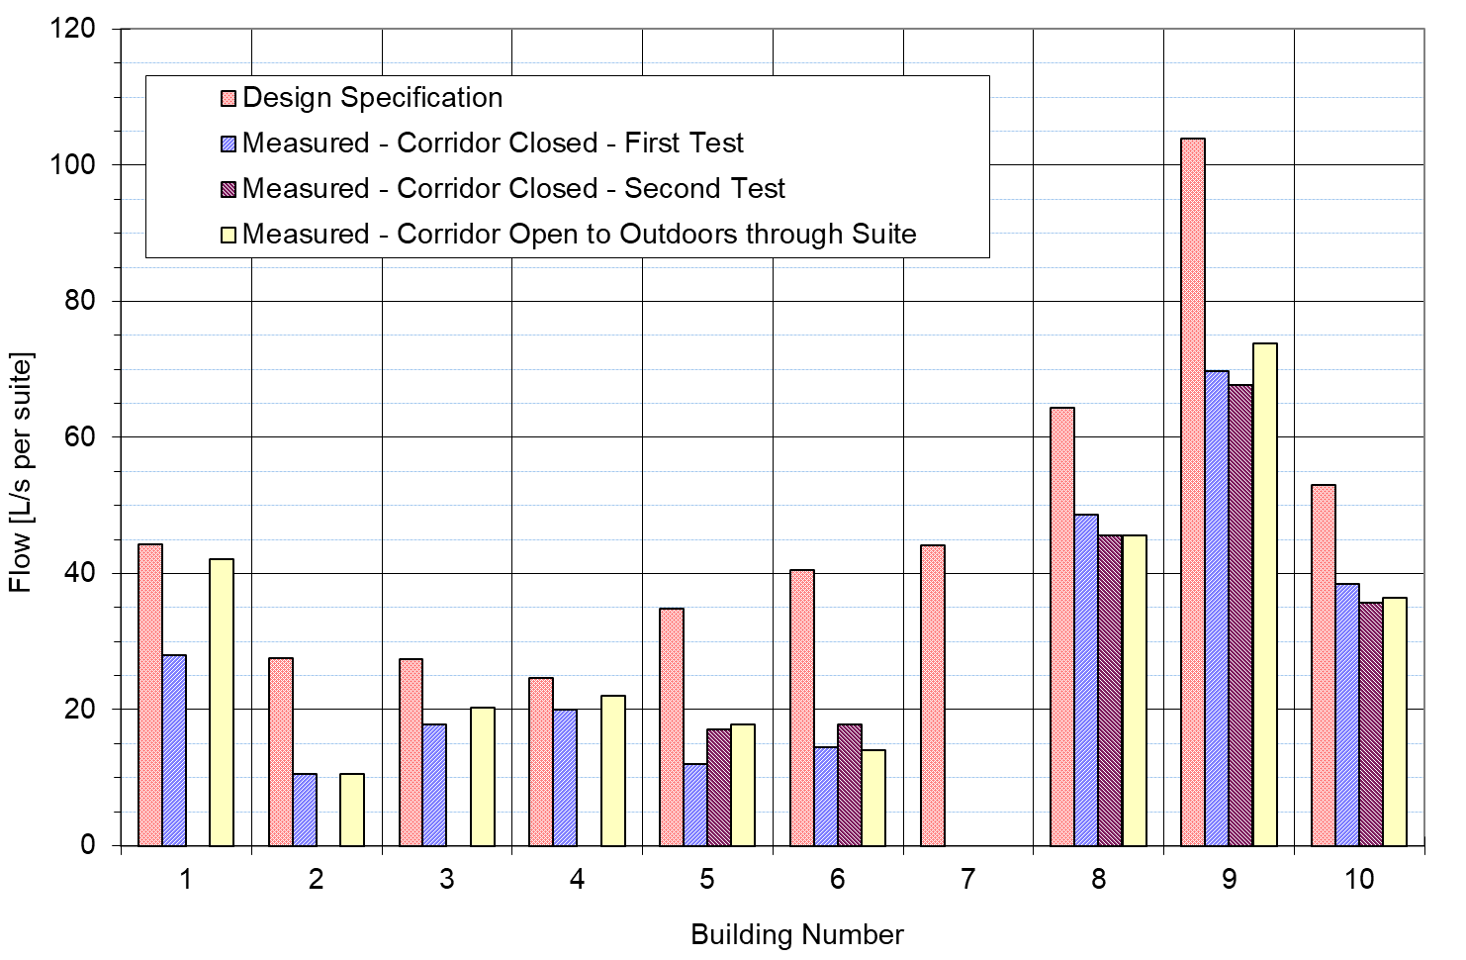
Corridor Supply Airflows
(Design vs. Measured)
L/s x 2.119 = cfm
Notes:
Key Conclusions / Findings:
1. Wide variation in design specifications.
2. Actual flows significantly lower than design flows.
3. Flows affected by temperature and wind over the course of a day, based on differences between first and second tests.
4. Airtightness of building envelope and suite access doors can affect flows.
Every test building had a rooftop corridor supply air system. Building 1 also had a second corridor supply air system on Floor 4, which served Floors 1 through 18. Its rooftop system served Floors 19 through 32.
In Building 7, the corridor supply air system was out of service due to maintenance problems, which could not be rectified at the time of testing.
First test and corridor open test in BC buildings (1-4) occurred during day (noon – 5p). No second test in these buildings due to small variations in stack and wind pressures. Corridor open test occurred within 15 minutes after first test.
First test in other buildings (5-6, 8-10) occurred at night (8p - 11p). Second test and corridor open test in these buildings occurred next day (noon – 3p). Corridor open test occurred within 15 minutes after second test.

Slide 19
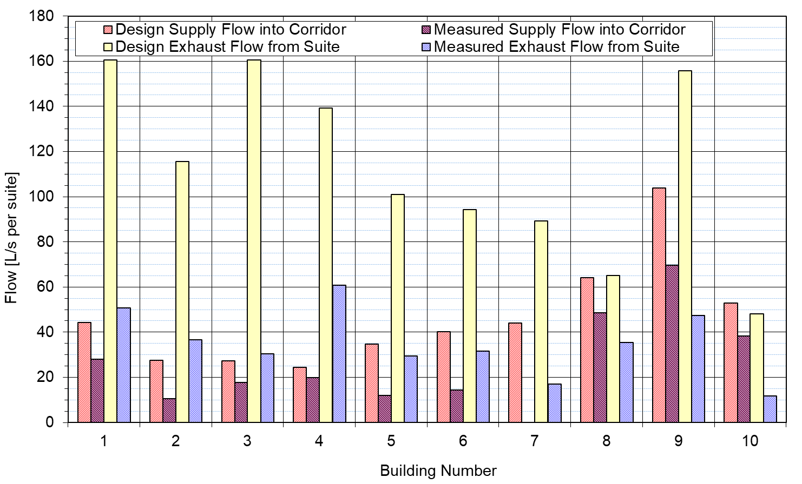
Corridor Supply Airflow vs Suite Exhaust Capacity
(Design vs. Measured)
L/s x 2.119 = cfm
Notes:
Key Conclusions / Findings:
1. Wide variation in design specifications for total suite exhaust capacity.
2. Actual exhaust flow capacity was always much lower than design exhaust flow capacity.
3. Design supply flow per suite was usually much lower than design suite exhaust flow capacity.
4. Actual supply flows and suite exhaust capacities were usually slightly closer together than design supply flows and suite exhaust capacities.
5. Differences between supply and exhaust flows indicate ventilation system not balanced.
6. Designer's did not ensure that there is always sufficient leakage between corridor and suite for transfer of makeup air that includes corridor supply air, nor did they ensure that additional makeup air for exhaust can always be provided by infiltration from outdoors.
Building 8 had a continuous exhaust system for the kitchen, bathroom, and an in-suite storage room in each suite. Building 10 also had a continuous exhaust system for the kitchen and bathroom. Building 7 had a continuous exhaust system for the bathroom. The kitchen had a separate in-suite intermittent exhaust system that was also connected to a second continuous exhaust system that served several stacked suites.
The other seven test buildings had separate intermittent exhaust systems for the kitchen and bathroom(s) in each suite.
Measured supply flows shown here correspond to daytime tests shown in Slide 18 (Test 1 for Buildings 1-4, Test 2 for Buildings 5-6 and 8-10). All exhaust capacity tests occurred during daytime.

Slide 20
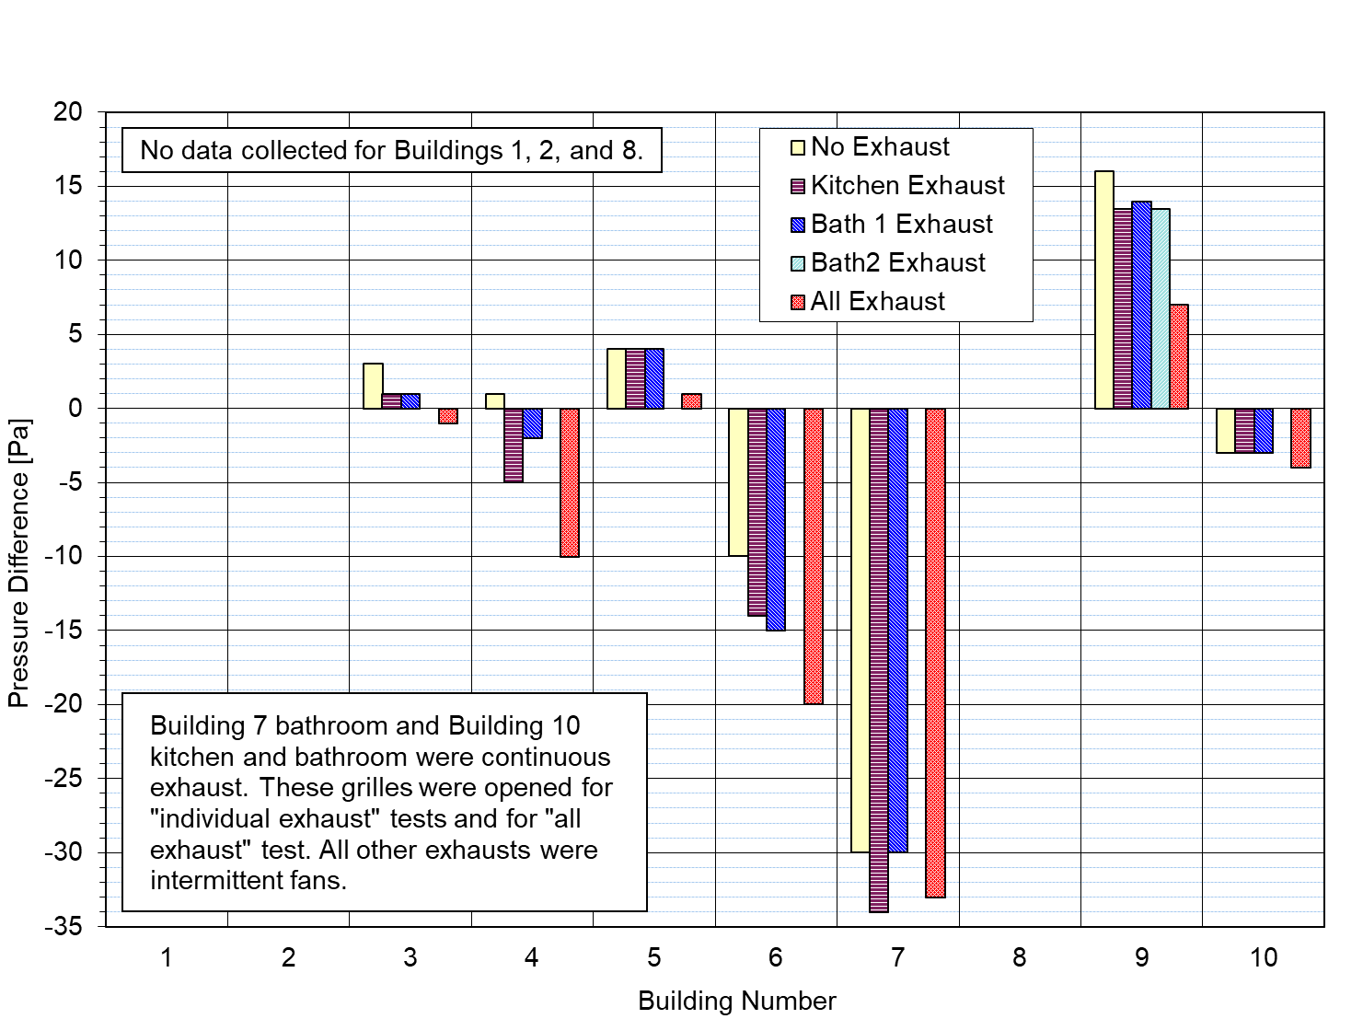
Measured Suite to Outdoors Pressure Differences
(With and Without In-Suite Exhaust)
Pa / 249 = in. of water
Notes:
Positive pressure difference means flow from the test suite to outdoors.
Induced depressurization of the test suite wrt outdoors is due to turning on or opening an exhaust device(s) relative to the no exhaust mode (sealed grilles and fans off).

Slide 21
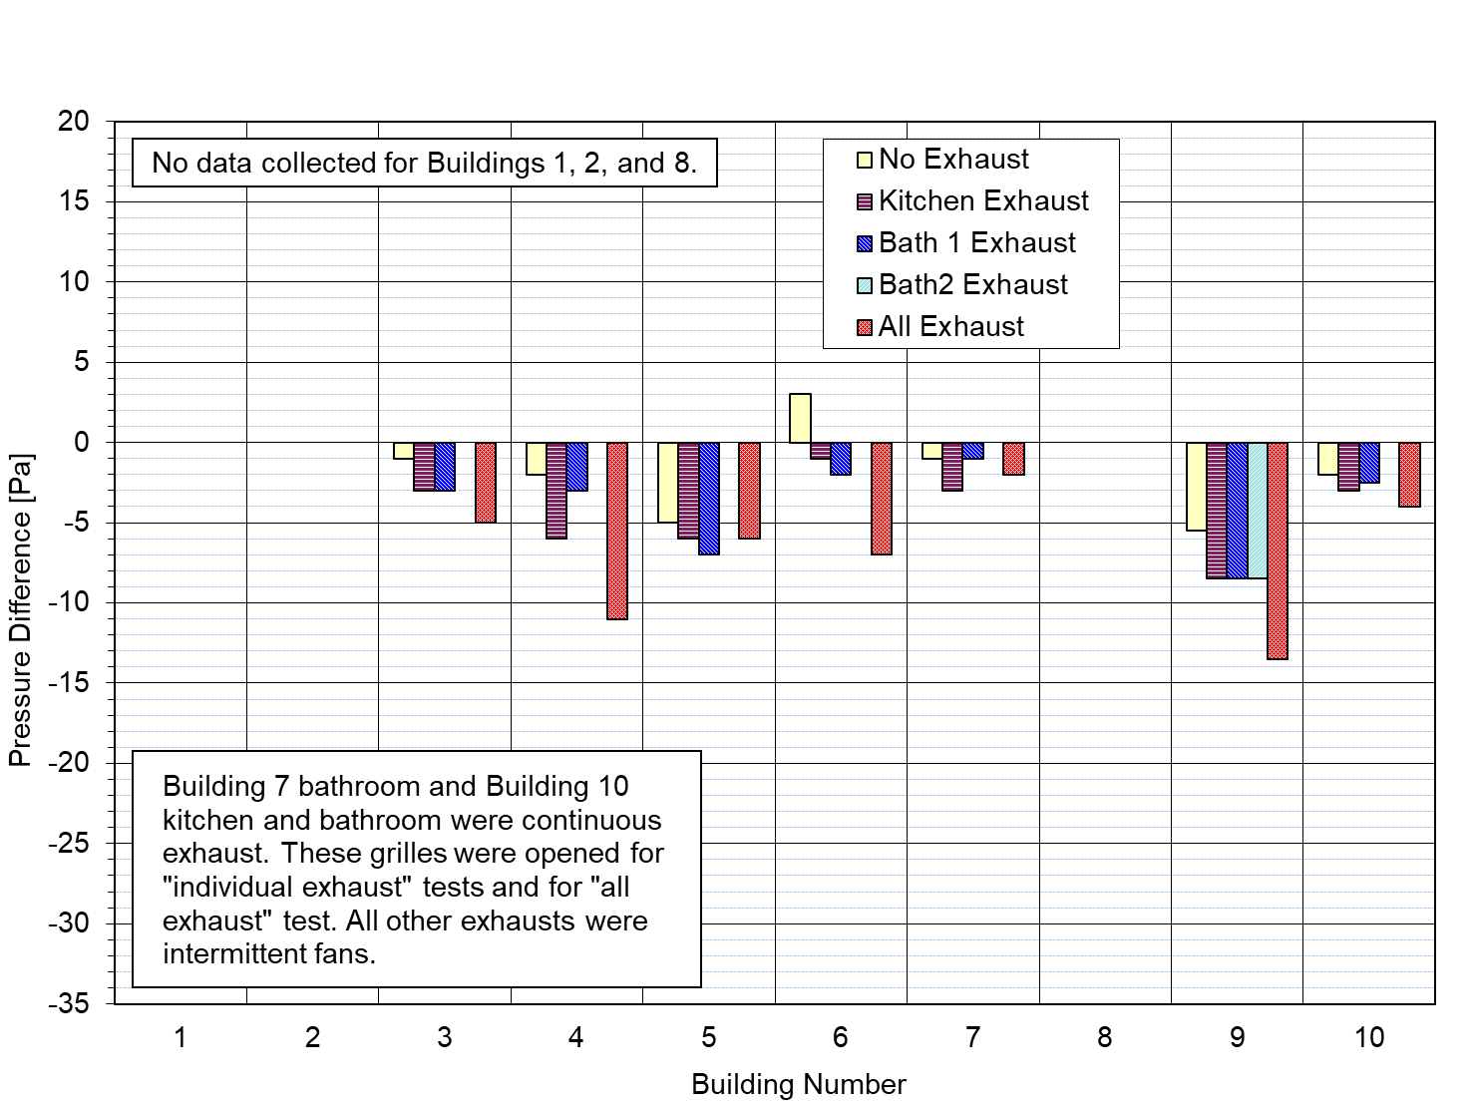
Measured Suite to Corridor Pressure Differences
(With and Without In-Suite Exhaust)
Pa / 249 = in. of water
Notes:
Positive pressure difference means flow from the test suite to the corridor.
Induced depressurization of the test suite wrt the corridor is due to turning on or opening an exhaust device(s) relative to the no exhaust mode (sealed grilles and fans off).

Slide 22
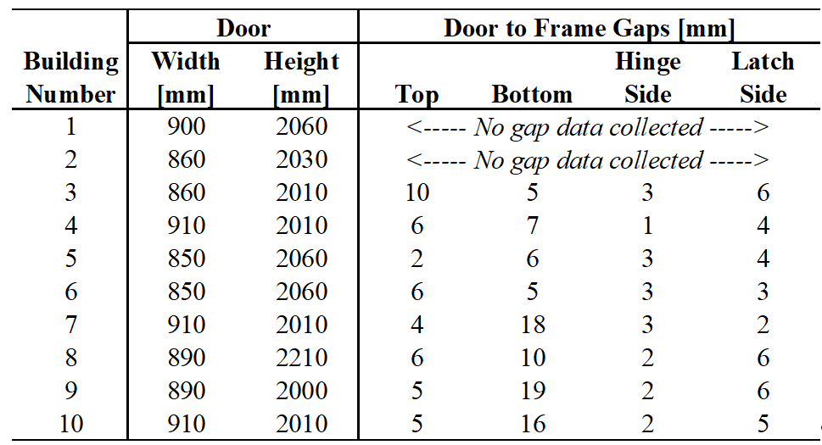
Geometric Characteristics of Suite Access Doors
mm / 25.4 = in.
Notes:
Four of the eleven test suites had fully weather-stripped suite access doors (two suites in Building 1, one in Building 3, and one in Building 8). However, the weather-stripping on the suite access doors for these four suites was often not completely in contact with some part of the door, threshold, or floor.
Two test suites had partially weather-stripped suite access doors. There was a spring-loaded sweep on the bottom of the suite access door in Building 4. However, this sweep did not contact the floor. It appeared that there had been weather-stripping along the top and sides of this door at one time, but there was no weather-stripping in these locations at the time of our tests. In Building 7, only about 67% of the latch side of the door was weather-stripped. There was no indication that the remainder of the door had been weather-stripped in the past.
There was no weather-stripping on the suite access doors of the other five test suites (Buildings 2, 5, 6, 9, and 10).
The suite access door in Building 9 fit poorly in its frame. This door could swing in and out at the latch side about 6 mm, even when the door was latched. This range of motion was due to a significantly oversized striker plate in the door frame. The access doors for the other test suites did not move significantly when latched.

Slide 23
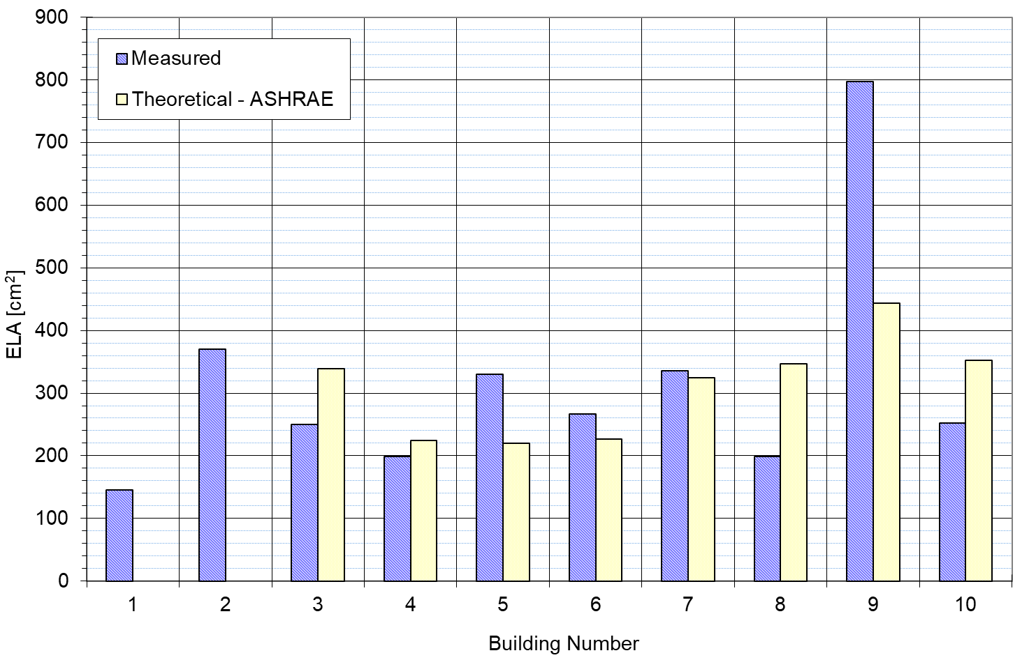
Leakage Area of Suite Access Door (Measured vs Theoretical)
cm² / 6.45 = in.²
Notes:
Key Findings / Conclusions:
1. Measured leakage areas of suite access doors are large and highly variable.
2. Measured leakage areas usually within allowable NFPA 80 (1992) limits for fire doors (470 cm²), but always exceeded allowable NBC (1990) limits for fire doors (3 mm top and sides, 6 mm bottom).
3. Measured leakage areas always exceeded allowable NFPA 105 (1985) limits for smoke-control doors (13 cm²).
4. Weather-stripping modifications by occupants can affect leakage areas of suite access doors.
5. Significant differences between theoretical and measured door leakage areas for some buildings.
Note: ASHRAE (1992) presents a theoretical method developed by Gross and Haberman for calculating the ELA of gaps between doors and their frame, without weather-stripping. The method uses empirical relationships between flow and pressure difference. These relationships depend on the geometry of the door frame and on the size of the gaps between the door and its frame.

Slide 24
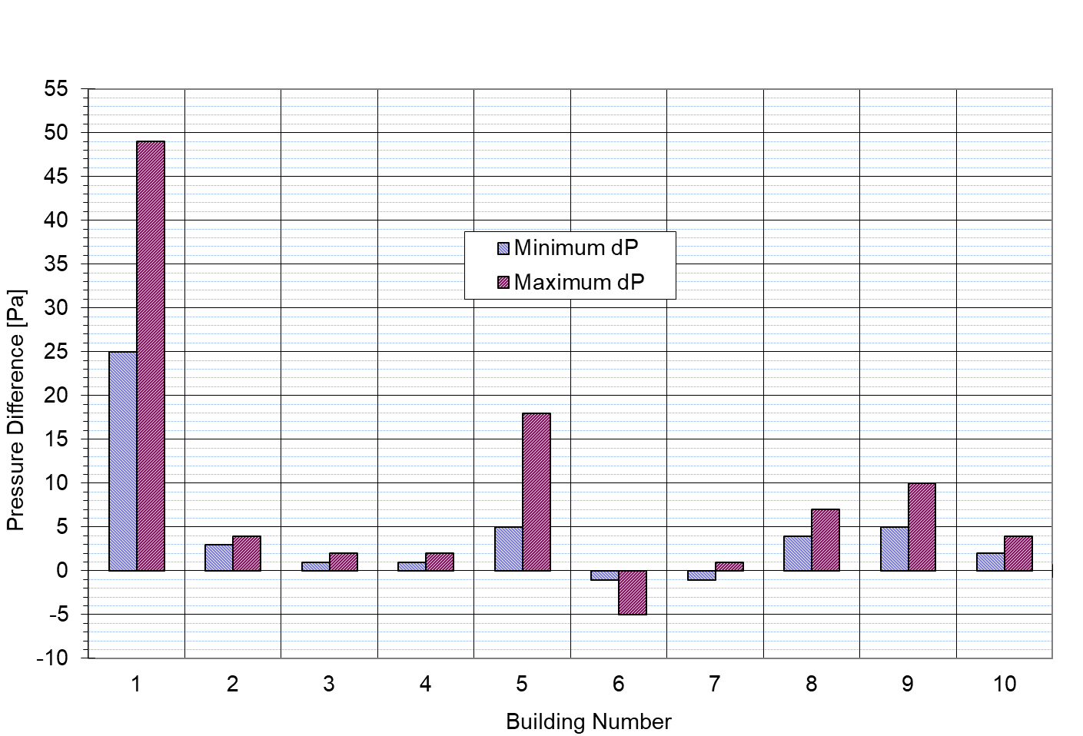
Measured Corridor to Suite Door Pressure Differences
Pa / 249 = in. of water
Notes:
Positive pressure difference means flow from the corridor to the test suite.
Data shown above for Building 1 are for the 32nd floor. Pressure differences measured on the 11th floor (below NPP) and the 32nd floor (above NPP) within 5 minutes of each other were 13 Pa and 49 Pa, respectively.

Slide 25
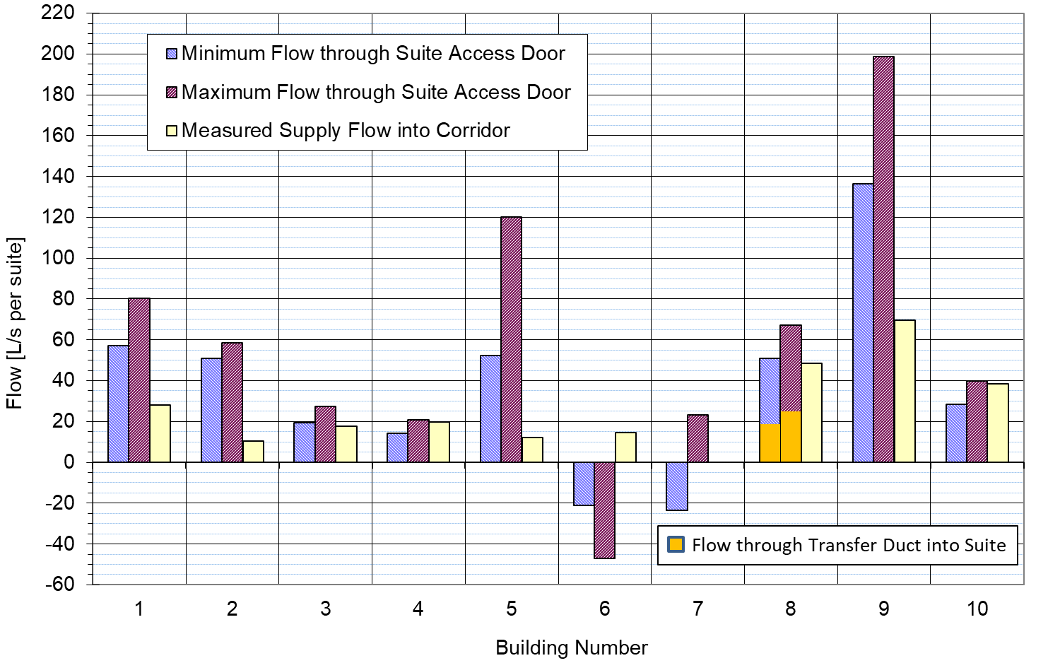
Suite Access Door and Transfer Duct Airflows vs Supply Flow into Corridor
L/s x 2.119 = cfm
Notes:
Key Findings / Conclusions:
1. Wide variation in door flows from building to building due to large door leakage areas and no control of pressure differentials across doors.
2. For some test suites, measured corridor supply airflows on per suite basis are significantly lower than “measured” airflows from the corridor through suite access doors.
3. Flows were reversed into corridor for some suites due to wind effects or due to inoperative supply systems.
4. Using leaks around suite access doors to supply ventilation air to suites is not a reliable system.
Building 8 airflows shown here include corridor-suite transfer duct airflows, which were estimated based on the duct characteristics and measured corridor pressurization of 4 to 7 Pa relative to the test suite: minimum 19 L/s @ 4 Pa, maximum 25 L/s @ 7 Pa.
The reversal of flows in Building 6 warrants further discussion. Our analyses of the stack and wind effects indicate the exterior wall of the test suite was pressurized from outside primarily (about 80%) by the stack effect. This pressurization occurred, because the suite was located below the neutral pressure plane. Wind effects also contributed to the pressurization of this wall from outside. The pressure differences across this wall ranged from 8 to 15 Pa. As a result, air tended to flow into the suite from outdoors. Without mechanical exhaust operating in the suite, the continuity of airflows required that this air then exit the suite into the corridor through the suite access door.

Slide 26
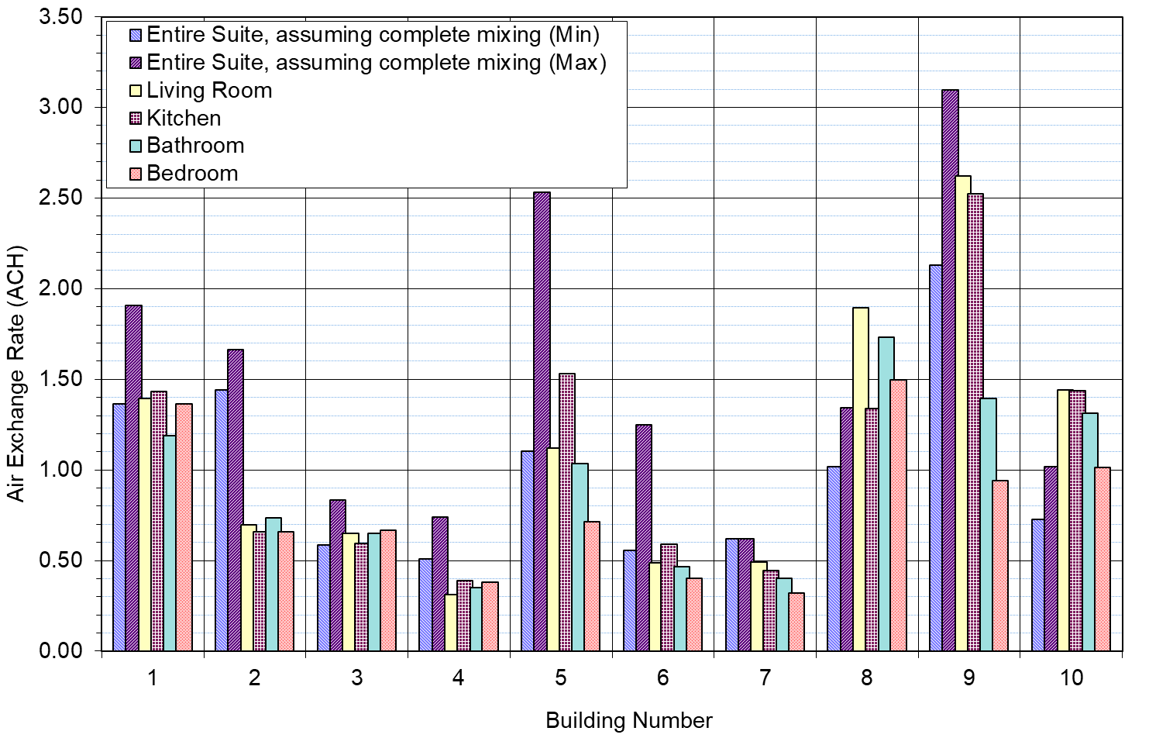
Air Exchange Rates in Suites (Interior Doors Open)
Notes:
Key Findings / Conclusions:
1. Compared to ASHRAE and CSA ventilation standards at time of tests, suites appeared to be well-ventilated, but some were marginal or slightly under-ventilated.
2. Large variation in air exchange rates.
3. Airflows from the corridor through the suite access doors appear to be primarily responsible for the air exchange in most of the test suites.
4. Distribution of air varies in suites, but usually room air exchange rates are fairly uniform.
5. Airflow through suite access doors responsible for most of the air exchange.
During the test, the test suite was unoccupied and operating “normally”. Normal conditions were defined as the suite’s exterior doors and windows closed, the suite’s interior doors open, the corridor supply air and central exhaust air systems operating (unless these systems could not be operated), and without the intermittent ventilation equipment in the test suite being operated.
All of the rooms appeared to meet or exceed the ASHRAE Standard 62 requirement of 0.35 ach (1990b) and CSA Standard F326 requirement of 0.30 ach (1993). However, most rooms did not meet the more stringent requirements when compared to the occupancy- or room-based air exchange rates of these standards.
With the exception of Buildings 6 and 7, air flowed into each test suite from the adjoining corridor during the decay tests. Comparing the calculated air exchange rates based on these door flows (“Entire Suite” values) with the measured room air exchange rates shown above, it appears that these door flows are primarily responsible for the air exchange in most of the test suites.

Slide 27
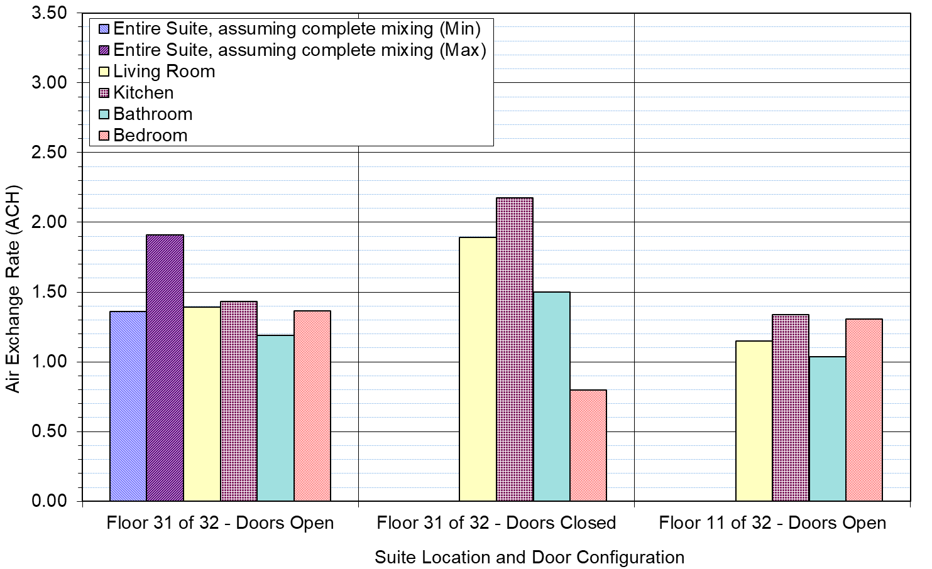
Air Exchange Rates in Two Suites of Building 1 (Interior Doors Open vs Closed, Suite Above vs Below Neutral Pressure Plane)
Notes:
Key Findings / Conclusions:
1. Closing interior doors within test suite can have complex effects, including reducing suite volume that is directly open to flows from suite access door and increasing the airtightness of these open volumes.
2. Air exchange rate for open living room and kitchen increased due to reduced open volume of suite.
3. Bathroom air exchange rate increased when its door was closed, possibly due to changes in mixing patterns within this room.
4. Bedroom air exchange rate decreased when its door was closed due to increased flow resistance between open areas of suite and outdoors through bedroom.
5. Similarity of air exchange patterns and rates above (Floor 31) and below (Floor 11) neutral pressure plane for this building may be fortuitous.

Slide 28
Inter-Suite Transfer Air Fractions
Notes:
Key Findings / Conclusions:
1. Most test suites had some transfer air flowing into them from other suites. Finding is significant, because National Building Code of Canada (NBC 1990) prohibits inter-suite transfer airflows.
2. Large variation in transfer air fractions. Average is 19%.
3. Corridor supply air systems do not always meet their primary design intent (corridor pressurization), because they are incapable of always preventing inter-suite transfer airflows.
Due to the low occupancy rate in Building 1 (about 30%), the zero transfer air fraction for this building does not indicate that the test suite was not exposed to transfer air from other suites. Different results might be obtained when the building is fully occupied.
Building 7 had the highest transfer fraction. One reason was that this building did not have an operative corridor supply air system. Another reason was that the continuous bathroom exhaust system for the test suite was inoperative in this building, which allowed the bathroom exhaust shaft to act as a large leak between the test suite and suites below. Air flowed weakly from this shaft into the test suite and sometimes reversed.

Slide 29
Conclusions
Field performance tests showed suite ventilation influenced by weather, suite location within the building, and leakage of both interior and corridor access doors.
Mechanically-driven supply airflows to and exhaust airflows from suites at any given time appear to be somewhat haphazard and do not meet design expectations.
Test results showed that there can be substantial amounts of transfer air entering some test suites.
To ensure that suite ventilation is both controlled and adequate under normal operating conditions, the building industry needs to develop and follow an improved set of ventilation design, commissioning, operation, and maintenance practices.

Slide 30
Recommendations
Develop new design and commissioning guidelines
New ventilation design and commissioning practices need to be developed to ensure suite ventilation can be controlled and meets expectations. Achieving better compartmentation and understanding pressure relationships throughout the building appear to be key issues. New practices should enhance occupant health vs energy use (Turner et al. 2013), and not compromise safety (e.g., smoke control).
Use multizone modelling to support further investigations
Field performance tests only provide snapshot of ventilation at point in time due to combined effects of driving forces on building ventilation. Computer simulations provide practical means to extrapolate test results and explore new design methods. See early exemplar multizone modelling efforts by Edwards (1999).

Slide 31
Bibliography
ASHRAE. 1990a. ANSI/ASHRAE Guideline 2-1986 (RA90), Engineering Analysis of Experimental Data. Atlanta, GA: American Society of Heating, Refrigerating and Air-Conditioning Engineers, Inc.
ASHRAE. 1990b. ANSI/ASHRAE Standard 62-1989, Ventilation for Acceptable Indoor Air Quality. Atlanta, GA: American Society of Heating, Refrigerating and Air-Conditioning Engineers, Inc.
ASHRAE. 1992. Design of Smoke Management Systems, Chapter 4. Atlanta, GA: American Society of Heating, Refrigerating and Air-Conditioning Engineers, Inc.
CSA. 1993. CAN/CSA-F326-M91, Residential Mechanical Ventilation Systems. Toronto, ON: Canadian Standards Association.
Edwards, C. 1999. “Modelling of Ventilation and Infiltration Energy Impacts in Mid and High-Rise Apartment Buildings”. Report of Sheltair Scientific Limited to Research Division, Canada Mortgage and Housing Corporation. December. airbase_13383.pdf
https://www.aivc.org/resource/modelling-ventilation-and-infiltration-energy-impacts-mid-and-high-rise-apartment-buildings

Slide 32
Bibliography
Moffatt, P., I. Theaker, and C. Wray. 1998. “Field Testing to Characterize Suite Ventilation in Recently Constructed Mid- and High-Rise Residential Buildings”. Report of Sheltair Scientific Limited to Innovation Centre for Highrise and Multiples, National Office, Canada Mortgage and Housing Corporation. November.
http://publications.gc.ca/site/eng/9.569458/publication.html
NBC. 1990. National Building Code of Canada. Ottawa, ON: Canadian Commission on Building and Fire Codes, National Research Council of Canada.
NFPA. 1985. ANSI/NFPA 105: Installation of Smoke- and Draft-Control Door Assemblies. Quincy, MA: National Fire Protection Association. August 12.
NFPA. 1992. ANSI/NFPA 80: Fire Doors and Fire Windows. Quincy, MA: National Fire Protection Association. August 14.
Turner, W.J., J.M. Logue, and C.P. Wray. 2013. “A Combined Energy and IAQ Assessment of the Potential Value of Commissioning Residential Mechanical Ventilation Systems”. Building and Environment, Vol. 60.
https://www.sciencedirect.com/science/article/abs/pii/S0360132312002818

Slide 33
Questions?
Craig Wray, P.Eng.
pharmeng@shaw.ca

