Slide 1
TC 8.2 Vapor Compression Cooling and Heat Pump Chillers – Main Meeting
Phoenix Annual- Hybrid Meeting
June 23, 2025 2:15-4:15 PM PST
In Person Location: Phoenix Convention Center North Bldg 230 (level 2)
Virtual Info: Join Zoom Meeting
https://us06web.zoom.us/j/89525956243?pwd=AnJZfjm6RI9h9uJfQHUc1LZy2uYIvM.1
View meeting insights with Zoom AI Companion
https://us06web.zoom.us/launch/edl?muid=fa61c6e3-a952-4a29-a58b-d731d4b25604
Meeting ID: 895 2595 6243
Passcode: 649953

Slide 2
Call to Order & ASHRAE Value Statement
In ASHRAE meetings, we will act with honesty, fairness, courtesy, competence, inclusiveness and respect for others, which exemplify our core values of excellence, commitment, integrity, collaboration, volunteerism and diversity, and shall avoid all real or perceived conflicts of interest. Our culture is one of inclusiveness, acknowledging the inherent value and dignity of each individual. We celebrate diverse and inclusive communities, understanding that doing so fuels better, more creative and more thoughtful ideas, solutions and strategies for the Society and the communities our Society serves. We respect and welcome all.

Slide 3
Agenda Review – T. Hunt
Introductions- please note what type of member you are & if you are a YEA &/or International Member for TC Activity Form (or write on sign-in sheet)
Quorum check – T. Abruzzo
TC 8.2 Mission Statement & Scope – T. Hunt
Reviewed/Approve Winter 2025 Meeting Minutes – Basecamp – T. Hunt
Reports:
Standards -
  ASHRAE Standard 90.1 (monitoring) – R. Good / R. Heiden/ B. Damas
  ASHRAE Standard 184 (cognizant TC) – P. Johnson
  ASHRAE Standard 225 (cognizant TC) – P. Johnson
  AHRI Standard 550/590|551/591 (monitoring) – P. Johnson
  MTG Low GWP Liaison Update – P. Johnson

Slide 4
Agenda
  ASHRAE Standard 30 (cognizant TC) – N. Zupp
  ASHRAE Standard 23 (monitoring) – S. MacBain
  AHRI Standard 1520 (monitoring) – M. Cambio
  ISO/TC 86/SC 4 - Justin Prosser
  ASHRAE Guideline 22 (monitoring) – D. Showalter
  ASHRAE SPC 196 – D. Showalter
Research – D. Showalter
Program – M. Rogan
Handbook – J. Medina
Membership & Transition – T Abruzzo

Slide 5
Agenda
Web Master – D. Kemper
Honors and Awards – R. Good
Chair’s Breakfast Report – T. Abruzzo
Old Business – T. Hunt
New Business – T. Hunt
For the Good and Wellbeing ….
Adjourn

Slide 6
Quorum Check – T Abruzzo
Voting Members/ … in attendance (… online)
Trent Hunt
Tiffany Bates Abruzzo
Scott MacBain
Chris Miller
Nick Zupp
Mike P
Brandon absent
6 of 7
Notes:
Updated 6/27

Slide 7
TC8.2 Vapor Compression Cooling and
Heat Pump Chillers Mission Statement
The Mission Statement of Technical Committee 8.2, Vapor Compression Cooling and Heat Pump Chillers is to provide world class technical expertise on all aspects of centrifugal refrigeration machines.
This committee is a resource to industry, academia, and others following society protocols through seminars, standards, technical papers/articles and other presentations.
The Scope of TC 8.2 is concerned with cooling and heat pump chillers that involves centrifugal or positive displacement compressors, including those with heat exchangers, drivers, controls, split evaporators and condensers, and other accessories.
Approved/ reaffirmed

Slide 8
Review and Approve Previous Meeting Minutes
2025 Winter Orlando Hybrid Meeting Minutes- see attachment, basecamp, & TC 8.2 website
approved

Slide 9
Standards Report
TC 8.2 Standards Subcommittee – Phil Johnson (chair)
Updated
TC 8.2 is the cognizant TC for:
  ASHRAE Standard 30-2025 Method of Testing Liquid Chillers
    [TC 8.2 is lead; TC 8.5 is co-cognizant]
  ASHRAE Standard 184-2020 Method of Test for Field Performance of Liquid-Chilling Systems
TC 8.2 also monitors activity for the following standards of interest to members:
  ASHRAE Guideline 22-2025 Instrumentation for Monitoring Central Chilled-Water Plant Efficiency
    [TC 9.1 is cognizant]
  ASHRAE Standard 23-2022 Methods for Performance Testing Positive Displacement Refrigerant Compressors and Compressor Units
  [TC 8.1 is cognizant]
ASHRAE Standard 90.1-2022 Energy Standard for Buildings Except Low-Rise Residential Buildings
    [TC 7.6 is cognizant]
ASHRAE Standard 196P Method of Test for Measuring Refrigerant Leak Rates
    [TC 3.1 is cognizant]
  ASHRAE Standard 205-2023 Representation of Performance Data for HVAC&R and Other Facility Equipment
    [TC 4.7 is cognizant]
  ASHRAE Standard 225-2020 Method for Performance Testing Centrifugal Refrigerant Compressors and Condensing Units
  [TC 8.1 is cognizant]
  AHRI Standards 550/590|551/591-2023 Performance Rating of Water-chilling and Heat Pump Water‑heating Packages using the Vapor Compression Cycle
  AHRI Standard 1520-2022 Performance Rating of Centrifugal Refrigerant Compressors
  ISO TC 86 / SC 4 Testing and rating of refrigerant compressors (ISO/AWI 18501, 18483, 18976)

Slide 10
Standards Report
ASHRAE Standard 30-2025 (Nick Zupp, Chair SSPC30)
Updated
2025 edition published! (incorporates Addenda a, b, c, d, f, h, i to the 2019 edition).
Now developing addenda to ASHRAE Standard 30-2025 “Method of Testing Liquid Chillers” (designated as continuous maintenance)
2025-Jun-23 meeting:
  AHRI has a test plan to collect test data for air sampler temperature array versus air sampler with aspirating psychrometer (for developing ‘Addendum e’, for the next edition). Contract in process. Test data collection pending.
  Voted in Orlando to recommend a seminar in Phoenix for ‘what’s new’ in Standard 30-2025.
Next meeting: Fall (hybrid or virtual), joint meeting with AHRI Chillers STC
Addendum a. Published in May 2020. Mainly clean-up including a requirement to test based on defined operating mode set points.
Addendum b. Published in April 2020. Mainly clean-up including clarification of Δp_{adj}. Republished to add missing calibration workbook (.xlsx).
Addendum c. Addition of adiabatic, free-cooling, and 4-pipe chillers by introduction of hybrid operating modes. APR1 Nov 2020. PPR1 public review May~Jul 2024. Published December 2024.
Addendum d. Published March 2024. Update to steady-state criteria.
Addendum e (for next edition). Harmonization with AHRI 550/590, Section 4. Addition of air sampling arrays. PPR1 public review possible in late 2025 after AHRI research data collection.
Addendum f. Published January 2023. Inclusion of AHRI 550/590, water pressure drop calculation tool.
Addendum g. Nomenclature to use for temperature differences (keep as-is or change). Advisory Public Review Jun~Jul 2024. Only 1 comment. SSPC30 decision to not change.
Addendum h. Miscellaneous changes, harmonization with AHRI 550/590. PPR1 public review Nov29~Dec 29 2024. One public comment received and resolved; will publish soon.
Addendum i. TPS changes, water to liquid. PPR1 public review Oct25~Nov24 2024. No public comments received. Published December 2024.
Notes:
Updaetd 6/27

Slide 11
Standards Report
ASHRAE Standard 184-2020 (Phil Johnson)
Updated
Standard 184-2020 was published in November under periodic maintenance.
TC 8.2 decided and voted (7-0-0-1) in Tampa on 2023-Jun-26 to recommend forming a committee to revise the standard (e.g. additional work on the uncertainty calculator spreadsheet workbook). 5-year cycle would need to publish next edition by 2025 (-ish?), deadline to decide “withdraw, reaffirm, or revise” was 2023-Nov-30.
Periodic Maintenance Recommendation form submitted 2024-01-18. Standards Reaffirmation Subcommittee (SRS to StdC) approved recommendation. StdC approved ballot ending 2024-10-25.
Chair: M.Rogan. Initial SPC 184 roster still in process of forming, will then have a public call for members (can add more). Informal meeting here in Phoenix.

Slide 12
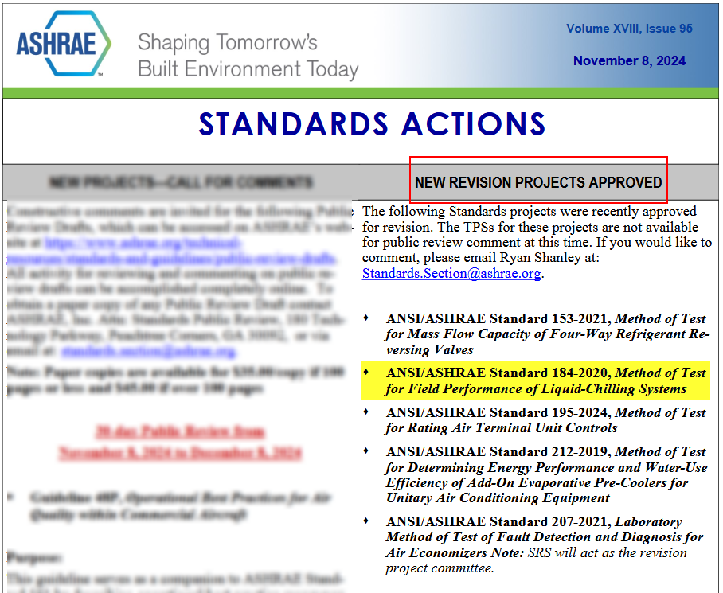
Standards Report
ASHRAE Standard 184-2020 (Phil Johnson)

Slide 13
Standards Report
ASHRAE Guideline 22-2025 (Daryl Showalter, Chair GPC22)
Not updated but okay as-is
ASHRAE Guideline 22-2025 “Instrumentation for Monitoring Central Chilled Water Plant Efficiency” (designated as periodic maintenance)
New edition recently published, supersedes the 2012 edition

Slide 14
Standards Report
ASHRAE Standard 23 (Scott MacBain, past Chair SPC23)
Not updated
Standard 23-2022 published “Methods for Performance Testing Positive Displacement Refrigerant Compressors and Compressor Units”.
There remains potential for either a future merger of 23 and 225, or perhaps harmonization activities.

Slide 15
Standards Report
ASHRAE Standard 90.1-2022 (Rick Heiden)
Not updated but okay as-is
Standard 90.1-2022 published (December 2022)
New addenda to the 2022 edition (when published) are available at:
https://www.ashrae.org/technical-resources/standards-and-guidelines/standards-addenda
Addenda of interest:
  L – of general interest → net zero operational energy emissions (NZOEE), informative appendix that jurisdictions could adopt for buildings to achieve NZOEE over 1-3 code cycles. Includes chiller emission factors.
  M – of interest for split chillers → hydronic and dx coils must be rated in accordance with AHRI 410-2023 (SI/I-P) Performance Rating of Forced-Circulation Air-Cooling and Air-Heating Coils
  Q – of interest for water cooled chiller systems → add pad-type (wetted media) adiabatic fluid coolers along with a minimum efficiency and the recently published CTI acceptance test code to Table 6.8.1-7 Heat Rejection Equipment. Technology being offered on some “free-cooling” air-cooled chillers https://www.thermalcare.com/adiabatic-fluid-coolers/
  V – of general interest → reference Std 169 Climate Data for Building Design Standards version 2021 instead of 2013, wrt US counties 85% no changes, 9% move to warmer zones, 3% to colder zones, 3% changes subzones (i.e. A, B, C)
Discussion topics within the 90.1 Mechanical Subcommittee of interest to this committee
  >15 dT chilled water distribution requirements (Hydronics working group)
  Chiller efficiency table updates in collaboration with related AHRI committee (Hydronics working group)
  Requirements for all electric buildings (Decarb working group)
Published (*of interest to this committee) | In process
bo,ca,cv,cw,a,b,d,f,h,I*,j,k,l,m*,n,o,p,q*,r,t,v*,x,z | c,g,i,s,u,w,y,aa,ab,ac,ad,ae,af,ag,ah

Slide 16
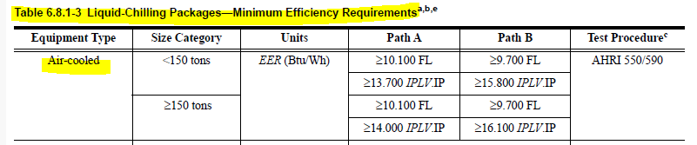
TC 8.2 Standards Report
ASHRAE Standard 90.1-2022 (Rick Heiden)
Updated RH 2025-06-22
Proposed Addenda BK – heat pump primary update → applied hydronic systems removed from scope
Addenda when published are available at:
https://www.ashrae.org/technical-resources/standards-and-guidelines/standards-addenda
90.1 Mechanical Subcommittee Hydronics Working Group is developing 2028 work plan.
Requesting that TC 8.2 evaluate the potential for more stringent air-cooled minimum efficiencies.
  12 years since last update (2010 addenda into 2013 version)
  Current version, 90.1-2022 Table 6.8.1-3
  Experience of users/specifiers suggest industry opportunity to do better
  Leverage AHRI if possible
Any additional non-standard conditions deserving of new Kadj or rating segmentation
Notes:
TC 8.2 Vapor Compression Cooling and Heat Pump Chillers

Slide 17
Standards Report
ASHRAE Standard 196P (Phil Johnson, Chair SPC 196P)
Updated
Developing new document ASHRAE Standard 196 “Method of Test for Measuring Refrigerant Leak Rates”
As of 2023-Jun (Tampa), have reached consensus on resolving a fundamental question with the measurement method (under what range of conditions are ideal gas assumptions sufficiently valid), now need to implement the changes into the draft (and propagate changes into the examples in the informative appendices)
Committee behind target to have PPR1 sent out in Q4 2024, now expecting Q2 2025

Slide 18
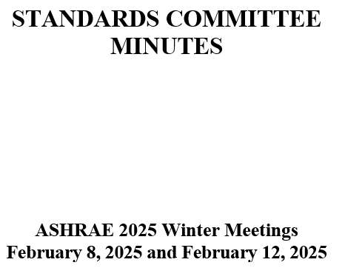
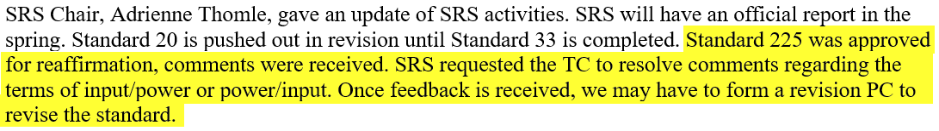
Standards Report
ASHRAE Standard 225-2020 (Phil Johnson)
Updated
SRS recommended and StdC approved at the Fall October 2024 meeting to reaffirm Standard 225-2020.
SRS reported to StdC in February 2025:
With the revised titles, scope, and mission statements of TC 8.2 and TC 8.1, it is now okay for TC 8.1 to be the cognizant TC.
See Orlando meeting minutes, motion to request transfer from TC 8.2 to TC 8.1 for cognizant TC of Standard 225 (also voted on similar motion in Indianapolis in June 2024)
Staff (M.Weber) confirmed on 2025-06-12 that TC 8.1 is now the cognizant TC (again)

Slide 19
Standards Report
ASHRAE Standard 30-2019 (Nick Zupp, Chair SSPC30)
Developing addenda to ASHRAE Standard 30-2019 “Method of Testing Liquid Chillers” (designated as continuous maintenance)
Will publish a 2025 edition (with Addenda a, b, c, d, f, h, i). Galley proof being prepared.
Updated errata sheet issued 2024-Apr-24
2025-Feb-10 meeting:
  Resolved public comment to Addendum h (which will now proceed to publication).
  AHRI has a test plan to collect test data for air sampler temperature array versus air sampler with aspirating psychrometer (for developing ‘Addendum e’, for the next edition). Contract in process. Test data collection pending.
  Voted to recommend a seminar in Phoenix for ‘what’s new’ in Standard 30-2025.
Next meeting: late Mar / early Apr (Arlington/hybrid), joint meeting with AHRI Chillers STC
Addendum a. Published in May 2020. Mainly clean-up including a requirement to test based on defined operating mode set points.
Addendum b. Published in April 2020. Mainly clean-up including clarification of Δp_{adj}. Republished to add missing calibration workbook (.xlsx).
Addendum c. Addition of adiabatic, free-cooling, and 4-pipe chillers by introduction of hybrid operating modes. APR1 Nov 2020. PPR1 public review May~Jul 2024. Published December 2024.
Addendum d. Published March 2024. Update to steady-state criteria.
Addendum e (for next edition). Harmonization with AHRI 550/590, Section 4. Addition of air sampling arrays. PPR1 public review possible in late 2025 after AHRI research data collection.
Addendum f. Published January 2023. Inclusion of AHRI 550/590, water pressure drop calculation tool.
Addendum g. Nomenclature to use for temperature differences (keep as-is or change). Advisory Public Review Jun~Jul 2024. Only 1 comment. SSPC30 decision to not change.
Addendum h. Miscellaneous changes, harmonization with AHRI 550/590. PPR1 public review Nov29~Dec 29 2024. One public comment received and resolved; will publish soon.
Addendum i. TPS changes, water to liquid. PPR1 public review Oct25~Nov24 2024. No public comments received. Published December 2024.
Notes:
Updaetd 6/27

Slide 20
Standards Report
ASHRAE Standard 23 (Scott MacBain, past Chair SPC23)
Standard 23-2022 published “Methods for Performance Testing Positive Displacement Refrigerant Compressors and Compressor Units”.
Discussion of cognizant TC for 225, or perhaps harmonization activities.

Slide 21
Standards Report
AHRI Standard 1520 (Matt Cambio)
AHRI Standard 1520-2022, Performance Rating of Centrifugal Refrigerant Compressors
This standard provides a rating method for centrifugal compressors and a calculation method to compare centrifugal compressors with positive displacement compressors.
A MatLab open-source tool is being created by Purdue for reading data and calculating performance as well as comparisons with positive displacement compressor 10 coefficient model
It is probable that a WG will be formed this year to review the standard to see how it’s working.
Would like to encourage use of the standard and participation in the next WG.
Additional Notes:
Reference to ASHRAE 225, Methods for Performance Testing Centrifugal Refrigerant Compressors and Condensing Units
Similar format to AHRI 540, Performance Rating of Positive Displacement Refrigerant Compressors and Compressor Units
AHRI Compressor Standards Technical Committee will maintain the standard (responsible for a total of 7 standards including 1520)

Slide 22
Standards Report
ISO/TC 86/SC 4 (Justin Prosser)
Key:
TC = Technical Committee
SC = SubCommittee
WG = Working Group
AWI = Approved Work Item
TC 86: Refrigeration and air-conditioning,
SC 4: Testing and Rating of refrigerant compressors
WG2: ISO 18501, Positive displacement refrigerant compressor (harmonizing: AHRI 540, EN 12900)
Published
WG3: ISO 18483, Centrifugal refrigerant compressor (harmonizing: AHRI 1520)
Published
WG4: ISO 18976, Testing of refrigerant compressors (harmonizing: ASHRAE 23 & 225, EN 13771-1, and withdrawn version of ISO 917)
To be published in Q3 2025

Slide 23
Standards Report
ASHRAE Guideline 22-2012 (Daryl Showalter, Chair GPC22)
Developing next edition of ASHRAE Guideline 22-2012 “Instrumentation for Monitoring Central Chilled Water Plant Efficiency” (designated as periodic maintenance)
PPR2 closed 2024-Jan-15. Some supportive comments with editorial changes.
Finally wrapping up since 2015, final publication submittal form sent and galley proof in process.

Slide 24
Research Subcommittee Report – Daryl Showalter (chair)
Research S/C Chair Breakfast notes of interest
Strategic Initiatives
Health, Sustainable and Resilent Communities
Empowered Workforce
Organization Agility
Emerging Technologies
Did you Know ?
ASHRAE currently has 37 active research projects.
Since 1959, ASHRAE has sponsored 1007 projects for a total cost of about $87.9M
ASHRAE members have FREE access to ALL research project final reports
ASHRAE provides its members with FREE digital downloads of all four Handbooks, which are the largest beneficiaries of ASHRAE research results.
All this is on ASHRAE.org, just click on RESEARCH
Notes:
Updated 6/28

Slide 25
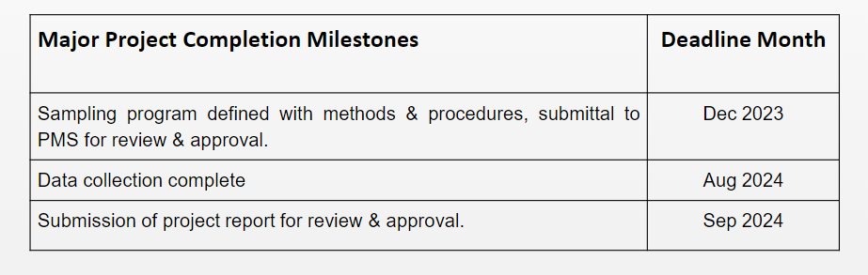
Research Subcommittee Report – Daryl Showalter (chair)
Current Activities
Research Subcommittee online meeting was held Feb 3rd,
Project update waiting on status
Project Status
1716 - Oil concentration of field-installed liquid chillers with flooded type evaporators.
  Project has been awarded. Philip Johnson is the chair.
  Project is stalled waiting on update from the project team.
  Of the 8 Chillers only on was found for testing.
Notes:
Updated 6/28

Slide 26
Research Subcommittee Report – Daryl Showalter (chair)
1793 - Development of Method of Test for Motor Component Thermal Conductivity
  TC8.1 is taking the lead on this one and will resubmit from the comments.
  This is now Dead and will be removed next time.
1879 – Foamability properties of LGWP Refrigerant and Oil Mixtures
  Sponsored by TC3.4 and Co-Sponsored by TC8.1
  Craig Bradshaw was the PI – Matt Cambio reported
Noted Davide and Craig were developing a RTAR related to semi-empirical compressor models. Lastly discussed an item related to sub-atmospheric operation with Low GWP low ambient heat pumps.
Notes:
Updated 6/28

Slide 27
Research Subcommittee Report – Daryl Showalter (chair)
  New RTAR ideas:
    TC8.2 Decarb in heating mode discussed
      Joe Sanchez also mentioned high temperature heat pumps – modeling- (RTAR initiated)
    TC8.2 What is the limit of high temperature heat pump vs. vapor recompression? (Bruno)
      Other novel architectures?
      What application 100, 150, 200C temperatures?
    TC 8.1 Davide & Craig submitting - Assessment of Extrapolation Capabilities and Uncertainty Quantification of Multi-Refrigerant Semi-Empirical Compressor Models TC 8.1
    TC 8.1 & 8.2 Effects of sub-atmospheric operation with low GWP, low ambient heat pumps. Leak rates and design suggestions (Matt / Daryl to follow up)
      System Contaminants
      Refrigerant breakdown
      Possibility of electrical arching in a vacuum
      Potential for combustion in the presence of oil
Notes:
Updated 6/28

Slide 28
Program Subcommittee Report – Mark Rogan (chair)
Combined TC 8.02/8.01 Program Subcommittee Report
2025 Summer Meeting, Phoenix, AZ
Subcommittee Meeting: June 10th, 12:00 pm -2:00 pm EST
Attendees: Tiffany Abruzzo, Daryl Showalter, Mathew Cambio, Justin Prosser, Michael Perevozchikov, Davide Ziviani, Craig Bradshaw, Dan Kemper, Alex Schmig, Tiffany Abruzzo, Phillip Johnson, Chris Miller, Farhan Jurati, Riley Barta, Jethrow Medina, Nicholas Zupp, Margaret Mathison, Erik Anderson, Yintao Wang, Bruno de Carvalho, Heinz Juergensen, Kalen Gabel, Andreas Hoess, James Spalding, Sugun Tej Inampudi, Rick Heiden
Phoenix Meeting Approval Update: 3 Programs Approved: Seminar 25(Reduced Order Models for Compressors)TC8.1, Seminar 40(Decarbonization with Thermal and Electrical Storage)CoSponser, Seminar 53(Decarbonization with MultiSource Heat Pumps)CoSponser

Slide 29
Program Subcommittee Report – Mark Rogan (chair)
Current Approved Programs – Summer Meeting Phoenix, AZ, 2025
Seminar 25 – Reduced Order Models for Positive Displacement and Centrifugal Compressors - Monday June 23rd, 2025, 8:00-9:30 WST Convention Center North 226BC (Level 2)
Seminar 40 Decarbonizing while saving money with Thermal and Electrical Storage - Tiffany Abruzzo (BAC) is chair of seminar. Cosponsored by TC8.2. Presenters: Stet Sanborn(SmithGroup San Francisco, Nancy Kohout(SmithGroup Chicago), Neil Conwan(e2 Company) Tuesday June 24th, 2025, 8:00 – 9:30 WST CCN 226BC
Seminar 53 – Decarbonization with Multisource Heat Pumps and CO2 – Tiffany Abruzzo (BAC) is chair of seminar. Cosponsored by TC 8.2. Presenters: Cynthia Cogil(SmithGroup Chicago), Victor Braciszewski(SmithGroup San Francisco), Robert Thompson (SmithGroup DC) Tuesday June 24th, 2025, 11:00-12:30 WST CCN 229B
Great Job to all involved!!!!!

Slide 30
Program Subcommittee Report – Mark Rogan (chair)
Future Program Ideas – Beyond Phoenix
Electrification of Heating Chapter 2: Industrial and Healthcare Markets as well as Heat Recovery Applications – Chris Miller possible chair.(should have good jobsite data by June) Good candidate for Track # 6; Heat Pumps, Refrigerants, and Decarbonization.
Electrification of various Heating Applications and the challenges of capacity modulation using different compressor types: Which applications can be served by electrification today and which ones cannot. Rick Heiden as a potential chair. Good candidate for Track # 6: Heat Pumps, Refrigerants and Decarbonization
Application Issues with New Refrigerants and Indoor Chillers: Does Standard 15 (equipment room design) properly cover the flammability issue? Phil Johnson as a potential chair. Good candidate for Track # 2: HVAC Systems and Equipment
Decarbonization and District Cooling / Heating – Tiffany Abruzzo possible chair. Good candidate for Track # 6; Heat Pumps, Refrigerants, and Decarbonization.
Applying Centrifugal Compressors to all Chiller Types. Oil Free Centrifugal Compressors increasing efficiency of Air-Cooled Chillers. Mark Rogan possible chair. Possible speakers mentioned: Ray Good, Tom Watson, Phil Johnson. Good candidate for Track # 2: HVAC Systems and Equipment.
Technologies for Data Center Cooling – Air-Cooled vs Water-Cooled : Possible Cosponsors 9.9, 8.1?
Service, Maintenance, & Troubleshooting of compressors including Scroll, Screw, Centrifugal, and Reciprocating Proposed by Joe Sanchez in SubCommittee meeting
Any other topic ideas? Open to the floor
Next Meeting
Subcommittee will meet via conference call in early January 2026

Slide 31
Program Subcommittee Report – Mark Rogan (chair)
2026 Winter Meeting/Conference Las Vegas Jan 31st-Feb 4th :
Important dates:
Friday August 1st - Program Proposals Due
Friday October 3rd - Program accept/reject notifications
TBD - Program submission deadline
2025 Summer Meeting/Conference Program Tracks Phoenix
  Track 1 - Fundamentals and Applications
  Track 2 - HVAC&R Systems and Equipment
  Track 3 – Refrigeration & Refrigerants
  Track 4 – Research Summit
  Track 5 – Energy Storage & Grid Resiliency
  Track 6 – Pathways to Building Decarbonization
  Track 7 – Artificial Intelligence
  Track 8 – Indoor Environmental Quality for Healthy Buildings
  Track 9 – Future Proofing the Built Environment

Slide 32
TC 8.1 & 8.2 Handbook – Jethro Medina (Chair)
TC 8.1:
  Refrigeration: Chapter 8 - Factory Dehydrating, Charging & Testing
    2022 Last Publication: MacBain, Sanchez, Perevozchikov
    2026 – Vote to approve updates at TC 8.1 Meeting
      Scott MacBain, Florian Simon, Andreas Josef Hoess, Haotian Liu, Jethro Medina
TC 8.1 & 8.2:
  2024 HVAC Systems & Equipment: Chapter 38 and 43 – Compressors & Liquid Chilling Systems
    Chapter 38: Compressors | Chapter 43: Liquid-Chilling Systems
    2028 Next Revision – Updates due in July 2027
  Volunteers for reviewing Chapters? Contact Jethro Medina (jethro.medina@chemours.com)

Slide 33
TC8.2 Leadership Roles – T. Hunt
Chair – Trent Hunt
V Chair – Tiffany Bates Abruzzo
Secretary – Scott MacBain
Handbook – Jethro Medina
Programs – Mark Rogan
Standards – Phil Johnson
Research – Daryl Showalter
Webmaster – Dan Kemper
Honors and Awards – Ray Good
MTG. LowGWP Liaison – Phil Johnson
MTG. LowGWP Alternate – #1 Ray Good (#2 Trent Hunt)
Effective until 2026 Annual Summer meeting – Austin, TX
Notes:
Updated 6/27

Slide 34
Membership – T Abruzzo https://tpc.ashrae.org/Membership?cmtKey=83a02e09-1a12-4ee1-bbf8-3ba74490dec7
Updated 6/2025- PLEASE keep your bio updated & let us know if you want to get more involved
How to Import Your TC Roster Information into MS-Outlook - http://www.ashrae.org/TCs
Annual Meeting Attendance:
 | Number Present
Voting Members (excluding Non-Quorum Members) | 6
Non-Quorum Members | 9
Corresponding Members | 8
Provisional Members | 10
Visitors/Guests | 12
All members/guests who are ALSO YEA members | 11
All members/guests who are ALSO International Members | 5

Slide 35
Webmaster – Dan Kemper
General updates and maintenance
  Meeting time, current power point agenda and links posted
  Past agenda, minutes, and power point posted
  Updated scope and verbiage throughout website to reflect accordingly
Please send documents from 2025 seminars so they can be added to the presentations section of the website
https://tc0802.ashraetcs.org
Notes:
Updated 6/28

Slide 36
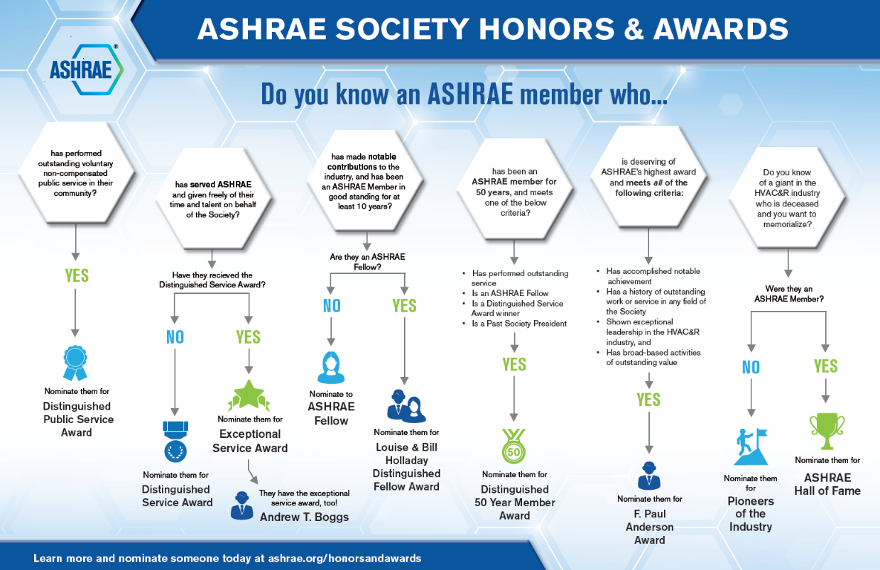
Honors and Awards Flowchart
Notes:
Flowchart is posted on the H&A webpage (www.ashrae.org/Honors) and available in printouts.

Slide 37
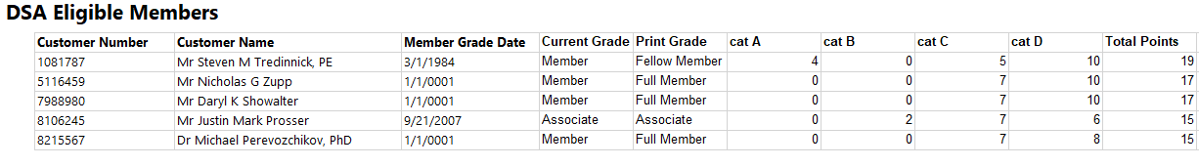
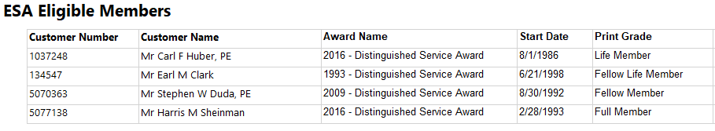
Honors and Awards – Ray Good Continued
TC8.2 Member DSA Qualifications (15 Points)
TC8.2 Member ESA Qualifications (45 Points)

Slide 38
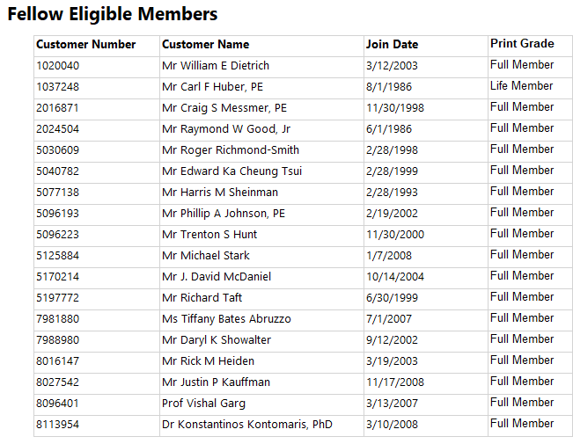
Honors and Awards – Ray Good Continued
TC8.2 Member Qualifications

Slide 39
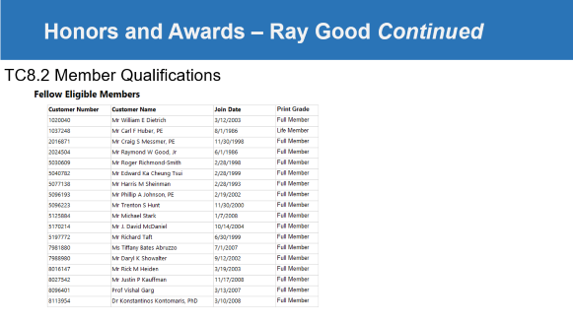

Honors and Awards – Ray Good Continued
Current Activities:
Currently Exploring
  Phil Johnson for Standards Achievement Award
Encourage all members to update their ASHARE bios in an effort to qualify for additional honors and awards recognition
Consider others who may qualify as a Fellow or other awards

Slide 40
TC Chairs Breakfast Report – T. Abruzzo
Section 8 head- Kashif Nawaz
Stephanie- ASHRAE 16 regions, 201 chapters, 3 Councils- For programs & RTARS- refer to ASHRAE 2025-28 Strategic Plan to align w/ top priorities: 2019-2024 ASHRAE Strategic Planning Documents; Chair- welcome visitors & start/stop on time
Costa & Blake- 5 Themes: Eng Guidance, Economics, Long term, Engagement, & AI Integration & innovation. CEBD & 9 other Special projects- $50-180K each
Maggie- CEC- 129 programs submitted, approved 86, 108 w/ papers, Vegas deadline August 1st for abstracts, 2027 Annual in Austin, TX, WiA LS April 13,14 2026, Please make sure Program & Handbook chairs attend trainings (Sunday morning & Tuesday afternoon)
Alice Yates- Government- subscribe to biweekly newsletter-Government Affairs Updates lots of uncertainty & confusion, 161 executive orders (not law) & 296 active legal challenges, tax exempt huge deal for ASHRAE, IAQ biggest topic
New TC 9.13- Space & MTG.GenAI (8 TC’s represented & 4 working groups)
TAC- need help with handbook response please! Roster updates for 25/26 year, Standards has weekly newsletter: Standards Actions Sign Up,

Slide 41
Old Business – T. Hunt
Mark Rogan- SPC184 Doc Review Meeting- Sheraton after Main Meeting
Tom, Tiff & Ray to Coordinate on ESA/DSA & email out Fellow PP

Slide 42
New Business – T. Hunt
2025-2026 Updated Voting Members:
Trent Hunt, Chair (Mechanical Products NSW)
Tiffany Abruzzo, Vice Chair (Baltimore Air Coil)
Scott MacBain, Secretary (Carrier)
Phillip Johnson (Daikin) – New
Mark Rogan (Aaon) – New
Daryl Showalter (H&H) – New
Jethro Medina (Chemours) – New
Dan Kemper (Trane) – New
9. Michael Dalon (Colvin)- New
10. James Spalding (now Hayward Pool)- New
11. Tom Watson (Retired)-New
12. Michael Perevozchikov (Emerson)
13. Ray Good (Danfoss)
14. Chris Miller (P2S)
15. Nick Zupp (Modine) NV now?

Slide 43
For the Good and Wellbeing & Action Items
Have a wonderful safe summer full of safe travel, grandkids, weddings, & CRC’s
Action Items:
Update slides & get to Tiffany if you have not done so already
If your membership level needs to be changed- let Tiffany know
If you need help applying for DSA/ESA/or Fellow- reach out to Ray & Tiff
If your company can help with Air Source Chiller KW/ton & COP vs Ambient info- please fill out AHRI survey for 90.1 updates
If you want to speak in Vegas let Mark & Tiffany know ASAP, deadline August 1st for full submissions (Chair must confirm speakers, provide overall abstract & quiz questions, each speaker must provide bio and title & abstract of section)
Subcommittee meeting tbd January 2026 w/ TC 8.1

Slide 44
Adjourn
Adjourned at 4:15 PM
Congrats to Trent on VP of Society!
THANK YOU ALL FOR ALL YOU DO FOR ASHRAE!!

